Slide 1
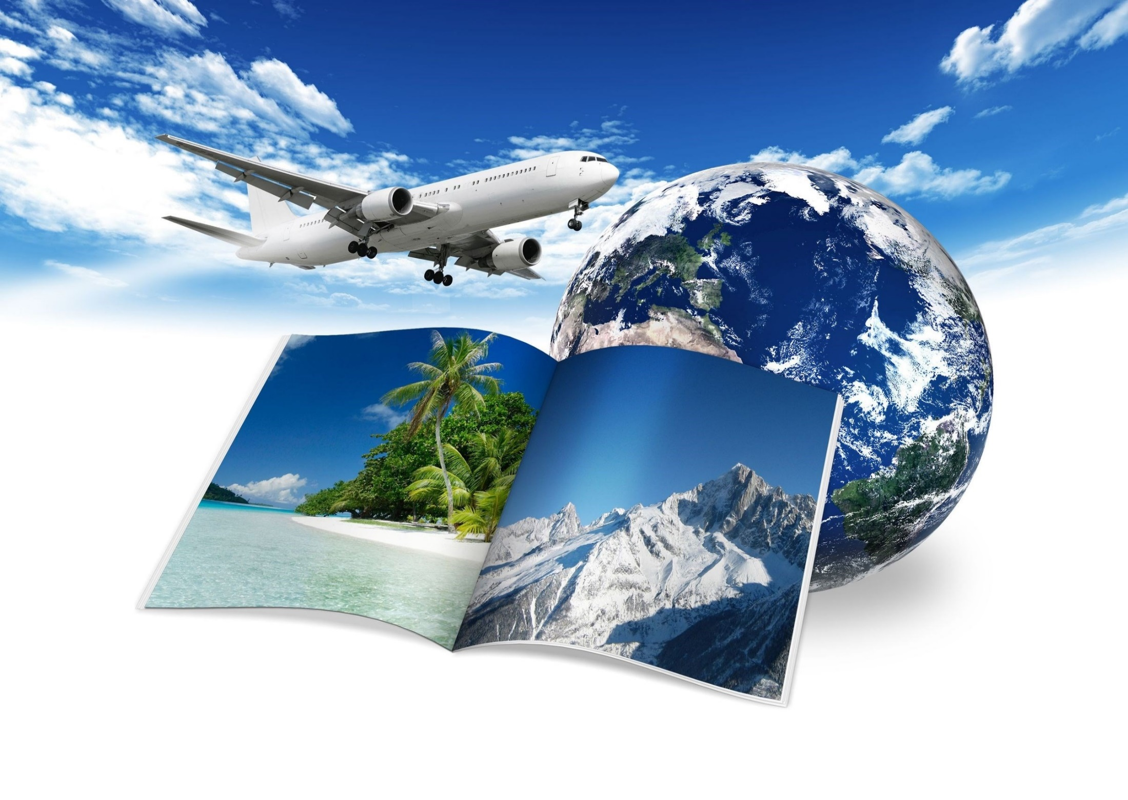
A world is a book and those who do not__________ read only a page.
St. Augustine

Slide 2

RVATLE
TRAVEL

Slide 3
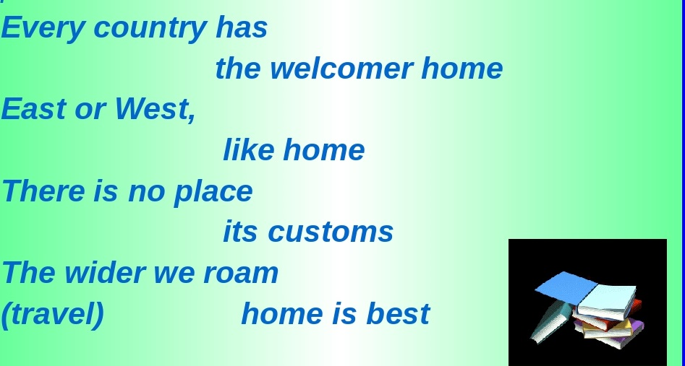
TIME TO MATCH

Slide 4
PEOPLE TRAVEL
What for ?
To relax
To meet
To discover
To communicate
To broaden
To try
To improve
To learn
To get to know

Slide 5

TIME TO LISTEN
Preparing for the State Exam
Выберите правильный ответ.
The airport officials are looking for a person who …
1) has lost their luggage.
2) has missed their check-in time.
3) has found another passenger’s documents.

Slide 6
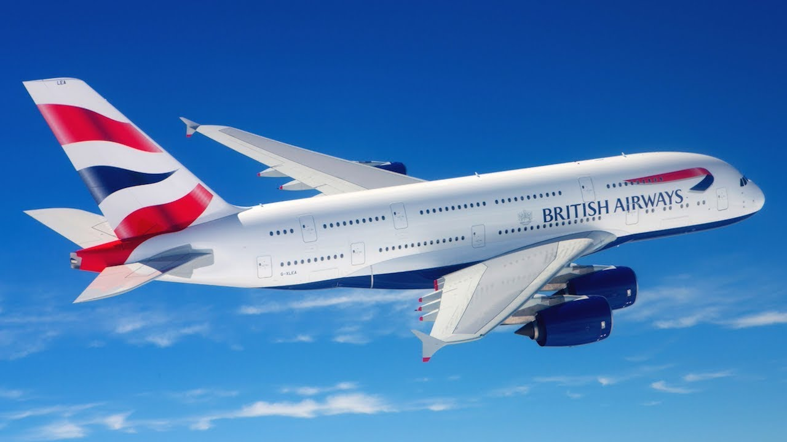
TIME TO TRAVEL

Slide 7
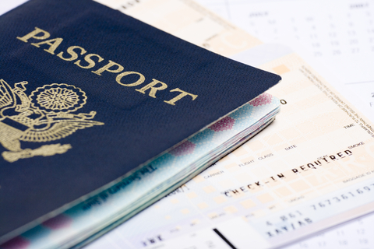

Slide 8
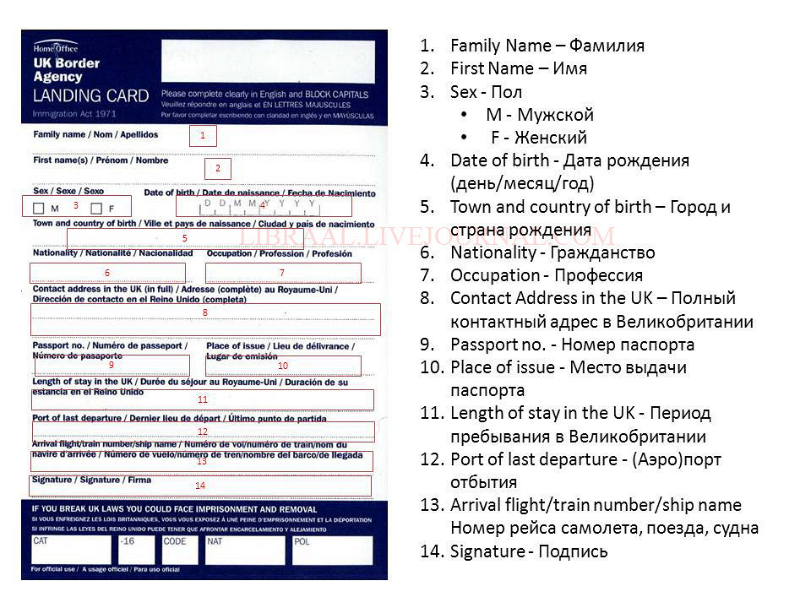

Slide 9

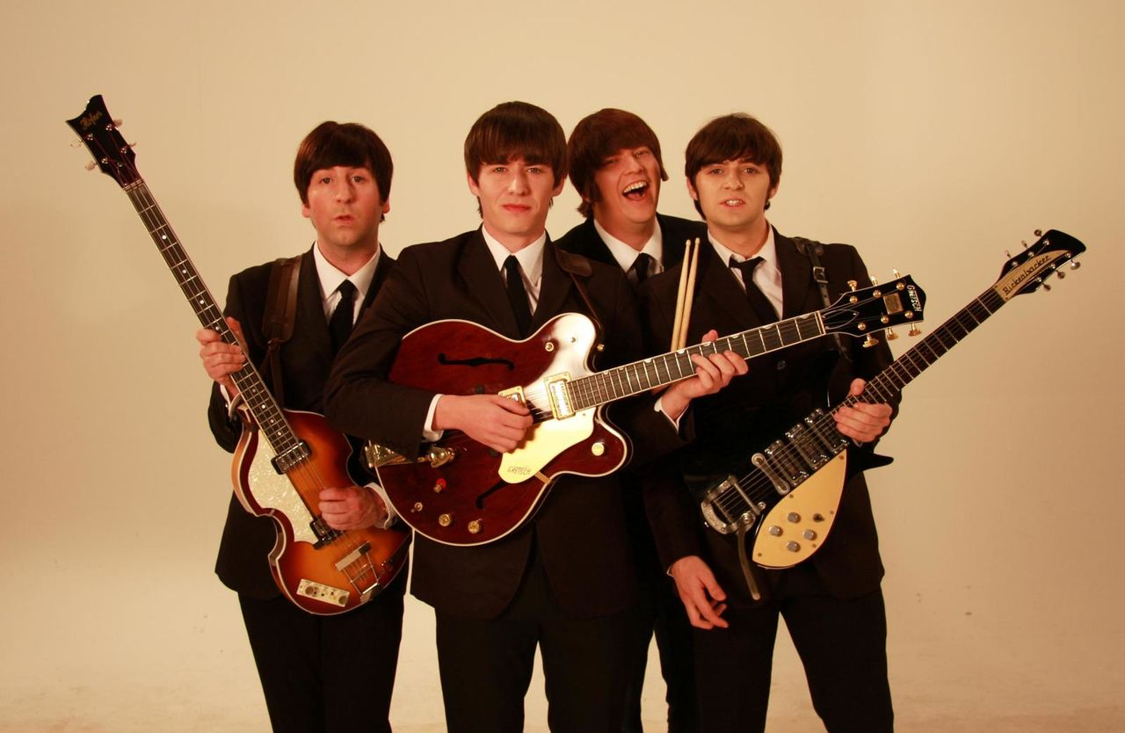
TIME TO RELAX

Slide 10
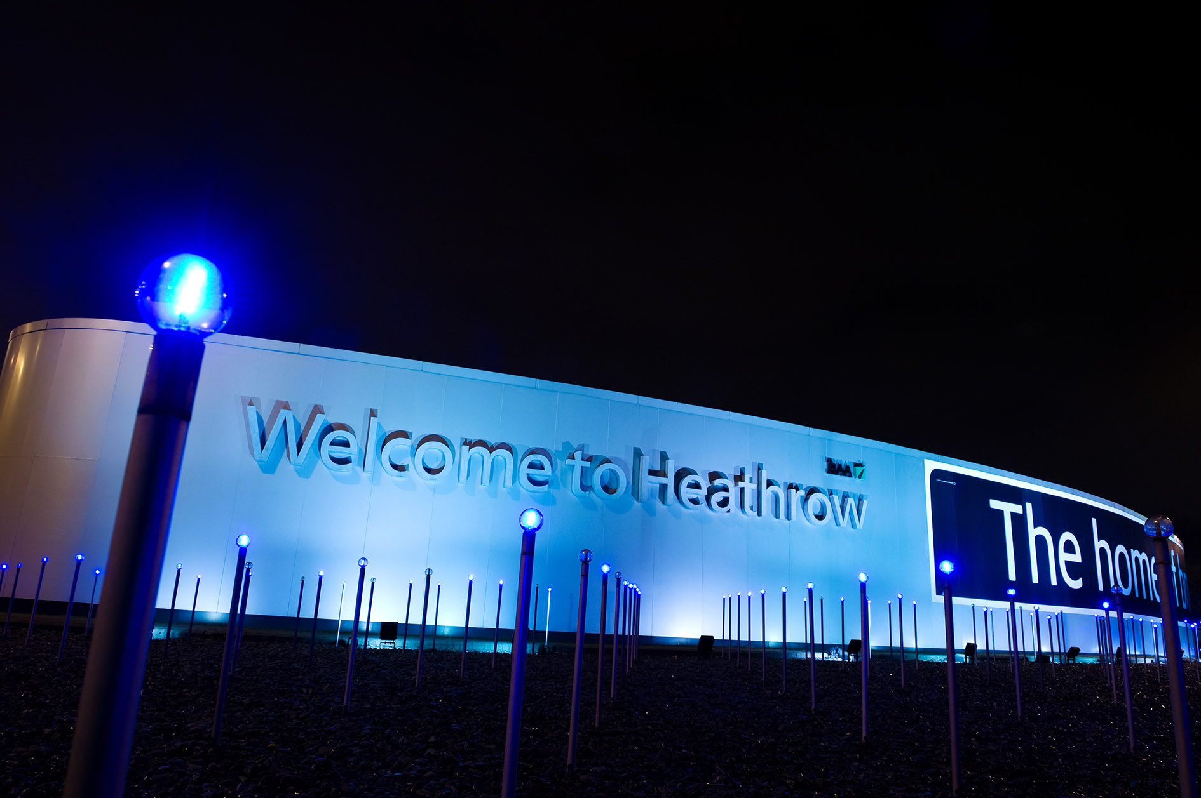
WELCOME TO HEATHROW

Slide 11
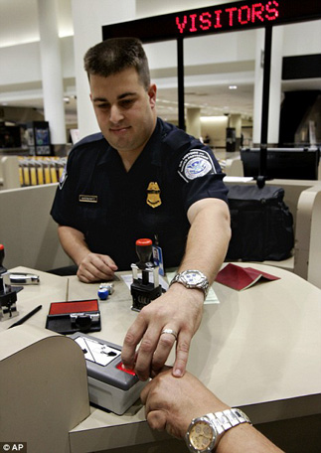
AT THE CUSTOMS
Pass the test and you'll know what questions you may be asked at the customs

Slide 12
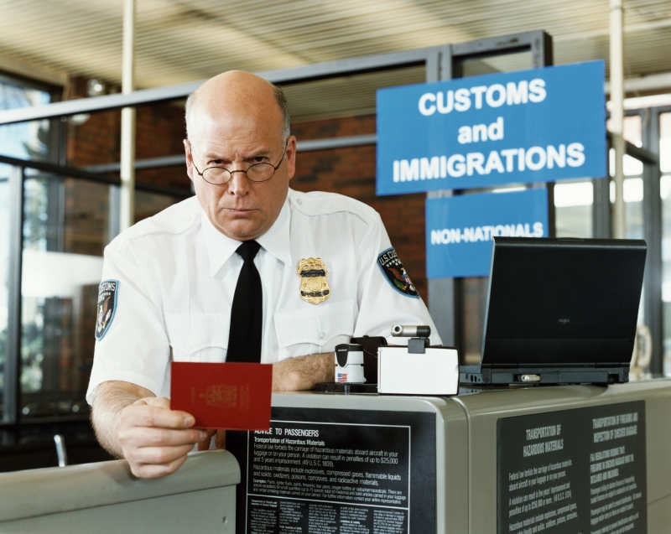
AT THE CUSTOMS

Slide 13

TIME TO TALK

Slide 14
CHOOSE A PROJECT
My dream holidays
My hometown visitors’ leaflet
An ideal tourist

Slide 15

TIME TO TELL

Slide 16
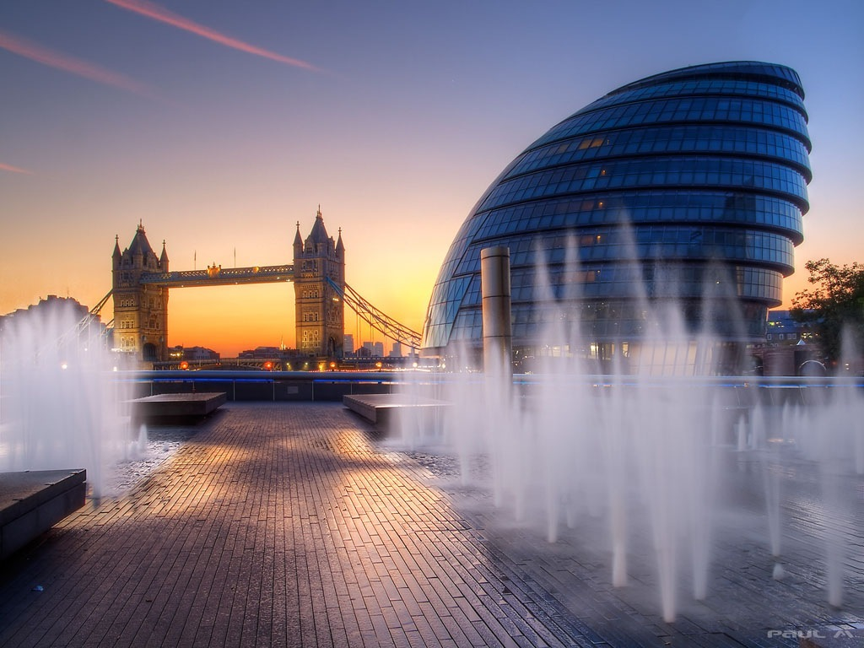
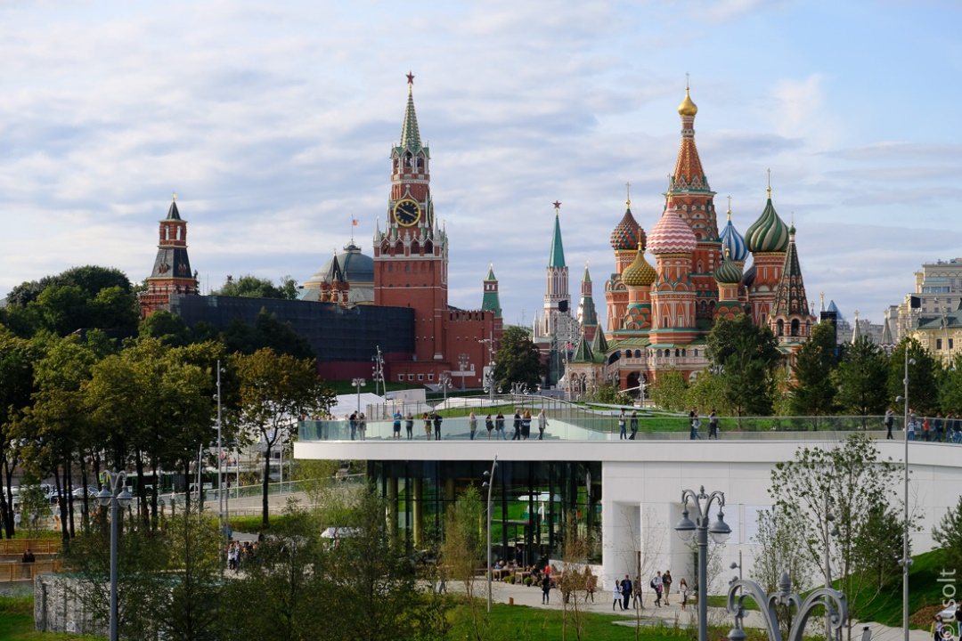
WELCOME
LONDON
MOSCOW

Slide 17
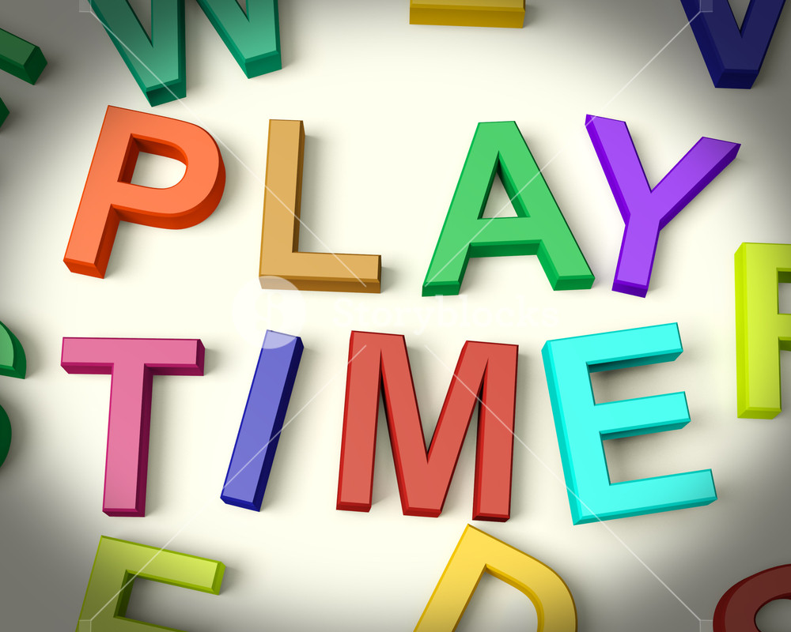
TIME TO PLAY

Slide 18
ASSES YOUR WORK
I took part in… | Very good | Good | Not good | Bad
Listening to the text
Answering questions
Discussing the ​problems
Doing tasks
Working in groups
Speaking
My score is _____

Slide 19
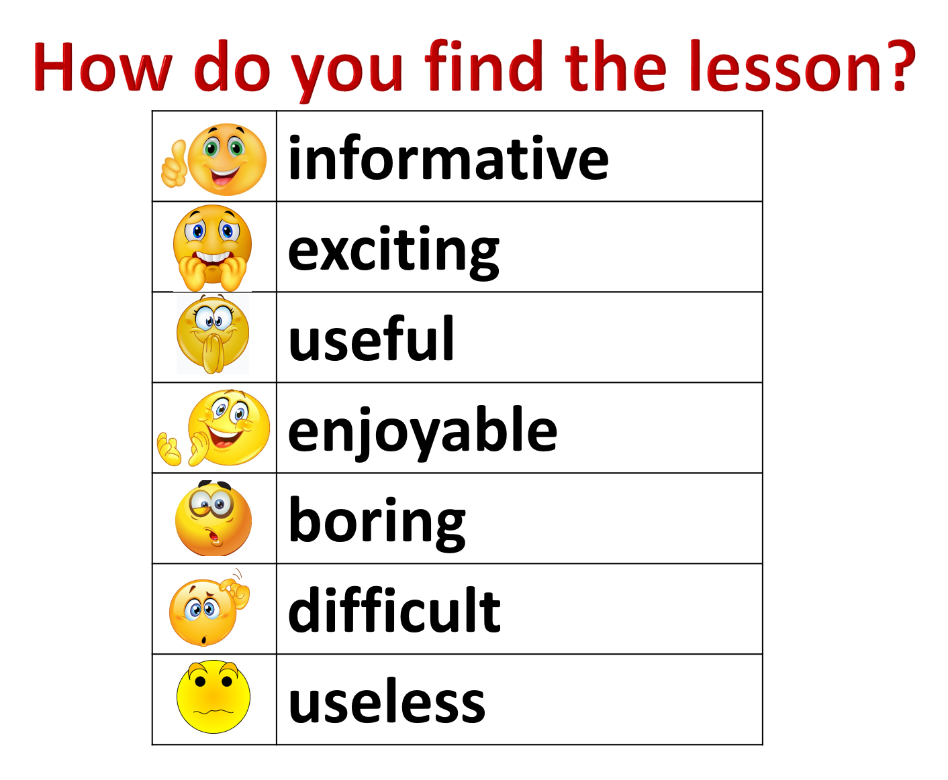

Slide 20
THANK YOU

