Slide 1
A VOICE MESSAGE

Slide 2
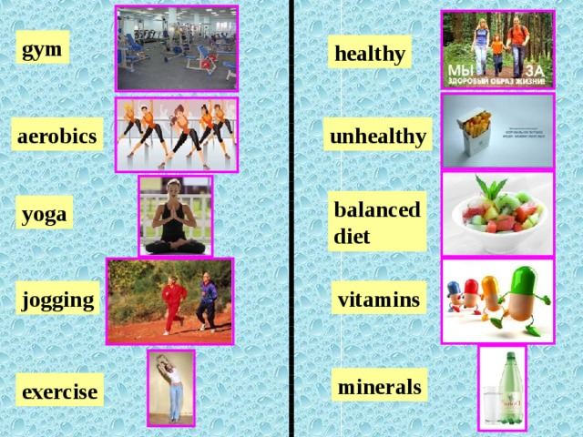


Slide 3


Slide 4
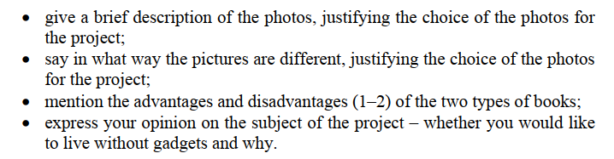

Slide 5
План ответа
introduction
give a brief description of the photos (connected with the topic) + justify the choice of photos for the project
say in which ways the pictures are different + justify the choice of photos for the project (2 черты – мой личный совет)
mention the advantages and disadvantages (2 пункта – мой личный совет)
express your opinion on the subject of the project (тема написана в задании)
conclusion

Slide 6
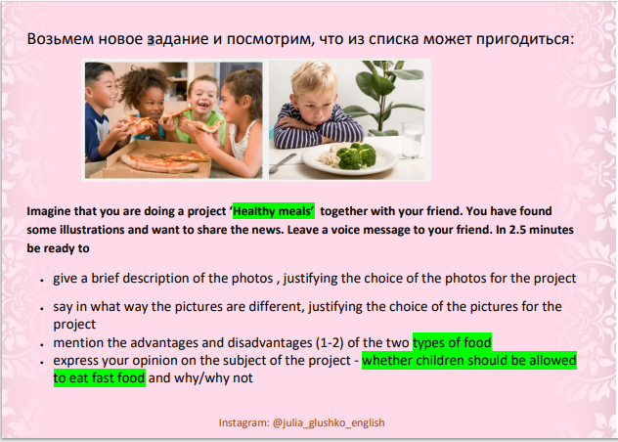

Slide 7
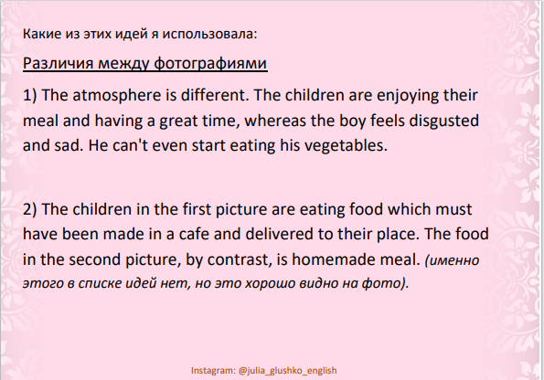

Slide 8


