Slide 1
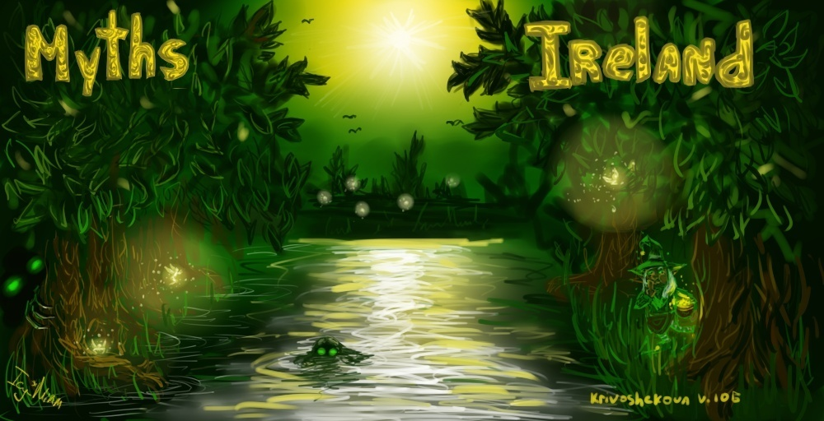

Slide 2
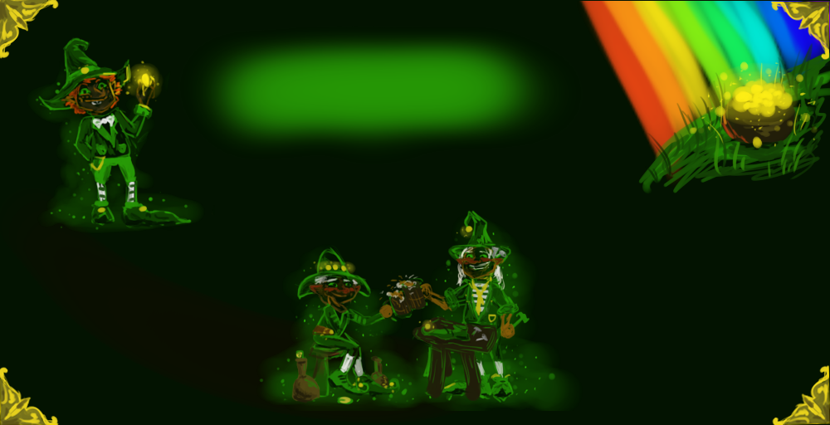
Мarch, 17 in Ireland is celebrated the day of St. Patrick. It's a fun holiday, with green beer, with painted faces in the colors of the Irish flag - and they dance a lot , of course. Irish people like their best symbol of this holiday – magic people, LEPRECHAUNS.
Leprechaun are only man in Celtic mythology, and they wear a beard. Some say, they live an average of 300 – 1000 years but no one knows. The older leprechaun is the more harmful it is to make dirty tricks.
The closest relatives of leprechauns are klurakans . But klurakans always drink too much, make scandals, steal and at night ride pets. They live in wine cellars.

Slide 3
Leprechauns
Leprechaun - the character of Irish folklore, traditionally portrayed as a small, stocky man dressed in a green suit and hat. . They are often drunk a lot, but it does not affect their shoemaker’s skills
They also make shoes for fairies. But no one has had a chance to catch the leprechaun at work . They always could be seen in one left shoe. Leprechauns’ duties included searching and storing of ancient treasures.
Leprechaunts were great hunters of treasures. Each family had a pot of gold coins, buried in the ground. Only the rainbow could point at the place of the treasures, but only the owner of gold coin could find it.

Slide 4
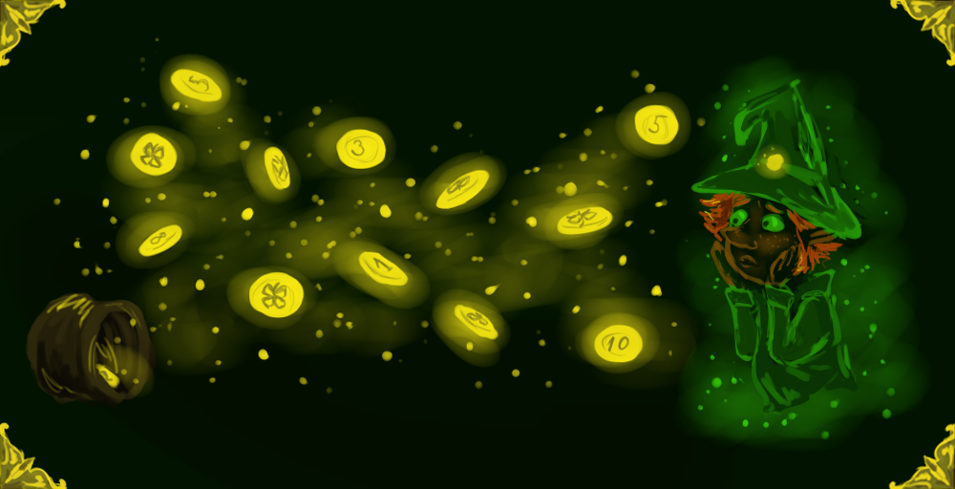
Oh!
I scattered the coins! Help me to collect them. Вut be cautious: not all of them belong to me.
Look for coins only with clover on the reverse.

Slide 5
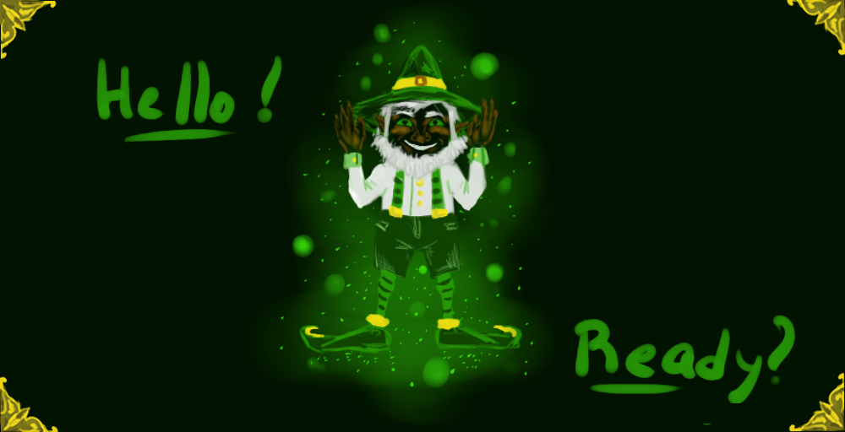
I love dancing. And Irish dancing is not so easy! Of course, I can easily teach you. Bat only if you are attentive students!
Repeat after me!

Slide 6
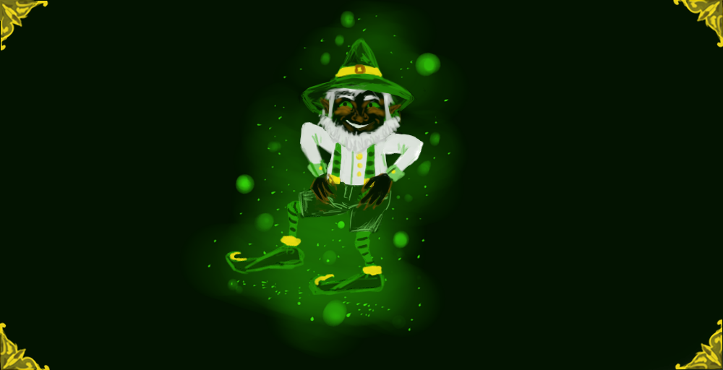

Slide 7
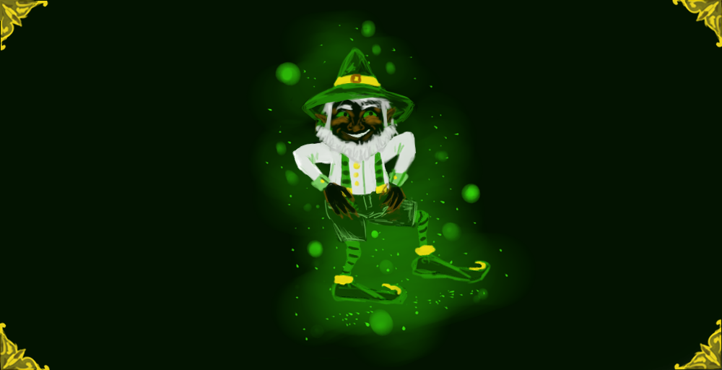

Slide 8
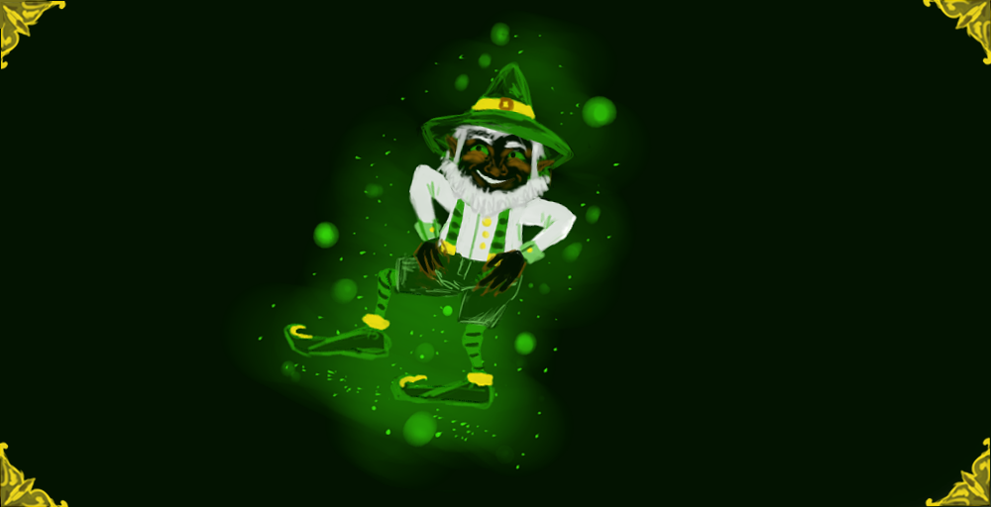

Slide 10
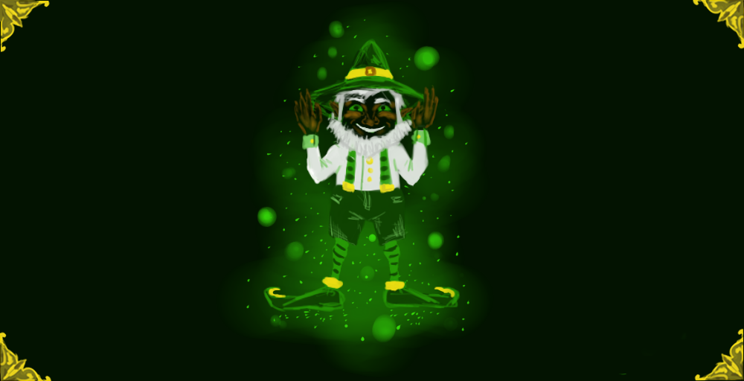

Slide 13
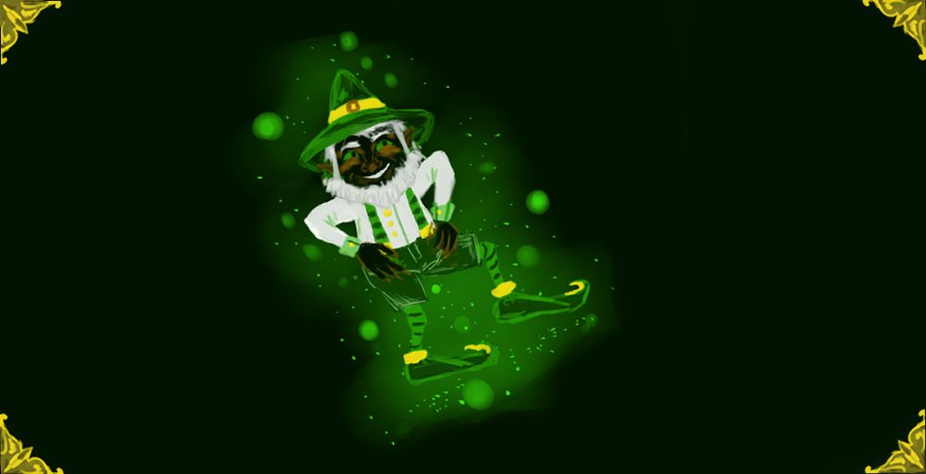

Slide 23
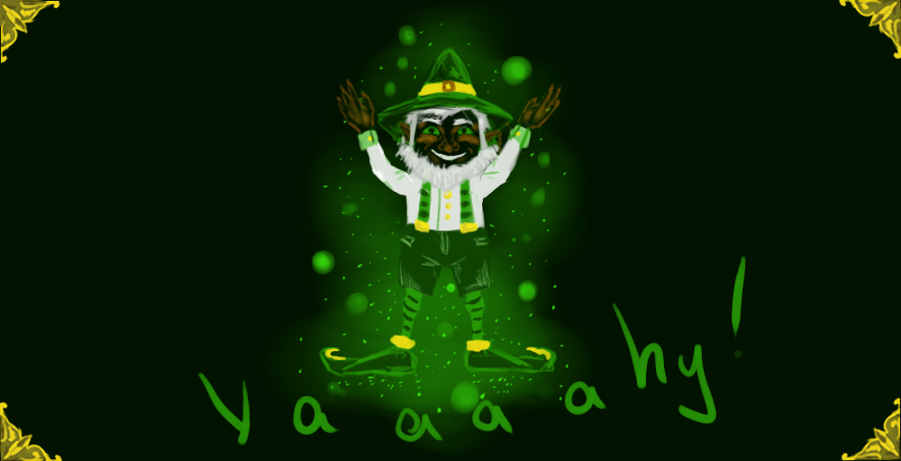

Slide 24
Мarch, (1) … in Ireland is celebrated the day of St. ( 2)P ……. It's a funny holiday, with green (3)b….., with painted faces in the colors of the Irish(4) f…… - and they dance a lot of, course. Irish people like the best (5) s….. of this holiday – (6) m……. people, LEPRECHAUNS.
Leprechaun are only man in Celtic mythology, and they wear a (7) b…… . Some say, they live an average of 300 – 1000 years but no one knows. The older a leprechaun is the more harmful it is to make dirty(8) t……
The closest relatives of leprechauns are klurakans . But klurakans are more (9)h……; always drink too much, make scandals, ( 10) s…… and at night ride their (11) p…... They live in wine (12) c…….

Slide 25
Мarch, (1) … in Ireland is celebrated the day of St. ( 2)P ……. It's a funny holiday, with green (3)b….., with painted faces in the colors of the Irish(4) f…… - and they dance a lot of, course. Irish people like the best (5) s….. of this holiday – (6) m……. people, LEPRECHAUNS.
Leprechaun are only man in Celtic mythology, and they wear a (7) b…… . Some say, they live an average of 300 – 1000 years but no one knows. The older a leprechaun is the more harmful it is to make dirty t( 8) t…...
The closest relatives of leprechauns are klurakans . But klurakans are more (9)h……; always drink too much, make scandals, ( 10) s…… and at night ride their (11) p…... They live in wine (12) c…….

Slide 26
Мarch, (1) … in Ireland is celebrated the day of St. ( 2)P ……. It's a funny holiday, with green (3)b….., with painted faces in the colors of the Irish(4) f…… - and they dance a lot of, course. Irish people like the best (5) s….. of this holiday – (6) m……. people, LEPRECHAUNS.
Leprechaun are only man in Celtic mythology, and they wear a (7) b…… . Some say, they live an average of 300 – 1000 years but no one knows. The older a leprechaun is the more harmful it is to make dirty ( 8) t…….
The closest relatives of leprechauns are klurakans . But klurakans are more (9)h……; always drink too much, make scandals, ( 10) s…… and at night ride their (11) p…... They live in wine (12) c…….

Slide 27
Find the missing words:
Leprechaun - the character of (1)..…. folklore, traditionally portrayed as a small, stocky man dressed in a (2)………and hat. They are skillful (3) sh……….
Also they made (6) b…. and leprechauns duties also included (7)…… of ancient treasures. Each family of leprechauns had pot of (8) g……., buried in the ground. One end of the (9) r…….. рoints the place of treasures, but only the owner of gold could find it.
They are masters of making shoes for supernatural forces - such as (4) f…….. But no one saw leprechaun at work. We can always see them usually only in one (5) l…… shoe.

Slide 28
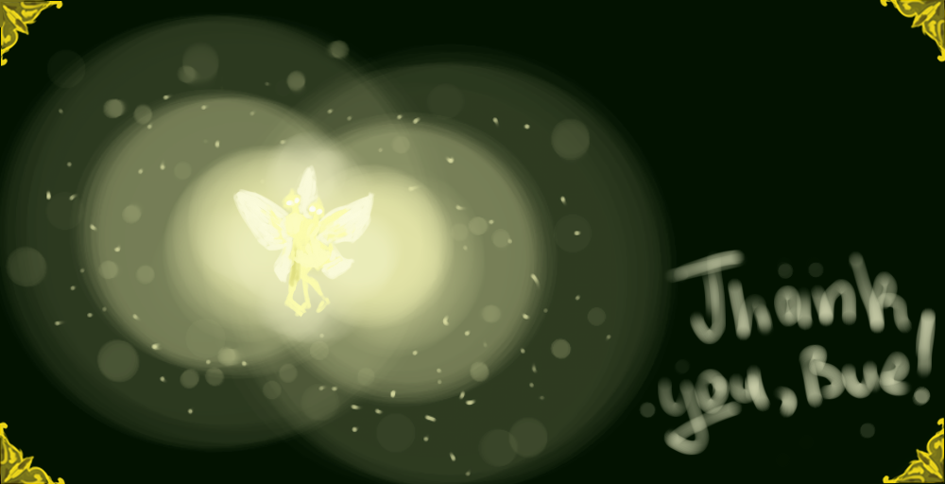

Slide 29
Мarch, (1) … in Ireland is celebrated the day of St. ( 2) P ……. It's a funny holiday, with green (3)b….., with painted faces in the colors of the Irish(4) f…… - and they dance a lot of, course. Irish people like the best (5) s….. of this holiday – (6) m……. people, LEPRECHAUNS.
Leprechaun are only man in Celtic mythology, and they wear a (7) b…… . Some say, they live an average of 300 – 1000 years but no one knows. The older a leprechaun is the more harmful it is to make dirty t( 8) ricks.
The closest relatives of leprechauns are klurakans . But klurakans are more (9)h……; always drink too much, make scandals, ( 10) s…… and at night ride their (11) p…... They live in wine (12) c…….

Slide 30
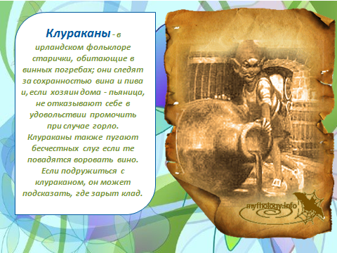
клуроканы

