Slide 1
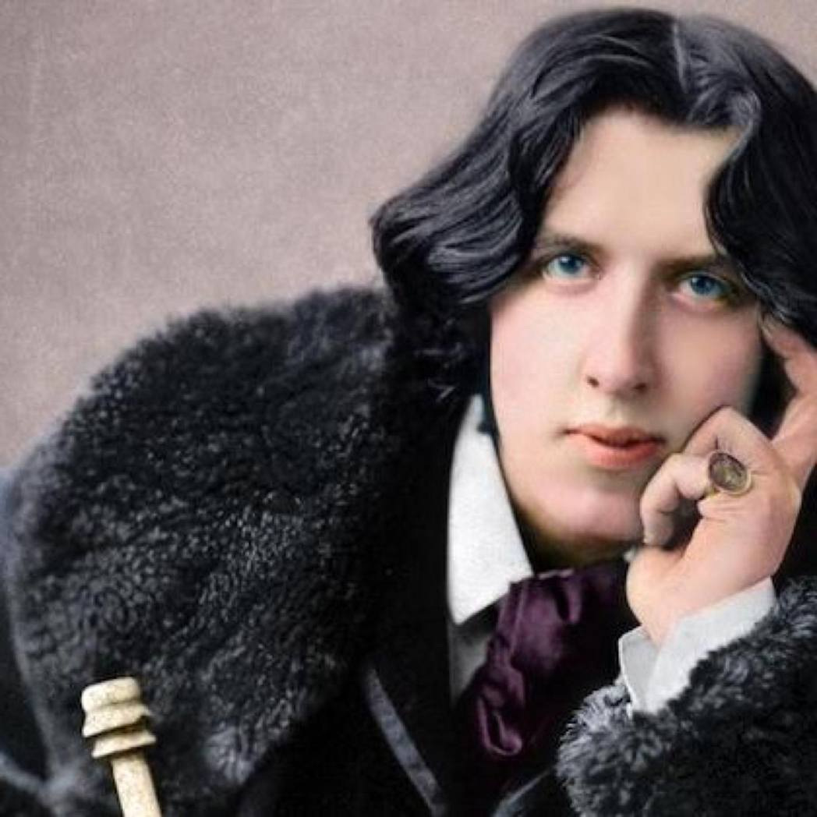
Oscar Wild

Slide 2
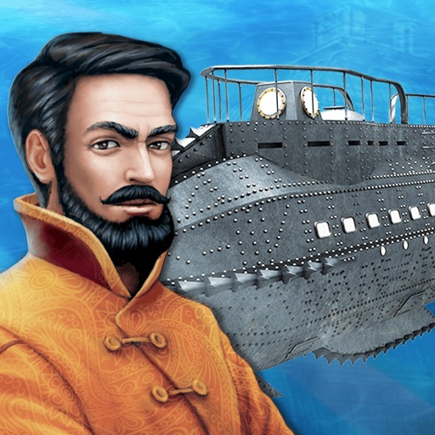
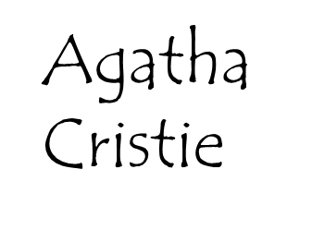
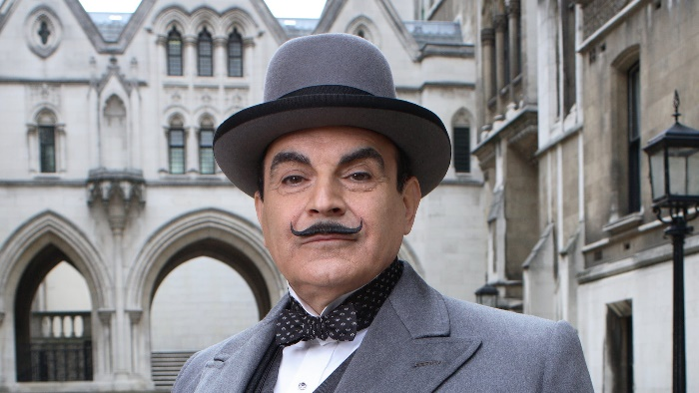
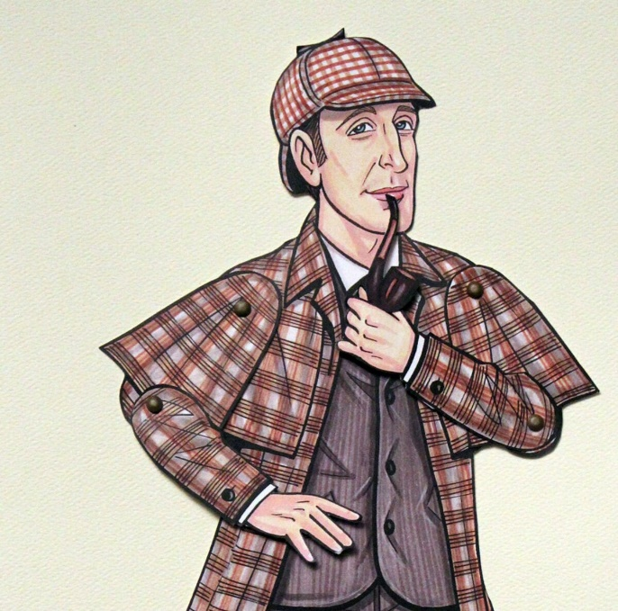
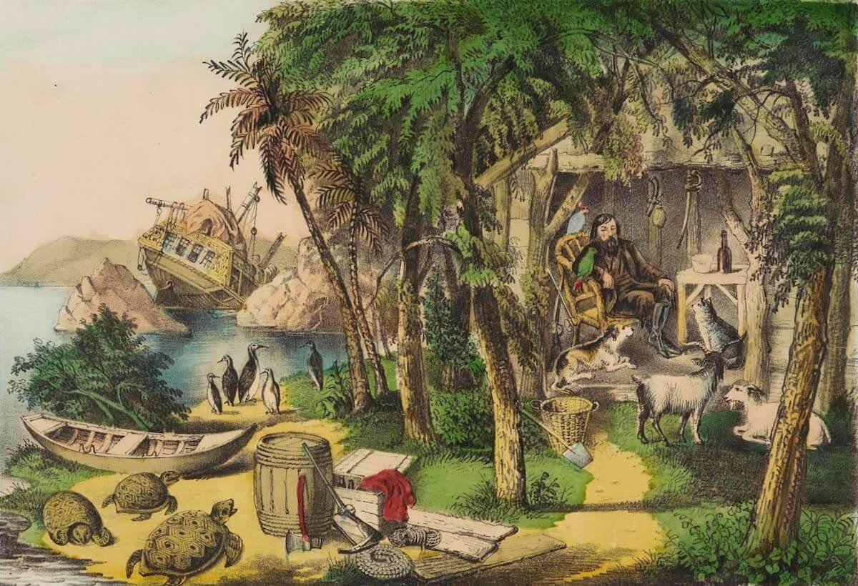
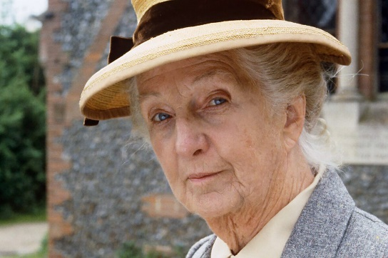
Hercule Poirot
Jules Verne
Daniel Defoe
Captain Nemo
Robinson Crusoe
Sherlock Holmes
Agatha Cristie
Miss Marple
Conan Doyle

Slide 3
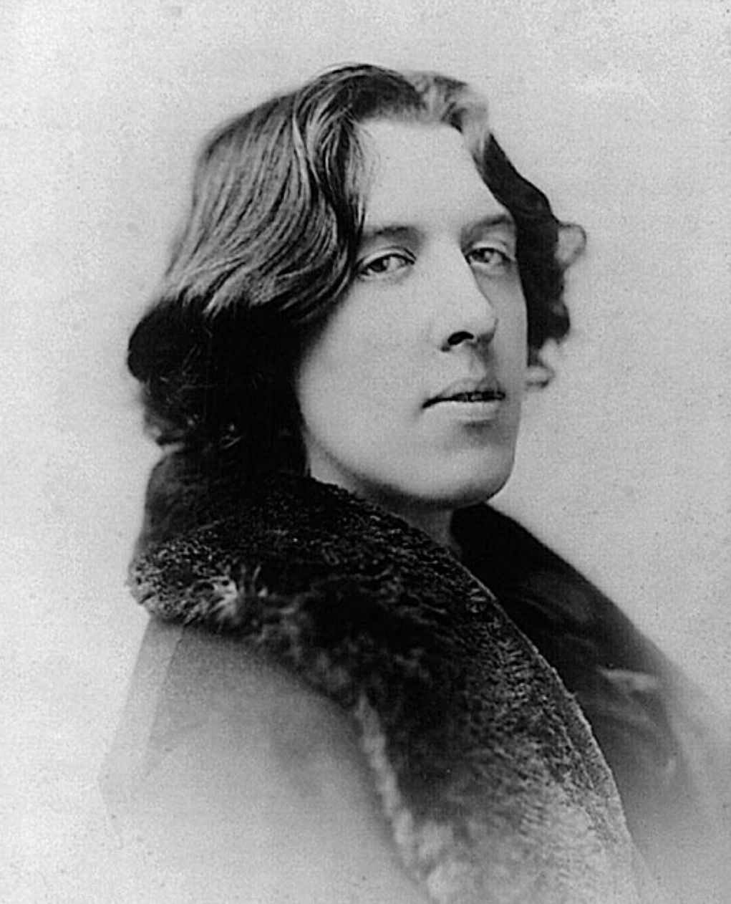
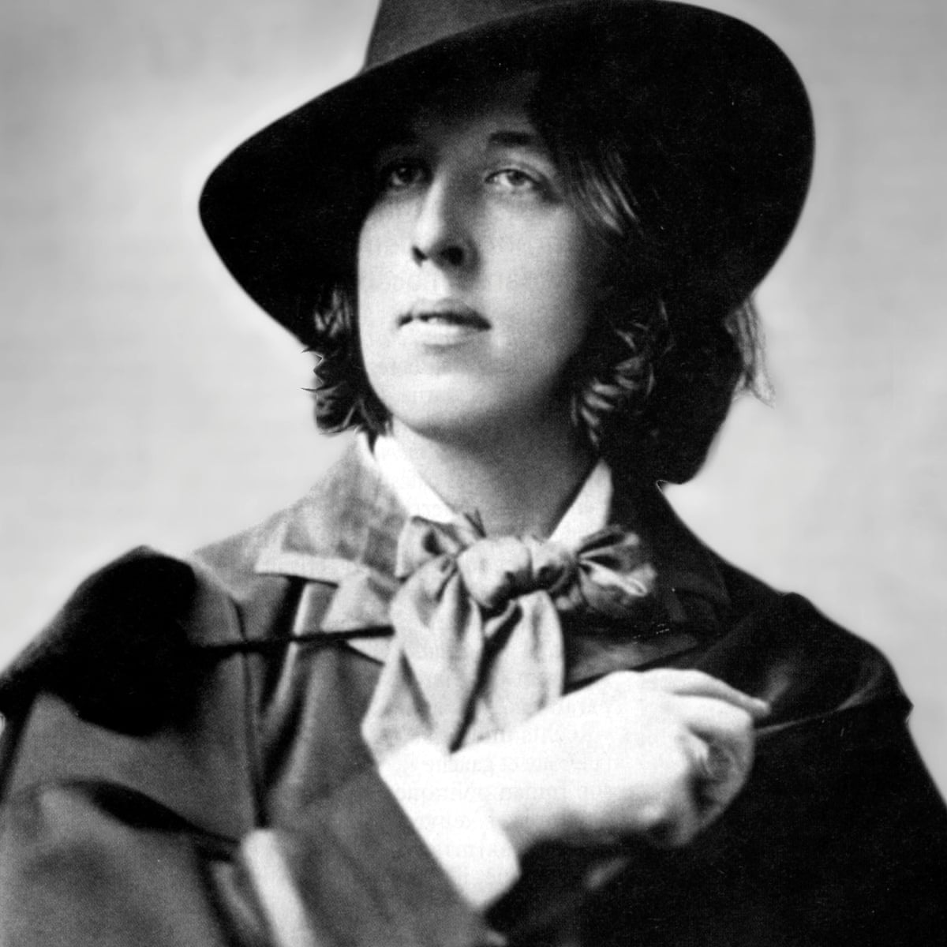
Oscar Wilde was born in Dublin in 1854, the son of a brilliant surgeon and a poetess. He was educated at Trinity college and then at Magdolen college (Oxford), where he won Newdigate prize for poetry.

Slide 4
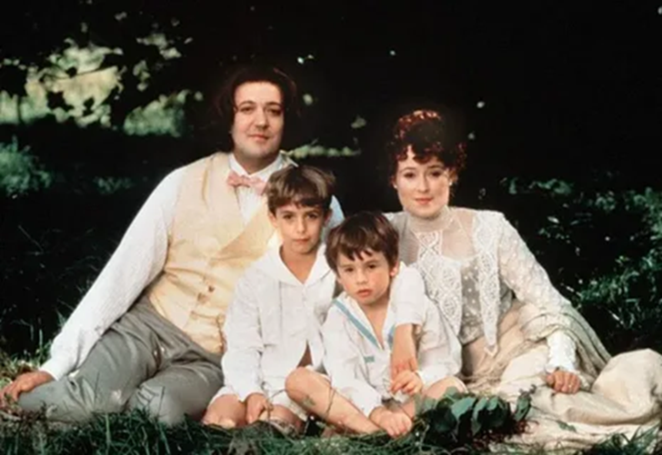
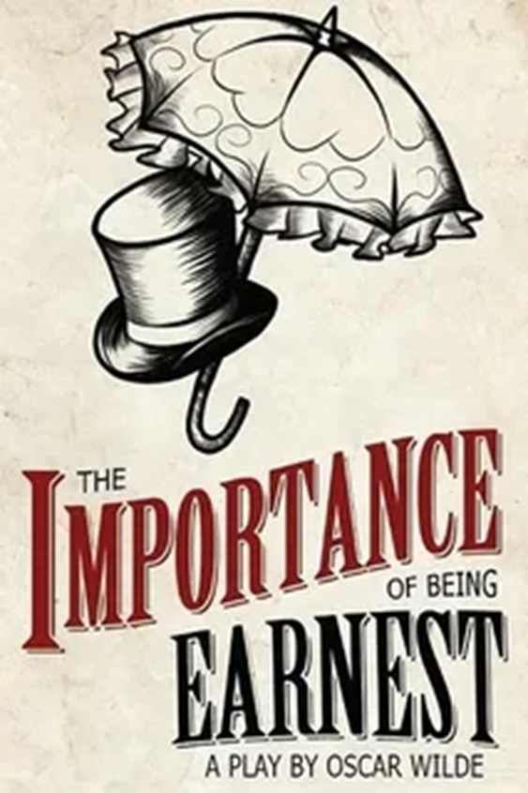
He became the leader of the aesthetic movement and was famous for the brilliance of his wit and conversation qualities made permanent in such plays as “Lady Windermere’s fan” and “Importance of being Earnest”.

Slide 5
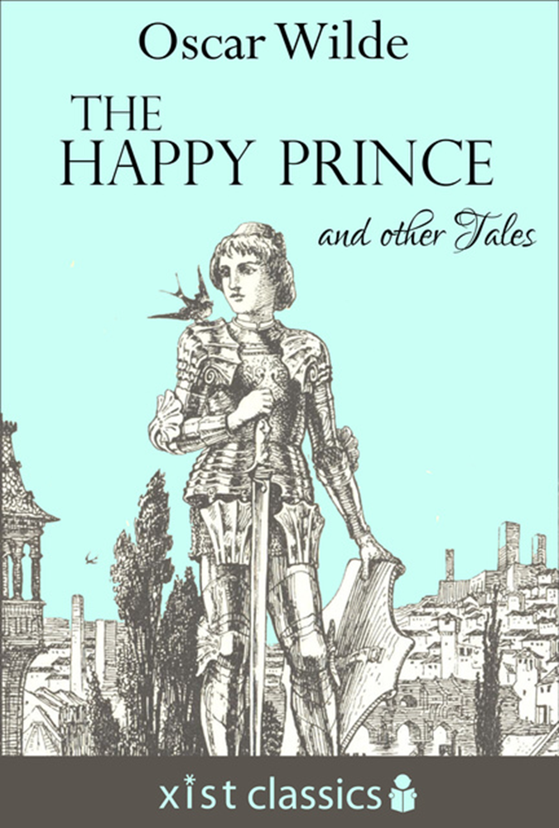

It was Oscar Wilde, who put forward
“art for art’s sake” theory.
He was the author of
some exceedingly
poetical tales, such as
“The Rose and the
Nightingale»,
«The Happy Prince»,
«The Devoted Friend”,
“The Selfish Giant”.

Slide 6

He is also the author of the novel “The Picture of Dorian Grey”. Oscar Wilde did not raise any social problems in his works. His characters are all people of upper circles. The upper class characters are engaged in clever and refined conversation, even if it is about a scheme how to rob their government.

Slide 7
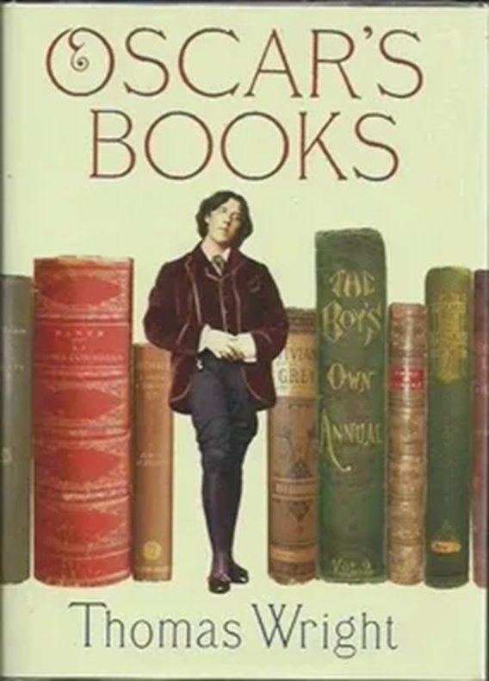
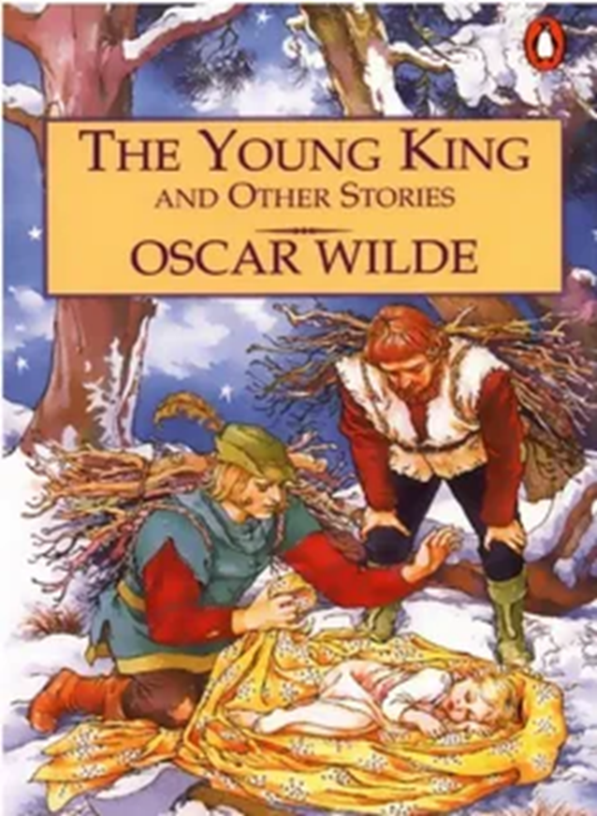
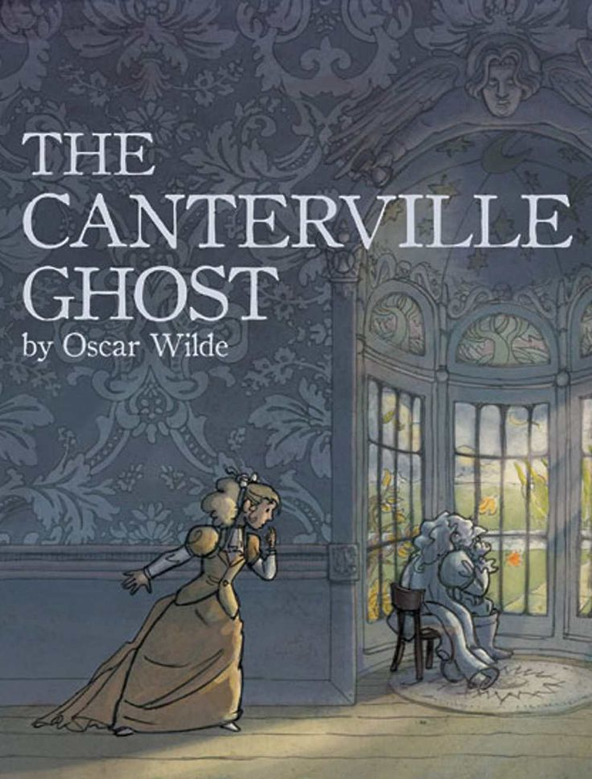
The interesting plot of Oscar Wilde’s plays and his humor help the plays to stay on the stages
of the theatres for more
than
90 years.

Slide 8
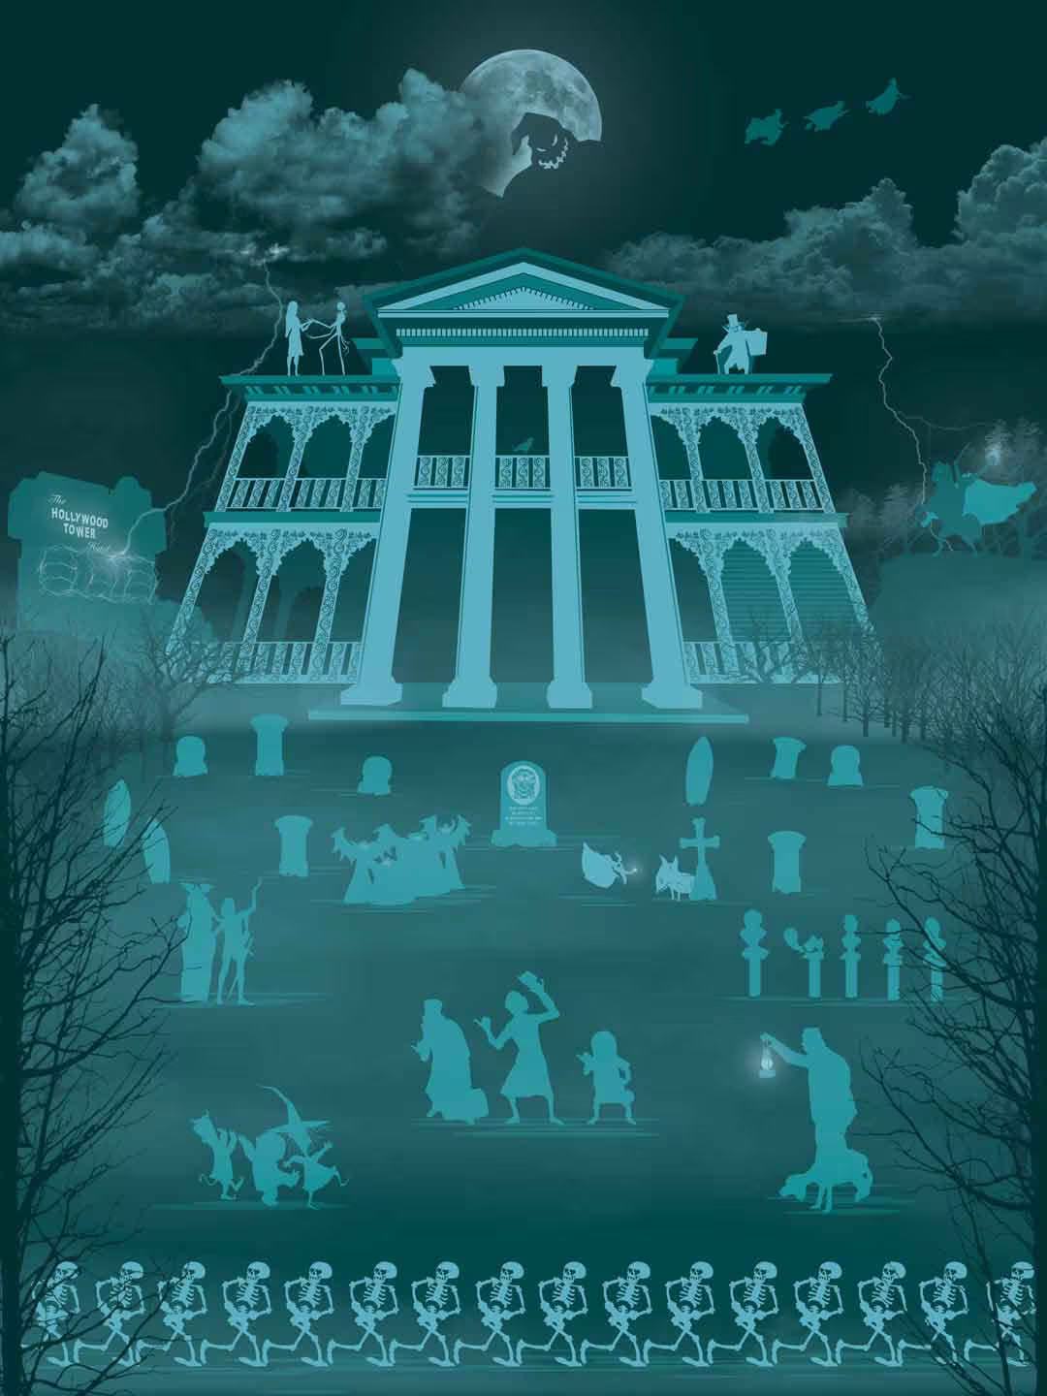


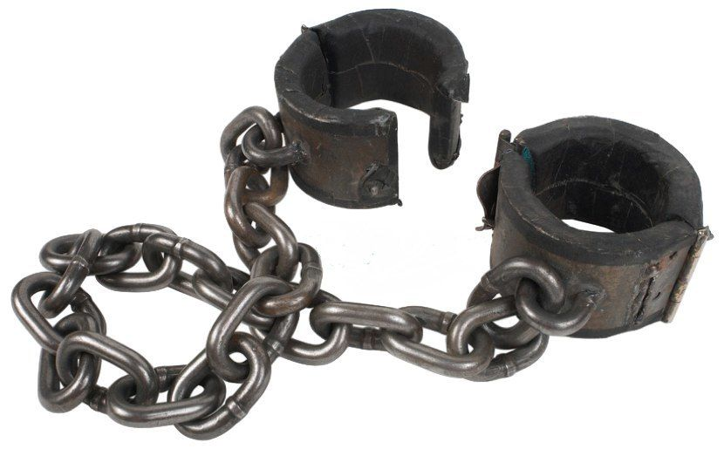




ambassador
handcuffs
oiling
haunted
rusty
strike a match
chain
foolish

Slide 9
