Slide 1
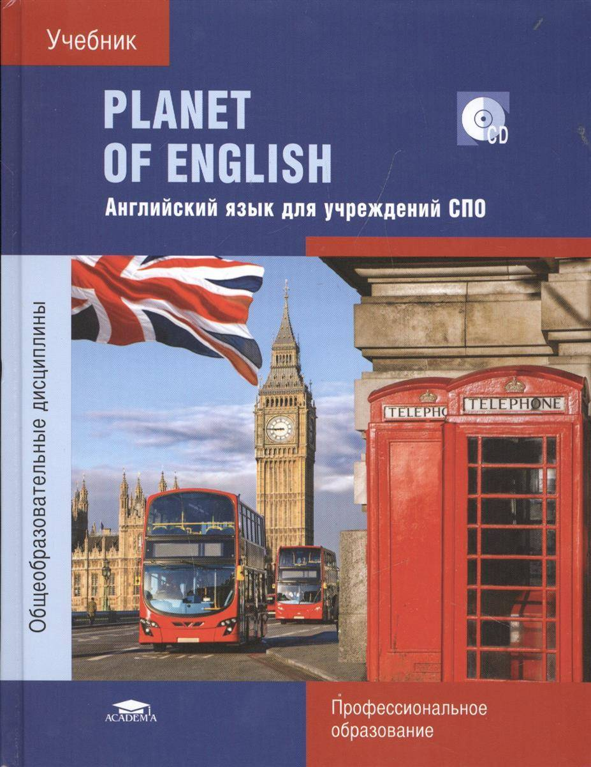
BASIC GRAMMAR REVISION
ZARAYSK
TEACHER TRAINING COLLEGE
PRESCHOOL EDUCATION

Slide 2
Have a look at the two columns
Match them to make phrases
1 | Fill in | a | the words/ names
2 | Form | b | the gaps
3 | Group | c | the questions
4 | Describe | d | plurals of the nouns
5 | Answer | e | the picture

Slide 3
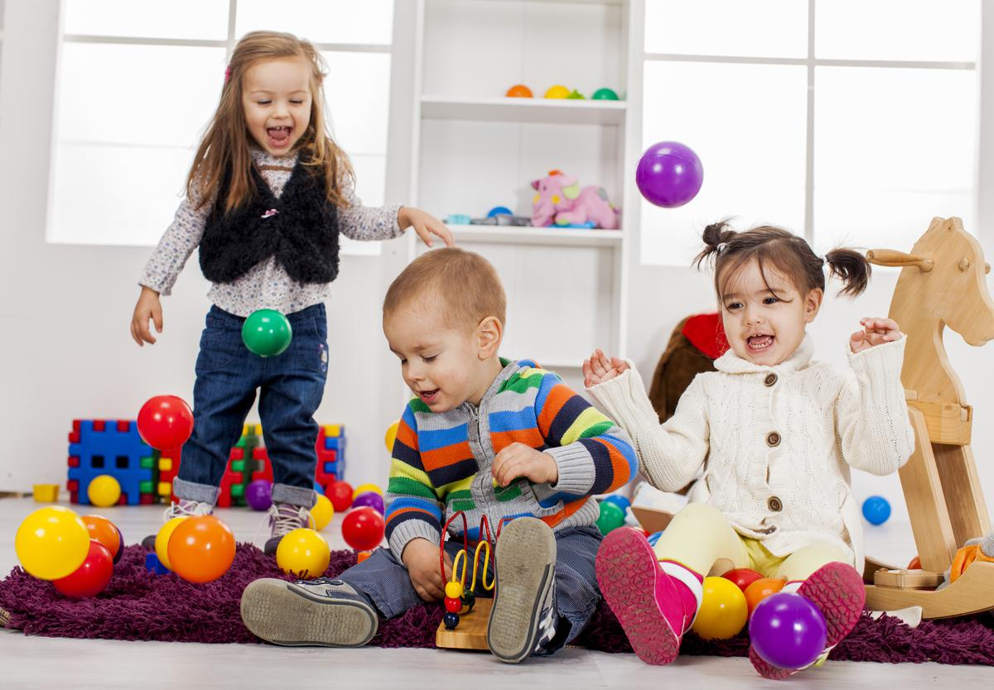

Slide 4
Group the names of the holidays according to the country they come from
Work in pairs
Holiday | Russia | Th UK
St. Andrew’s Day
Maslenitsa
Burns Night
Hogmanay
National Unity Day
Paratroopers’ day
The Defender of the Fatherland Day
Pancake day
Christmas
Russia | Th UK
Maslenitsa | St. Andrew’s Day
National Unity Day | Burns Night
Paratroopers’ day | Hogmanay
The Defender of the Fatherland Day | Pancake Day
(Orthodox) Christmas (Catholic)

Slide 5
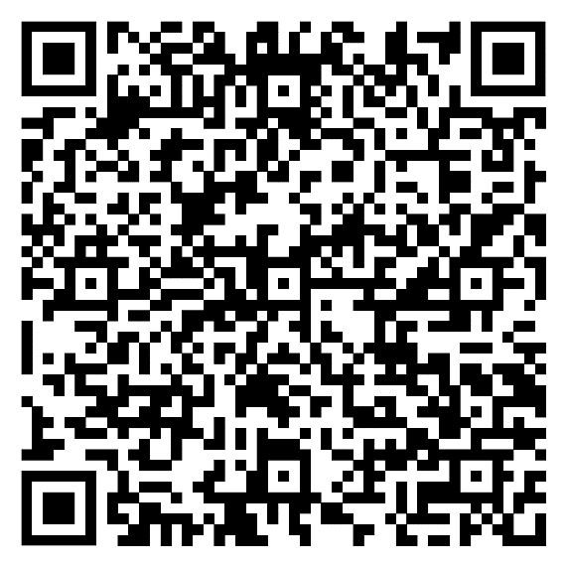
Scan the qr code
Group plural foms of the nouns
stocking Santa Claus holly gingerbread candy angel sleigh Christmas tree present reindeer snowman

Slide 6
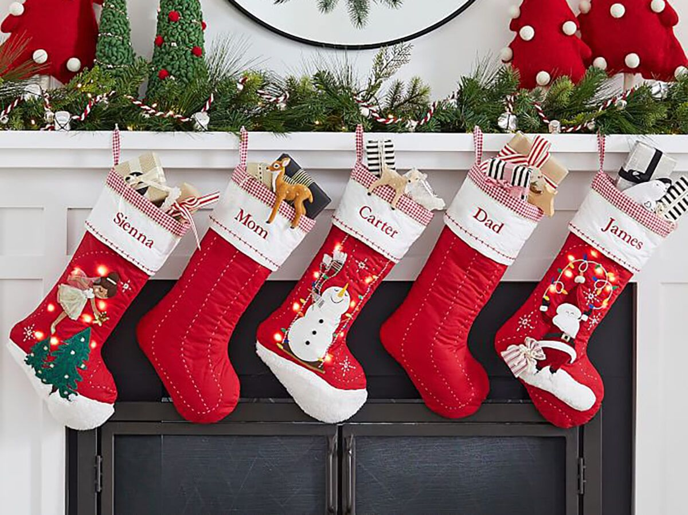
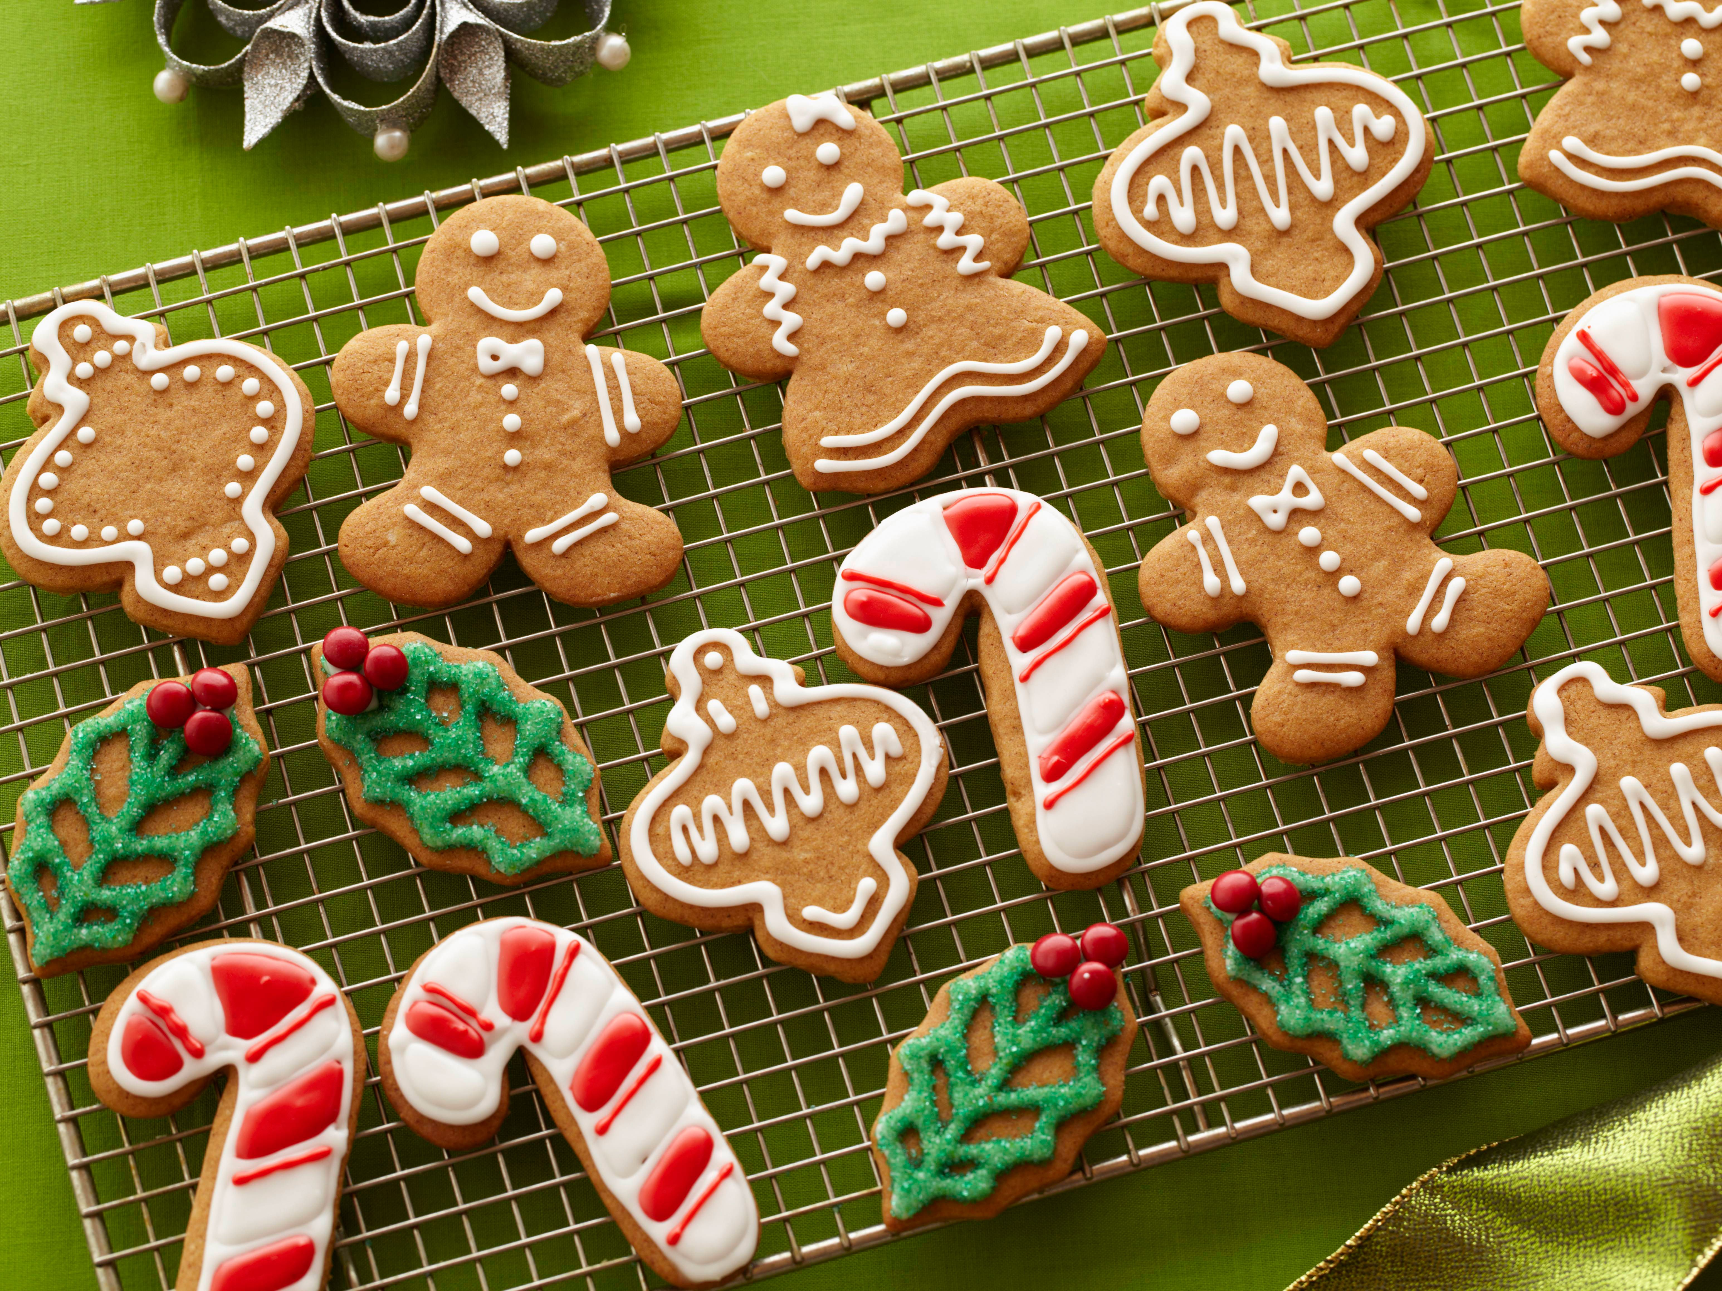
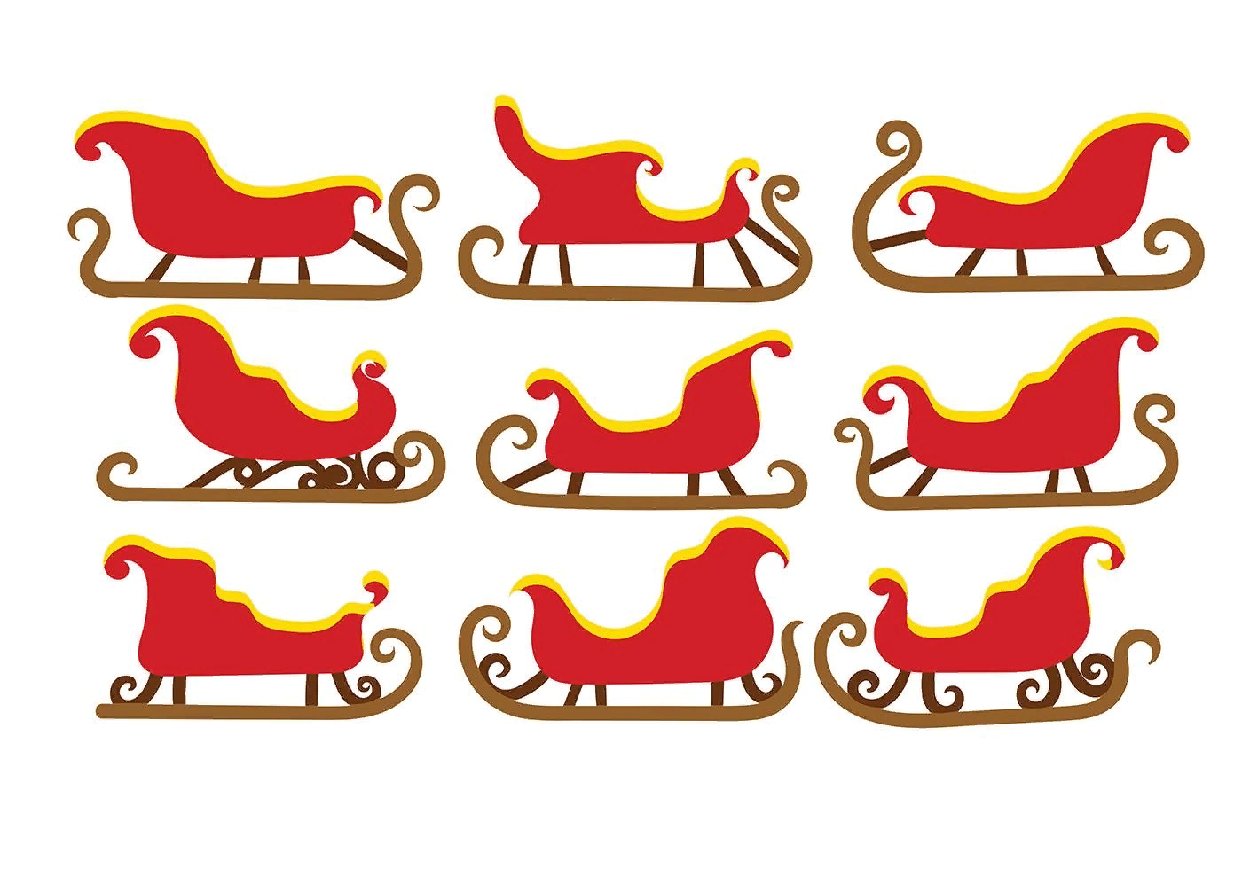
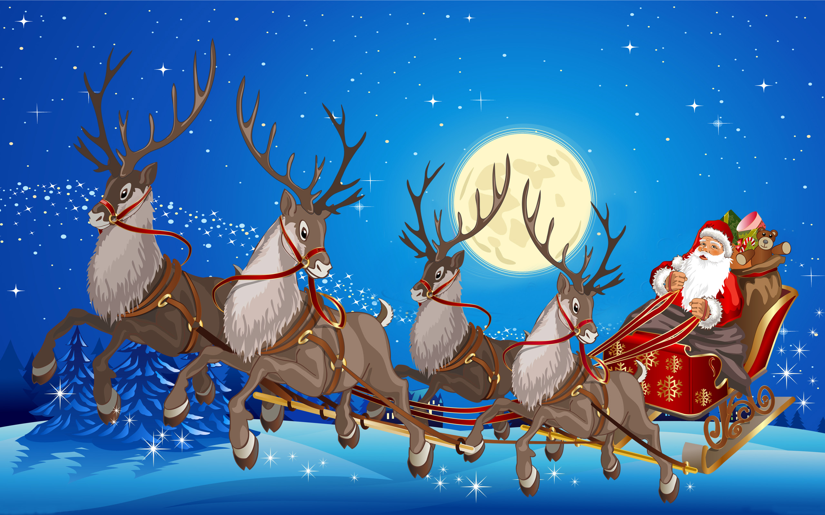
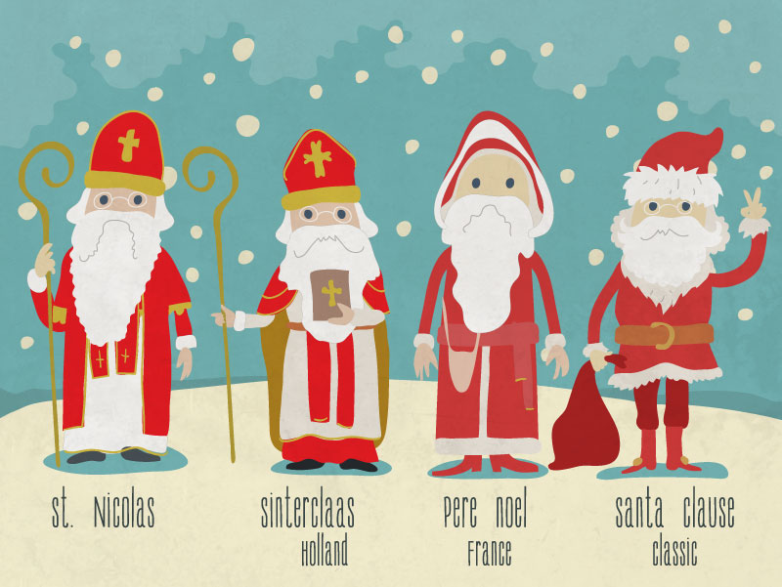
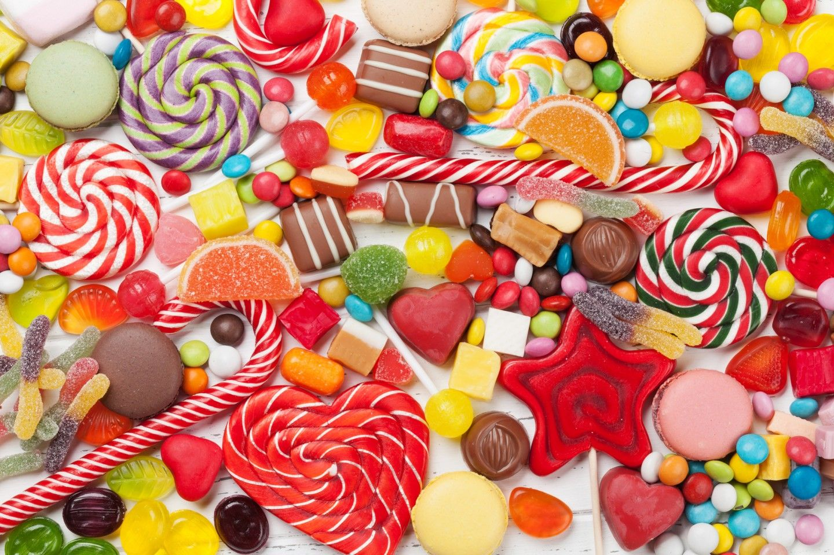
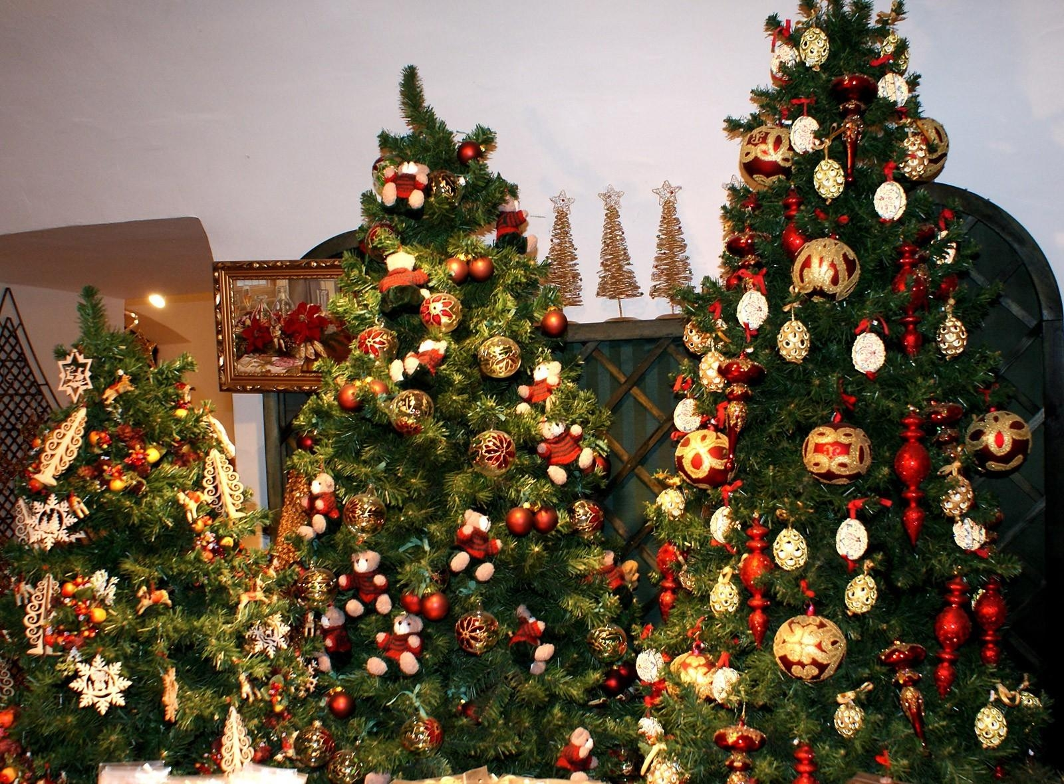
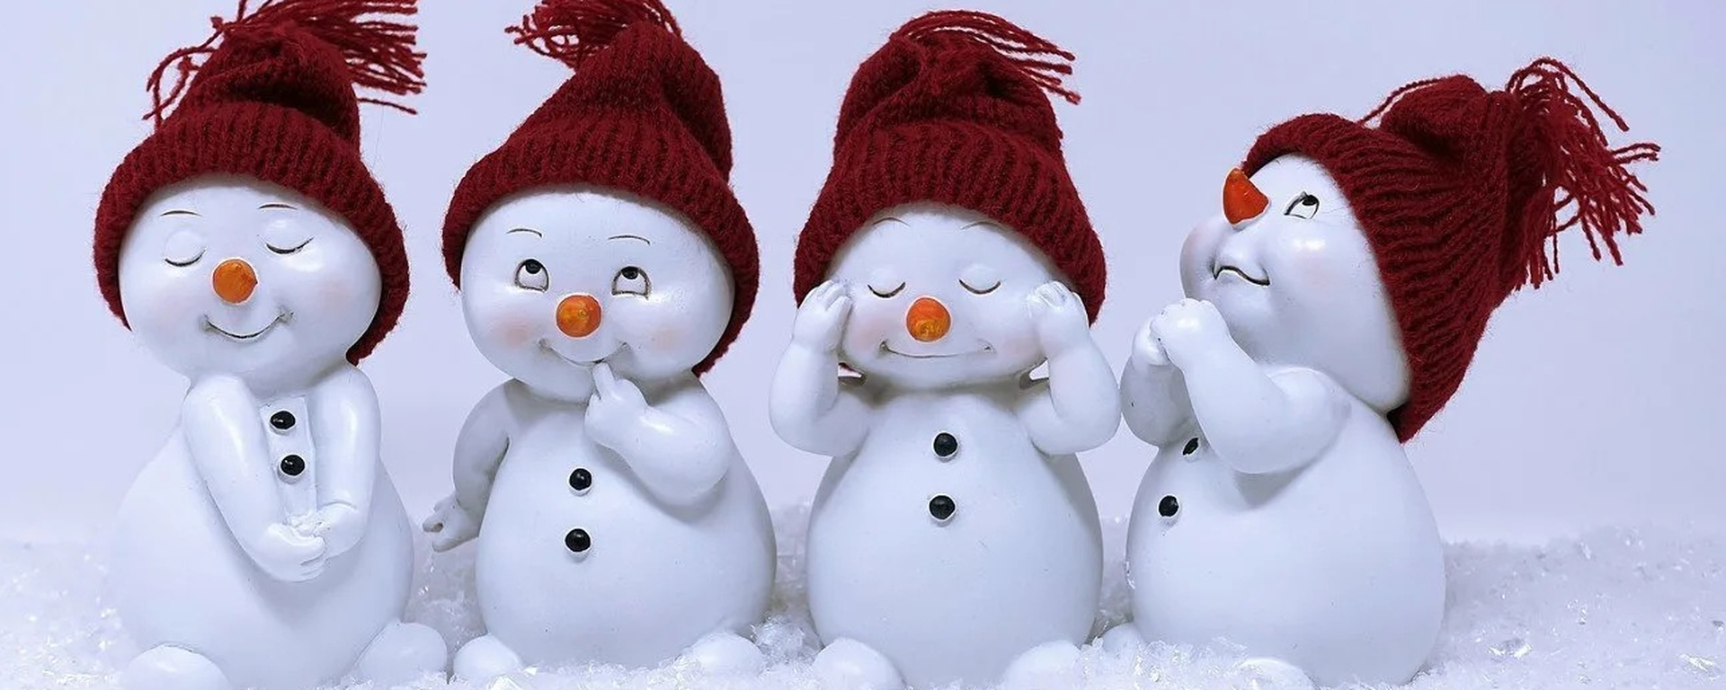

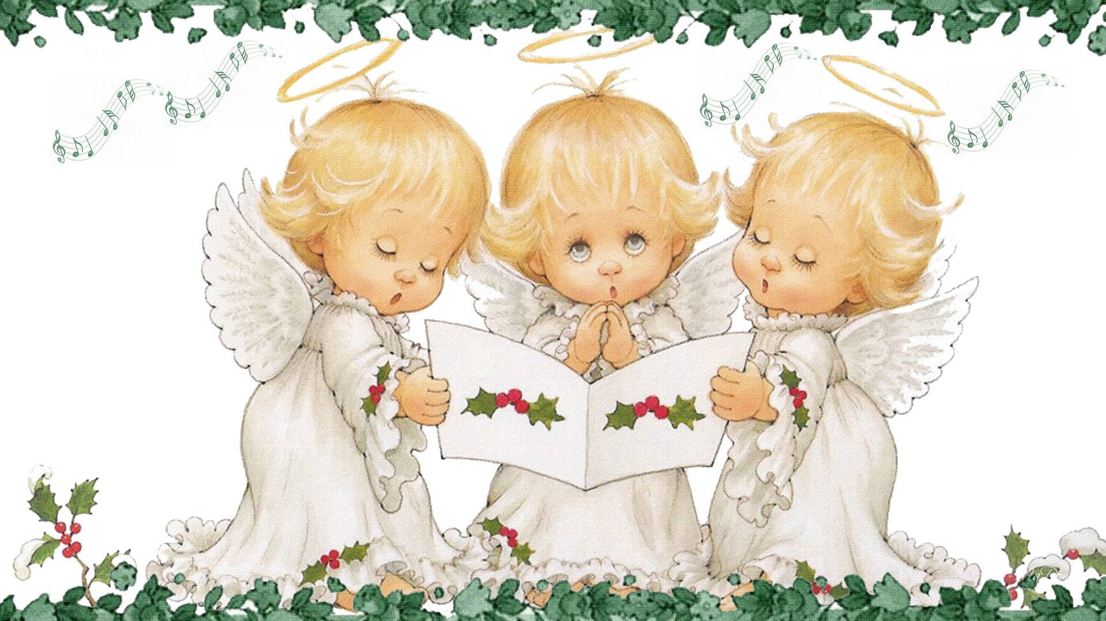


Slide 7

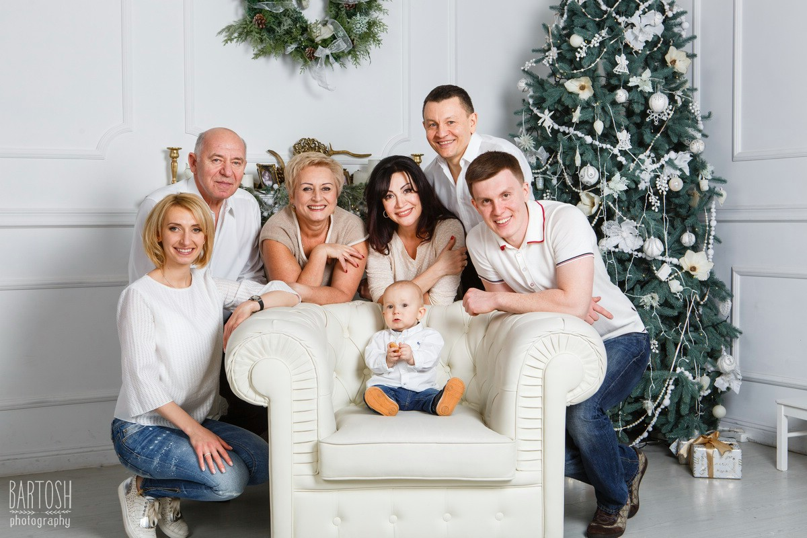
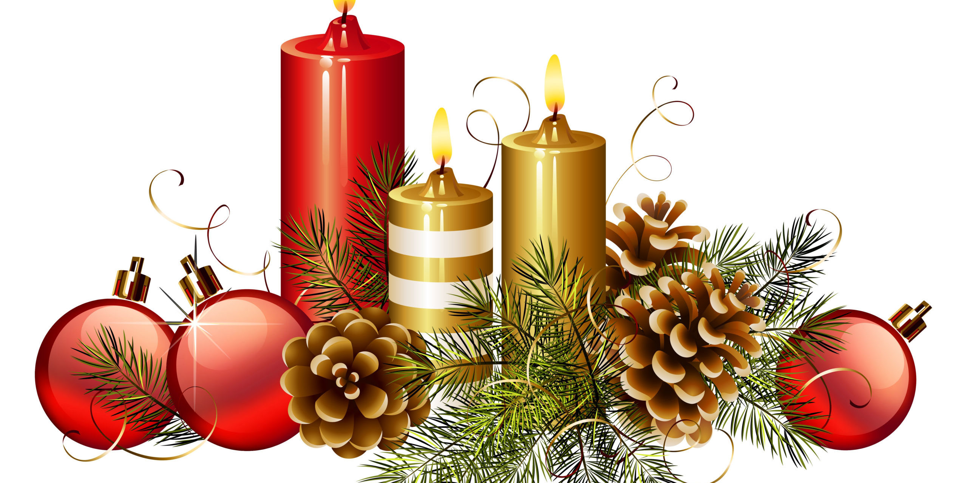
Who is the tallest in your family? – My father is.
Who is the cleverest in your family? -
Who is the most creative in your family? -
Who is the strongest in your family? -
Who is the most hard-working in your family? -
Who is the most sensitive in your family? -
Who is the most cheerful in your family? -
Who is the most ambitious in your family? -
Who is the most talkative in your family? -
Who is the most generous in your family? -
Who is the most hot-tempered in your family? -

Slide 8
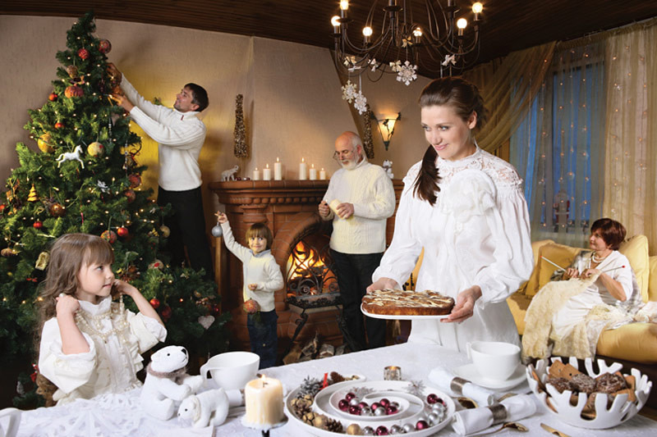
Now join into groups of four students
Describe the picture in some full sentences using the construction there is/are.
Follow the example: There is a family in the room/in the picture.

Slide 9

There are six people in the room
There are two children in the room
There is a Christmas tree in the corner of the room
There is a fireplace in the room
There is a table in the room
There are cups and a candle on the table
There is a sofa at the window
There is a girl at the table
There are baubles on the table

Slide 10
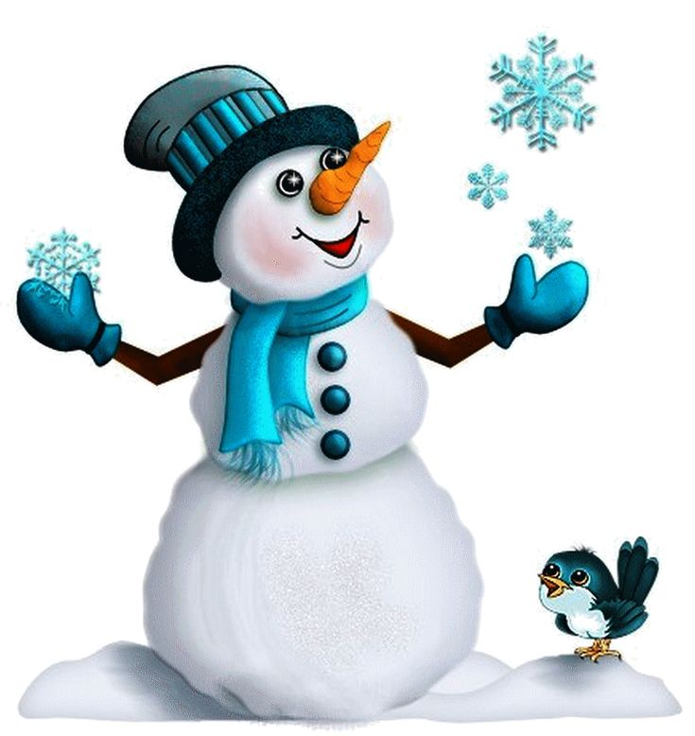

I’m a little snowman Short and … Made from little snowflakes That fell to the … I have two eyes And a … for a nose Oh, I am the … little snowman I know I’m a little … Short and round Made from little snowflakes That fell to the ground | With a … to keep me warm And a hat on my … Oh, I am the happiest little snowman I … I’m a little snowman Short and round Made from little snowflakes That fell to the ground I have three … 1, 2, 3 Oh, I am the happiest little snowman I know | Happiest Head Carrot Snowman Know Scarf Round Buttons Ground

Slide 11


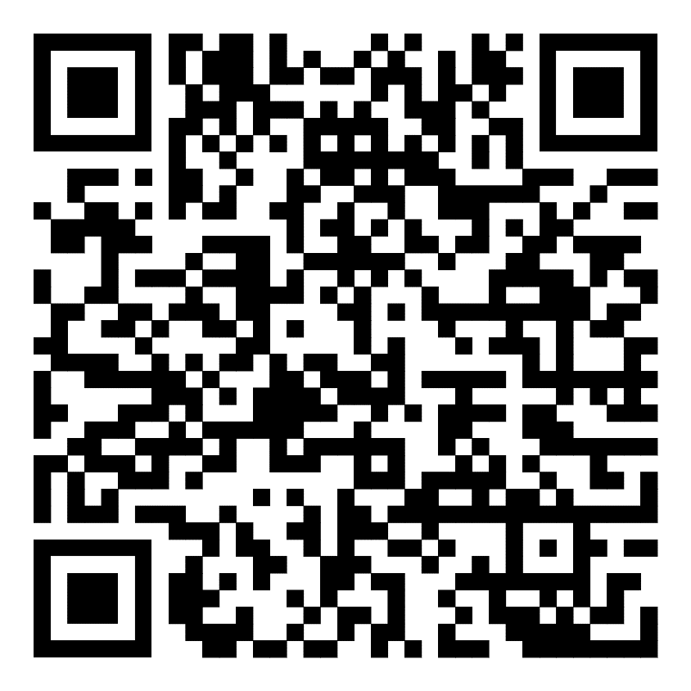
Scan the qr code and do the test

Slide 12

