Slide 1

Whizz-kids Vкласс
Учитель английского языка
Мокина Елена Владимировна

Slide 2
Do you know fairy tales? | 1.1 | 1.2 | 1.3 | 1.4
Words and Grammar | 2.1 | 2.2 | 2.3 | 2.4
Logic puzzles | 3.1 | 3.2 | 3.3 | 3.4

Slide 3
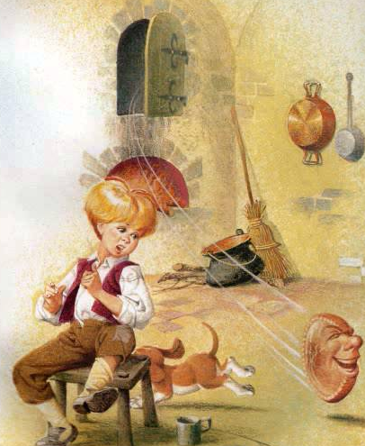
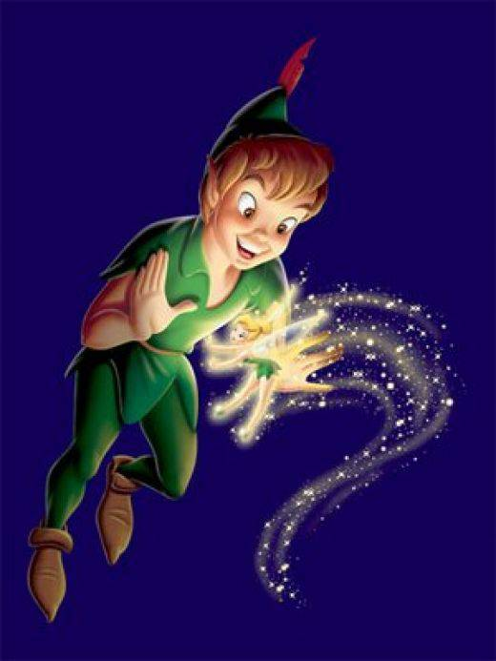
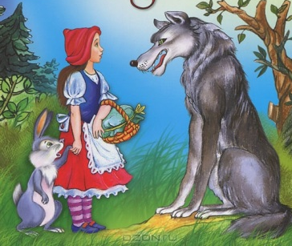
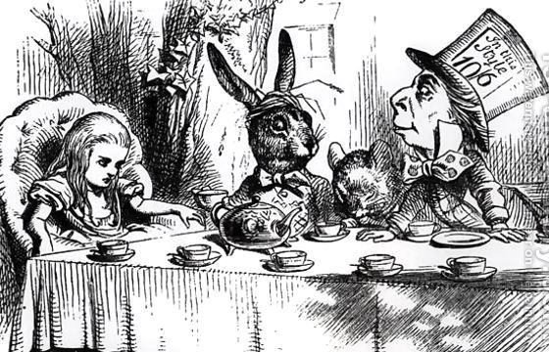

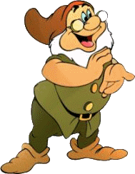
a)
1.1
Match:
Peter Pan in the Kensington Gardens
Alice's Adventures in Wonderland
Little Red Riding Hood
Johnny-Cake
Puss in Boots
b)
c)
d)
e)

Slide 4
1.2
As | cool busy flat white proud slow hungry fat blind | as a | peacock pig bat cucumber snail bee pancake ghost wolf

Slide 5
Tale
Jack and the beanstalk
1.3
Jack sold the cow to a man for some magic beans.
The next morning, there was a giant beanstalk.
Jack and his mother were very poor. They had no money, only a cow.
There was a beautiful castle. Jack went inside.
Jack’s mother cut down the beanstalk and the giant crashed to the ground.
Jack’s mother was very angry. She threw the beans in the garden.
Jack took the hen and the harp and ran away home, down the beanstalk.
Jack and his mother lived happily ever after.
Jack climbed up the beanstalk up to the sky through the clouds.
“Fee, Fi, Fo, Fum!” There was a giant! He had a magic hen and a magic harp.

Slide 6
1.4
1.Sleeping Beauty | a) In this story, a princess is given a test to see if she's truly royalty. Will she be able to feel one tiny pea placed beneath a tall stack of mattresses?
2.Snow White | b) A jealous stepmother forces her beautiful stepdaughter into the woods where she meets seven dwarves who care for her. After an evil spell forces Snow White into a deep sleep, a prince awakens her with a kiss.
3.The Princess and the Pea | c) She is a princess who has been cursed by an evil witch to die if pricks her finger on a spindle. A good fairy is able to reverse the curse partially, however, and the princess and everyone in her kingdom are made to sleep until she is awakened by the kiss of a handsome prince.
4.Puss and Boots | d) One of the most famous fairy tales of all time, this story tells about a girl who is constantly mistreated by her wicked stepmother and stepsisters. She goes to a ball, and then meets up with a handsome prince.
5.Cinderella | e) The story of a manipulative cat who tricks people in order to marry a princess and become wealthy.

Slide 7
Find seven grammar mistakes
in this letter:
2.1
Hello Jane,
How is you? Hope you are Ok. I want to tell you about my family.
I haven’t got a small family. My family are big. I has got a parents and a grandparents. I have got a friend, too. She am my cousin. Her name is Kate. She are 9 and she’s a student.
I love my big family.
Have you got a big family? Have you got a cousins? What are their name?
Write me soon. Bye for now.
Love,
Anna

Slide 8
2.2
He does it every day.

Slide 9
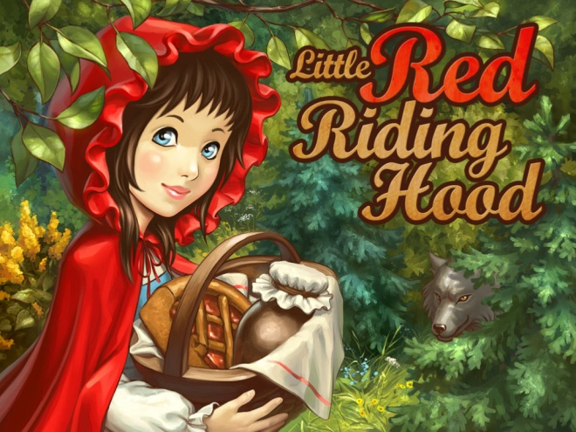
2.3
Little Red Riding Hood lives in a wood with her mother.
Every week she 1… (go) to visit her granny. But last week Little Red Riding Hood 2 … (not, see) her grandmother because she 3 … (be) ill.
And now she 4 … (go) to granny’s house with a nice cake in her basket. Grandma 5 … (like) cakes very much.

Slide 10
Funny Riddles
What is it?
2.4
1. It belongs to you, but your friends use it more. What is it?
2. Where are the lakes always empty, the mountains always flat and the rivers always still?
3. What has legs but cannot walk?
4. Bob’s mother has three children. Their names are Huey, Dewey, and … ?
5. What has to be broken before you can use it?

Slide 11
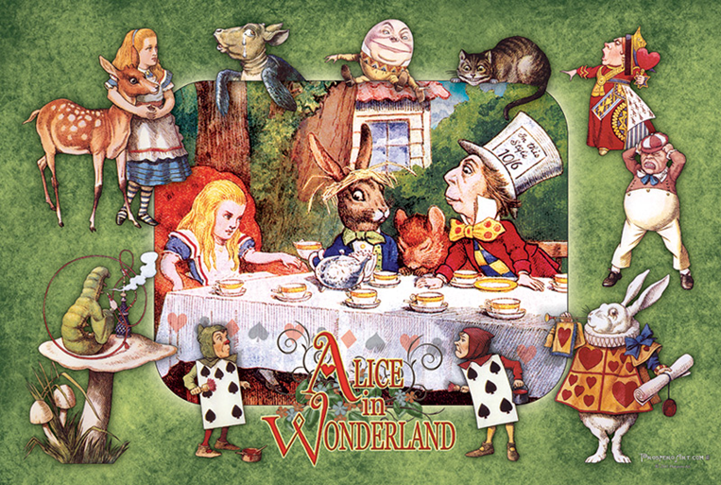
Find these words in the box
3.1
c | v | b | q | r | n | t | h | e | r | a | b | i | t | o | f
a | l | e | c | e | b | i | l | t | h | e | q | u | b | e | n
m | a | a | l | i | c | e | b | b | i | t | h | e | i | r | t
c | h | e | s | i | r | c | a | t | w | h | i | t | l | o | n
m | o | k | t | u | l | e | h | a | r | e | c | a | l | m | u
q | u | e | c | h | e | s | h | i | r | e | c | a | t | m | f
h | a | g | t | m | d | t | e | r | c | a | p | h | h | a | t
l | i | r | t | o | u | h | a | r | d | r | a | b | e | b | i
m | a | y | r | c | c | h | g | r | y | f | o | n | l | i | z
h | e | p | a | k | h | r | t | s | t | h | e | l | i | z | a
q | w | h | i | t | e | r | a | b | b | i | t | i | z | p | o
t | o | o | s | u | s | w | m | a | r | c | h | h | a | r | e
l | x | n | q | r | s | l | i | z | s | a | d | o | r | e | c
m | o | h | a | t | t | e | r | k | n | m | v | w | d | e | r
t | h | e | r | l | b | b | i | t | w | h | i | t | e | r | a
w | q | u | e | e | n | o | f | h | e | a | r | t | s | q | b
Alice - Алиса
The White Rabbit - Белый Кролик
Bill the Lizard - Ящерка Билль
The Duchess - Герцогиня
The Cheshire Cat - Чеширский кот
The Hatter - Шляпник (Болванщик)
The March Hare - Мартовский заяц
The Queen of Hearts - Королева червей
The Gryphon - Грифон
The Mock Turtle - Черепаха Квази

Slide 12
1. Good clothes open all doors | a) Без труда не вытащишь и рыбки из пруда
2. A cat in gloves catches no mice | b) Добрая слава лучше богатства
3. A friend in need is a friend indeed | c) Буря в стакане воды
4. A good name is better than riches | d) Нет дыма без огня
5. A storm in a teacup | e) По одежде встречают
6. There is no smoke without fire | f) Друзья познаются в беде
7. То know what's what | g) Не учи рыбу плавать. Не учи ученого.
8. Never offer to teach fish to swim | h) Знать что к чему
3.2

Slide 13
3.3
Make as many words
as you can:
Rumpelstiltskin

Slide 14
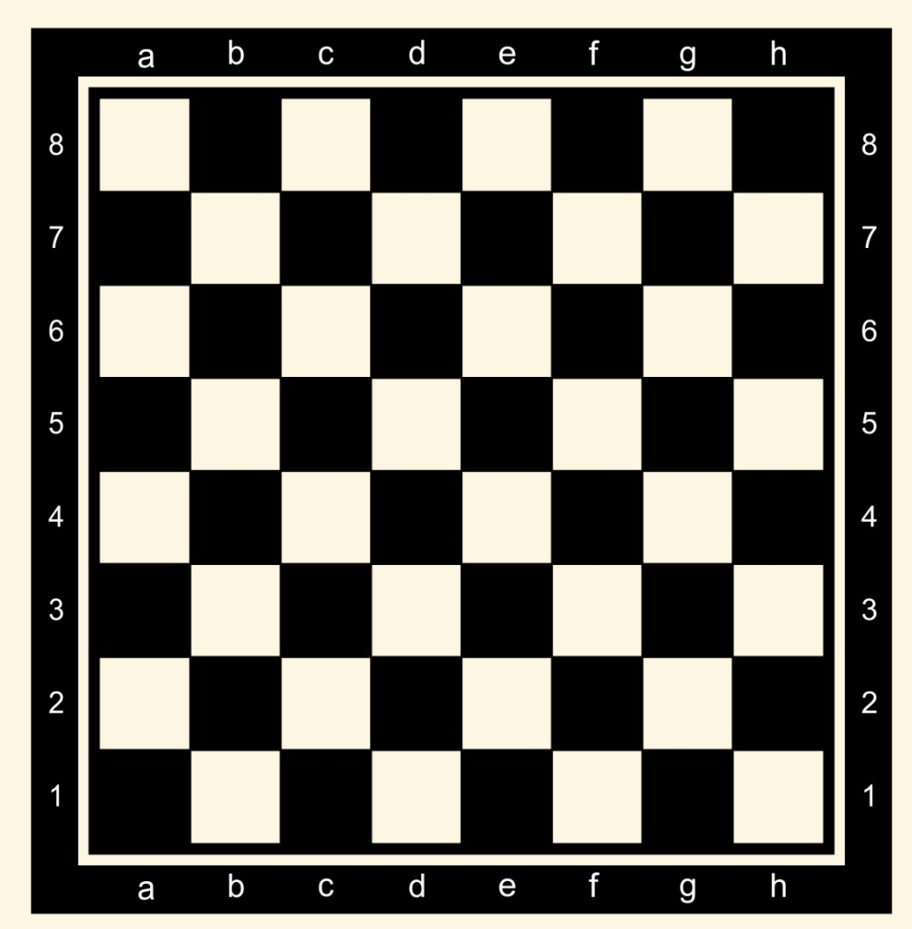
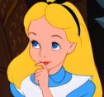
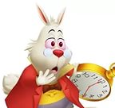
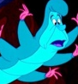
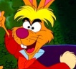
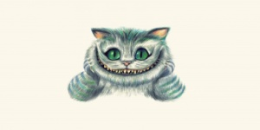
3.4
Symbol | Description
A | Alice
WR | The White Rabbit
C | The Caterpillar
MH | The March Hare
CC | The Cheshire Cat
A is behind the CC
C is on the f6
WR is between A and C
MH is behind WR
C: f6-g6
WR: e6-f5
MH: e7-f6
A: d6-f4
CC: d5-e5
Who is behind A?

