Slide 1
ЕГЭ по английскому языку
Устная часть
Задание 2

Slide 2
ВОПРОСЫ
Общие
Вспомогательный глагол | подлежащее | Основной глагол | дополнение | обстоятельство
DO/DOES IS ARE HAVE HAS CAN IF | you /your/ the - для первого вопроса упомянуть место куда вы звоните I | provide offer have include need got pay | Accommodation Admission fee Morning classes Discounts Preparations Credit car Special clothes Tuition fee | In the price
Задание Составьте вопросительные предложения.

Slide 3
Проверь себя
1 Do you provide any accommodation?
2 Does your school have morning classes?
3 Is the accommodation included?
4 Have you got any admission fee?
5 Do you offer any discounts?
6 Can I pay by a credit card?
7 Do I need any special clothes?
8 Do I need any preparations?

Slide 4
Специальные вопросы
Вопросительное слово | Вспомогательный глагол | подлежащее | сказуемое
what - что? when — когда? where — где? куда? who — кто? How much/many-сколько? why — почему? зачем? how — как? How long- как долго? | Do/ Does Are Is | You The flight The duration The guarantee period The hotel The age restrictions The membership The class | Cost Located last
Задание Составьте вопросительные предложения.

Slide 5
Проверь себя
1 What are the age restrictions?
2 How long is the flight?
3 What is the duration of the flight?
4 How much does the membership cost?
5 Where is the hotel located?
6 How long is the guarantee period?
7 How long does the class last?

Slide 6
Вопрос с конструкцией
Is there/ Are there
Is there Are there | что | где
Is there Are there | Admission fee Age restrictions Discounts Free parking Guarantee Membership fee Morning classes | Near the shop In your fitness center in your school
Задание Составь вопросительные предложения.

Slide 7
Проверь себя
1 Is there any admission fee?
2 Are there any age restrictions?
3 Are there any discounts?
4 Is there any free parking near the shop?
5 Is there any guarantee?
6 Is there any membership fee in your fitness center?
7 Are there any morning classes in your school?

Slide 8
Ловушка
В рекламном слогане с названием магазина/организации часто используется прилагательное new, и согласно правилам английского языка необходим неопределенный артикль, например: A new library in your district!
Но в вопросе нужен определенный артикль, потому речь идет не о какой-то неопределенной новой библиотеке, не о любой новой библиотеке, а именно о той, которая рекламировалась.

Slide 9
Подсказка
Если в задании не указано о каком объекте идет речь, то смотрим на фотографию в рекламном объявлении

Slide 10
Let’s practice

Slide 11
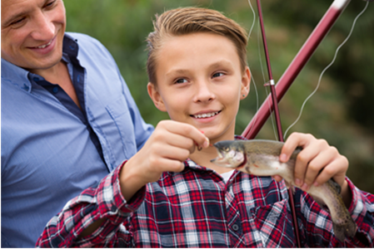
Task 2. Study the advertisement.
You are considering going on the family weekend A family weekend in the lake.
and now you’d like to get more information.
In 1.5 minutes you are to ask four direct questions to
find out about the following:
1) location;
2) accommodation;
3) price for the weekend for a family of three;
4) fishing equipment rental.

Slide 12
Check yourself
1 Where is the lake located?
2 Do you offer any accommodation?
3 How much does the weekend cost for a family of three?
4 Can I rent your fishing equipment?

Slide 13
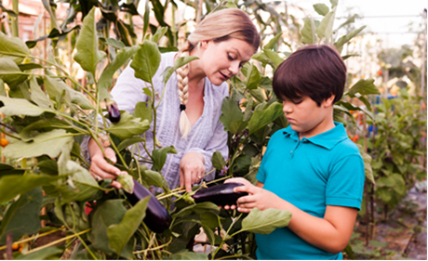
Task 2. Study the advertisement.
You are considering going to the botany club and now you’d like to get more information.
In 1.5 minutes you are to ask four direct questions to find out about the following:
Join our botany club!
1) activities;
2) timetable;
3) minimum age;
4) number of members in the club.

Slide 14
Check yourself
1 What activities do you offer in your botany club?
2 Where can I see your timetable?
3 What is the minimum age to attend your botany club?
4 How many members are there in your botany club?

Slide 15

Task 2. Study the advertisement.
You are considering getting some professional photos and now you’d like to get more information.
In 1.5 minutes you are to ask four direct questions to find out about the following:
1) location of the studio;
2) historical costumes;
3) professional make-up;
4) the cost of an hour’s work

Slide 16
Check yourself
1 Where is your professional photo studio located?
2 Are historical costumes provided?
3 Do you offer any professional make-up?
4 How much does it cost per hour?

Slide 17
I wish you success!

