Slide 1

Would you like to write a postcard?
Смекалина Ольга Евгеньевна, учитель английского языка МКОУ «Поповская СОШ» Чернский район Тульская область

Slide 2
LET’S
HAVE A GOOD TIME!

Slide 3

United Nations Day
24,October 1945
United Nations Organisation

Slide 4

Special Forces Day
Special Forces — спецслужбы, спецподразделение, спецназовцы, специальные войска, войска специального назначения
- special force — спецназ, особая сила, специальный отряд
- special mission unit — спецназ
- special police — специальная полиция, спецназ

Slide 5
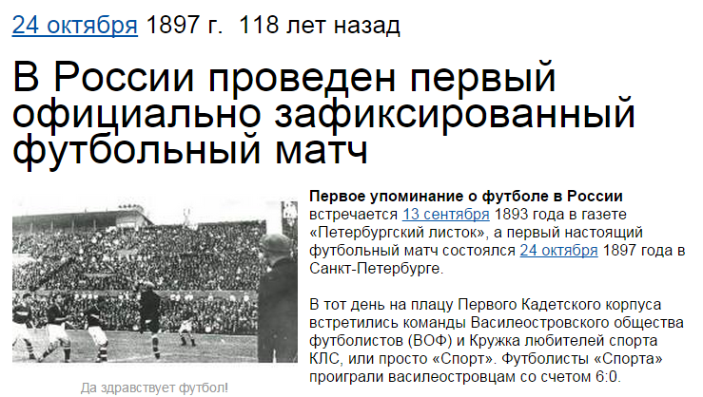
First Football Match Day
24,October 1897
The first football match in
St.Petersburg

Slide 6
Celebrations in Britain
Match occasions with dates
Valentine’s Day | moving into a new house/flat
Birthday | on their birthday
Housewarming | on the 14th of February
Graduation | on the 2nd Sunday in May
Christmas | after finishing school
Mother’s Day | on the 25th of December
People in Britain/ British people/ The British celebrate ……

Slide 7
Holidays and associations
What things are these holidays associated with?
Valentine’s Day | а postcard, а greeting card, а valentine,
Birthday | sweets, a cake, a box of chocolate,
Housewarming | success, a diploma
Graduation | a new house, flowers, fireworks,
Christmas | comfort, Christmas tree, gifts, joy
Mother’s Day
As for me I associate … with…
… is associated with …
I associate … with such things as…

Slide 8
Would you like to write a postcard?

Slide 9

Wishes & Congratulations

Slide 10






How to write a postcard?
Take a greeting card

Slide 11
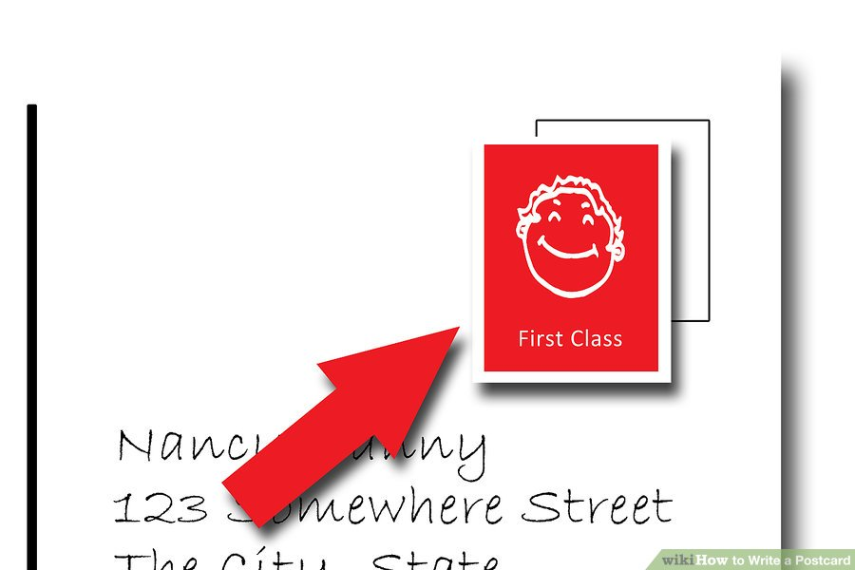

How to write a postcard?
Flip the postcard photo side down.
The top right corner is generally where the stamp goes

Slide 12
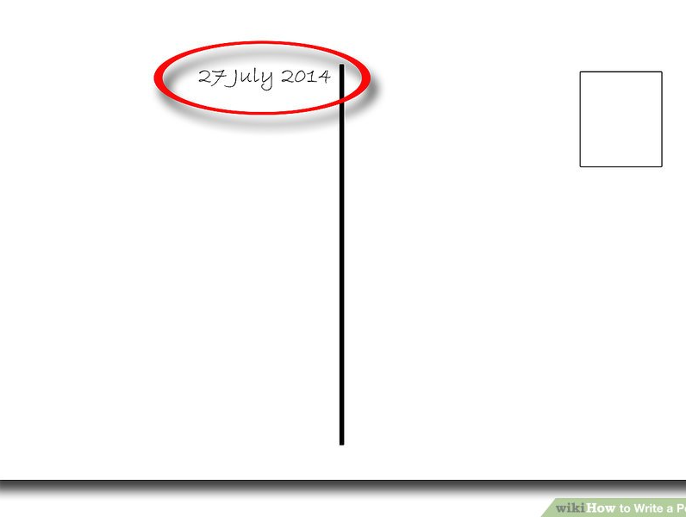
How to write a postcard?
Put the date in the upper right of the note area

Slide 13

How to write a postcard?
Begin by addressing the person :
“Dear John,”
“My dearest, Most darling, beloved Aunt Nancy.”

Slide 14

How to write a postcard?
Write your message.

Slide 15
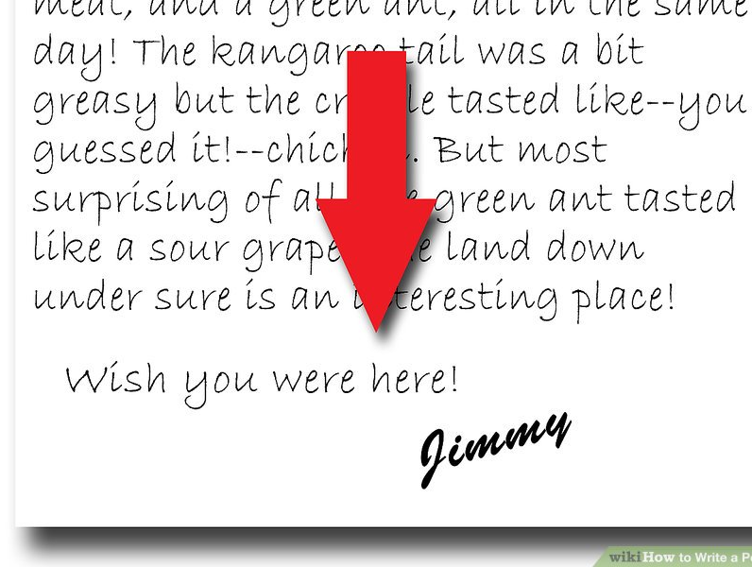
How to write a postcard?
Sign your card:
Love,
With love,
Best wishes,
All the best,

Slide 16
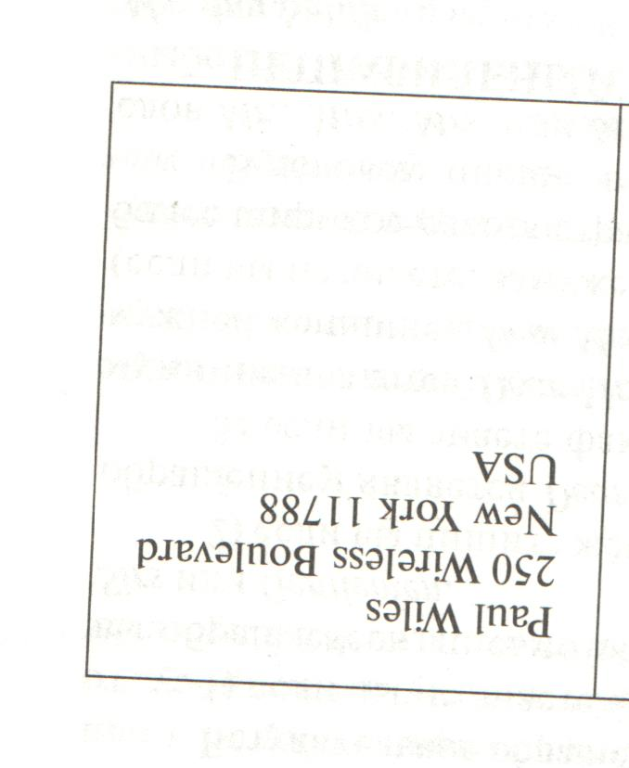
How to write a postcard?
Write the address on the right side of the card:
Name
House, Street
City(town), Zip code
Country

Slide 17
Now I know…
I can understand…
I can read …
I can say…
I can write…

Slide 18
Thank you!

