Slide 1
Social Networking
Do social networks have more positive or negative points???
Khmyrova I.A.
Sakhalin region, Korsakov school №1

Slide 2
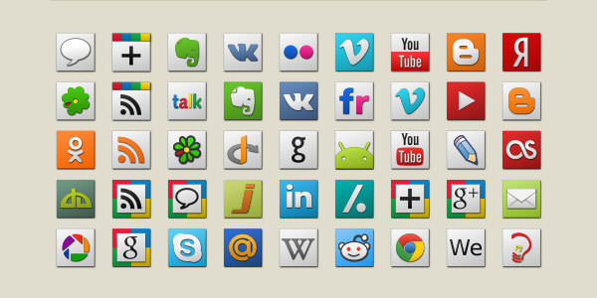
What do these icons mean?

Slide 3

What social networks do you use? How often? Do you use them for fun or for some other purposes like education?
Is the popularity of social networking still growing?
How is it better for you to communicate: face-to-face or digitally?
Are people concerned about the influence of social networks on their lives?
Do benefits outweigh its drawbacks?
What opportunities do they provide for adults? For teenagers?
Do they serve to foster (укрепить) teacher-parent communication?
Is it necessary to be worried about data theft and viruses ?
Can your personal information be passed to third parties?
How to be prevented from accessing of those users?

Slide 4
Comment on the following statement Various social networks have aroused great interest among Internet users. However, some people say that they have a lot of drawbacks.
What is your opinion? Do you agree with this statement?
Write 200–250 words.
Use the following plan:
- make an introduction (state the problem)
- express your personal opinion and give 2–3 reasons for your opinion
- express an opposing opinion and give 1–2 reasons for this opposing opinion
- explain why you don’t agree with the opposing opinion
- make a conclusion restating your position

Slide 5
Do you agree or disagree to these… Advantages Disadvantages
Link together users of the Internet;
Give people an opportunity to look for old and new friends, to build communities, to send messages, to share news and pictures;
Help to keep in contact with each other;
Can be used for doing assignments, tests, quizzes;
User’s privacy is not protected; it can be viewed by anyone;
Serious problems with communicating;
Cause physical and mental disorders;

Slide 6

Use books rather than social networks!!!

