Slide 1
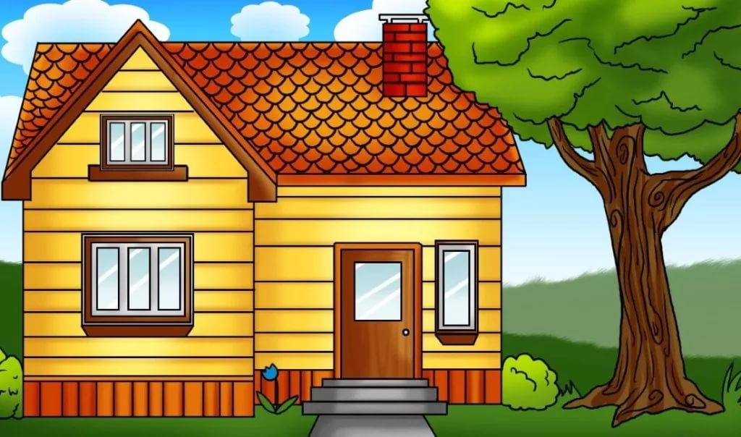
Home and house

Slide 2
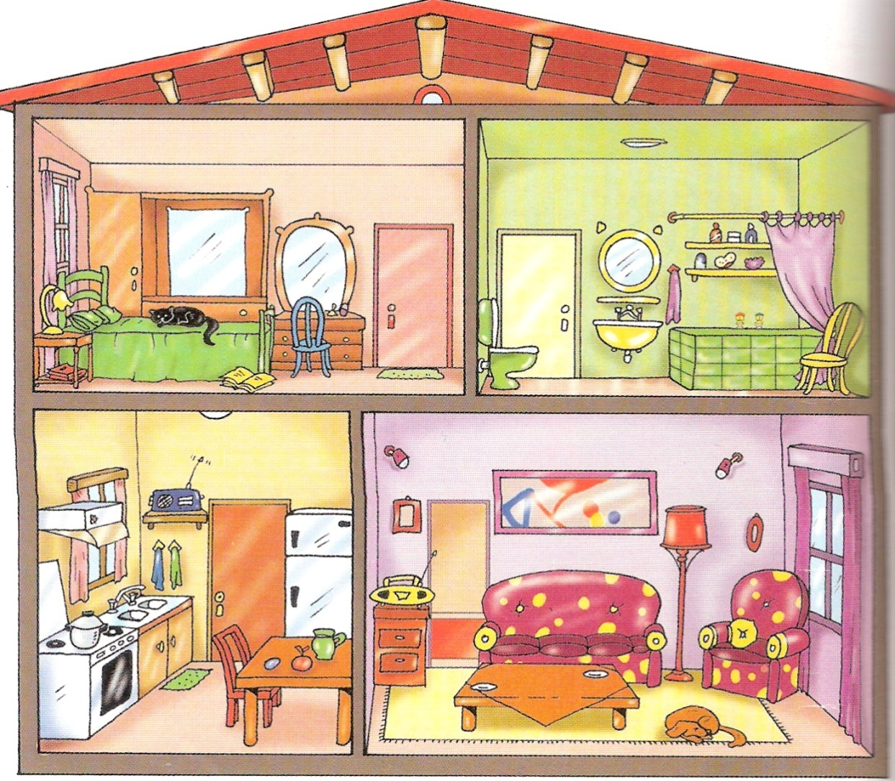
1
2
3
4

Slide 3
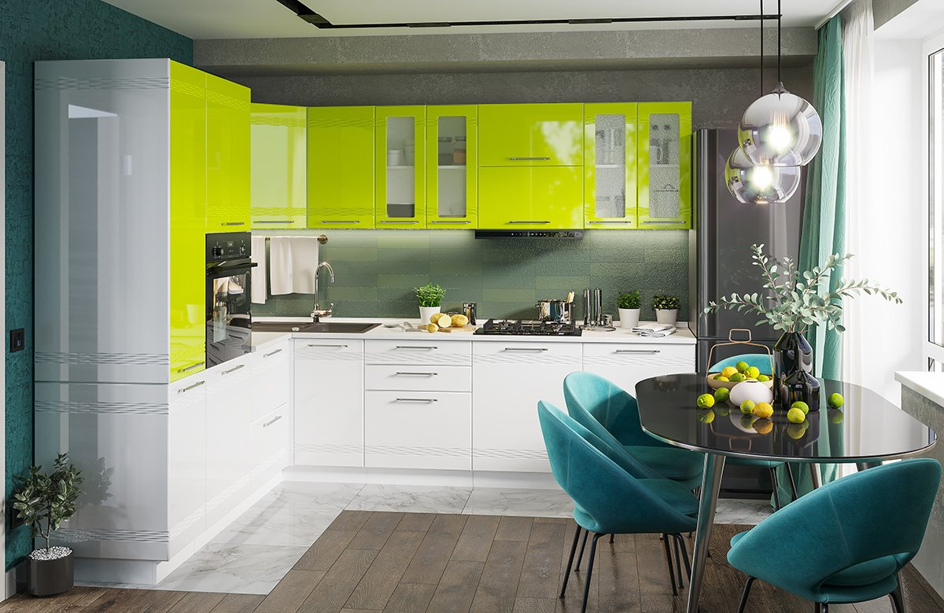
kitchen

Slide 4
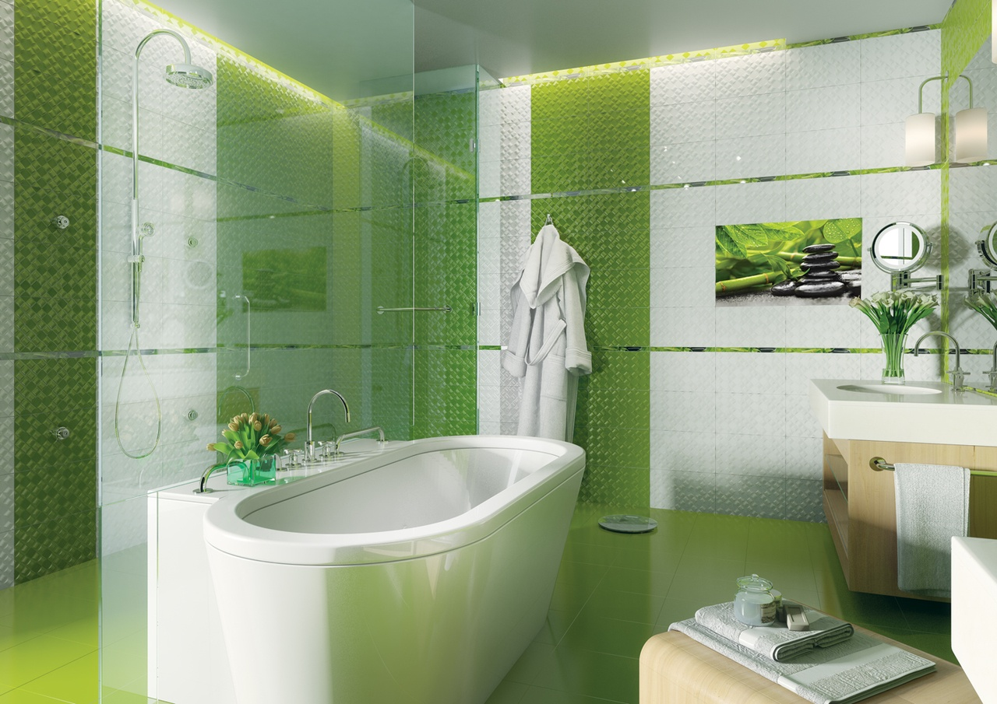
bathroom

Slide 5
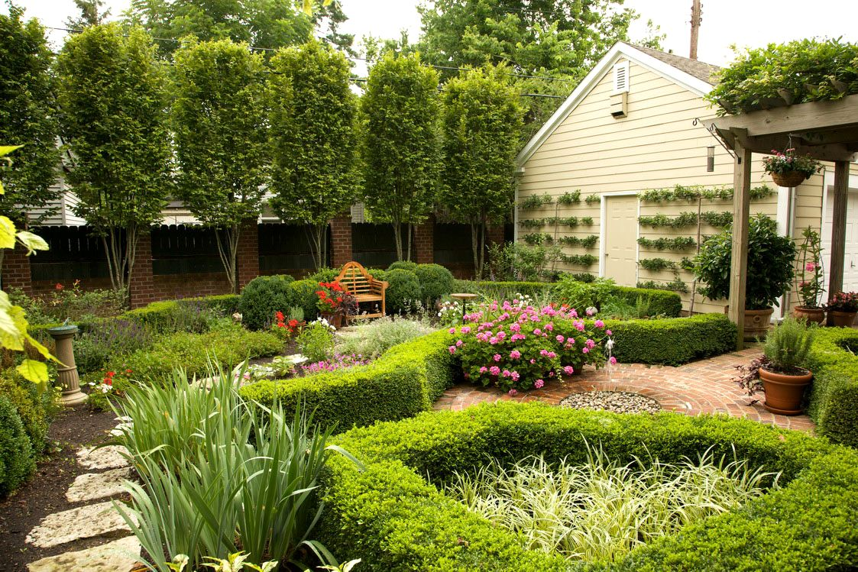
garden

Slide 6
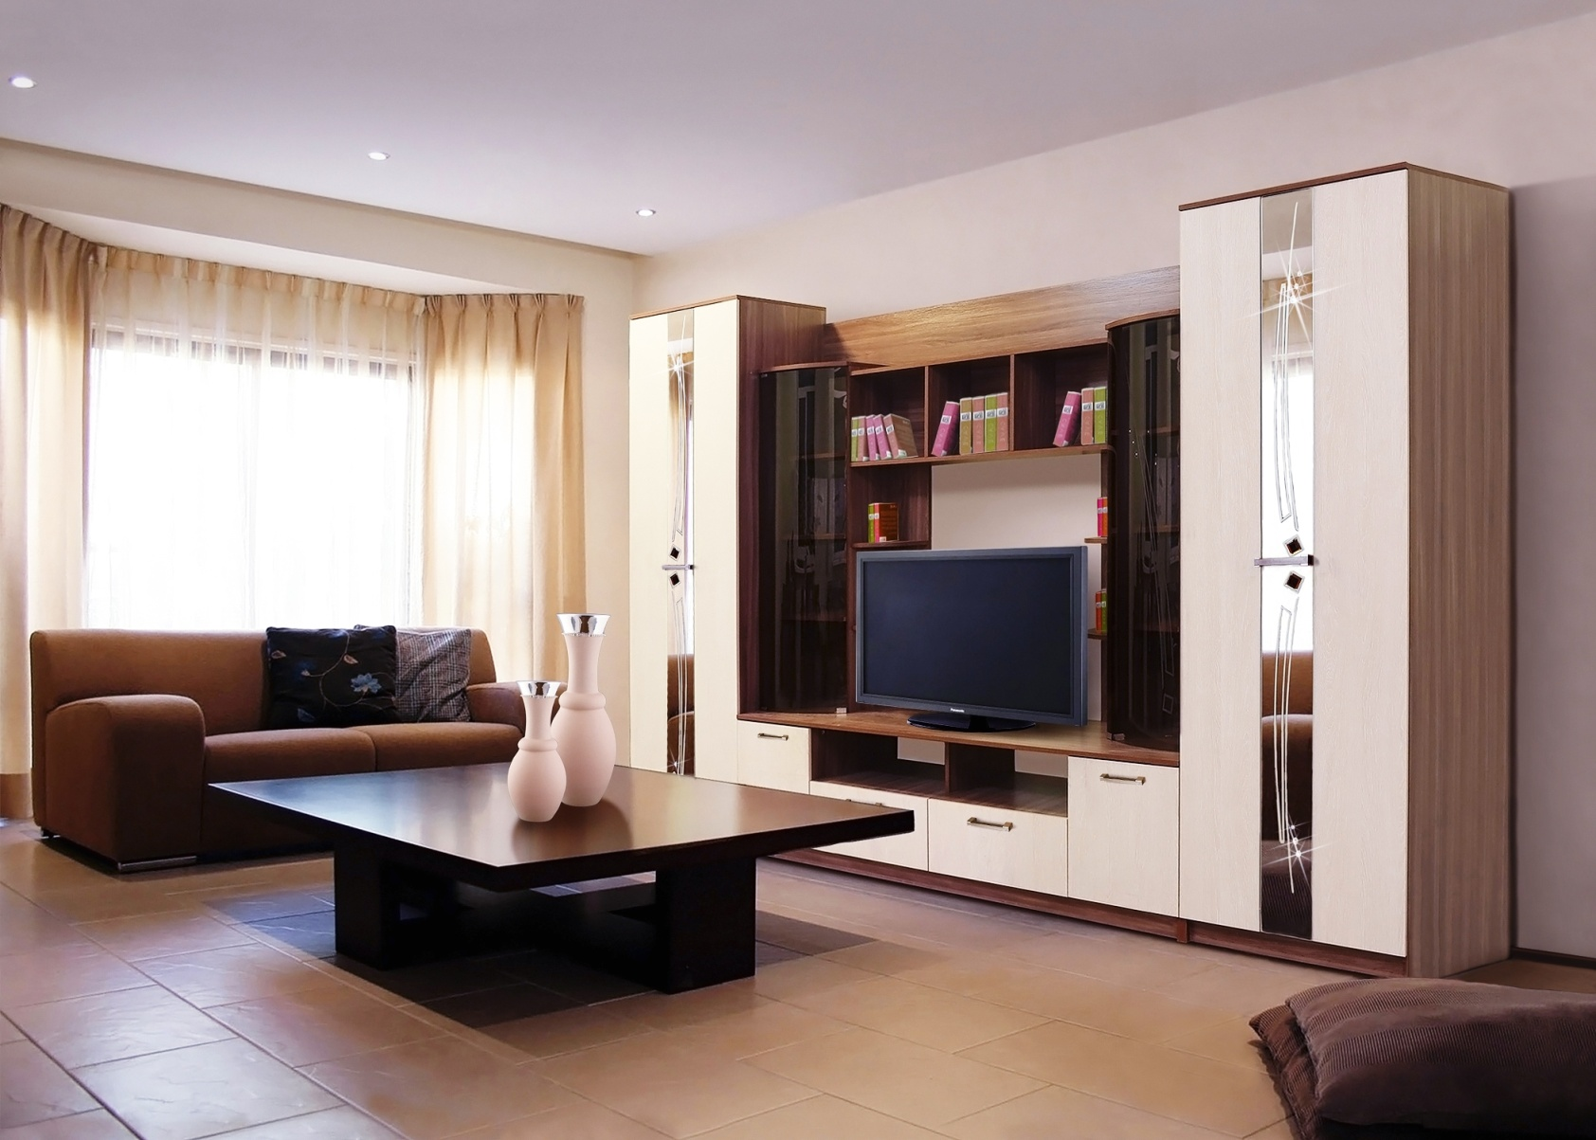
living room

Slide 7
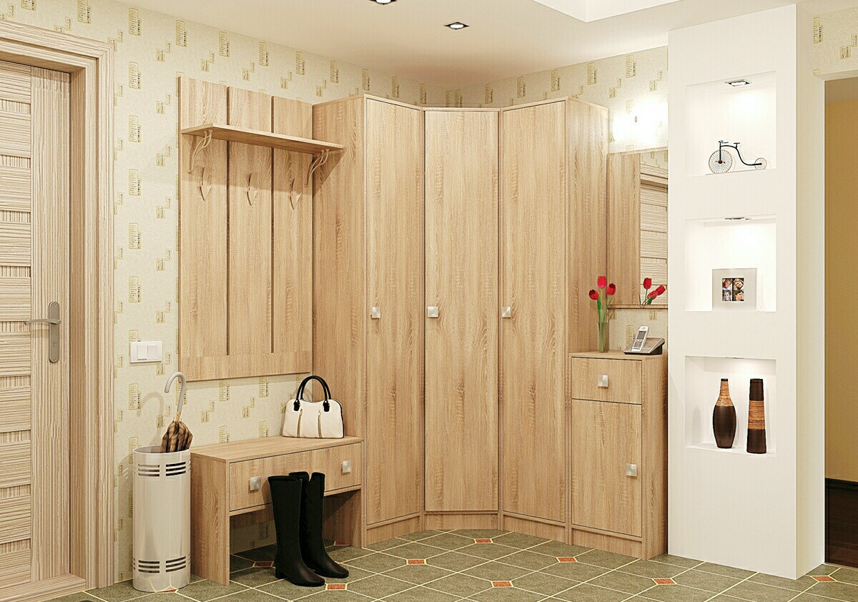
hall

Slide 8
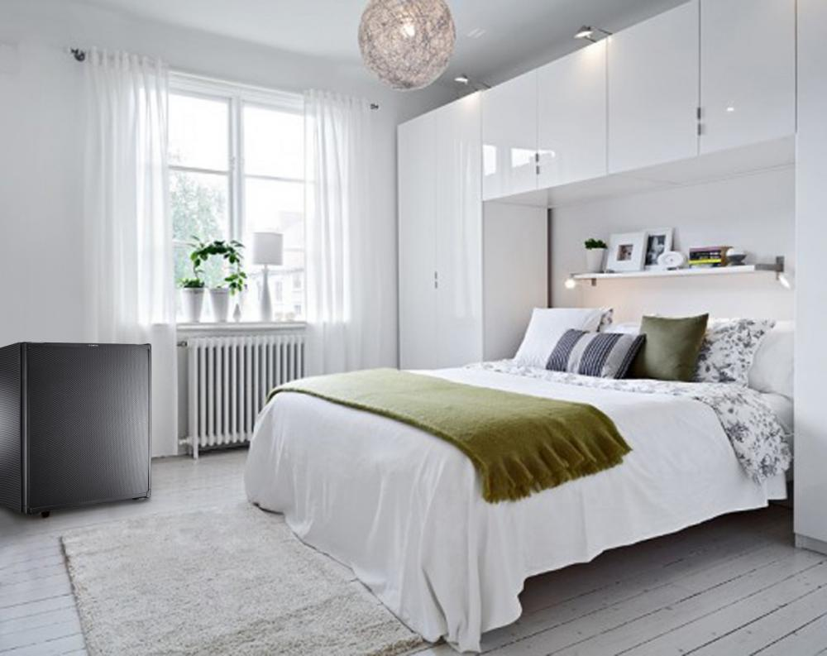
bedroom

Slide 9
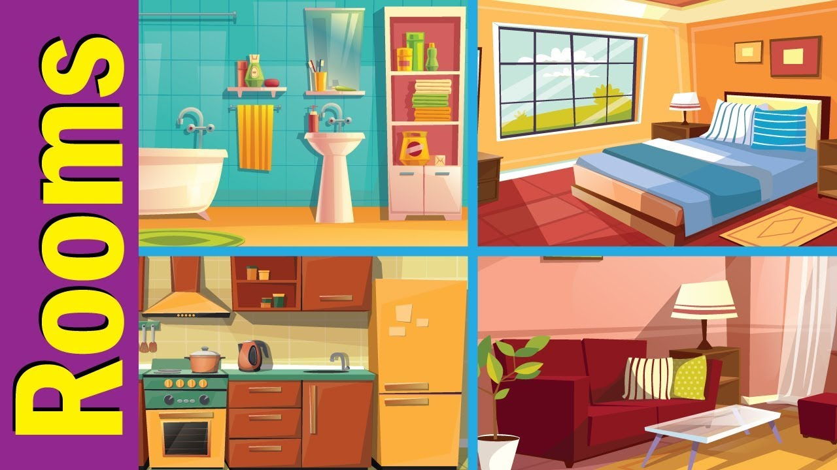

Where is the cat?

Slide 10
Where is the cat?

Slide 11
Where is the cat?

Slide 12
Where is the cat?

Slide 13
Where is the cat?

Slide 14
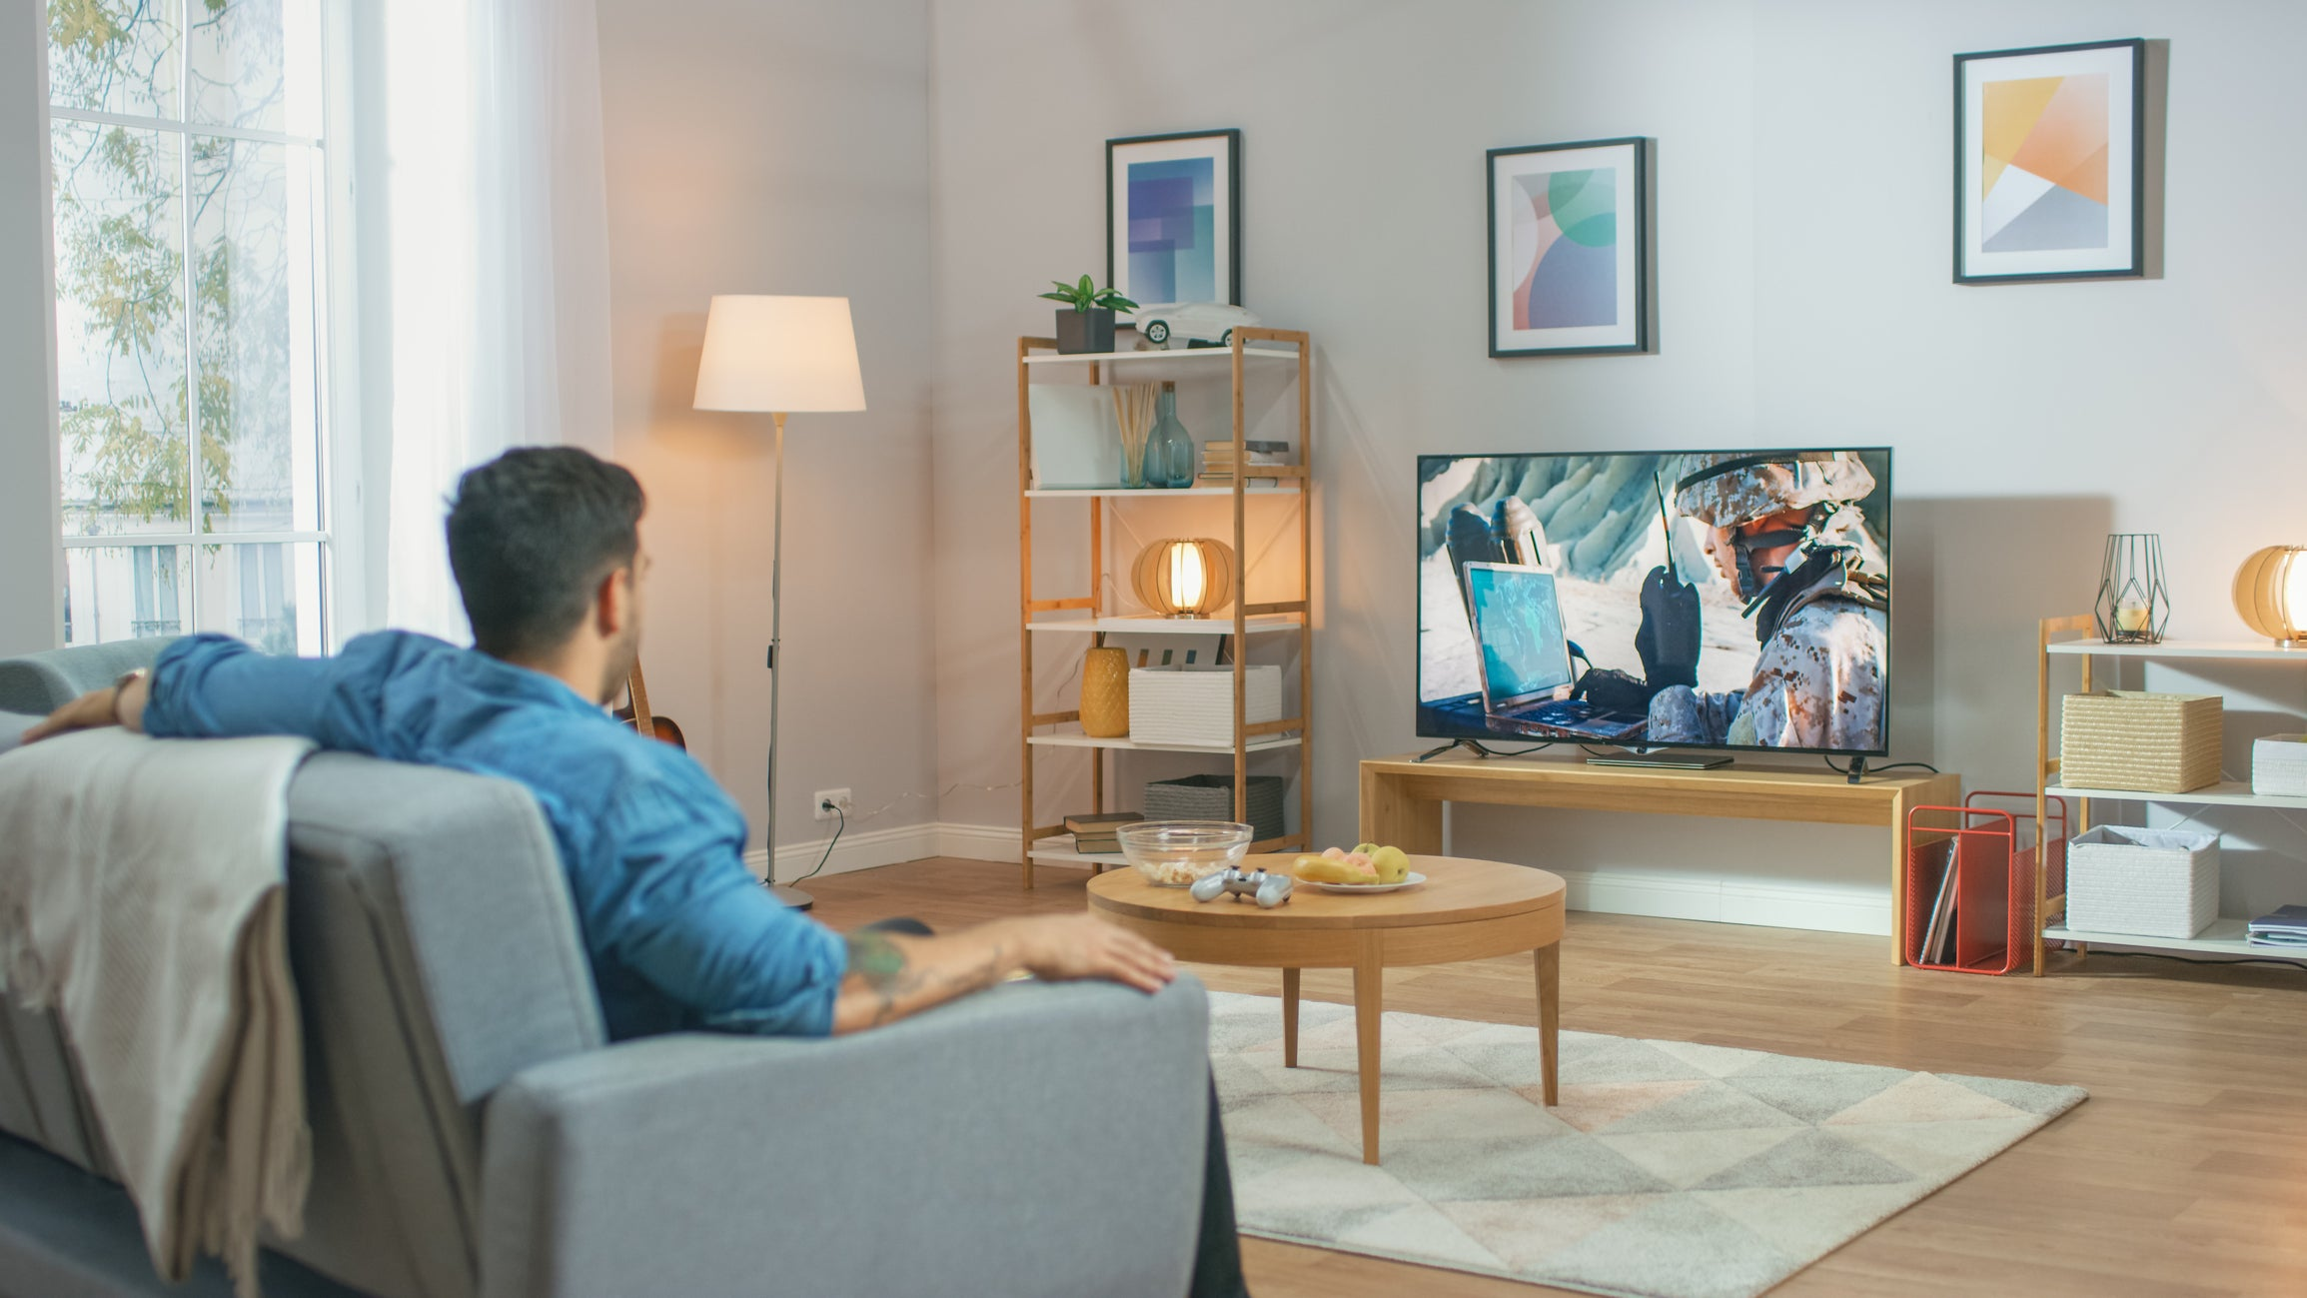
Where’s he?

Slide 15

Where’s she?

Slide 16
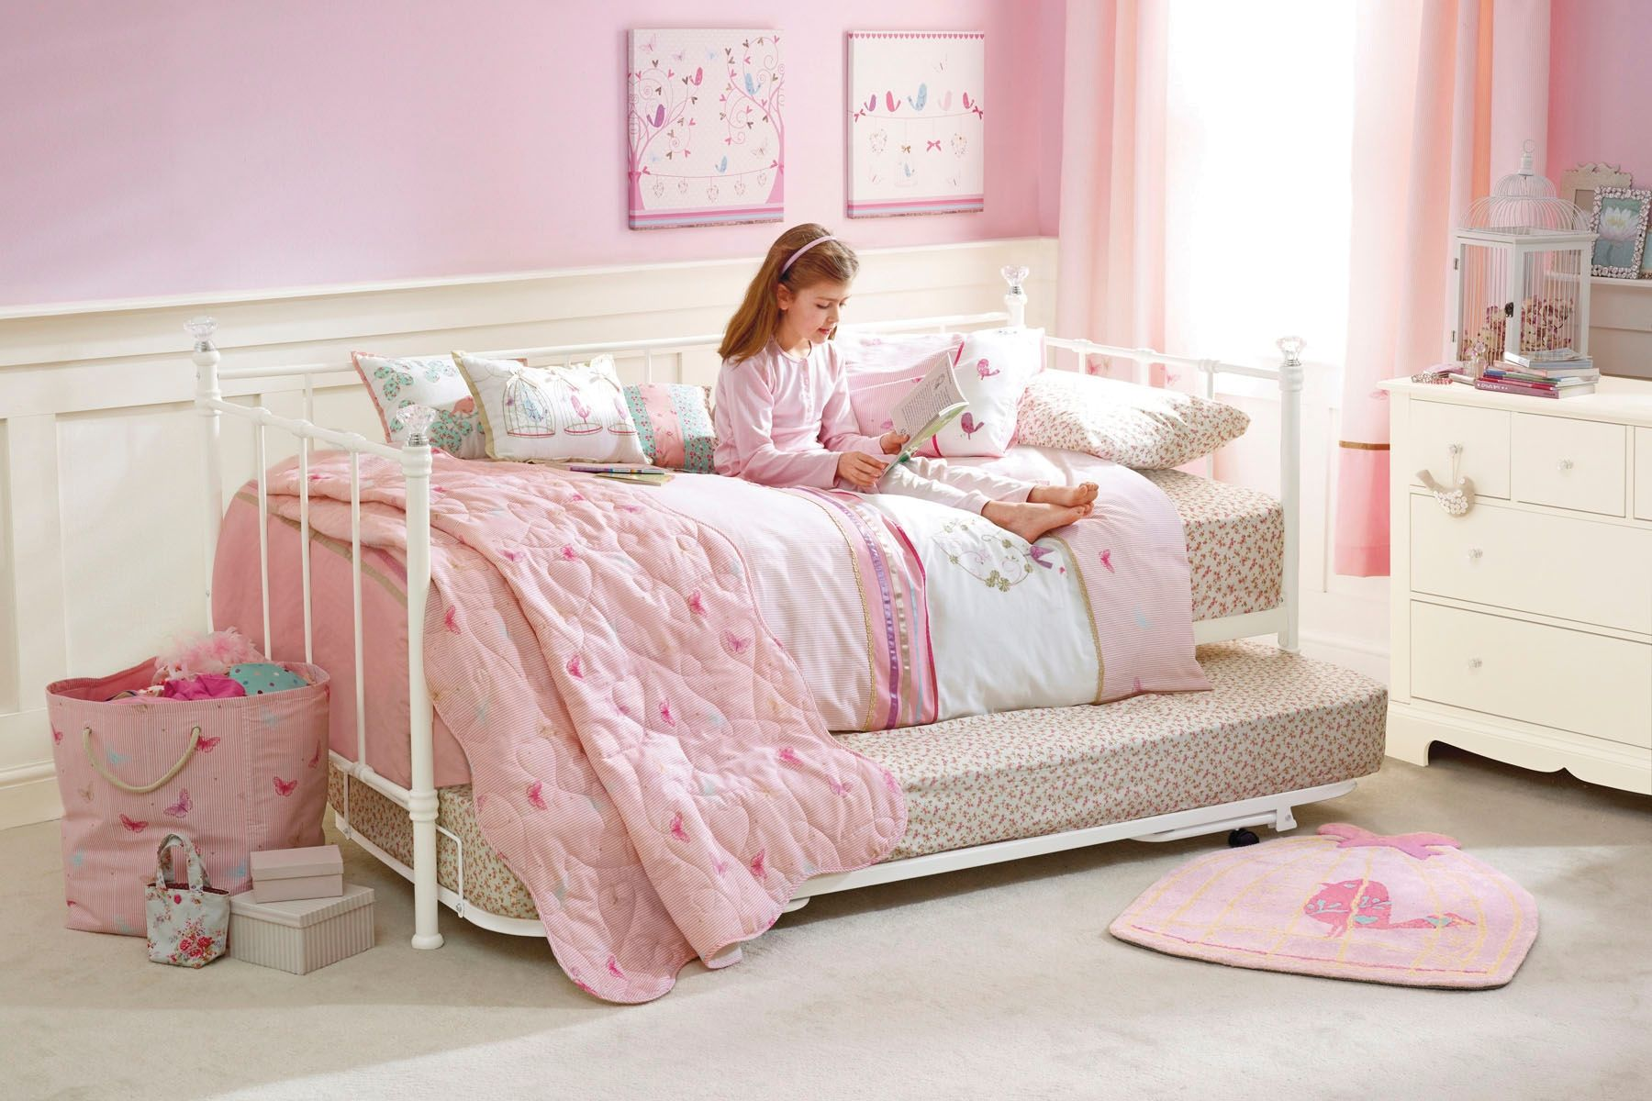
Where’s she?

Slide 17
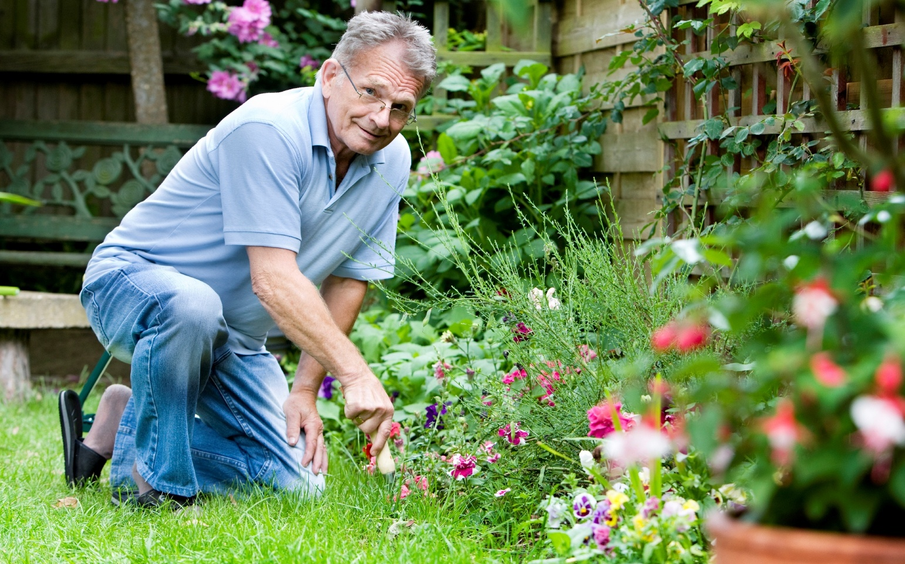
Where’s he?

Slide 18
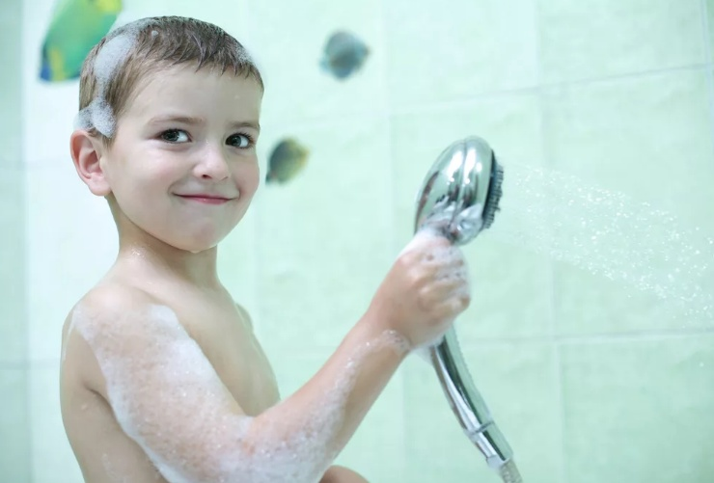
Where’s he?

Slide 19
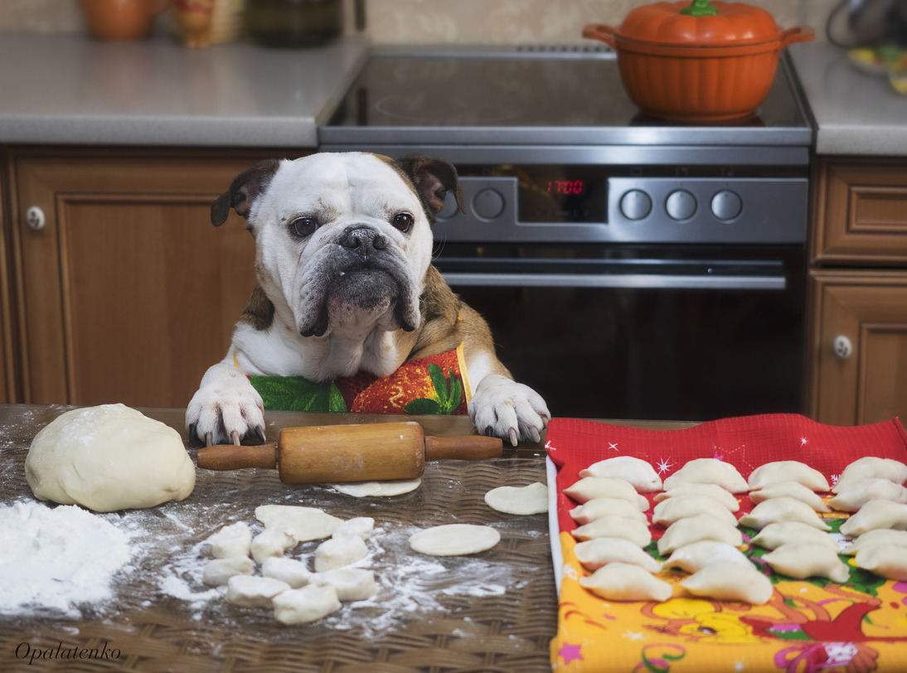
Where’s the dog?

