Slide 1

WHY DO THE BRITISH TALK SO MUCH ABOUT THE WEATHER?
AUTHOR: Galeev Said, school № 9
SUPERVISOR: Amineva L.A.

Slide 2
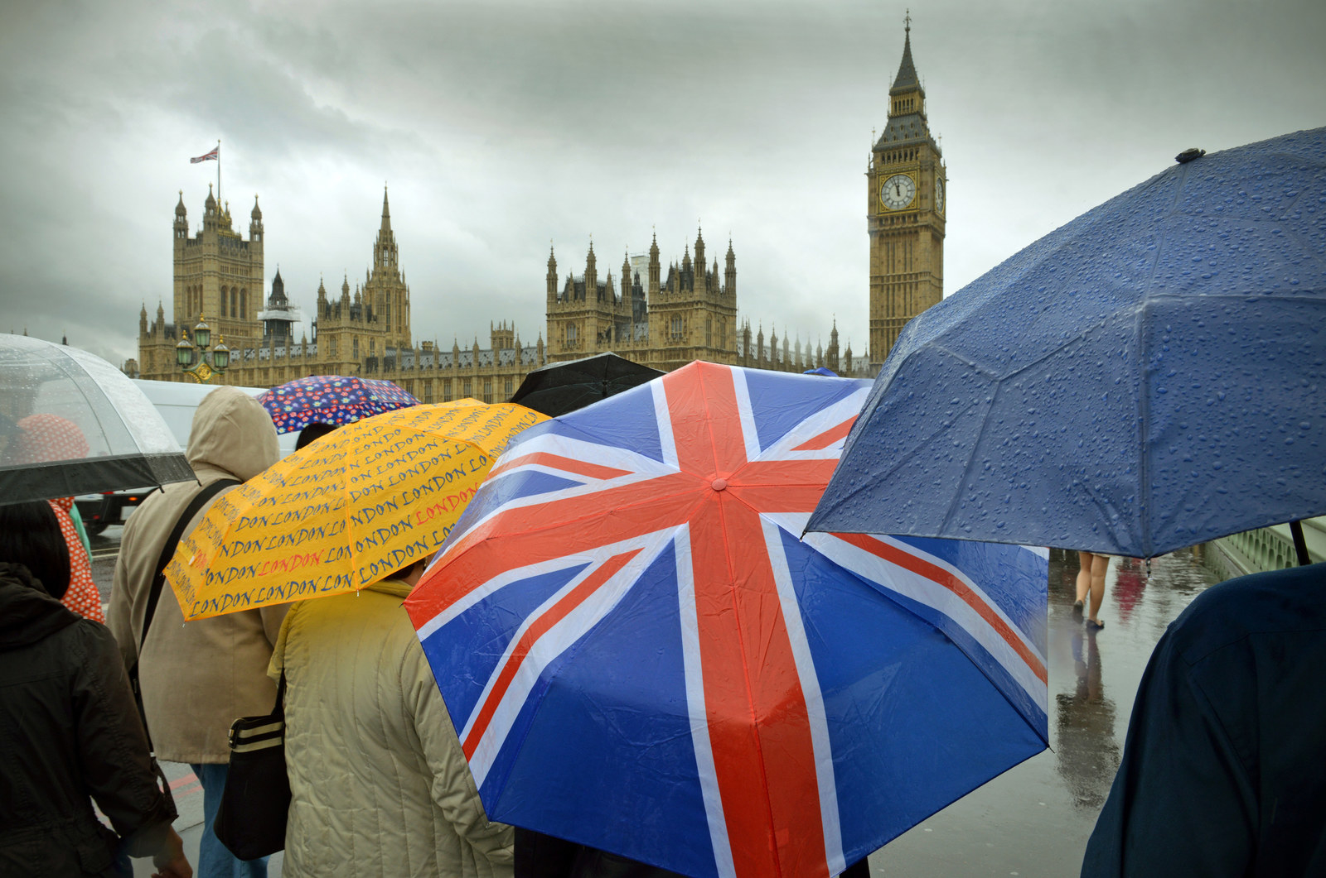
During English lessons we often touch the topic about the weather in Britain. Is it a simple coincidence?
Notes:
GOALS: Get to know more about the British and their lifestyle.
Find out the reasons for the obsession of British people to talk
about the weather so much.
METHODS: Search for necessary information in English and Russian

Slide 3
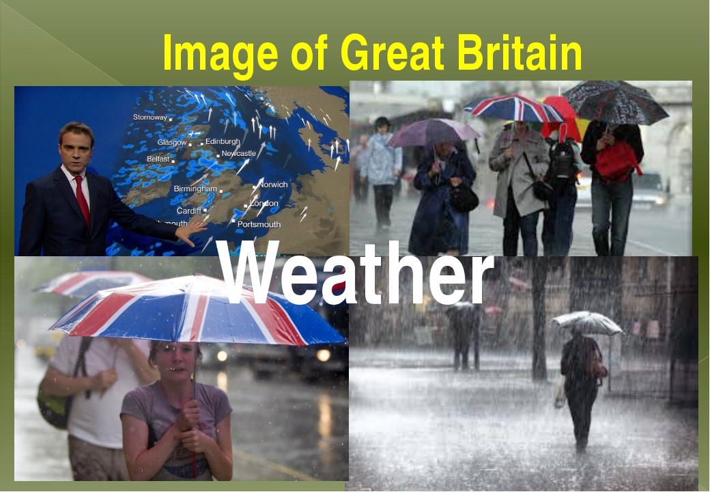
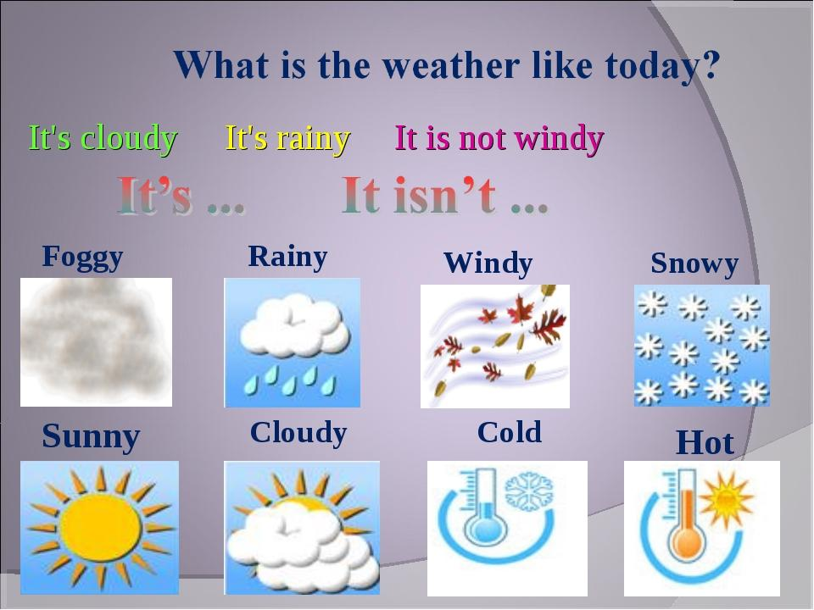
Image of Great Britain
The British manage to mention the weather when they are not talking about the weather

Slide 4


Slide 5
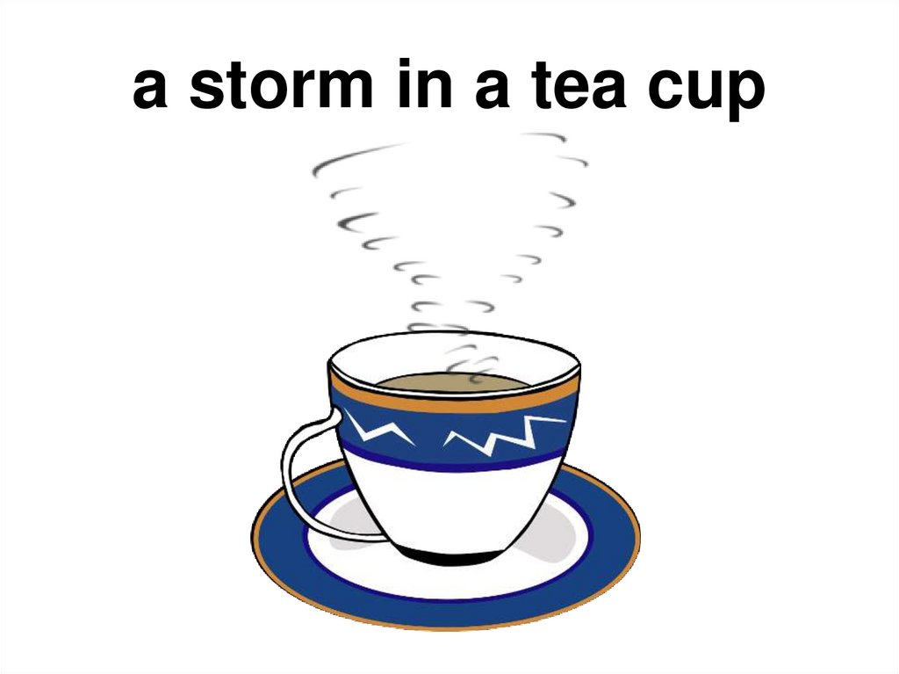

Slide 6
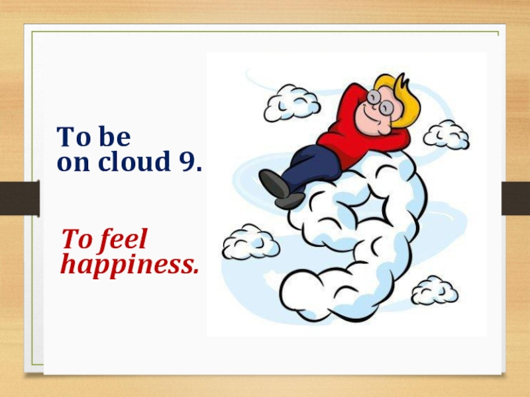

Slide 7
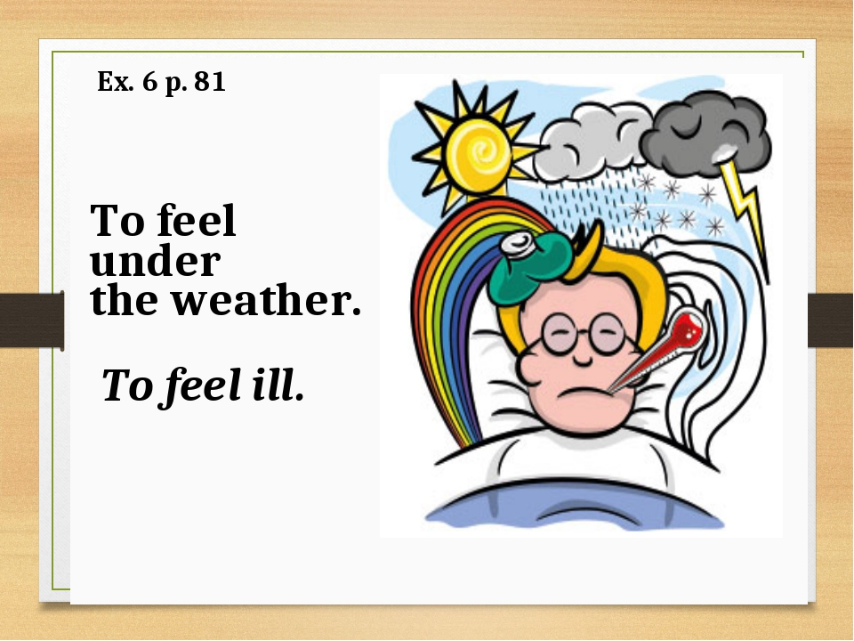

Slide 8

One third of the country are talking about the weather at any given time

Slide 9
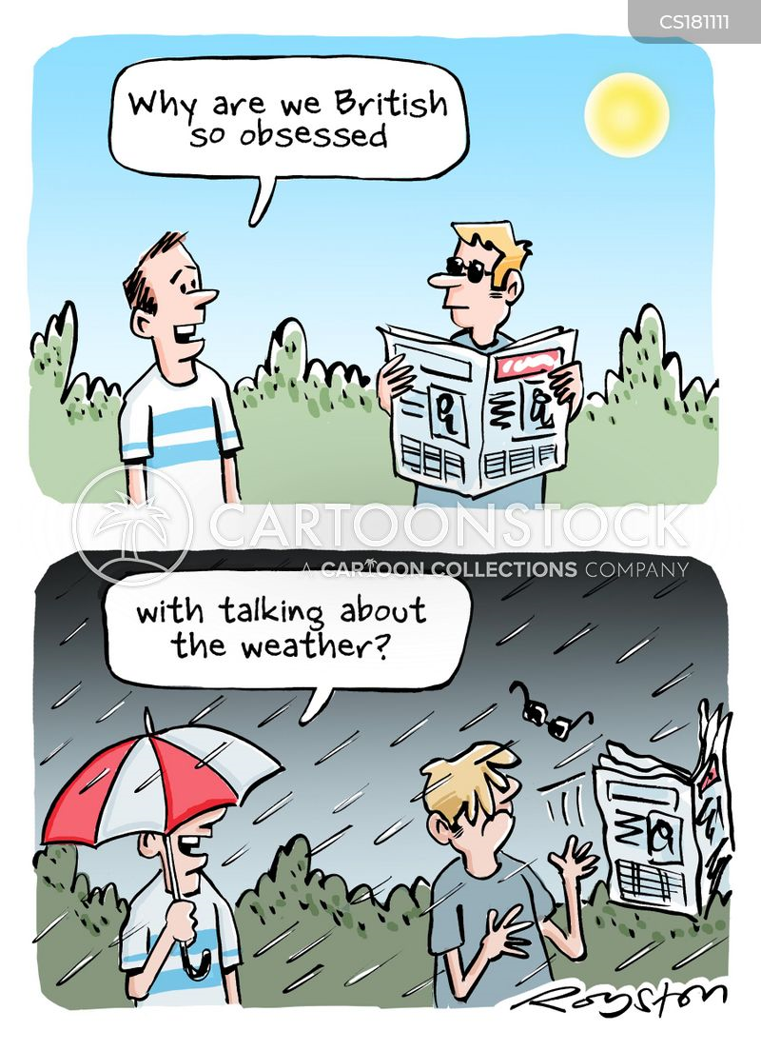


Slide 10
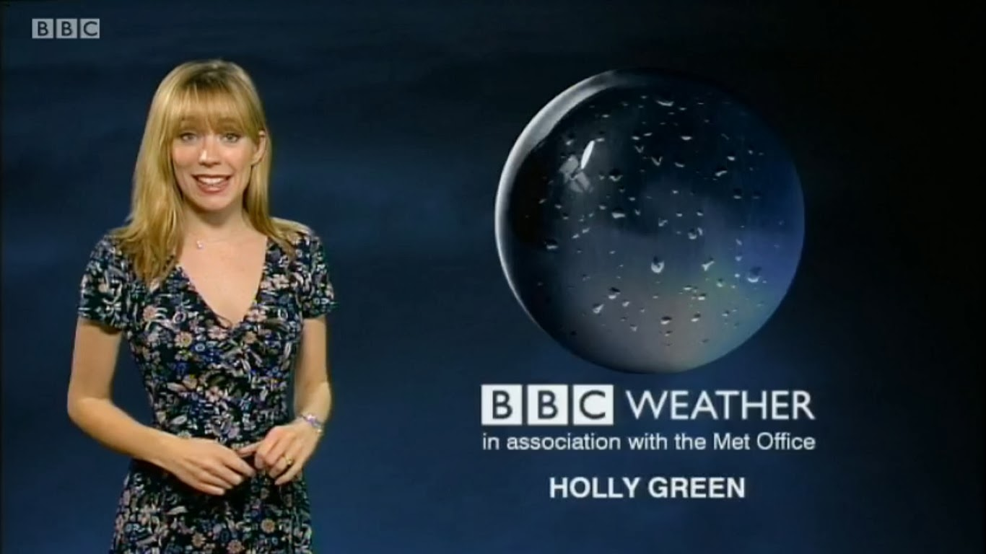


Slide 11
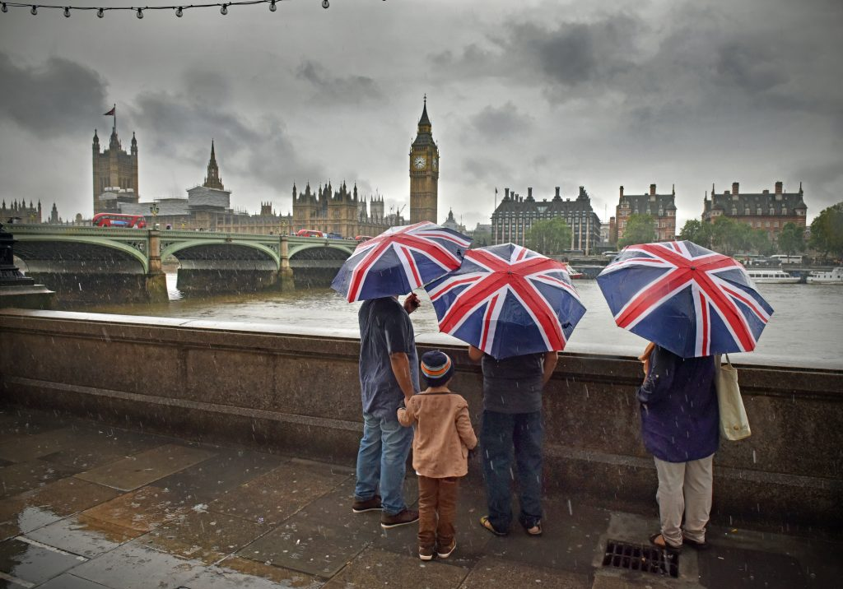

The reasons for such a strange obsession are ENGLISH WEATHER and ENGLISH CHARACTER

Slide 12
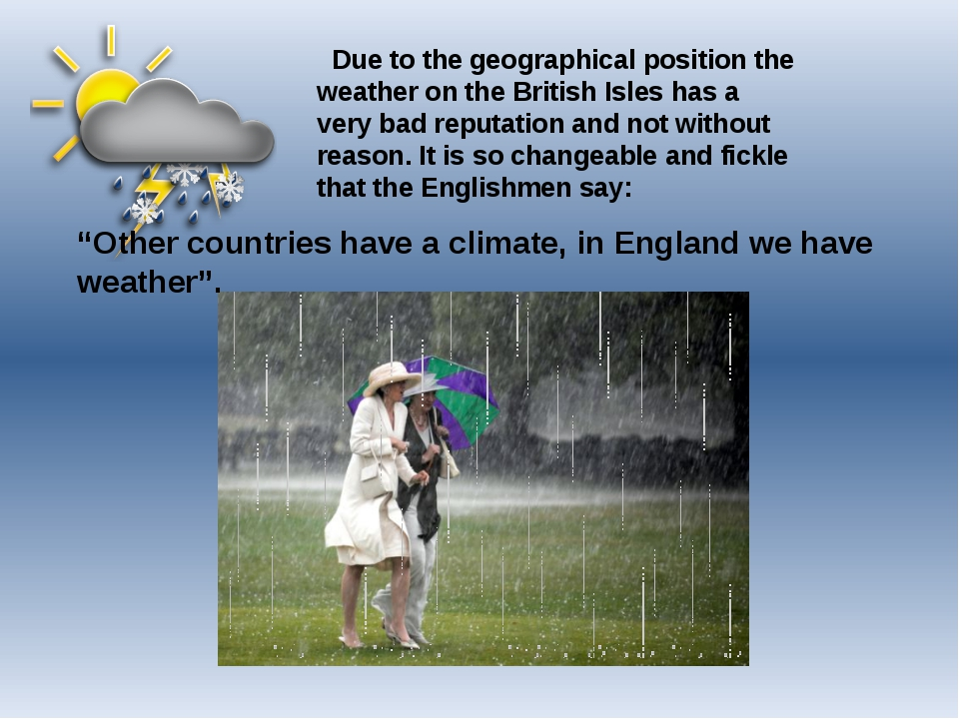
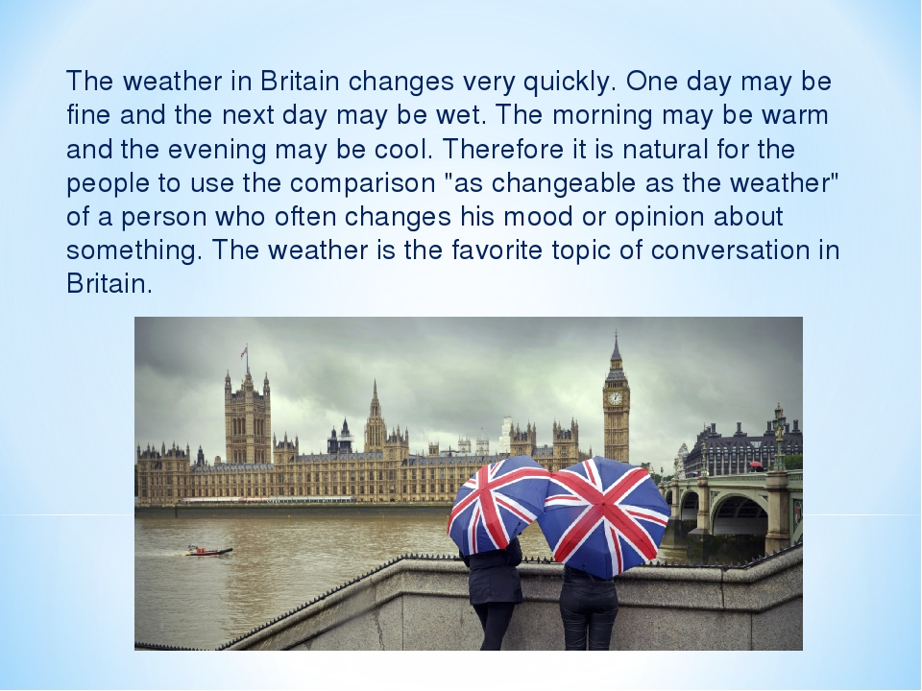

Slide 13
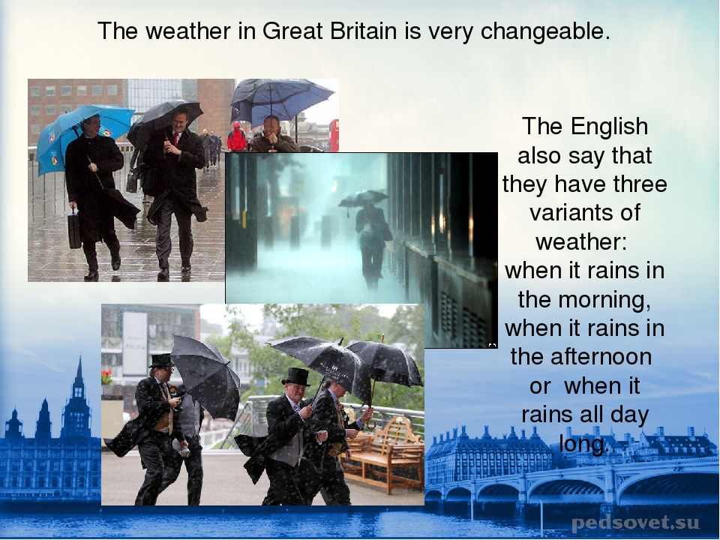

Slide 14
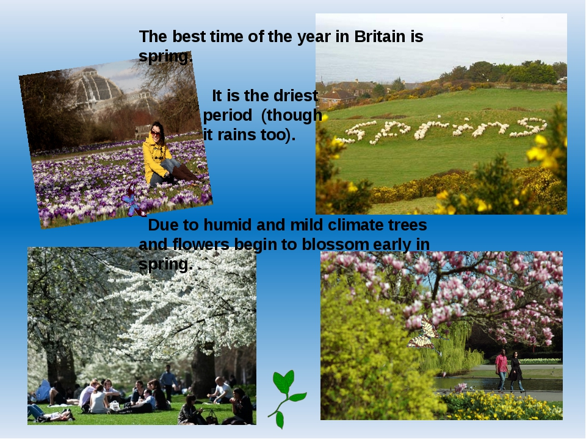

Slide 15
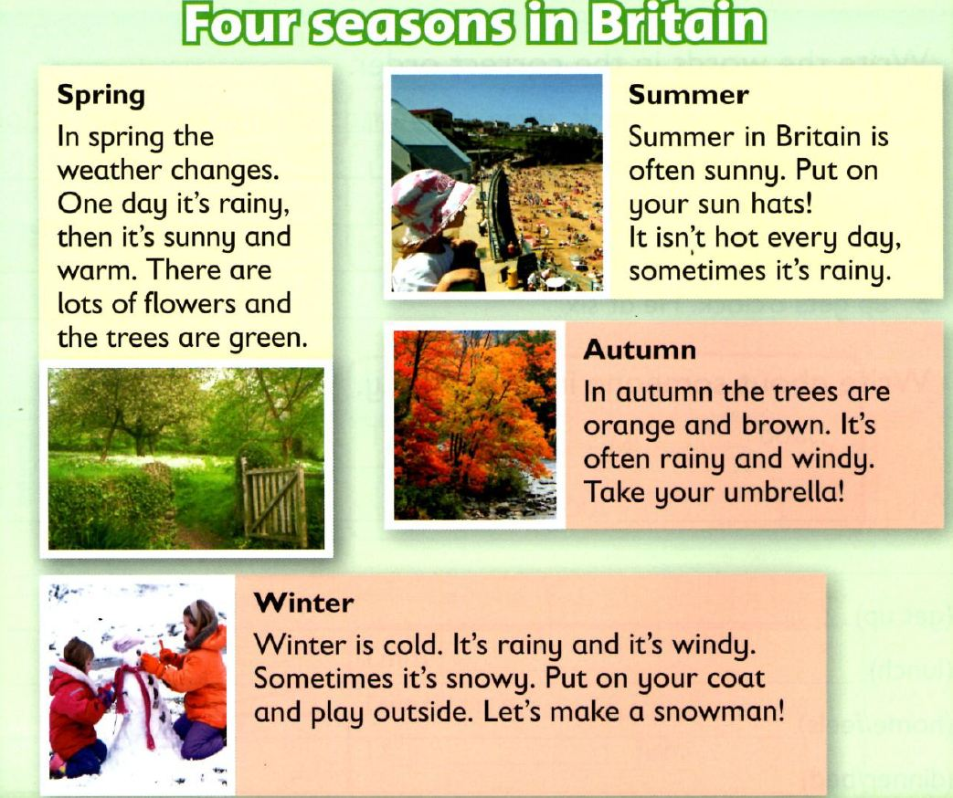

Slide 16

Winter months in Britain are very cold, damp and unpleasant. The best place in the world then is at home by the fire

Slide 17
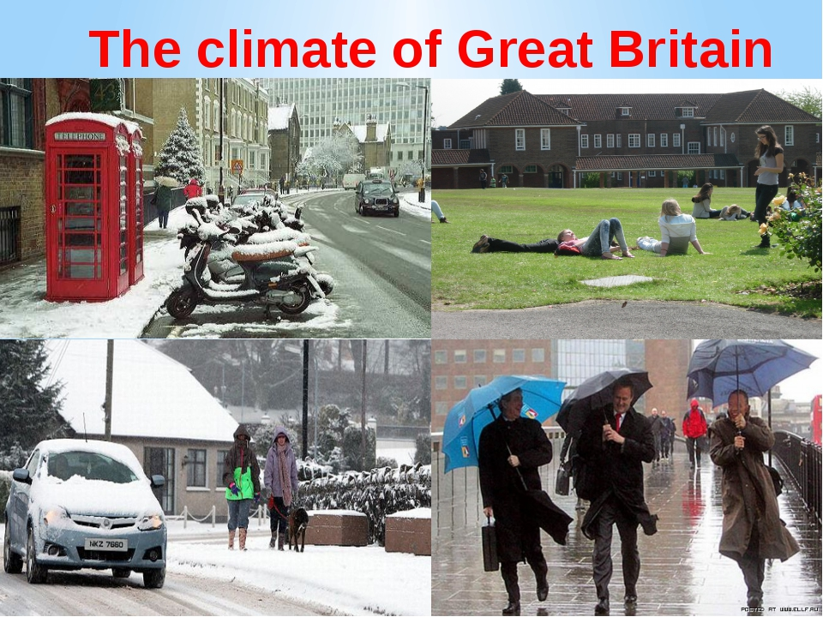
The location on the globe causes a very unpredictable changing climate in Britain and this is a strong reason to complain about, discuss, wonder how is or hope for (the weather of course)

Slide 18
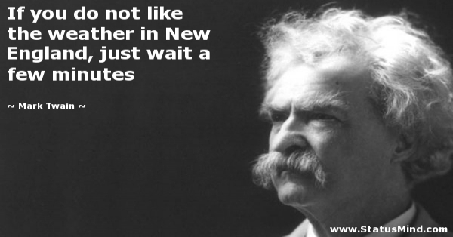

Slide 19
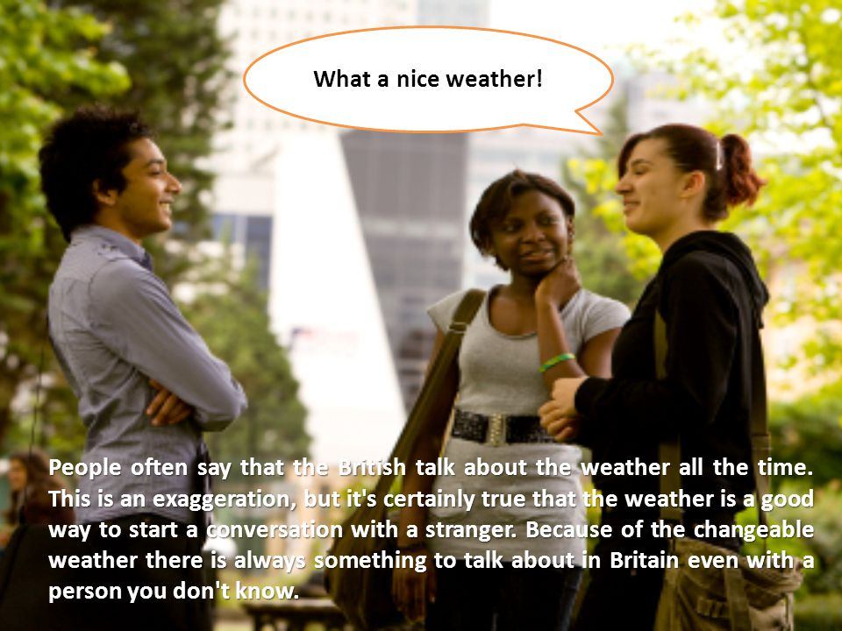

Slide 20
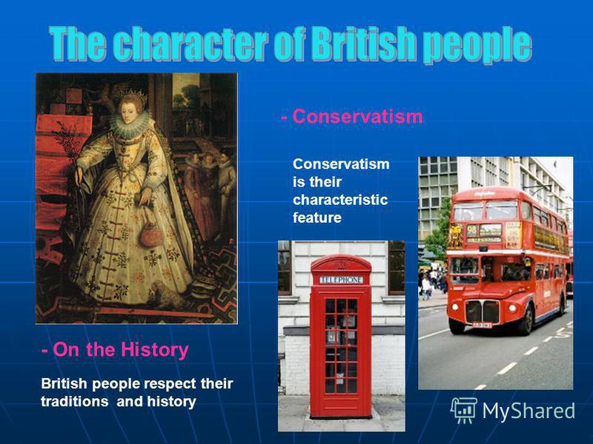
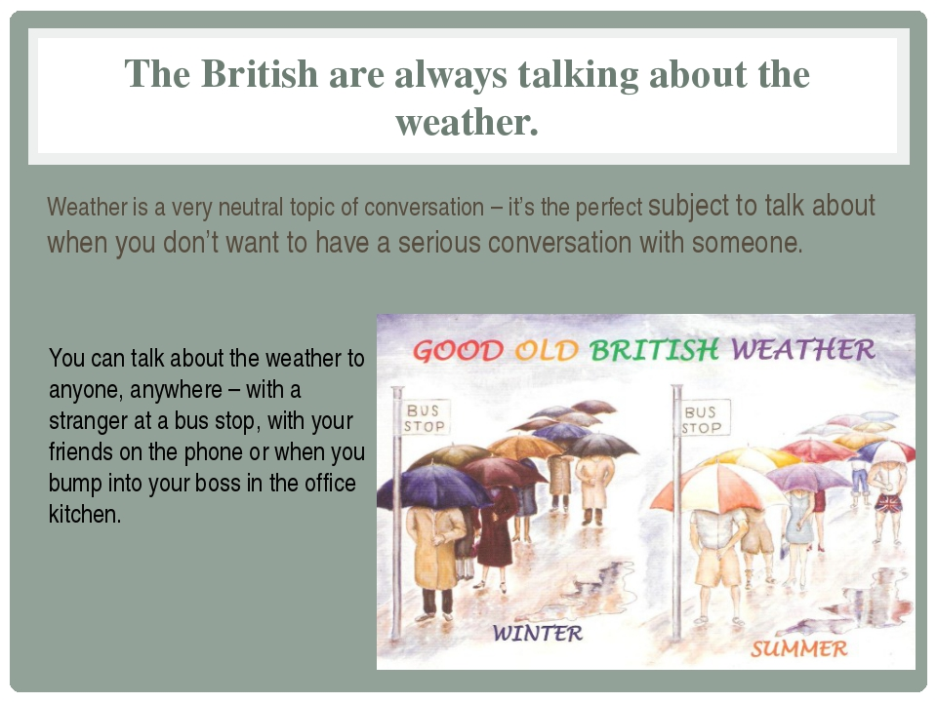

Slide 21
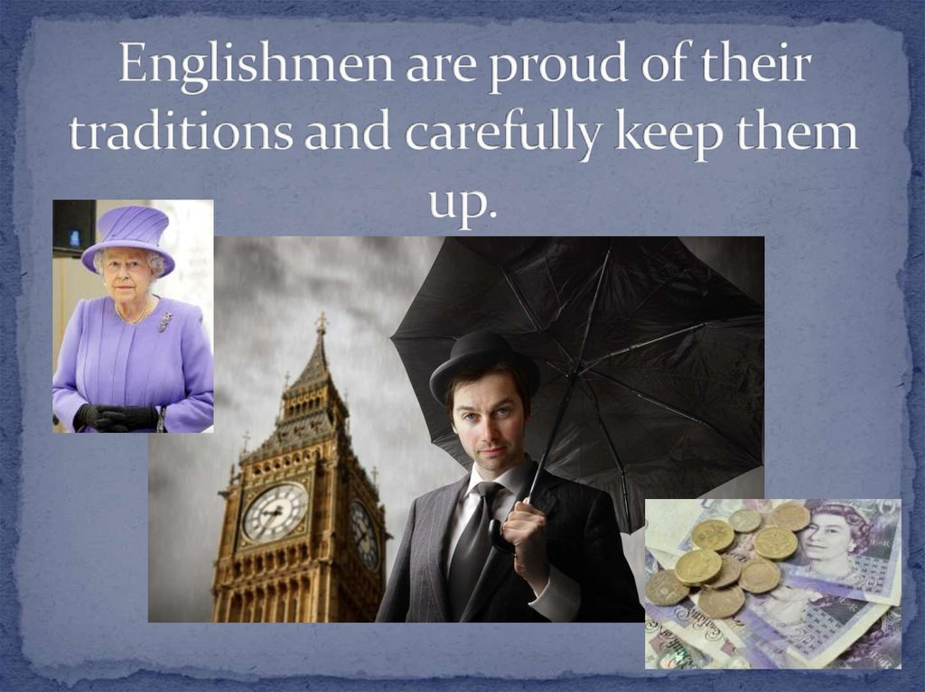

Slide 22
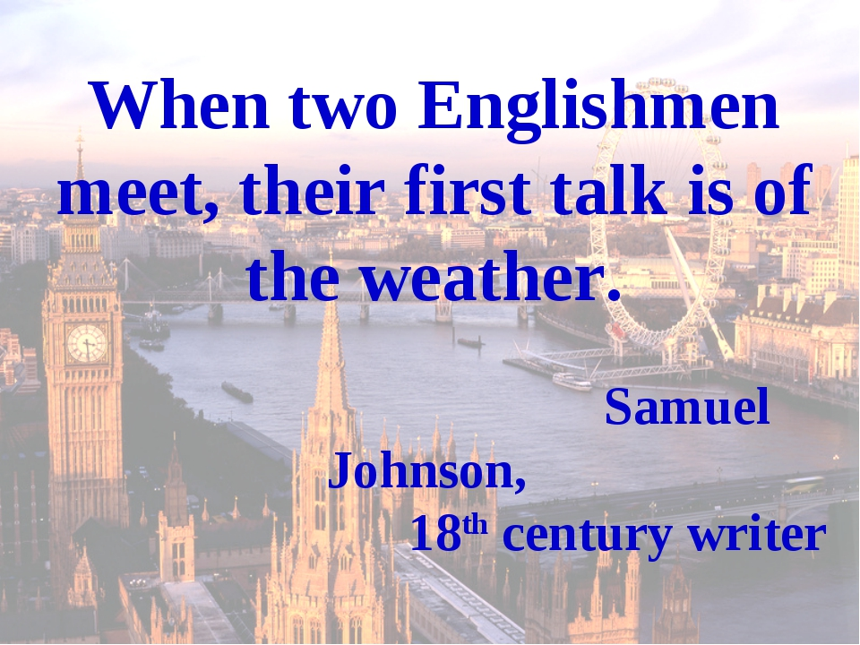

Slide 23
Handling Britain’s weather obsession is also easy, simply join in!

Slide 24
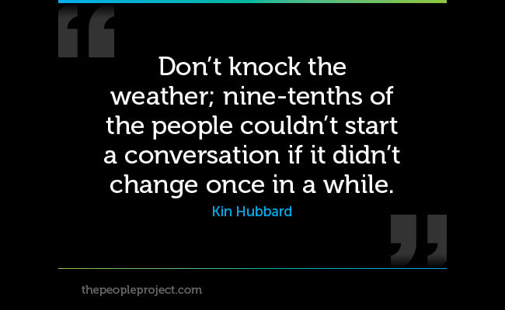

Slide 25

REFERENCES:
Кейт Фокс «Англия и Англичане. О чем молчат путеводители»
Rachel Howard and Bill Nash « Secret London. An unusual guide»
Анна Павловская « 5 o’clock и другие традиции Англии», «Англия и англичане»
Коробов А.И., Иванова Ю. « Все о Великобритании»
www.bbc.com
https://native.chat
culture.wikireading.ru
britainrus.co.uk

