Slide 1

Цветик-семицветик
Spotlight 3
Module 2
Nemchenko S.S.

Slide 2


The strong wind is blowing. The leaves go out from tree.
Only one flower has its petals. Poor flower. Let`s help it. We must do seven task to save this flower.

Slide 3

Task 1

Slide 4
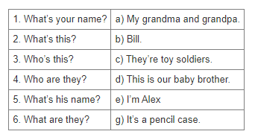
1 | 2 | 3 | 4 | 5 | 6
e | g | d | a | b | c

Slide 5

Task 2

Slide 6
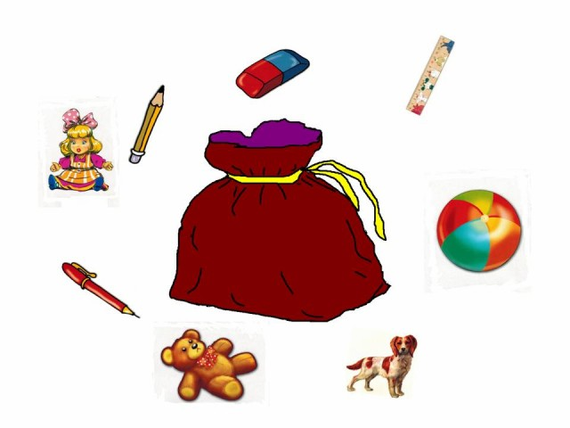

Slide 7
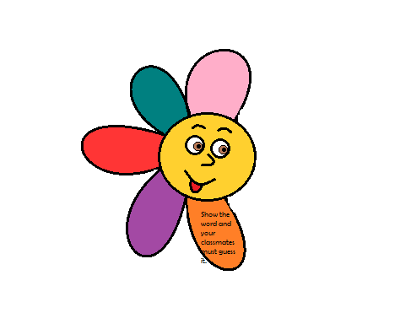
Task 3

Slide 8
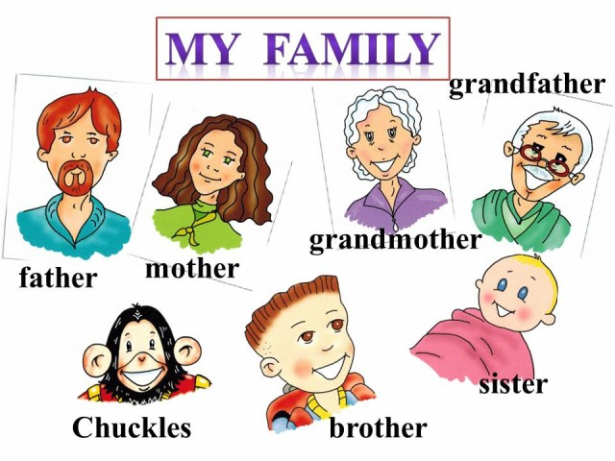

Slide 9
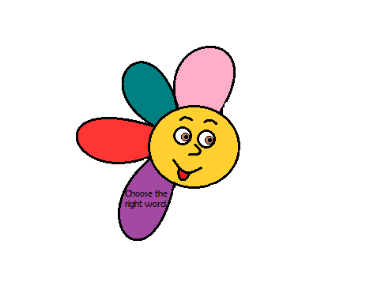
Task 4

Slide 10
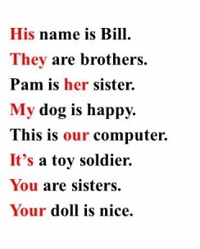
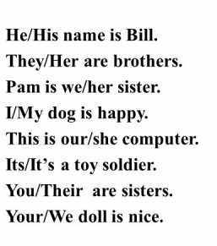

Slide 11
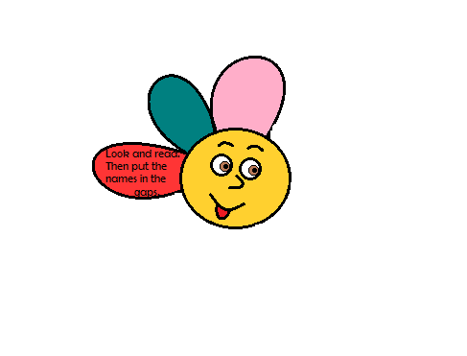
Task 5

Slide 12
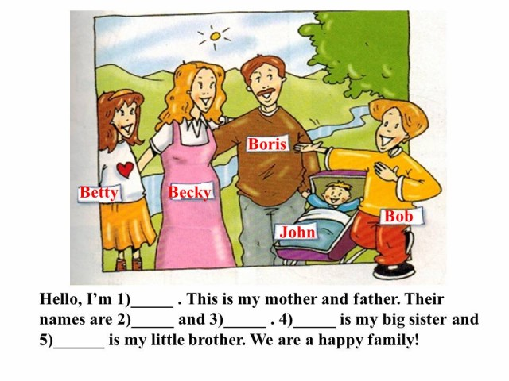

Slide 13
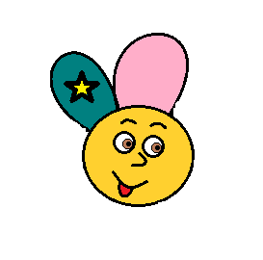
Task 6: dance!

Slide 14


Slide 15
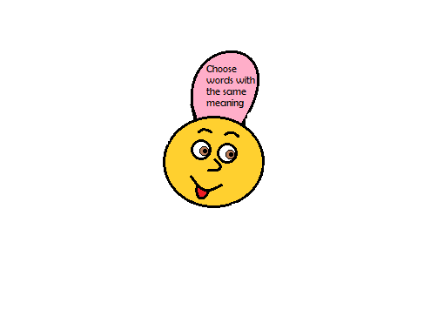
Task 7

Slide 16
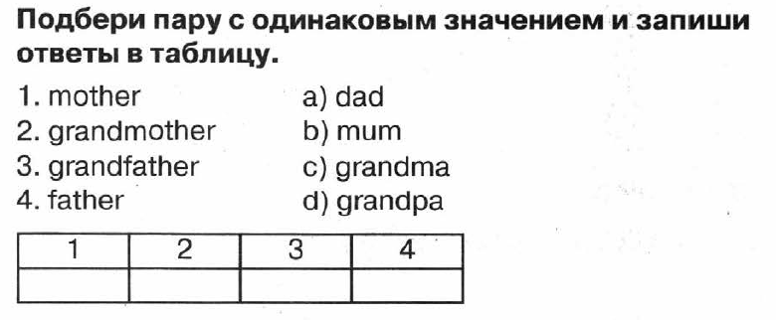

Slide 17
You’ve picked up all petals and saved our flower
Now it is happy!
Thank you, boys and girls!

