Slide 1
Round the Clock
Grade 5, Module 6

Slide 2
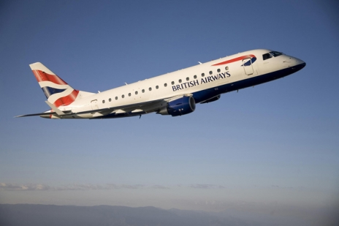
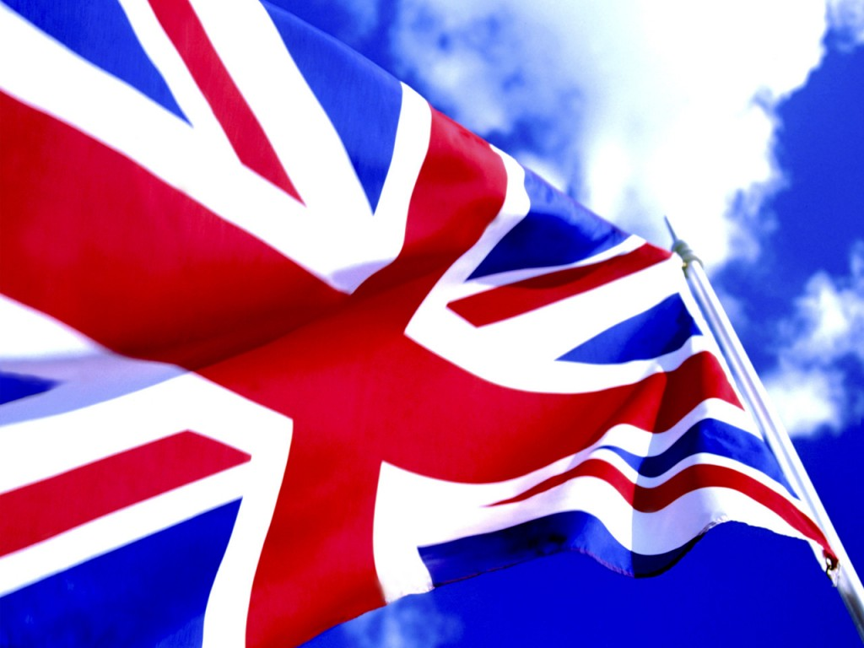
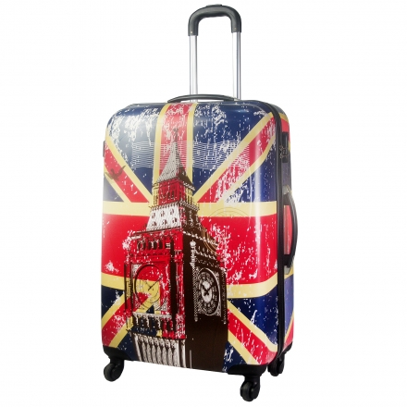

Slide 3
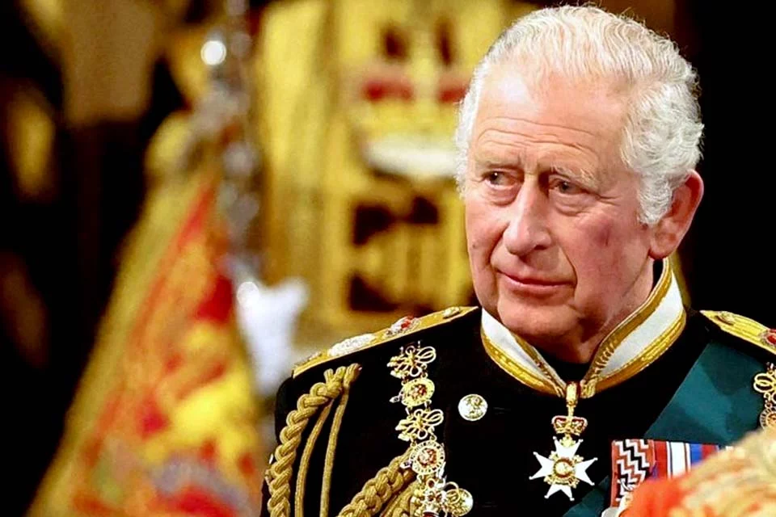
Who is it?

Slide 4
ADVERBS OF FREQUENCY
Always
Usually
Sometimes
Often
TELLING THE TIME
Clock
quarter to
half past
DAY TIME
DAILY ACTIVITIES
in the morning
in the afternoon
in the evening
at night
wake up
have breakfast
eat dinner

Slide 5
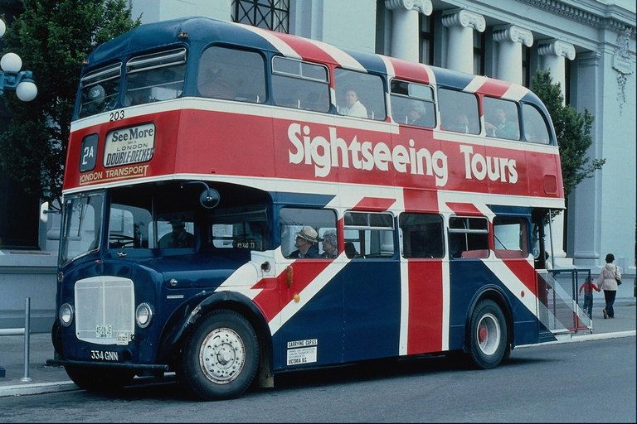
QUIZ

Slide 6
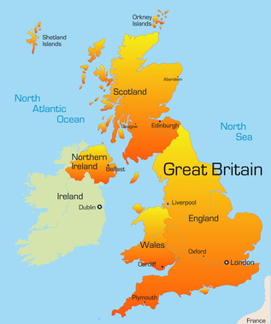
1. There are … regions in the UK.
2
3
4

Slide 7
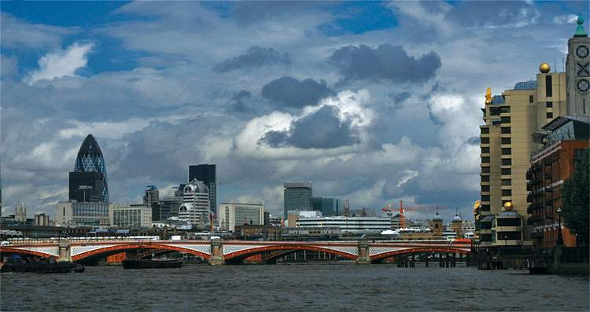
2.The capital of Great Britain is
Cardiff
London
Manchester

Slide 8

3. The name of the British flag is
The Union Jack
Black Jack
Merry Christmas

Slide 9
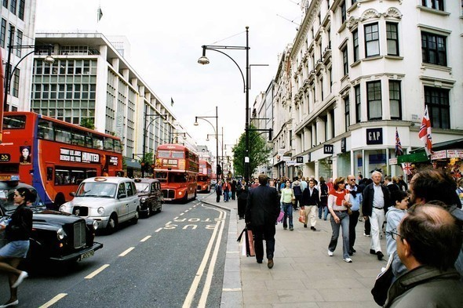
4. How many people live in the UK?
120 million
60 million
30 million

Slide 10
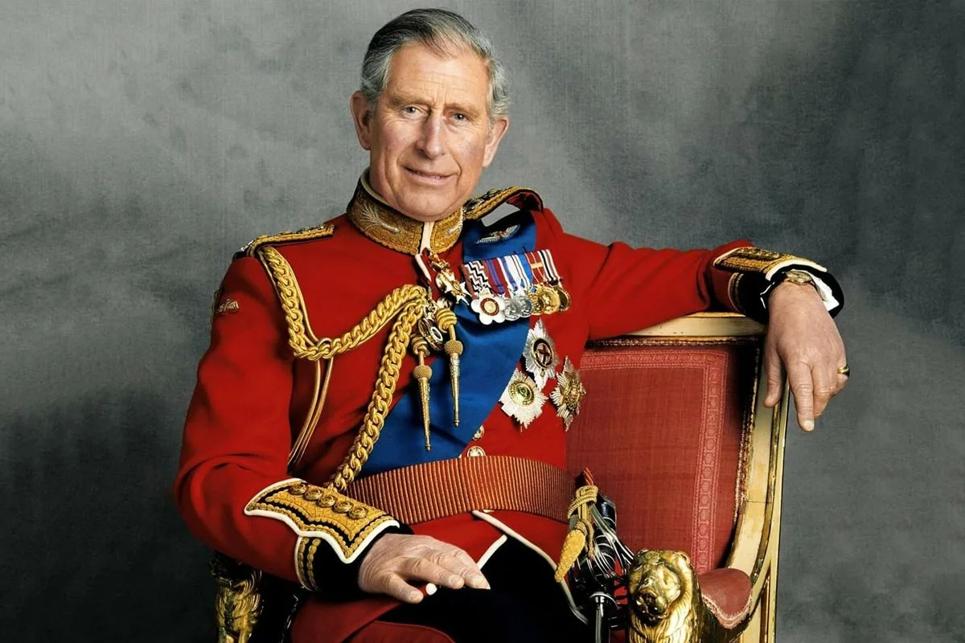
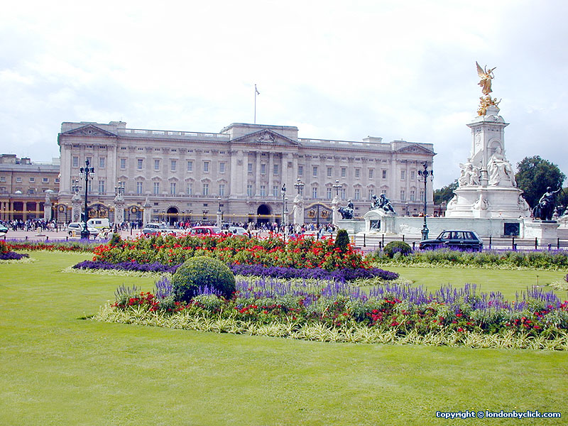
5. The King lives in
Trafalgar Square
Buckingham Palace
The Tower

Slide 11
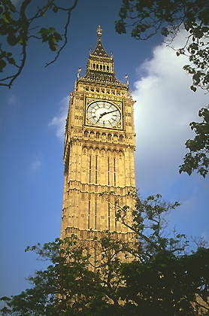
6. Big Ben is
A clock tower
A bell tower
A huge bell

Slide 12
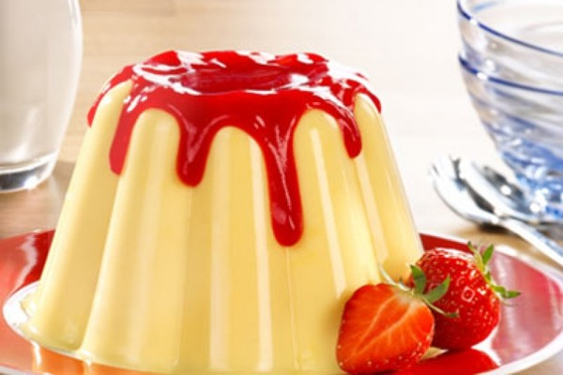
7. What is the typical English dessert?
Chocolate
Sweets
Pudding

Slide 13
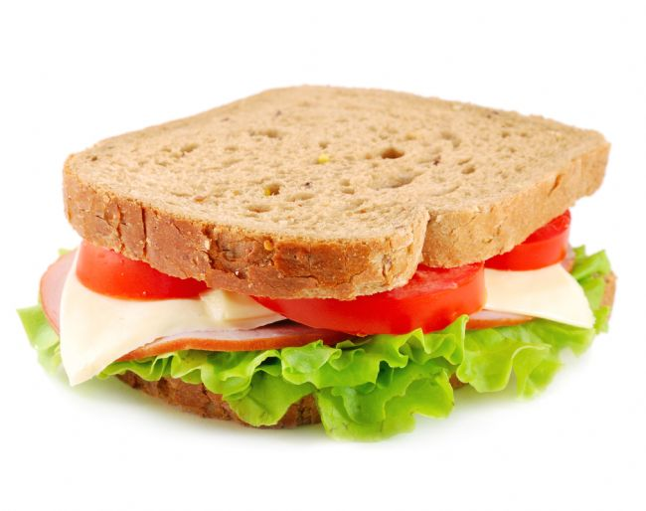
8. What food was invented in England?
Burger
Sandwich
Pancakes

Slide 14
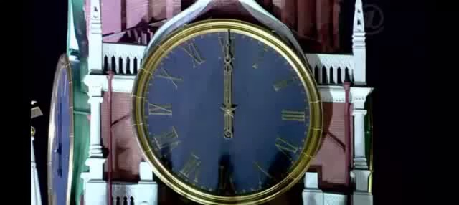
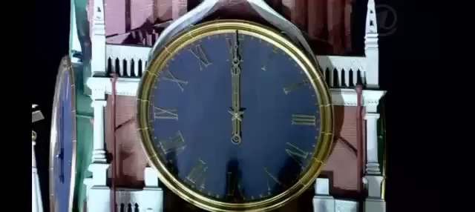

Slide 15
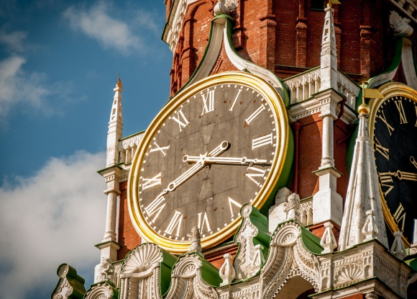
Mark the statements TRUE or FALSE
The name of the clock is Kuranti. _____________________
The clock is placed on the Spasskaya Tower in the capital of Russia. __________________
The clock is new. __________________
The clock face is huge. _____________
The clock doesn’t tell accurate time. __________________
On New Year's Eve Kuranti strike 12 times. __________
There is one clock face on the Spasskaya Tower.______

Slide 16

Listen and fill in the blanks
The Spasskaya Tower (Спасская башня) is the main tower of the __________ Kremlin, which overlooks the _______ Square.
The Spasskaya Tower was built in 1491 by the ___________ architect Pietro Antonio Solari. The tower’s name comes from the icon (икона) of Spas Nerukotvorny (Спас Нерукотворный), which was placed (поместили) on the tower in 1658. The tower is _________ meters high.
The Kremlin Clock (Kuranti) is a Russia’s most_________ clock on the Spasskaya Tower of the Moscow Kremlin. The first clock on the Spasskaya Tower was placed in 1491 and the present Kremlin chimes (Кремлёвские куранты) were installed (установлены) in _______. The clock tells ____________ Moscow Time. On New Year's Eve Kuranti strike 12 times. All people are patiently waiting (ждут) for in front of the _____and with champagne in their hands.
The Kremlin clock face is 6.12 meters wide. There are clock faces on all four sides of the Spasskaya tower. The Roman numerals (цифры) are 0.72 m tall. The length of the hour hand is 2.97 meters long, and the minute hand is 3.27 meters long. The total weight (вес) of the clock and the bells is _____ tons.
Moscow
Red
Italian
71
famous
1851
official
TV
25

Slide 17
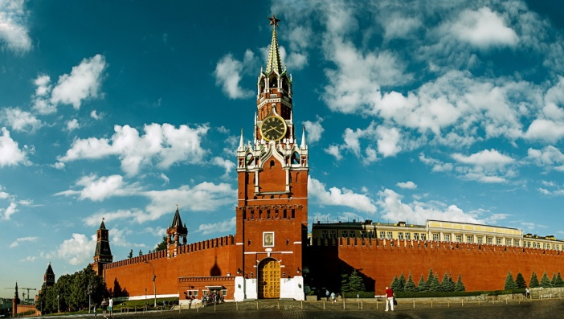
Read and complete the fact file.
Landmark
Place
Who built
When it was built
Height
The clock on the landmark
What the clock does
The clock face
The hour hand
The minute hand
The weight of the clock and the bells
The Spasskaya Tower
MOSCOW, Red Square
Italian architect Pietro Antonio Solari
1491
71
The Kremlin Clock
tells official Moscow Time
6.12 meters wide
2.97 meters long
3.27 meters long
25 tons

Slide 18
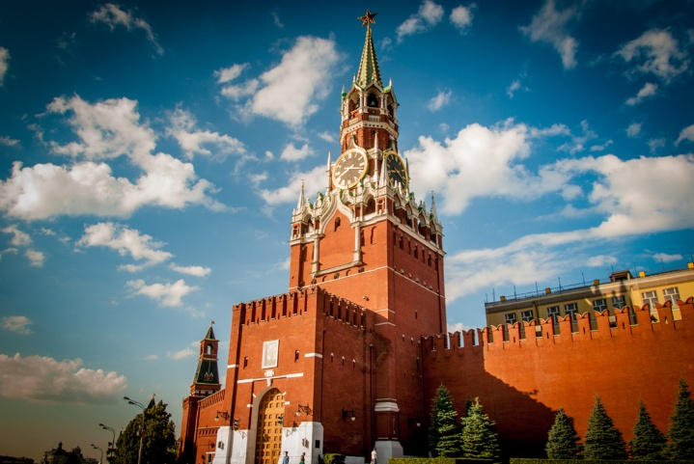
Arguments | Yes Why? | No Why?
1. The Spasskaya Tower overlooks the Luzhniki stadium.
2.Russian architects built this tower.
3.The tower is named after a famous icon.
4.The tower is more than 70 meters high.
5.The present day clock was installed in the 19th century.
6.Nobody waits for the clock to strike on New Year’s Eve.
7.There are clock faces on all the sides of the tower.

Slide 19
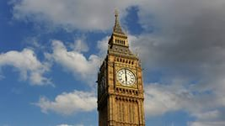

Read and compare.
Data | Big Ben | The Spasskaya Tower | Conclusion
What is it?
Its name comes from…
The tower is … meters high. |  |  | Which tower is taller?
 | The bell inside is … tons. | The total weight (вес) of the clock and the bells is … tons. | Which bell is heavier?
How many clock faces has the tower got?
 | The clock face is … meters wide. | The clock face is … meters wide. | Which clock face is wider?
 | The hour hand is … meters long. | The hour hand is … meters long. | Which hour hand is longer?
 | The minute hand is … meters long. | The minute hand is … meters long. | Which minute hand is longer?
Do tourists go to see this landmark?

Slide 20
Mark the statements TRUE or FALSE
The name of the clock is Kuranti. _____________________
The clock is placed on the Spasskaya Tower in the capital of Russia. __________________
The clock is new. __________________
The clock face is huge. _____________
The clock doesn’t tell accurate time. __________________
On New Year's Eve Kuranti strike 12 times. __________
There is one clock face on the Spasskaya Tower.______
T
T
F
T
F
T
F

Slide 21
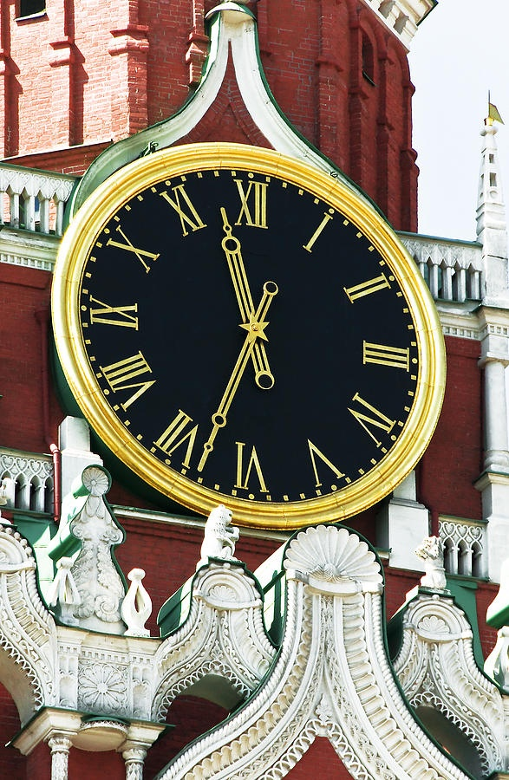
Cinquain
“The Kremlin Clock”

Slide 22
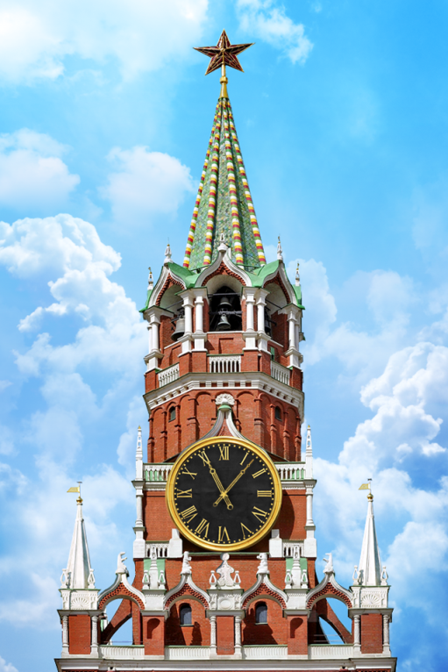
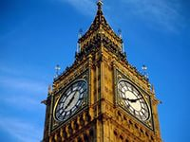
Thank you very much!

