Slide 1
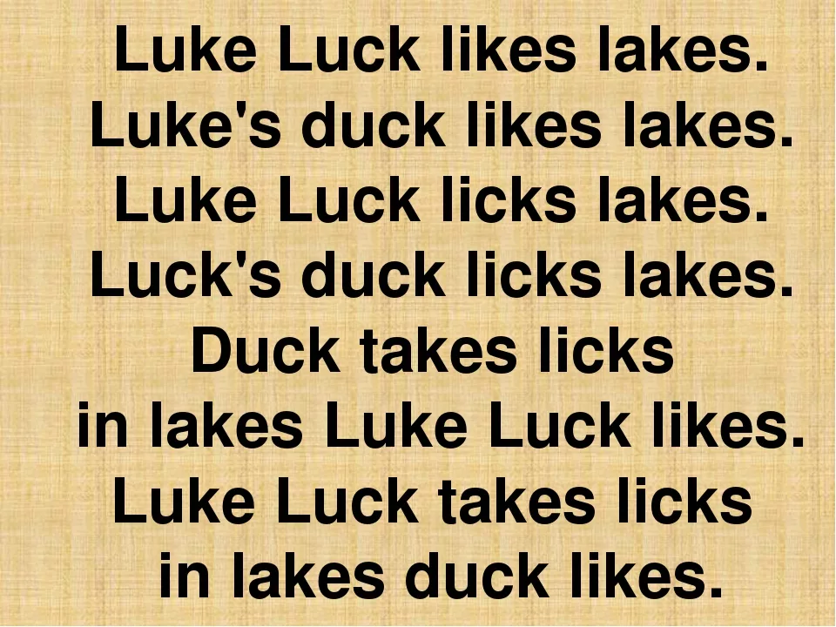

Slide 2
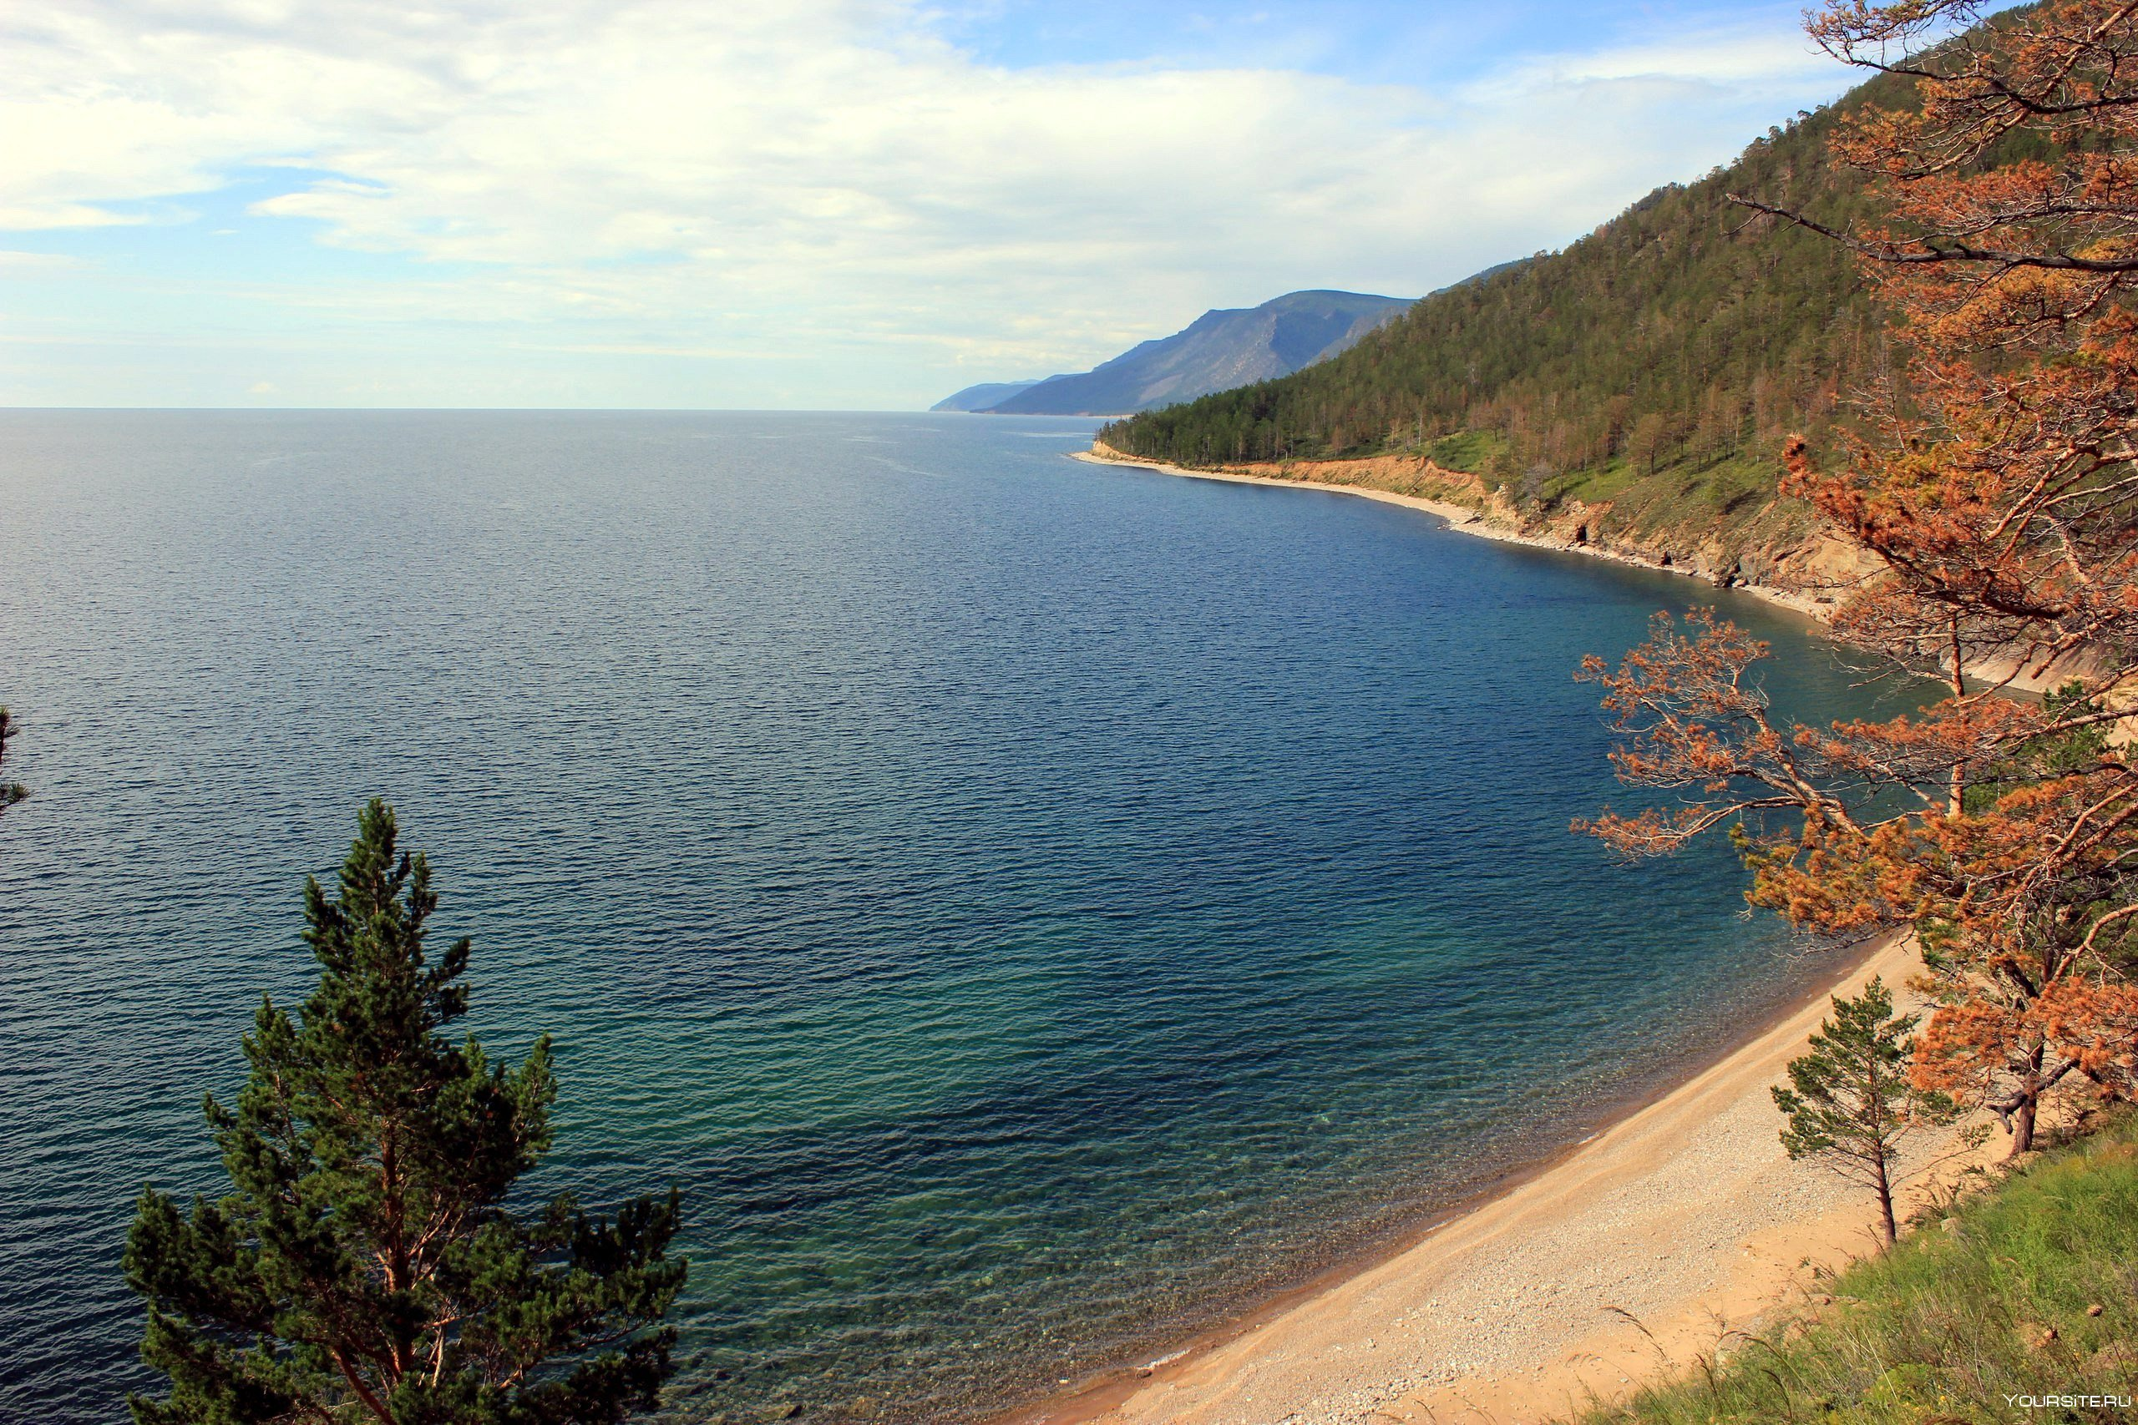
Where do you like having a rest in summer?

Slide 3

The natural of Lake Baikal
Our goals for lesson today:
To get information about Baikal in English
To learn some new words in this topic
To lean working with information in different tasks
To discuss ecological problems of Baikal
To work in team
To have fun

Slide 4
Words for help
Bountiful
Species
Baikal seal
Freshwater
Expand
Sponges
Shrimp
Amphipod
Invaluable
Heritage
Щедрый
Обитатели
Байкальские нерпы
Пресная вода
Расширяться
Морские губки
Рачки
Бокоплавы
Бесценный
Наследие

