Slide 1
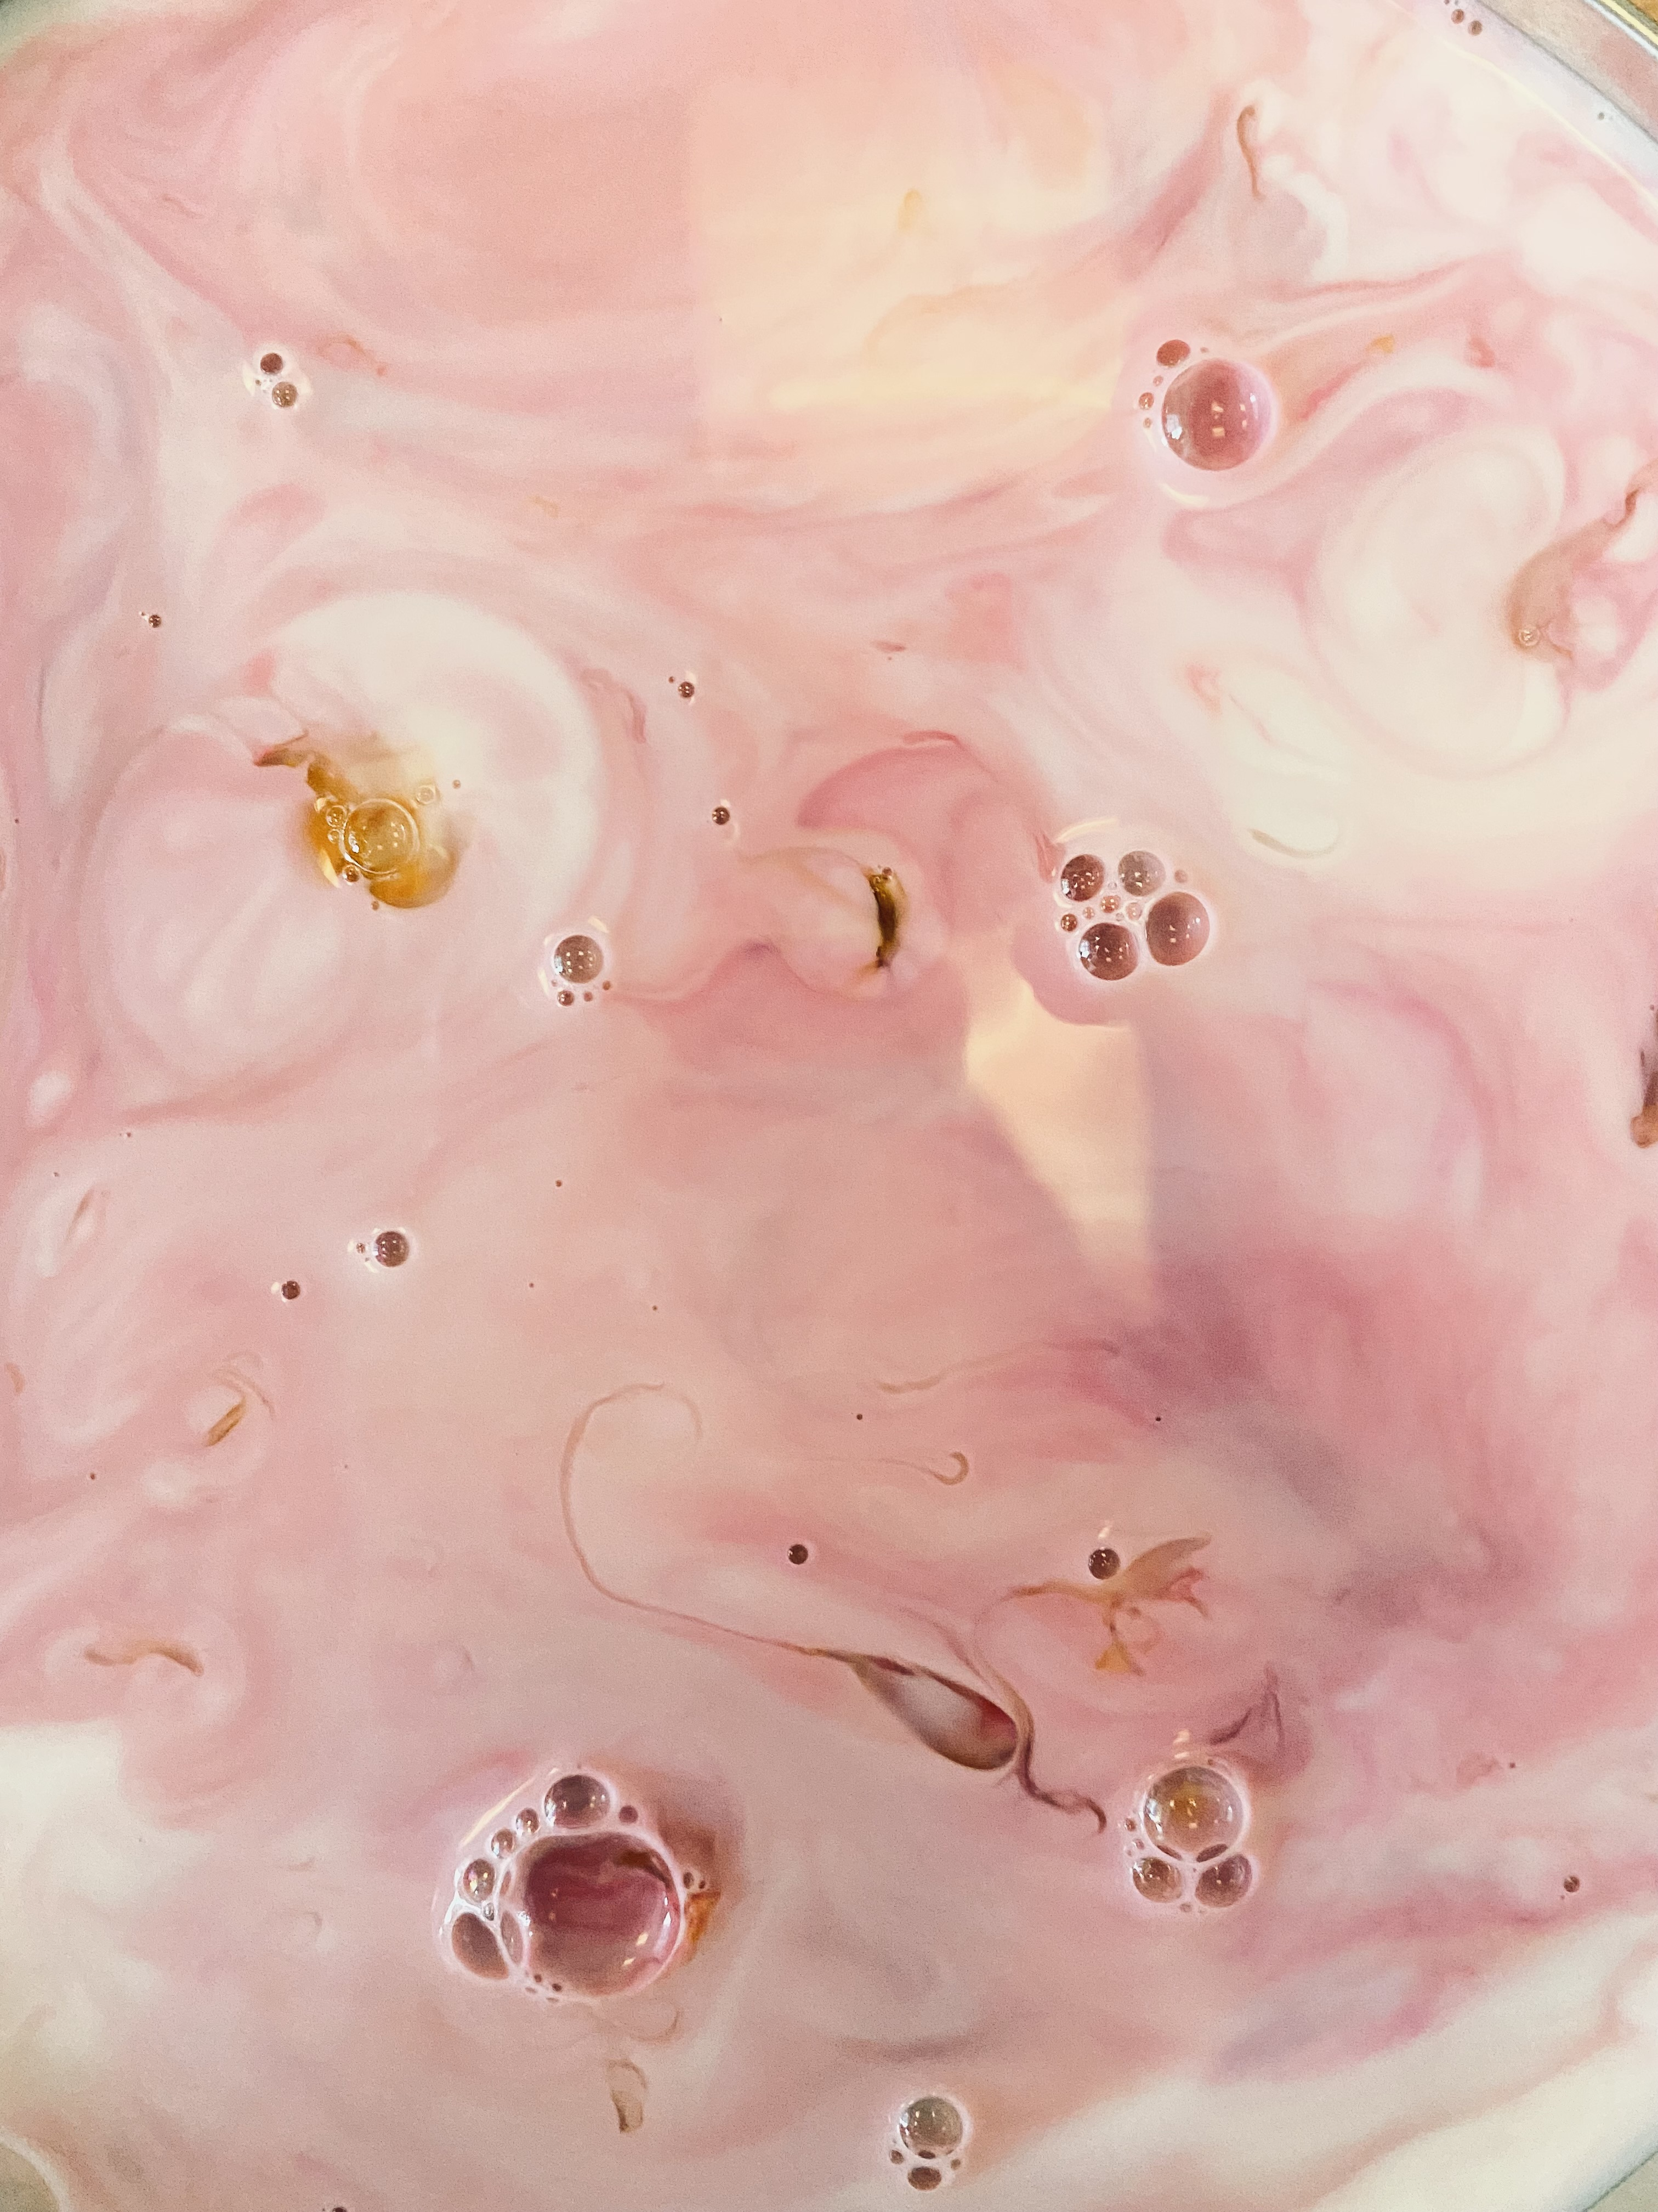
Magic milk experiment

Slide 2
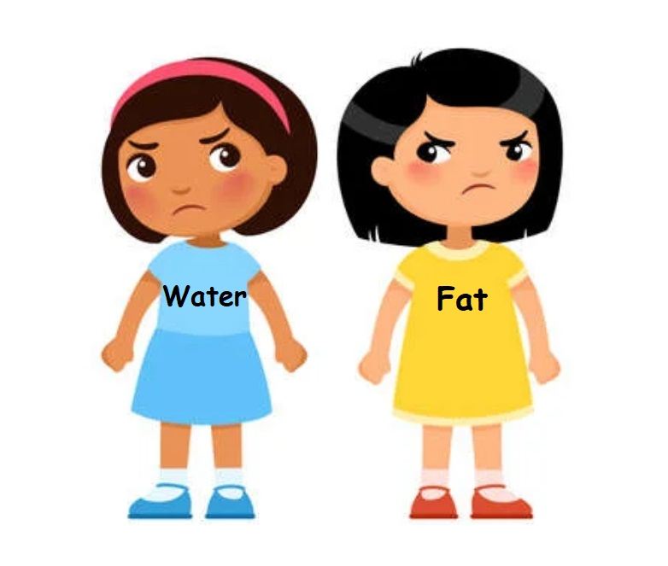
Fat and water are not friends.

Slide 3
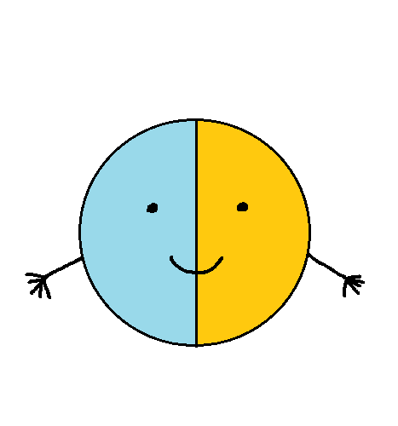
Soap molecule has got TWO parts:
This part loves water.
It is called hydrophilic.
This part hates water and loves fat.
It is called hydrophobic.

Slide 4

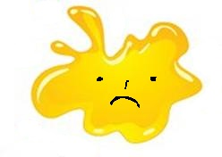
Water and fat don’t like each other.

Slide 5
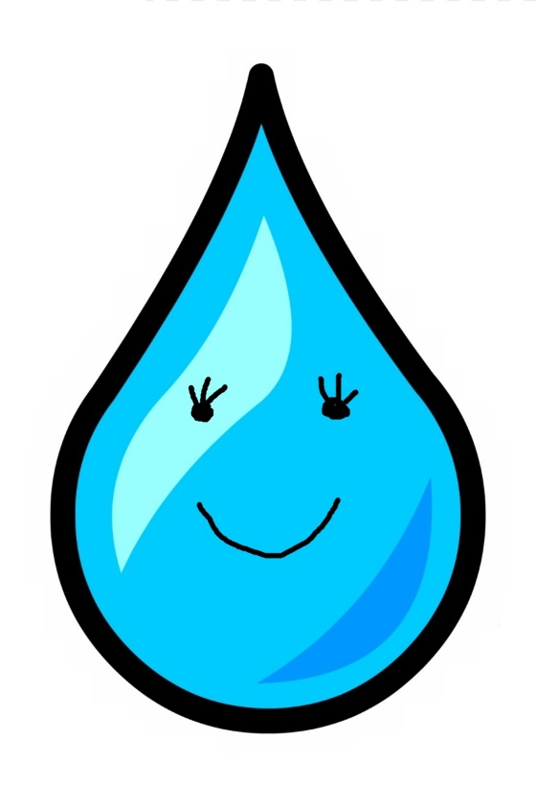
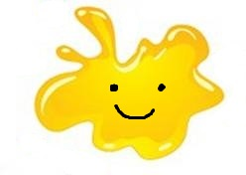
But they both like soap.

Slide 6
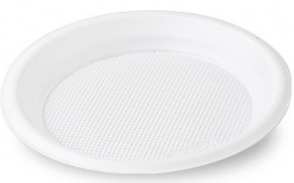
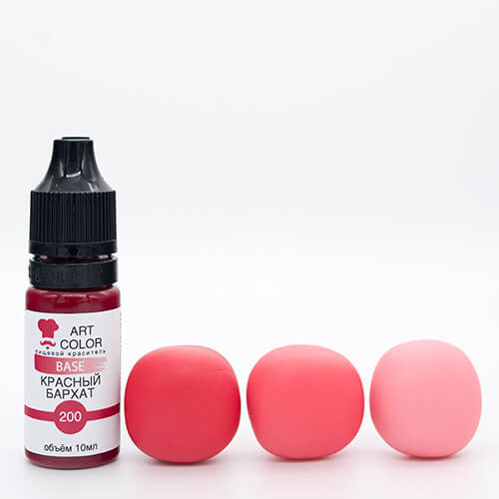
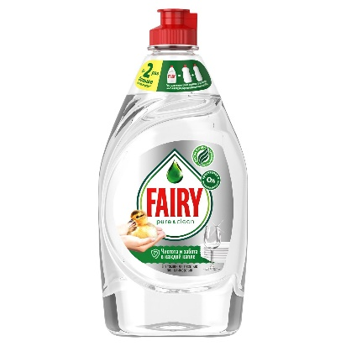
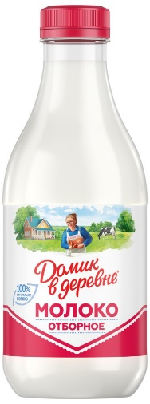
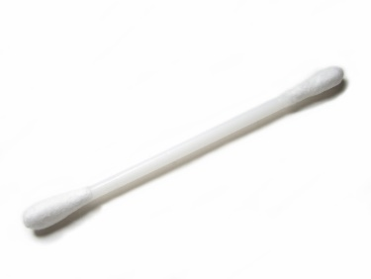
For this experiment you need:
a plate
some soap
food colouring
some milk
a cotton bud

Slide 7
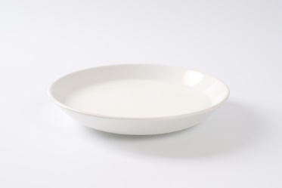
Step 1.
Put some milk in the plate.

Slide 8
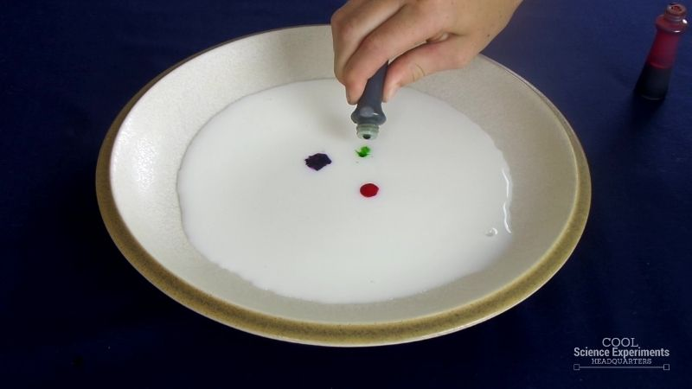
Step 2.
Put little drops of the food colouring in the middle.

Slide 9
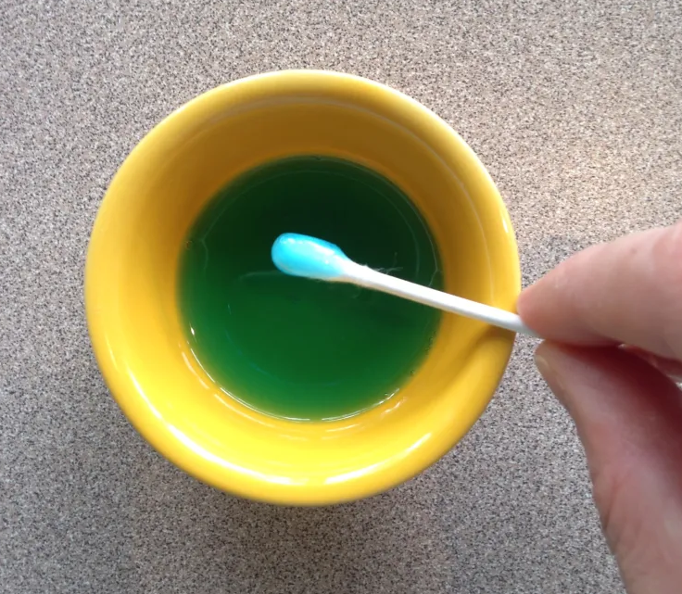
Step 3.
Take the cotton bud and put some soap on it.

Slide 10
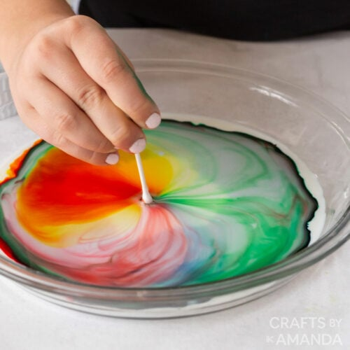
Step 4.
Put the cotton bud with the soap in the milk and see the magic milk dancing.

Slide 11
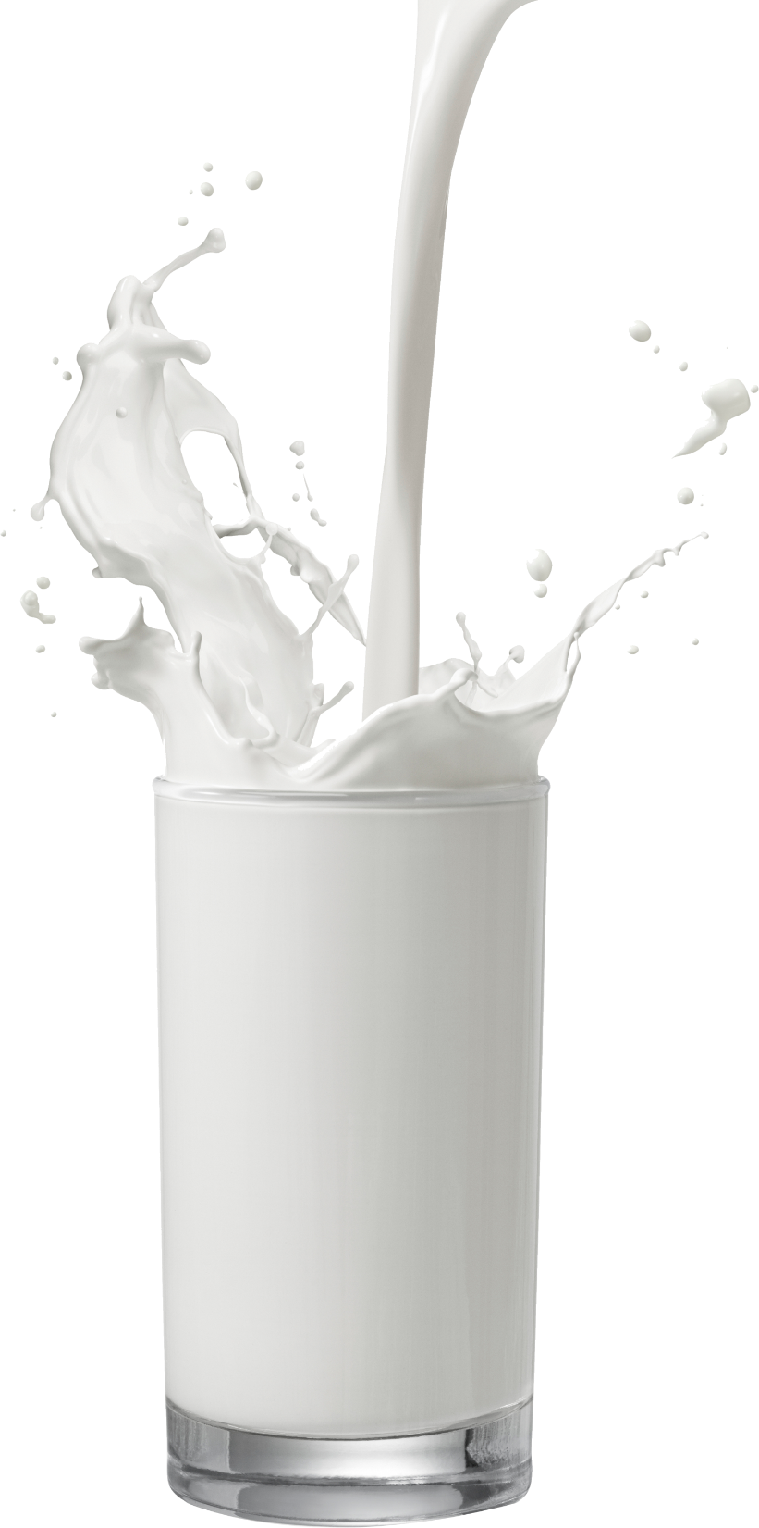
Milk consists of:
Water
Protein
Fat
Carbohydrates
Vitamins and minerals

Slide 12
