Slide 1
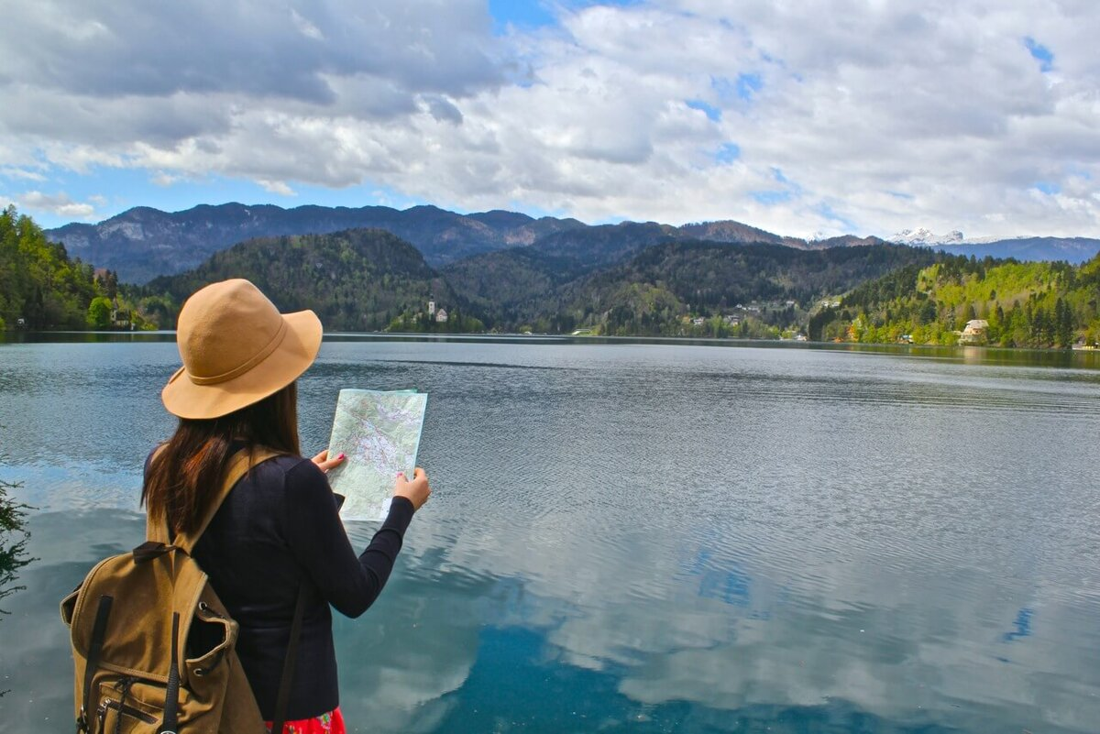
Travelling
Кузнецова Ирина Геннадьевна,
учитель английского языка,
МАОУ «Гимназия №56»

Slide 2
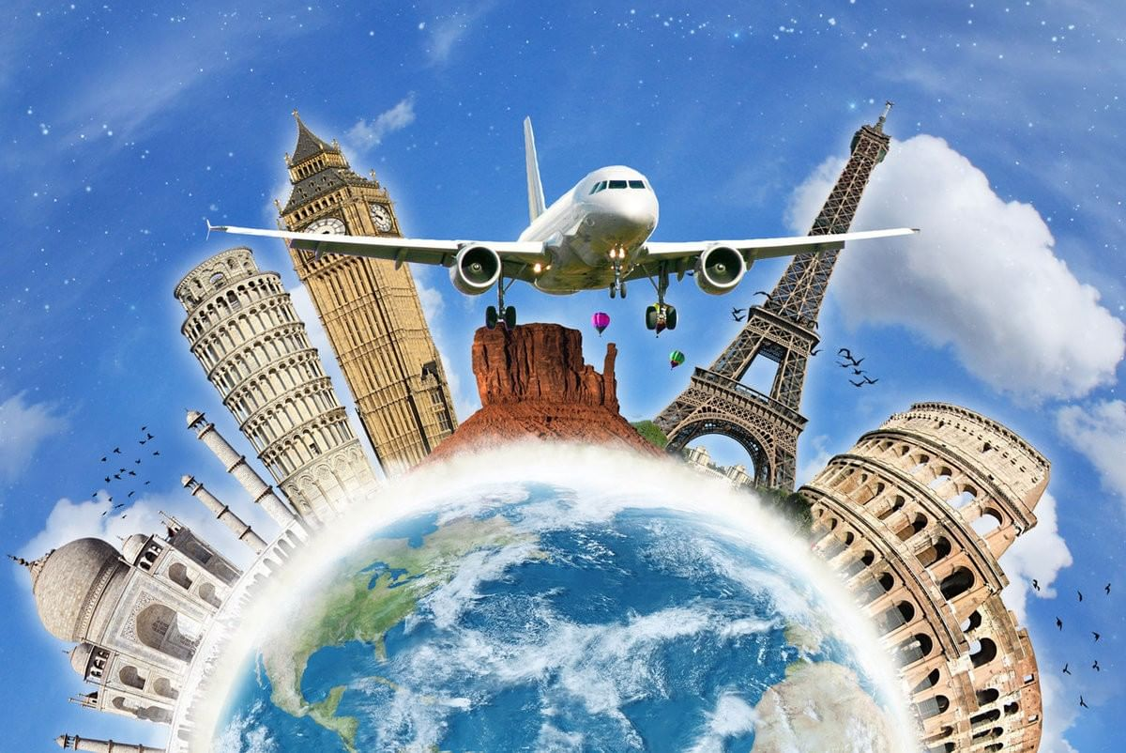
Why do people travel? (make sentences using these words)
Picturesque
Magnificent
Impressive
Breathtaking
Gorgeous
Discover new places
Learn about culture
Improve your knowledge of
Escape from boring life and daily routine
Explore new places
Expand your outlook

Slide 3
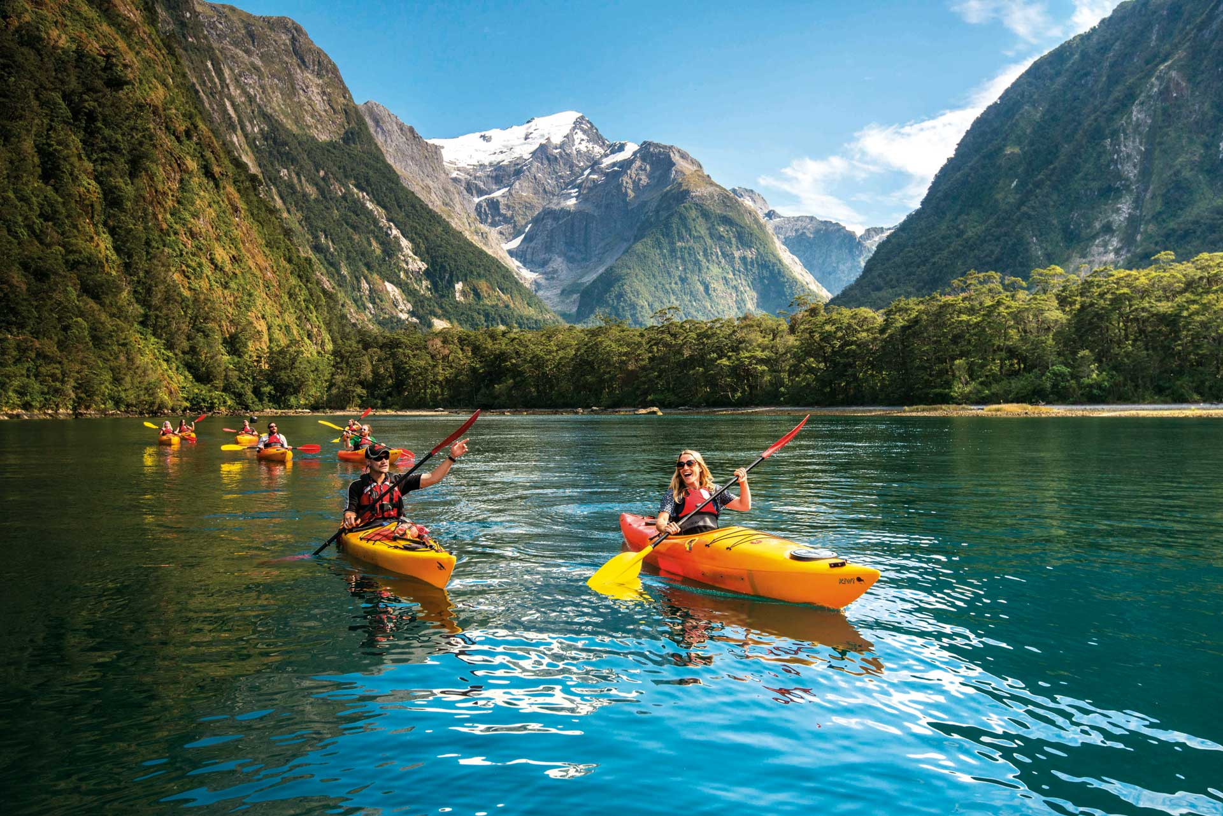
Read the text and answer the question: What do people travel for?
Millions of people all over the world spend their holidays travelling. They travel to see other countries and continents, modern cities and ruins of ancient towns, they travel to enjoy picturesque places, or just for a change of scene.

Slide 4
Read the text and answer the question: What do people travel for?
Millions of people all over the world spend their holidays travelling. They travel to see other countries and continents, modern cities and ruins of ancient towns, they travel to enjoy picturesque places, or just for a change of scene.

Slide 5
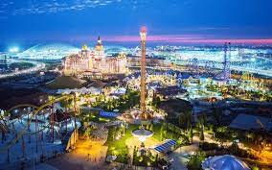
How do people living in the country spend their holidays? What do city-dwellers usually like?
Those who live in the country like to go to a big city and spend their time visiting museums and art galleries, looking at shop windows and dining at exotic restaurants. City-dwellers usually like a quiet holiday by the sea or in the mountains, with nothing to do but walk and bathe and laze in the sun.

Slide 6
How do people living in the country spend their holidays? What do city-dwellers usually like?
Those who live in the country like to go to a big city and spend their time visiting museums and art galleries, looking at shop windows and dining at exotic restaurants. City-dwellers usually like a quiet holiday by the sea or in the mountains, with nothing to do but walk and bathe and laze in the sun.

Slide 7
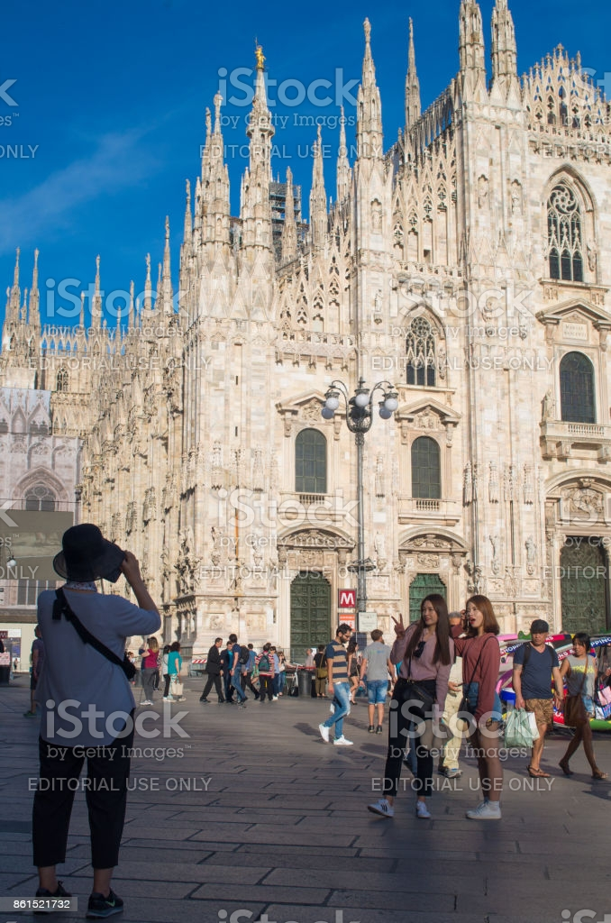
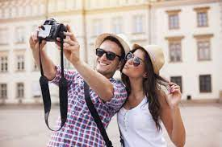
Why do most travelers and holiday-makers take a camera with them for?
Most travellers and holiday-makers take a camera with them and take pictures of everything that interest them – the sights of a city, old churches and castles, views of mountains, lakes, valleys, plains, waterfalls, forests, different kinds of trees, flowers and plants, animals and birds.
Later, perhaps years later, they will be reminded by the photos of the happy time they have had.

Slide 8
Why do most travelers and holiday-makers take a camera with them for?
Most travellers and holiday-makers take a camera with them and take pictures of everything that interest them – the sights of a city, old churches and castles, views of mountains, lakes, valleys, plains, waterfalls, forests, different kinds of trees, flowers and plants, animals and birds.
Later, perhaps years later, they will be reminded by the photos of the happy time they have had.

Slide 9
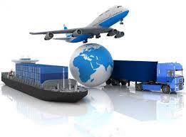
Why do people choose different means of transport?
People travel by train, by boat, by car.
All means of travel have their advantages and disadvantages. And people choose one according to their plans and destinations.

Slide 10
Why do people choose different means of transport?
People travel by train, by boat, by car.
All means of travel have their advantages and disadvantages. And people choose one according to their plans and destinations.

Slide 11
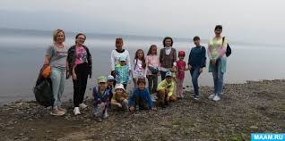
Why is travelling so useful?
If we are fond of travelling, we see and learn a lot of things that we can never see or learn at home, though we may read about them in books and newspapers, and see pictures of them on TV. The best way to study geography is to travel, and the best way to get to know and understand the people is to meet them in their own home.

Slide 12
Share with your partner what you have learnt about travelling. Use these questions as a plan.
What do people travel for?
How do people living in the country spend their holidays?
What do city-dwellers usually like?
Why do most travelers and holiday-makers take a camera with them for?
Why do people choose different means of transport?
Why is travelling so useful?

Slide 13
Match types of travelling and definitions
Adventure holiday
a holiday where you go travelling with your clothes, etc.in a backpack.
Backpacking holiday
a short holiday in a city.
City break
a journey on a large bus that you make for pleasure, during which you visit many places.
Coach tour
a holiday where you do outdoor sports such as rock climbing, canoeing, etc.

Slide 14
Match types of travelling and definitions
Adventure holiday
a holiday where you go travelling with your clothes, etc.in a backpack.
Backpacking holiday
a short holiday in a city.
City break
a journey on a large bus that you make for pleasure, during which you visit many places.
Coach tour
a holiday where you do outdoor sports such as rock climbing, canoeing, etc.

Slide 15
Match types of travelling and definitions
Adventure holiday
a holiday where you go travelling with your clothes, etc.in a backpack.
Backpacking holiday
a short holiday in a city.
City break
a journey on a large bus that you make for pleasure, during which you visit many places.
Coach tour
a holiday where you do outdoor sports such as rock climbing, canoeing, etc.

Slide 16
Match types of travelling and definitions
Adventure holiday
a holiday where you go travelling with your clothes, etc.in a backpack.
Backpacking holiday
a short holiday in a city.
City break
a journey on a large bus that you make for pleasure, during which you visit many places.
Coach tour
a holiday where you do outdoor sports such as rock climbing, canoeing, etc.

Slide 17
Match types of travelling and definitions
Adventure holiday
a holiday where you go travelling with your clothes, etc.in a backpack.
Backpacking holiday
a short holiday in a city.
City break
a journey on a large bus that you make for pleasure, during which you visit many places.
Coach tour
a holiday where you do outdoor sports such as rock climbing, canoeing, etc.

Slide 18
Match types of travelling and definitions
DIY holiday
a holyday that is taken by two people who have just got married.
Honeymoon
a holiday where you choose and book the accommodation, transport, activities, etc. yourself.
House swap
a holiday where the accommodation, travel, activities, etc. are arranged for you by a company.
Package holiday
an arrangement where two people or families move into each other’s houses for a holiday.

Slide 19
Match types of travelling and definitions
DIY holiday
a holyday that is taken by two people who have just got married.
Honeymoon
a holiday where you choose and book the accommodation, transport, activities, etc. yourself.
House swap
a holiday where the accommodation, travel, activities, etc. are arranged for you by a company.
Package holiday
an arrangement where two people or families move into each other’s houses for a holiday.

Slide 20
Match types of travelling and definitions
DIY holiday
a holyday that is taken by two people who have just got married.
Honeymoon
a holiday where you choose and book the accommodation, transport, activities, etc. yourself.
House swap
a holiday where the accommodation, travel, activities, etc. are arranged for you by a company.
an arrangement where two people or families move into each other’s houses for a holiday.
Package holiday

Slide 21
Match types of travelling and definitions
DIY holiday
a holyday that is taken by two people who have just got married.
Honeymoon
a holiday where you choose and book the accommodation, transport, activities, etc. yourself.
House swap
a holiday where the accommodation, travel, activities, etc. are arranged for you by a company.
Package holiday
an arrangement where two people or families move into each other’s houses for a holiday.

Slide 22
Match types of travelling and definitions
DIY holiday
a holyday that is taken by two people who have just got married.
Honeymoon
a holiday where you choose and book the accommodation, transport, activities, etc. yourself.
House swap
a holiday where the accommodation, travel, activities, etc. are arranged for you by a company.
Package holiday
an arrangement where two people or families move into each other’s houses for a holiday.

Slide 23
Match types of travelling and definitions
a holyday where you stay in a house or flat and cook for yourself.
Self-catering holiday
Sightseeing holiday
a holyday where you stay at home and relax or go on a day trip.
Staycation
a holyday where you visit the sights of a city as a tourist.
Working holiday
a journey where you help a charity or the local people in the place you are visiting.

Slide 24
Match types of travelling and definitions
a holyday where you stay in a house or flat and cook for yourself.
Self-catering holiday
Sightseeing holiday
a holyday where you stay at home and relax or go on a day trip.
Staycation
a holyday where you visit the sights of a city as a tourist.
Working holiday
a journey where you help a charity or the local people in the place you are visiting.

Slide 25
Match types of travelling and definitions
a holyday where you stay in a house or flat and cook for yourself.
Self-catering holiday
Sightseeing holiday
a holyday where you stay at home and relax or go on a day trip.
Staycation
a holyday where you visit the sights of a city as a tourist.
Working holiday
a journey where you help a charity or the local people in the place you are visiting.

Slide 26
Match types of travelling and definitions
a holyday where you stay in a house or flat and cook for yourself.
Self-catering holiday
Sightseeing holiday
a holyday where you stay at home and relax or go on a day trip.
Staycation
a holyday where you visit the sights of a city as a tourist.
Working holiday
a journey where you help a charity or the local people in the place you are visiting.

Slide 27
Match types of travelling and definitions
a holyday where you stay in a house or flat and cook for yourself.
Self-catering holiday
Sightseeing holiday
a holyday where you stay at home and relax or go on a day trip.
Staycation
a holyday where you visit the sights of a city as a tourist.
Working holiday
a journey where you help a charity or the local people in the place you are visiting.

Slide 28
Which types of holidays would you like to have and which ones wouldn’t you like to have? Why?
Adventure holiday
Backpacking holiday
City break
Coach tour
DIY holiday
Honeymoon
House swap
Package holiday
Self-catering holiday
Sightseeing holiday
Staycation
Working holiday
a holiday where you do outdoor sports such as rock climbing, canoeing, etc.
a holiday where you go travelling with your clothes, etc.in a backpack.
a short holiday in a city.
a journey on a large bus that you make for pleasure, during which you visit many places.
a holiday where you choose and book the accommodation, transport, activities, etc. yourself.
a holyday that is taken by two people who have just got married.
an arrangement where two people or families move into each other’s houses for a holiday.
a holiday where the accommodation, travel, activities, etc. are arranged for you by a company.
a holyday where you stay in a house or flat and cook for yourself.
a holyday where you visit the sights of a city as a tourist.
a holyday where you stay at home and relax or go on a day trip.
a journey where you help a charity or the local people in the place you are visiting.

Slide 29
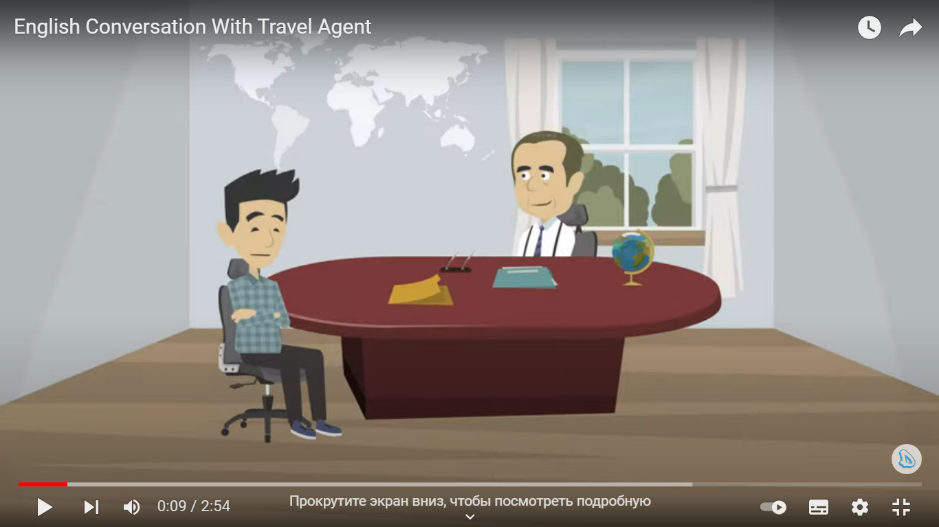
Listen to the dialogue “In a travel agency”, write down useful expressions.
https://www.youtube.com/watch?v=mhxFRatrw_I

Slide 30
Choose a role card and prepare a dialogue between a travel agent and a tourist.
Student B
Student A
You are a travel agent. Think about what visitors can see and do in your town. Decide which activities and palaces would appeal to different types of tourist. Listen to Student B, then give advice about what they can see and do.
You are a tourist. Tell student A what you want from your holiday and what type of activities you enjoy. Ask them for advice about what you can see and do.

Slide 31

What new have you learnt today?

Slide 32
https://go.mail.ru/search_images?fr=ps&gp=843253&q=%D0%BA%D0%B0%D1%80%D1%82%D0%B8%D0%BD%D0%BA%D0%B0%20%D0%BE%20%D0%BF%D1%83%D1%82%D0%B5%D1%88%D0%B5%D1%81%D1%82%D0%B2%D0%B8%D0%B8&frm=web#urlhash=882380375413687233 – картинки
«95 устных тем по английскому языку» Е.Л. Занина, Айрис Рольф , Москва, 1997г.
“Insight” Intermediate, Jayne Wildman, Oxford University Press
https://www.youtube.com/watch?v=mhxFRatrw_I - диалог

