Slide 1

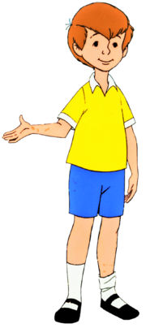
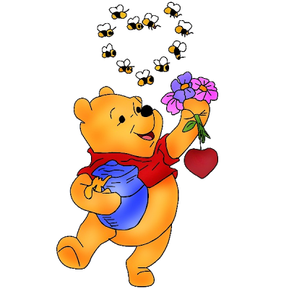
Christopher Robin
and Winnie-the-Pooh
Quiz
Гуила Н.А., ГБОУ СОШ №347 СПБ

Slide 2

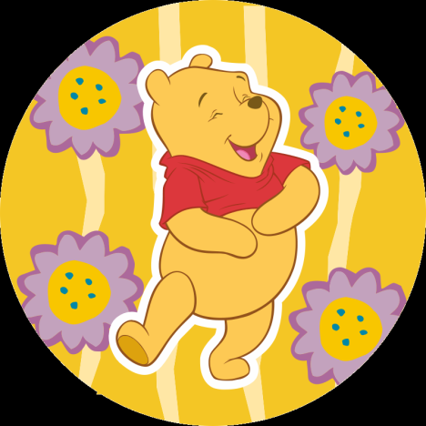
1
2
3
4
5
6
7
8
9
10
11
12
13
14
15

Slide 3
What is Winnie-the-Pooh’s favorite food?
Haycorns
Hunny
Birthday cake

Slide 4
2. Which is NOT One of Eeyore’s Problems?
a. Bees bother him when he eats
b. His house keeps falling down
c. His tail keeps coming off

Slide 5
3. Two of these characters are boys. Which one is a girl?
Piglet
Eeyore
Kanga

Slide 6
4. What is a “Smackerel”?
A small taste of food
A fish
A slap

Slide 7
5. Who originally wrote the Winnie-the-Pooh stories?
Disney;
A. A. Milne;
Winnie-the-Pooh

Slide 8
6. Which of these sayings is not spoken by Pooh?
a. “Think, think, think”
b. “Oh, Bother”
c. “That’s Re-dikorus”

Slide 9
7. What is Eeyore’s favorite food?
Hunny;
Thistles;
Haycorns

Slide 10
8. Who is “Henry Pootel?”
a. Winnie-the-Pooh
b. A cleaned-up Piglet
c. One of Rabbit’s relations

Slide 11
9. What is Tigger’s favorite thing to do?
Bounce;
Garden;
Eat hunny

Slide 12
10. What does Roo dislike?
Milk
Tigger
Extract of Malt

Slide 13
11. Which Character is not in either of the two original Pooh Books?
Tigger
Gopher
Kanga and Roo

Slide 14
12. How long did the terrible flood last?
5 Days
3 Days
3 Weeks

Slide 15
13. Which book was not written by A. A. Milne?
a. Winnie-the-Pooh
b. The House at Pooh Corner
c. Adventures of Eeyore

Slide 16
14. What is Pooh’s reason for why bees make hunny?
a. “Is for me to eat it”
b.“Because they like to”
c. “To trap other critters”

Slide 17
15. Where does Christopher Robin live?
a. Next Door
b. 100 Acre Wood
c. In a Heffalump Trap

Slide 18

Yes, it’s right!!!

Slide 19

No, it’s wrong!!!

Slide 20
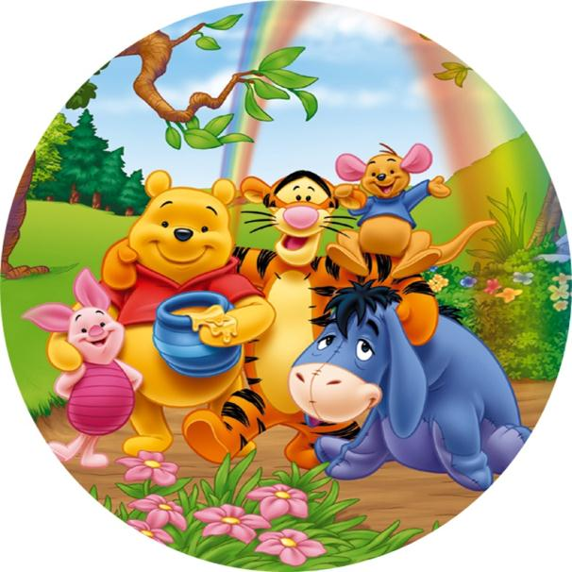
Bye!

