Slide 1
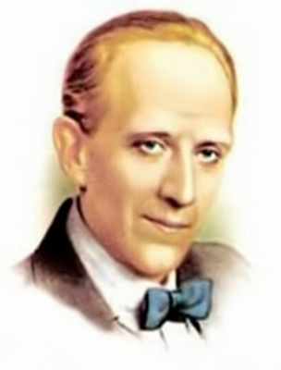

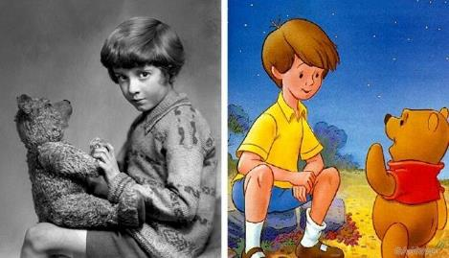
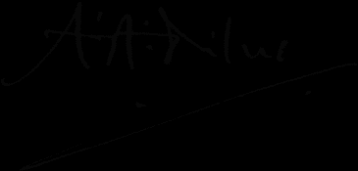
Alan Alexander Milne
(1882-1956)
The man behind
Winnie the Pooh
Гуила Н.А., ГБОУ СОШ №347 СПб

Slide 2
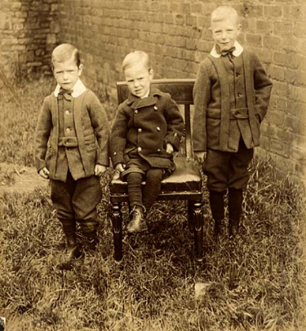
Alan Alexander Milne’s whose full name is Alan Alexander Milne was born on January 18, 1882, in London, England.
He and his two older brothers
David Barrett Milne and Kenneth John Milne were raised in London by their parents, Sarah Marie (née Heginbotham) and John Vine Milne, the headmaster of a private school named Henley House. One of his teachers was H. G. Wells who taught there in 1889- 90.

Slide 3
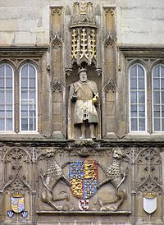
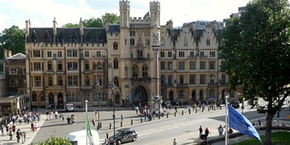
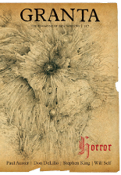
Later, in 1893, he won a scholarship to Westminster School
where he studied for seven years before taking admission
at the Trinity College, Cambridge.
While at Cambridge, he studied mathematics and also edited and wrote for the student magazine Granta.
He collaborated with his brother Kenneth and their articles appeared over the initials AKM.

Slide 4
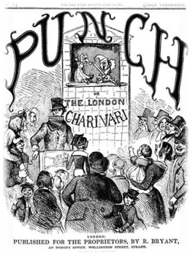
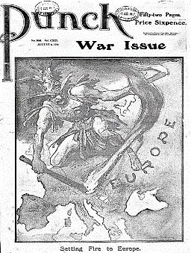
Realizing that writing was his true vocation, he moved to London
after his graduation in 1903.
Milne's work came to the attention of the leading British humour magazine Punch, where Milne was to become a contributor and later an assistant editor.
He began writing for the literary magazine Punch in 1906,
and his essays and humorous poetry were published in the magazine
through 1914.

Slide 5
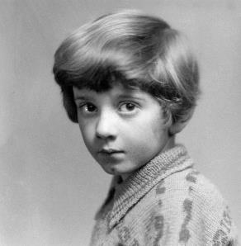
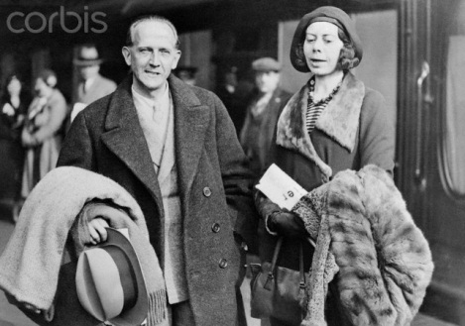
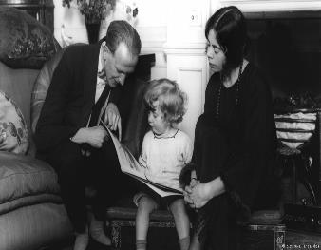
Milne married Dorothy "Daphne" de Sélincourt in 1913. The couple had a son, Christopher Robin, born in 1920.

Slide 6
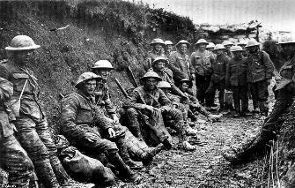
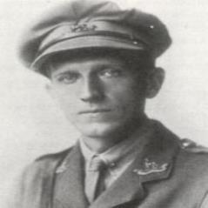
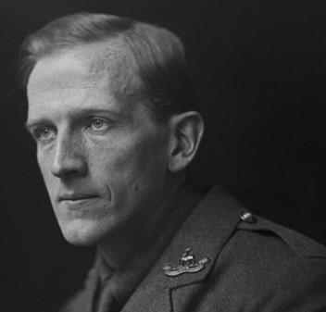
Despite being a pacifist, in 1915, Milne served in World War I, enlisting in the Royal Warwickshire Regiment, and then working in the Royal Corps of Signals. Milne was discharged in 1919 and settled in London with his wife and son.

Slide 7
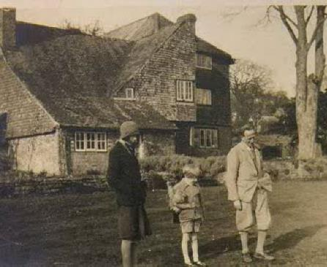
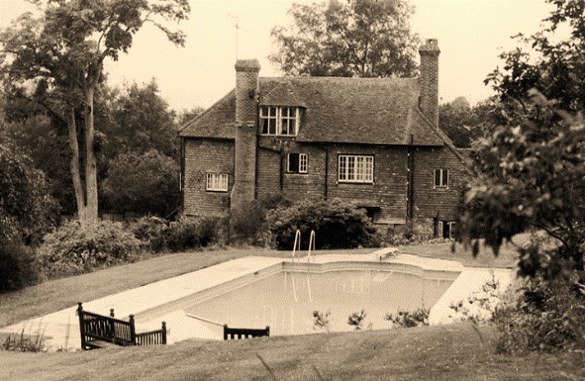
In 1925, A. A. Milne bought a country home, Cotchford Farm, in Hartfield, East Sussex.

Slide 8
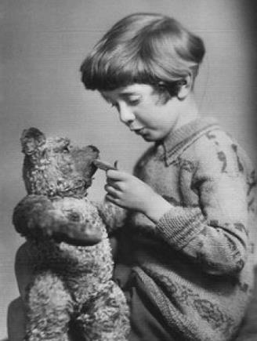
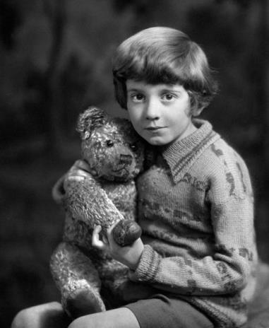
The Milnes bought him a teddy bear for his first birthday.

Slide 9
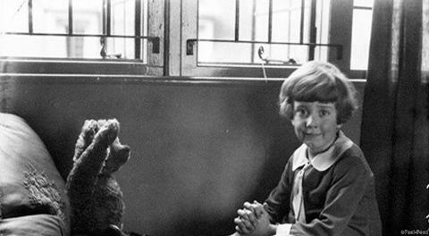
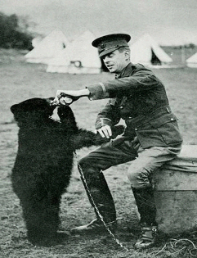
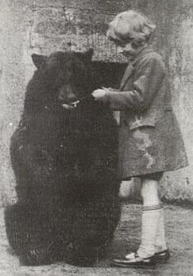
They called him Winnie. Christopher Robin Milne's stuffed bear, originally named "Edward", was renamed "Winnie-the-Pooh" after a Canadian black bear named Winnie (after Winnipeg), which was used as a military mascot in World War I, and left for London Zoo during the war. "The pooh" comes from a swan called "Pooh".

Slide 10
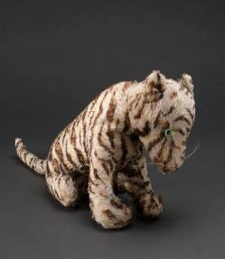
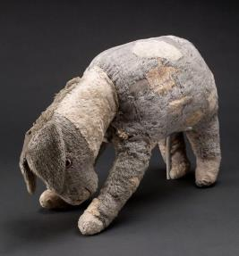
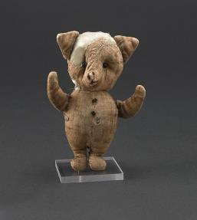
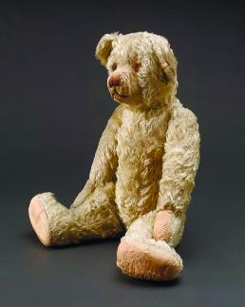
The rest of Christopher Robin Milne's toys, Piglet, Eeyore, Kanga, Roo and Tigger, were incorporated into A. A. Milne's stories, and two more characters – Rabbit and Owl -were created by Milne's imagination.

Slide 11
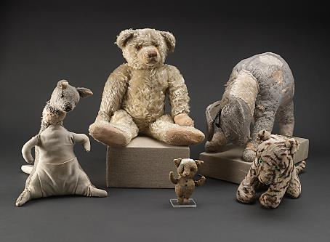
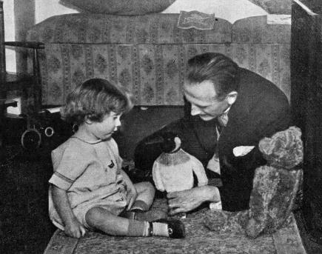
Christopher Robin Milne's own toys are now under glass in New York where 750,000 people visit them every year.

Slide 12
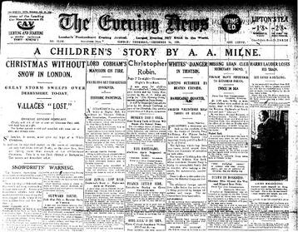
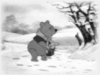
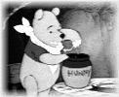
Winnie-the-Pooh first appeared by name on 24 December 1925, in a Christmas story commissioned and published by the London newspaper The Evening News.

Slide 13
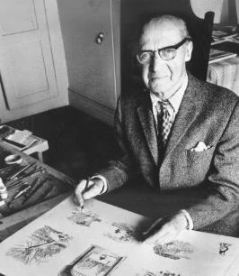
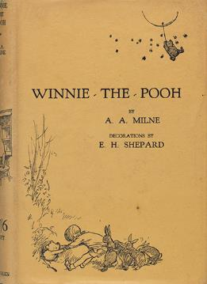
E. H. Shepard was named when A. A. Milne asked to recommend
someone to illustrate his book.
To do the illustrations for ‘Winnie-the-Pooh’, Shepard observed the real
Christopher Robin Milne, but not the real Pooh.
The bear in the pictures is in fact based on Growler, a toy belonging to Shepard’s own son.

Slide 14
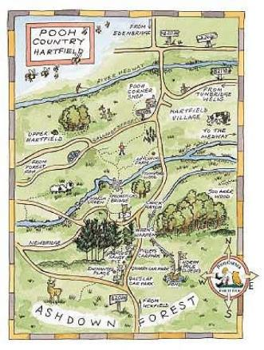
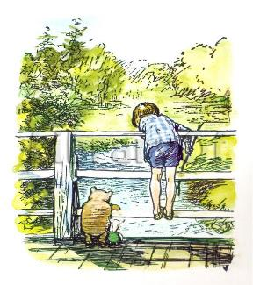
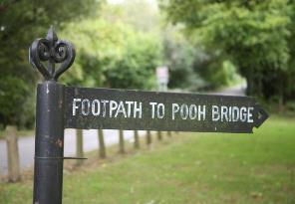
E. H. Shepard drew on the landscapes of Ashdown Forest as inspiration
for many of the illustrations he provided for the Pooh books.
The wooden Pooh Bridge in Ashdown Forest, where Pooh and Piglet invented Poohsticks, is a tourist attraction.

Slide 15
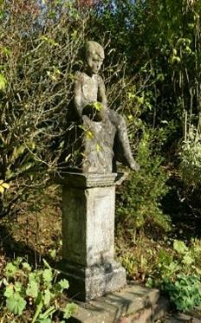
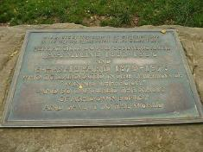
A memorial plaque in Ashdown Forest, unveiled by Christopher Robin in 1979, commemorates the work of A. A. Milne and Shepard in creating the world of Pooh.
Milne once wrote of Ashdown Forest:
"In that enchanted place on the top of
the forest a little boy and his bear
will always be playing".
Milne suffered from illness in the early 1950s and died at his home in Hartfield, East Sussex, England, on January 31, 1956.

Slide 16
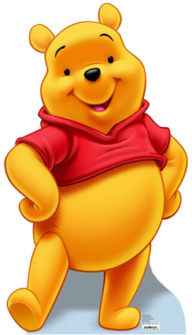
Disney’s «Winnie-the-Pooh»
The rights to the Pooh books were left to four beneficiaries: his family, the Royal Literary Fund, Westminster School and the Garrick Club. After Milne's death in 1956, his widow sold her rights to the Pooh characters to the Walt Disney Company, which has made many Pooh cartoon movies, a Disney Channel television show, as well as Pooh-related merchandise. In 2001, the other beneficiaries sold their interest in the estate to the Disney Corporation for $350m. The copyright on Pooh expires in 2026.

Slide 17
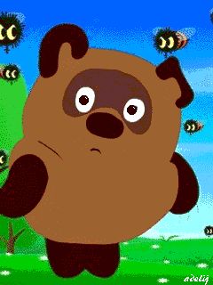
Russian
«Winnie-the-Pooh»
In the Soviet Union, three Winnie-the-Pooh, stories were made into a celebrated trilogy of short films by Soyuzmultfilm (directed by Fyodor Khitruk) from 1969 to 1972.
Films use Boris Zakhoder's translation of the book. Pooh was voiced by Yevgeny Leonov. He looked distinctly different from both the yellow-and-red Disney incarnation and Shepard's illustrations - he was brown instead of yellow, as he is known in the US.

Slide 18
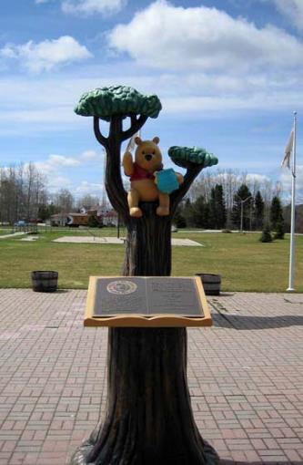
The popularity of this book was
so great that at London zoo was
a monument to their hero toy
the little bear Winnie the Pooh.
In 1997 by UNESCO
the literary hero Winnie the Pooh was granted the honorary title of «Ambassador of friendship».

Slide 19
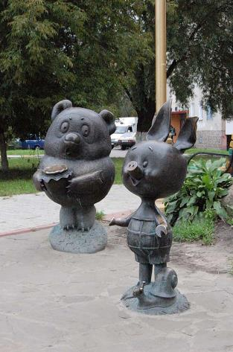
In Russia there's a monument to Winnie the Pooh too. It can be seen in Ramenskoye Moscow region.
Quiz

Slide 20
Used sources:
www.peoples.ru/art/cinema/actor/miln
www.Miln.com
www.A.Miln.com
www.old-pictures.ru
www.photochronograph.ru
http://vestnikk.ru/index.php?newsid=22915
http://www.izbrannoe.com/news/lyudi/vinni-pukh-pokhititel-detstva/
https://www.egmont.co.uk/blog/advice-for-life-from-the-worlds-most-lovable-bear/
https://en.wikipedia.org/wiki/A._A._Milne
https://www.biography.com/people/aa-milne-9409137
https://www.poemhunter.com/alan-alexander-milne/biography/
https://shaundhani.wordpress.com/2016/01/18/the-real-forest-that-inspired-winnie-the-poohs-hundred-acre-wood/
http://www.just-pooh.com/ashdown.html

