Slide 1

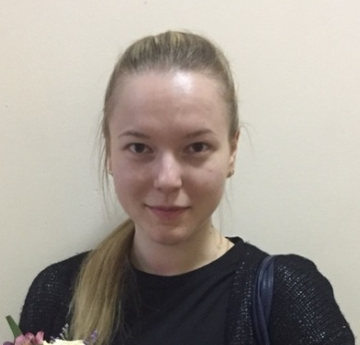

ГБОУ СОШ № 213 с углубленным изучением английского языка
Английский язык
8 класс
Тема урока: Sports Equipment and Places
Учитель: Мурлина Татьяна Дмитриевна
2021

Slide 2
Plan
ГБОУ СОШ № 213 с углубленным изучением английского языка
Revision of different types of sports
Learning words on topic “Sports equipment”
Revision of Conditional II
Doing exercises
Making your own sentences about sports

Slide 3
ГБОУ СОШ № 213 с углубленным изучением английского языка
Is sport important in your life? Why?
What kind of sport do you like?
You know, there are Winter and Summer Olympic Games. What winter/summer sports do you know?

Slide 4
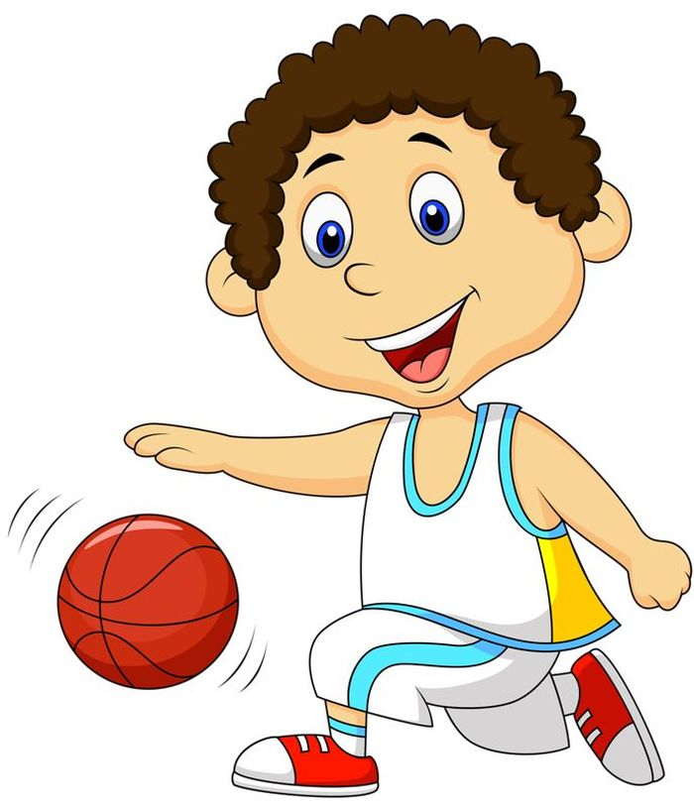
ГБОУ СОШ № 213 с углубленным изучением английского языка
Exercise 1. Listen to the poem and write the missing words
Let's turn off our video games, and run outside. From so many sports, we may choose and decide. Baseball, ____________, and ____________ are fun, Let's grab some friends, and play in the sun. In baseball, you will be, running around. When you hit the __________, it's a beautiful sound.
In football, you pass the ball, wearing ___________, Wear a ____________, and run to the ___________. In basketball, alas, you don’t
have a _____________, Unlike in ____________ and
big _____________ set. Whatever sports, you decide to play, Enjoy them with friends, each and every day.
boots
jersey
goals
football
basketball
net
volleyball
tennis
ball

Slide 5
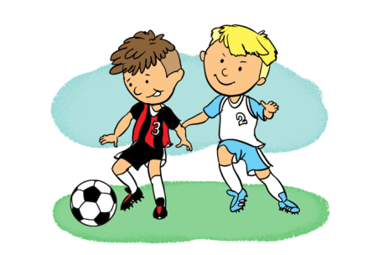
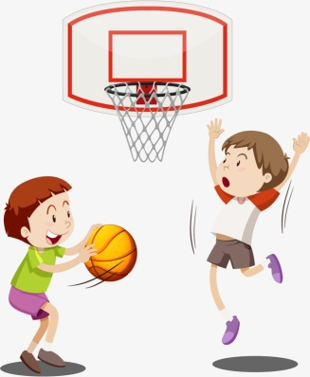
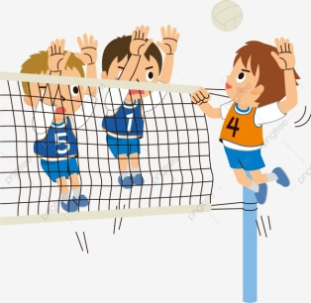
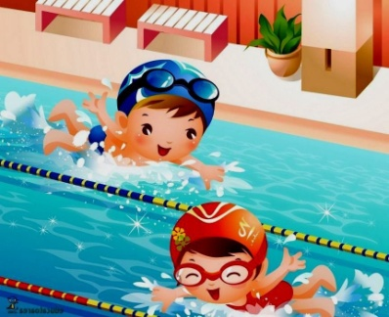
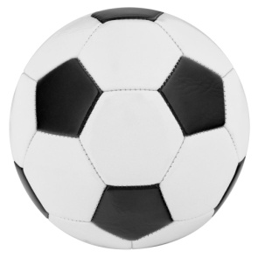
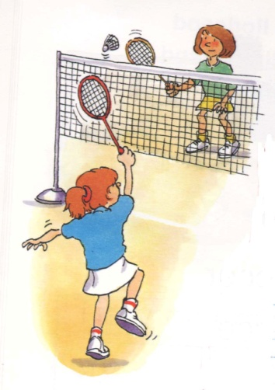
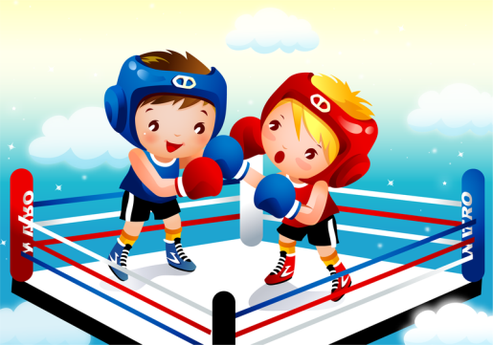
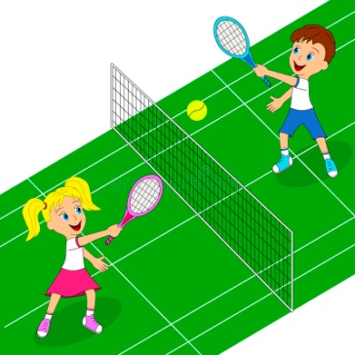
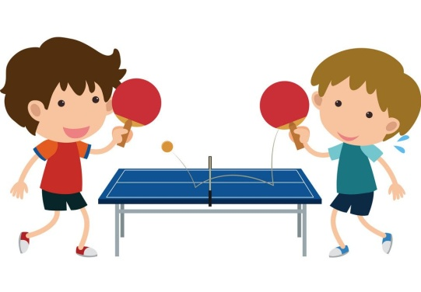
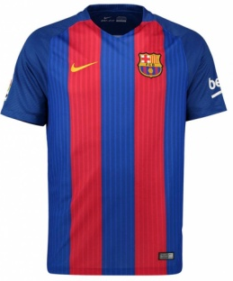
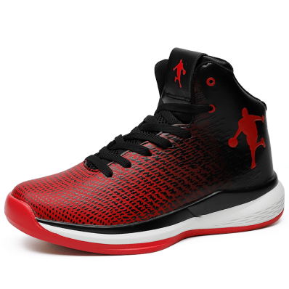
ГБОУ СОШ № 213 с углубленным изучением английского языка
Exercise 2. Circle the words that you have heard in the poem

Slide 6
Do we need any equipment for different types of sports?
ГБОУ СОШ № 213 с углубленным изучением английского языка

Slide 7
ГБОУ СОШ № 213 с углубленным изучением английского языка

Slide 8
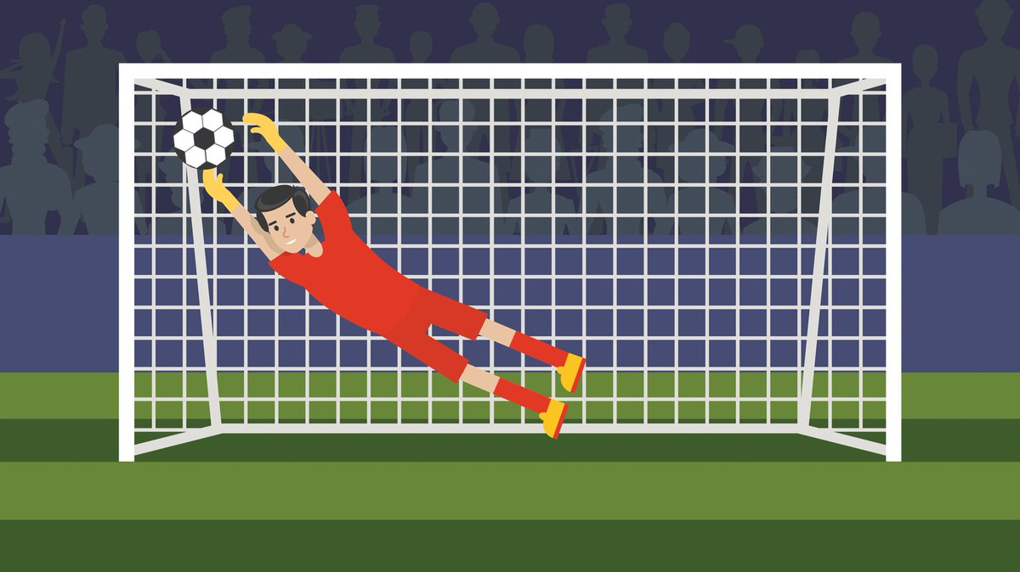
Football
ГБОУ СОШ № 213 с углубленным изучением английского языка
Football pitch
gates/
goals
ball
gloves
jersey
boots

Slide 9
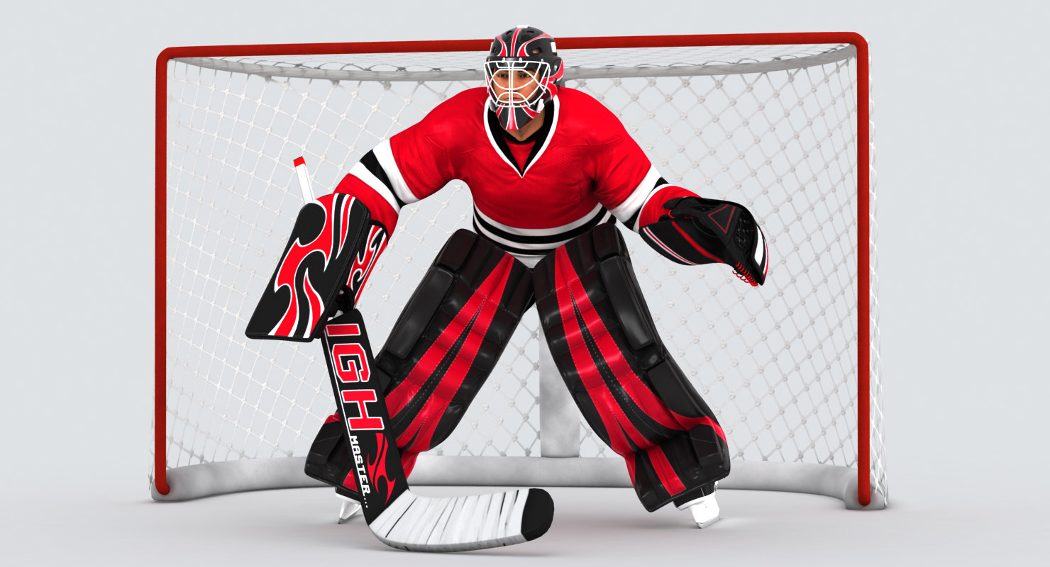
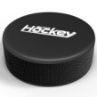
Hockey
ГБОУ СОШ № 213 с углубленным изучением английского языка
helmet
Rink
gates
hockey gloves
skates
shin pads
hockey stick
puck

Slide 10
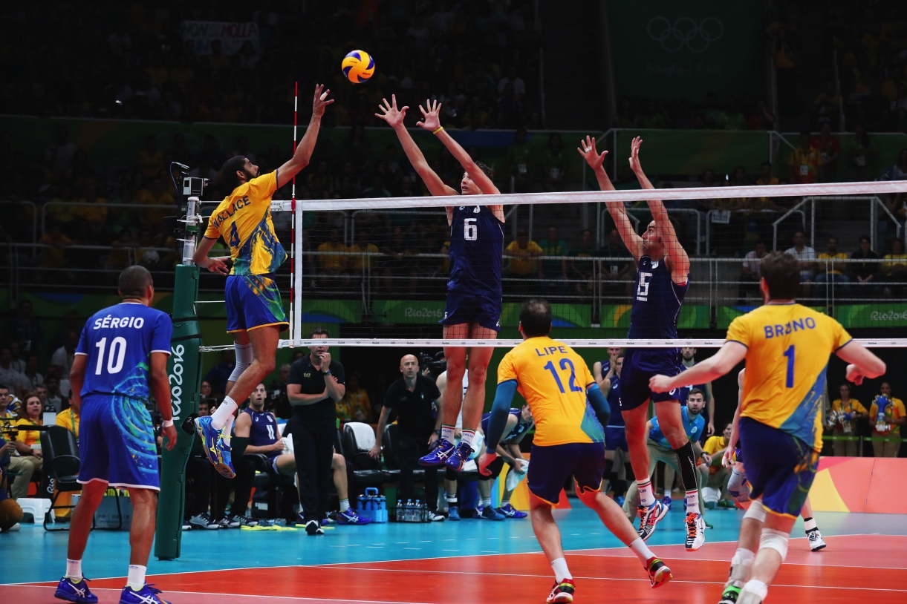
Volleyball
ГБОУ СОШ № 213 с углубленным изучением английского языка
Gym, hall
ball
net
trainers
kneepads

Slide 11
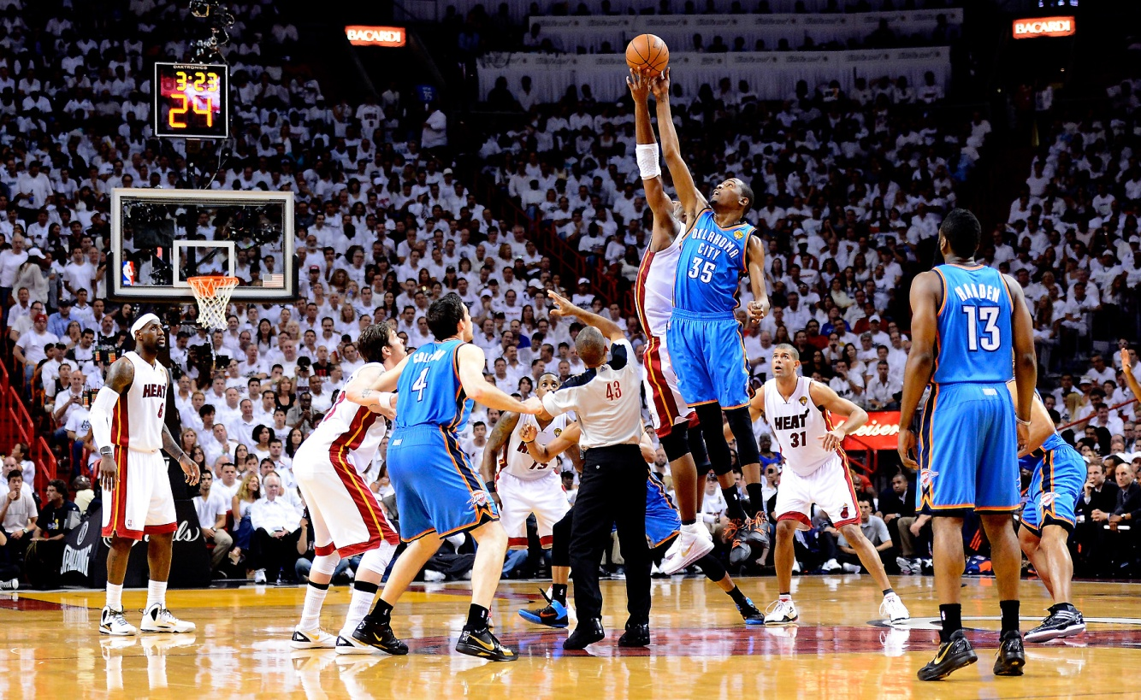
Basketball
ГБОУ СОШ № 213 с углубленным изучением английского языка
Gym, hall
ball
basket
kneepads
trainers

Slide 12
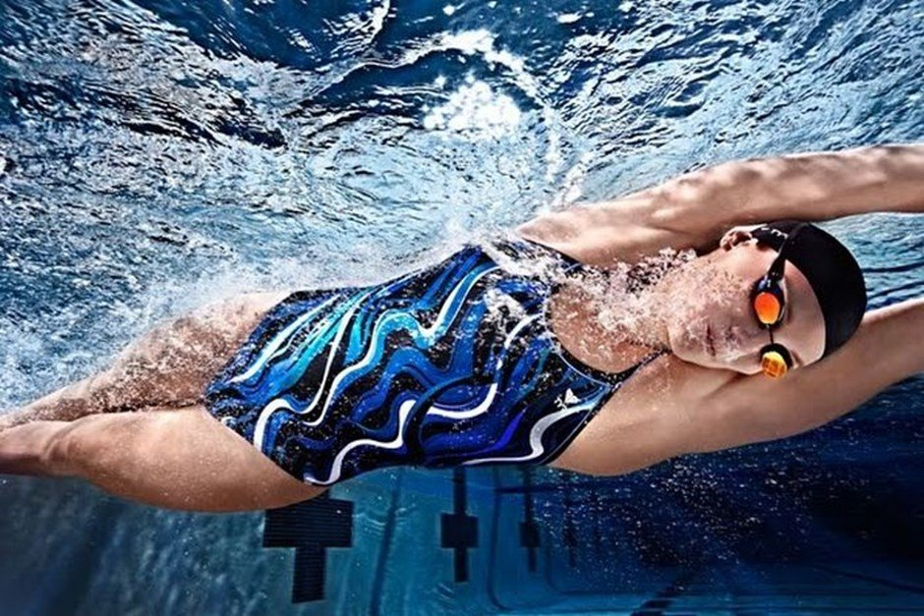
Swimming
ГБОУ СОШ № 213 с углубленным изучением английского языка
Swimming pool
swimming cap
goggles
swimsuit

Slide 13
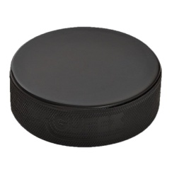
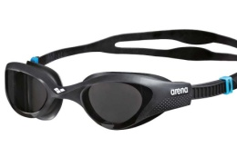
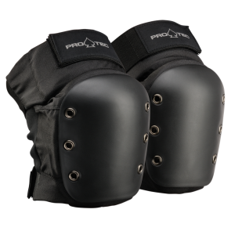
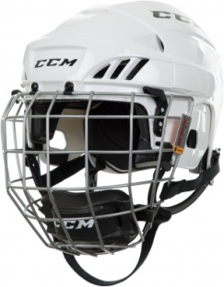
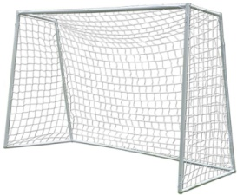
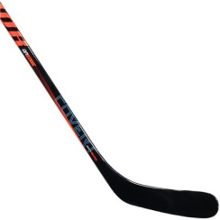
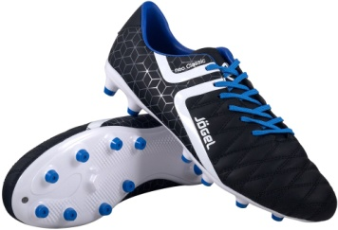
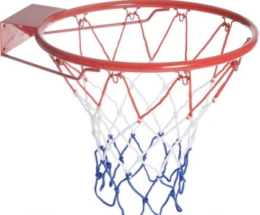
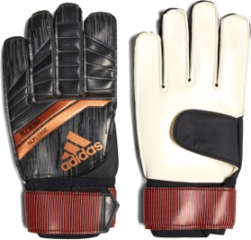
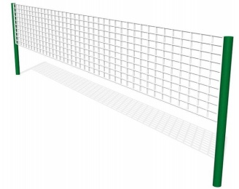
Exercise 3. Match the names with the pictures
ГБОУ СОШ № 213 с углубленным изучением английского языка
ball puck stick helmet swimsuit basket net boots kneepads gates goggles trainers gloves jersey
helmet
stick
gates
goggles
puck
kneepads
ball
boots
basket
jersey
gloves
net
trainers

Slide 14
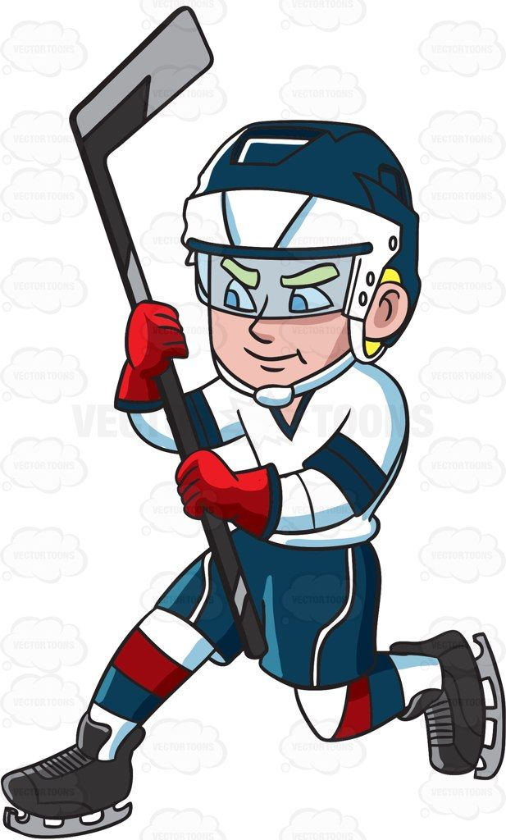
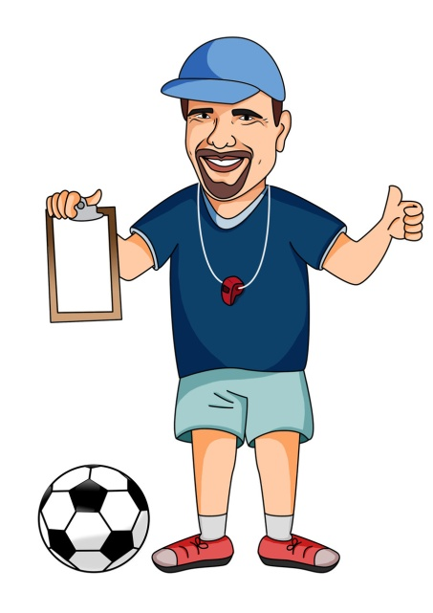
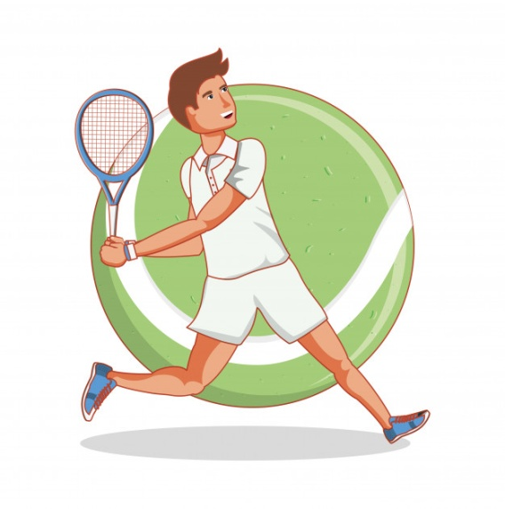
ГБОУ СОШ № 213 с углубленным изучением английского языка
If I had a better stick, I would score a goal.
If a had new boots, I would run quicker.
If I had a new racket, I could win the first prize.

Slide 15
Conditional II
ГБОУ СОШ № 213 с углубленным изучением английского языка
Unreal events in the future or in the present
If – clause, | Result
If + past simple | Would/could + infinitive
If I had a new hockey stick, I could score a goal.
Если бы у меня была новая клюшка, я мог бы забить гол.

Slide 16
Exercise 4. Correct the mistakes
ГБОУ СОШ № 213 с углубленным изучением английского языка
hockey
If you had a puck, you could play football.
If you were in the hall, you could play hockey.
If you had a basket, you could play volleyball.
If you were in the swimming pool, you could play basketball.
If you had trainers, you could play football.
basketball or volleyball
basketball
do swimming
basketball or volleyball

Slide 17
Exercise 5. Make up sentences
ГБОУ СОШ № 213 с углубленным изучением английского языка
Example: If you had a basket and a ball you could play basketball in the hall.
If you had | a basket and a ball | you could | play football | in the swimming pool
 | a net and a ball |  | play hockey | in the hall
 | a swimsuit and goggles |  | play volleyball | on the rink
 | a stick, gates and a helmet |  | play basketball | at the pitch
 | a ball, boots and goals |  | do swimming | in the gym

Slide 18
Answers
ГБОУ СОШ № 213 с углубленным изучением английского языка
If you had a net and a ball, you could play volleyball.
If you had a swimsuit and goggles, you could do swimming.
If you had a stick, gates and a helmet, you could play hockey.
If you had a ball, boots and goals, you could play football.

Slide 19
Thanks for your attention! See you on Thursday! Good Luck!
ГБОУ СОШ № 213 с углубленным изучением английского языка

