Slide 1


Slide 2
Christmas Symbols

Slide 3

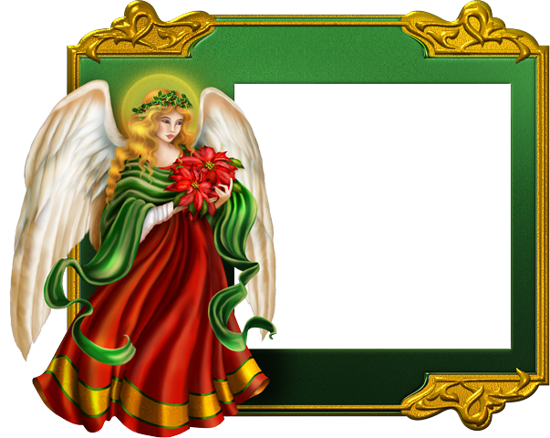
Angel

Slide 4
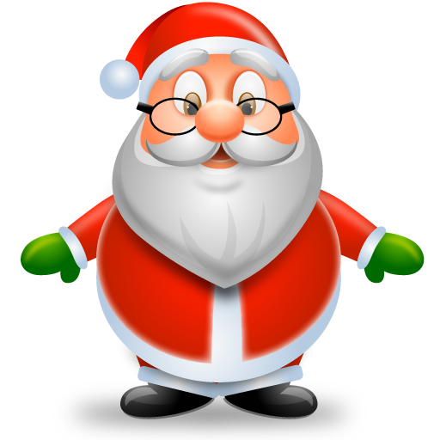
Santa Claus

Slide 5
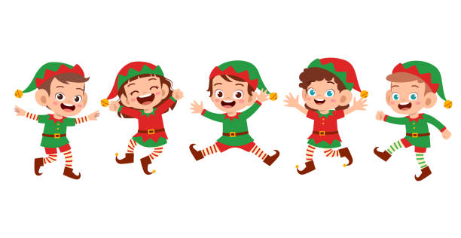
an elf - elves

Slide 6
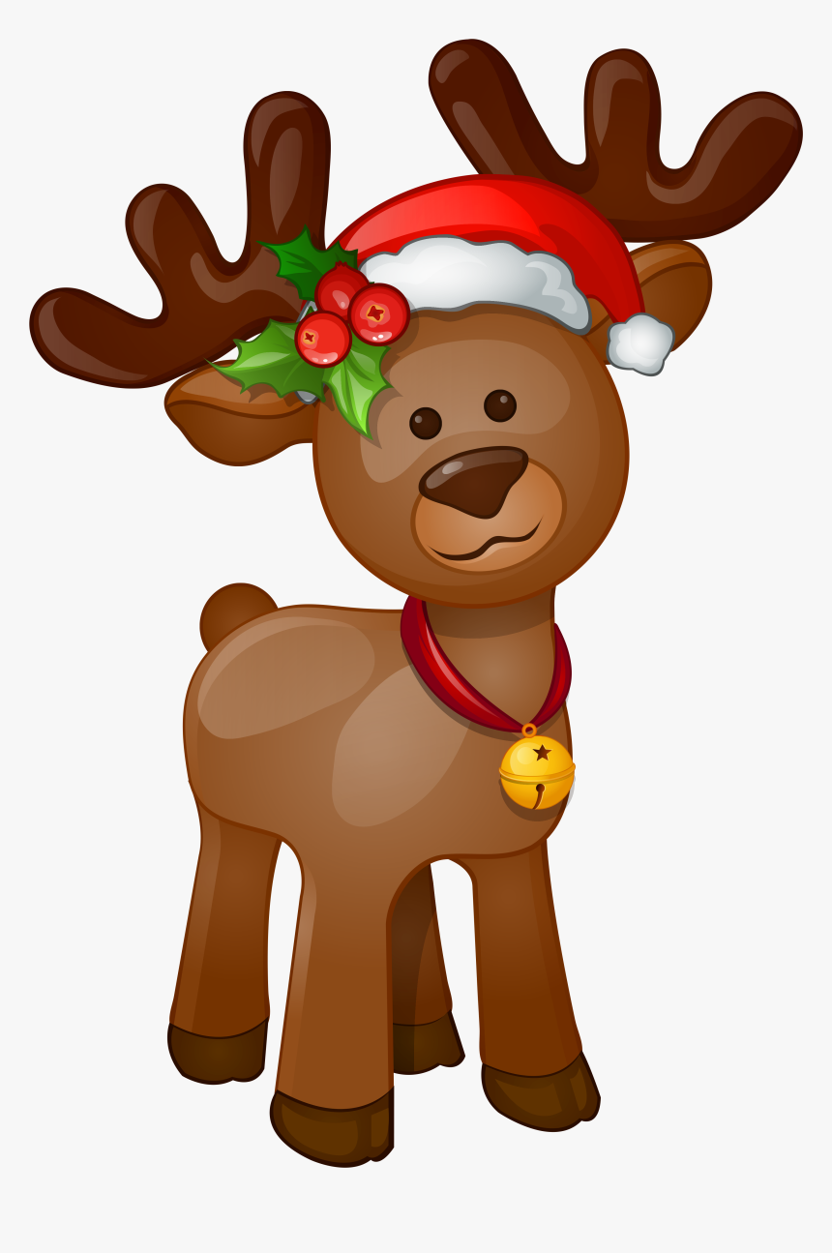
Reindeer

Slide 7
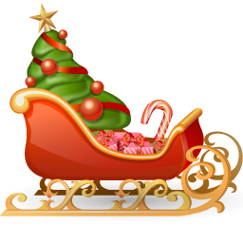
Sleigh

Slide 8
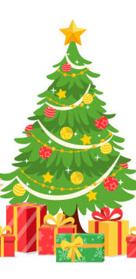
Christmas Tree

Slide 9
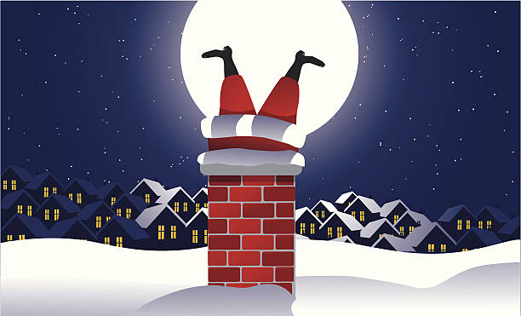
Chimney

Slide 10
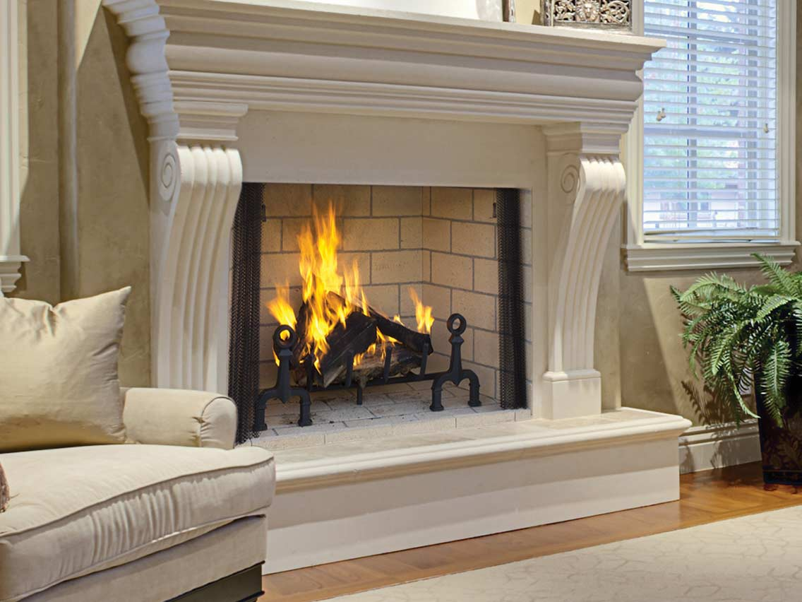
Fireplace

Slide 11
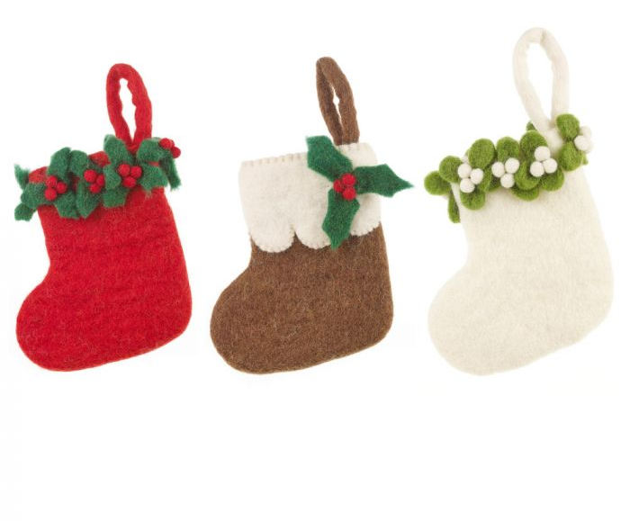
Stockings

Slide 12

Wreath

Slide 13
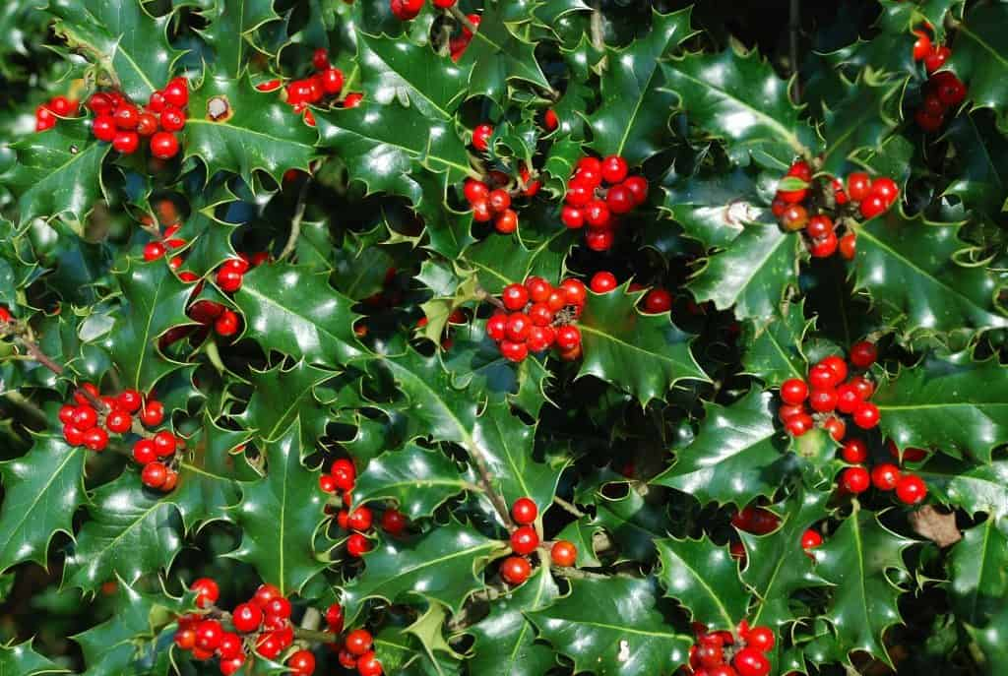
Holly

Slide 14
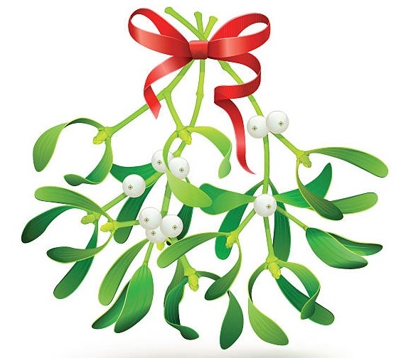
Mistletoe

Slide 15
Christmas Traditions

Slide 16
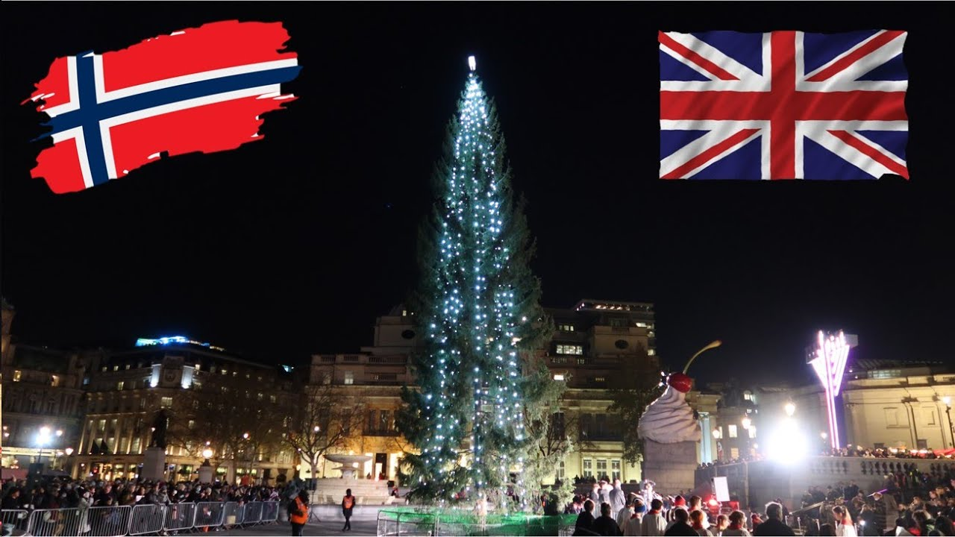
Every year the people of Norway give the city of London a present… What is it?
A big Christmas tree

Slide 17
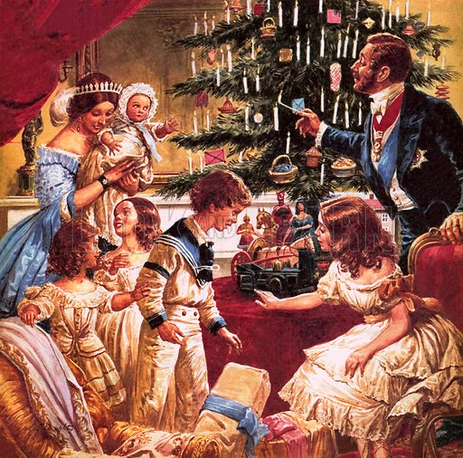
Who brought the tradition of decorating Christmas tree to Britain?
Prince Albert, Queen Victoria’s husband

Slide 18
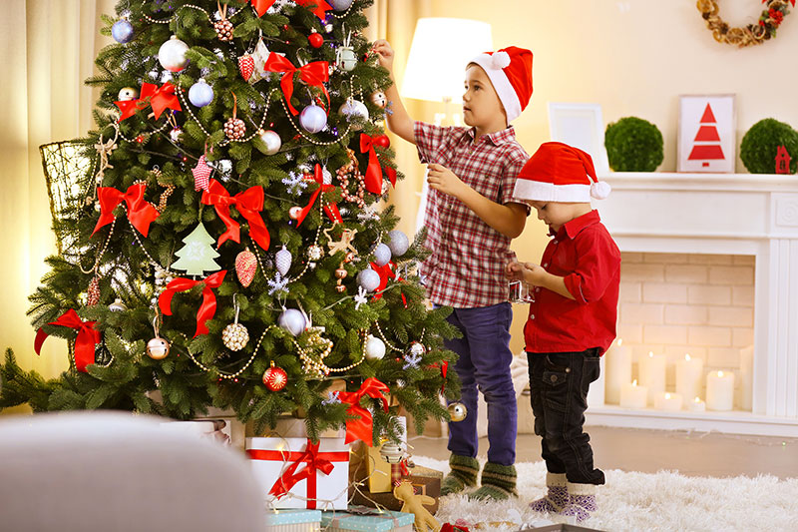
When do people traditionally decorate Christmas tree and when do they take the decorations down?
On December, 24th (Christmas Eve)
and on January, 5th (Twelfth Night)

Slide 19
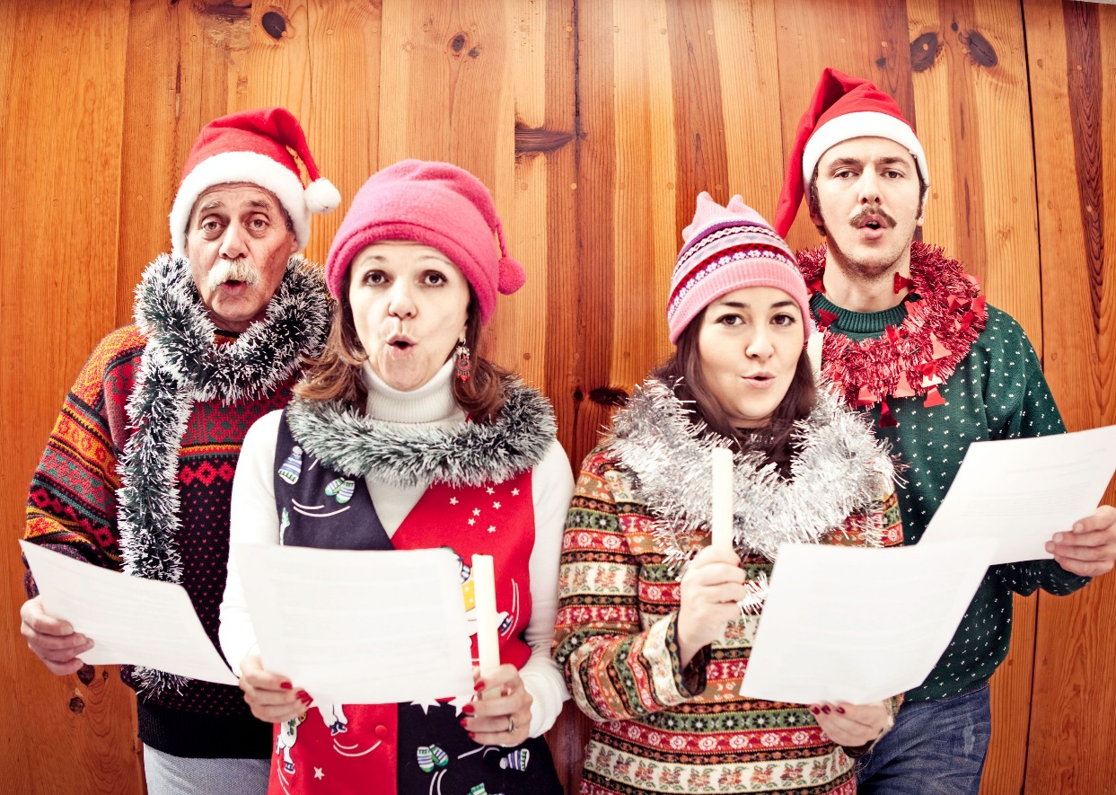
What do groups of people sing on Christmas Eve going from house to house?
Christmas carols

Slide 20
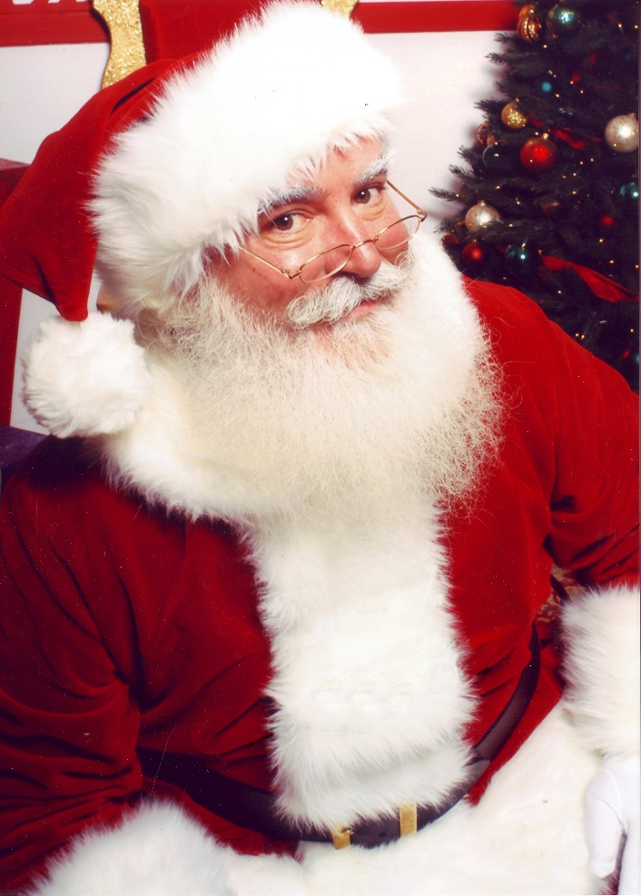
What are the 2 names of a magician who brings presents at Christmas?
Santa Claus and Father Christmas

Slide 21
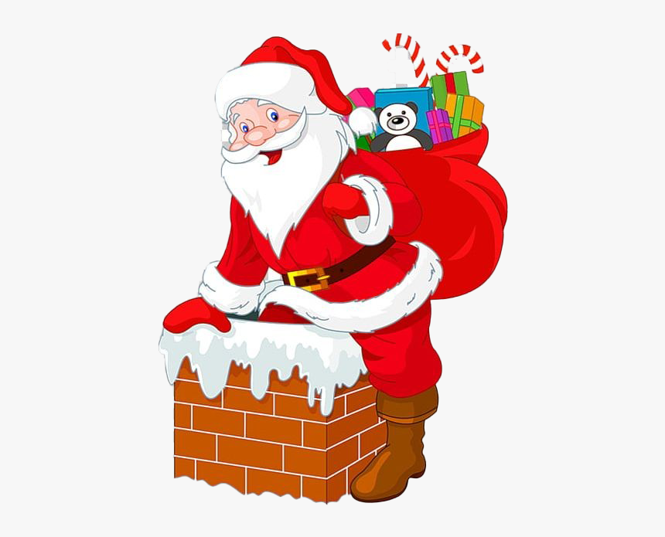
How does Santa get to the house to put his presents under the Christmas tree?
Through the chimney

Slide 22
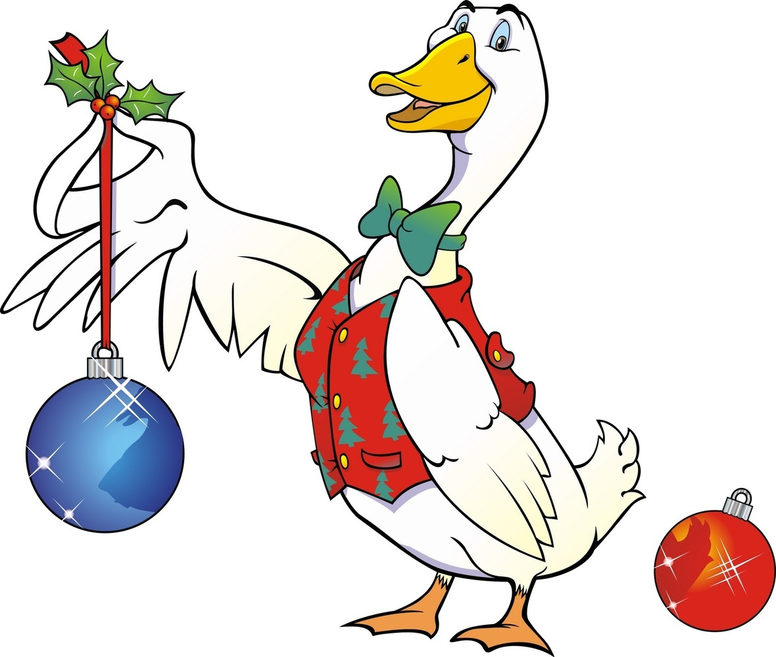
What was the traditional dish for Christmas dinner before the 19th century?
Christmas goose

Slide 23
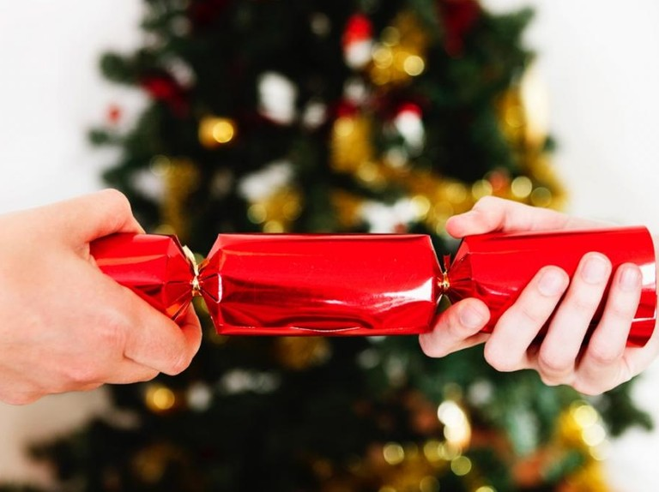
What can you find inside a cracker?
A toy or a joke on a piece of paper

Slide 24
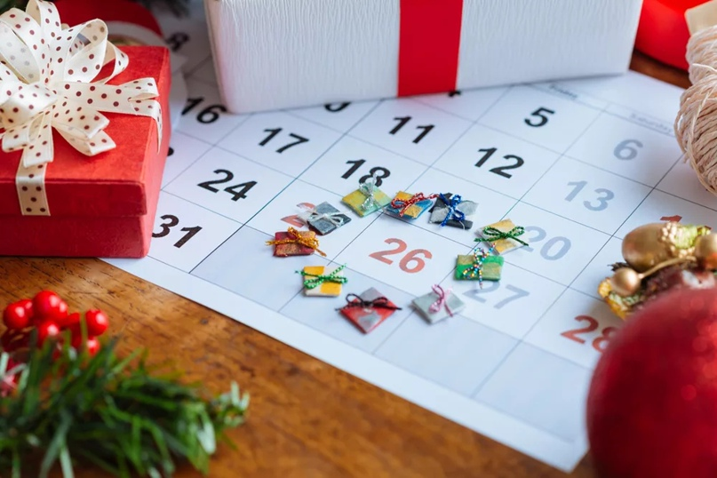
What extra holiday do British people have on December 26th ?
Boxing Day

Slide 25
