Slide 1
Emails reviewing books
Module 5e
Автор: Сафронова Наталья Ивановна,
учитель английского языка
МОУ «Гимназия г. Невеля Псковской области

Slide 2

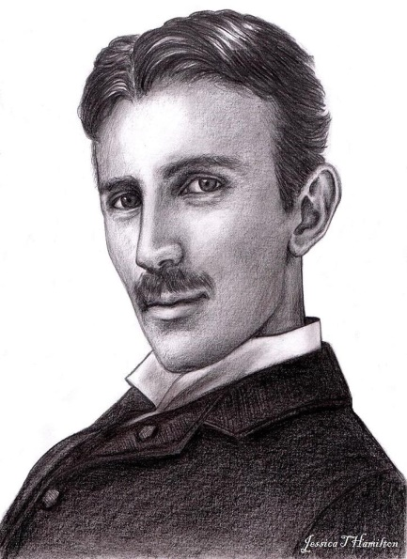
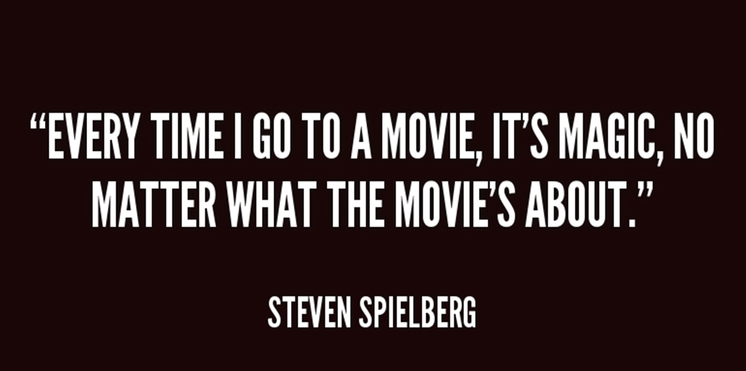
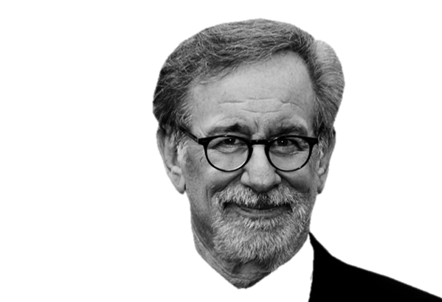
Nikola Tesla

Slide 3

I prefer reading books to watching films because …

Slide 4
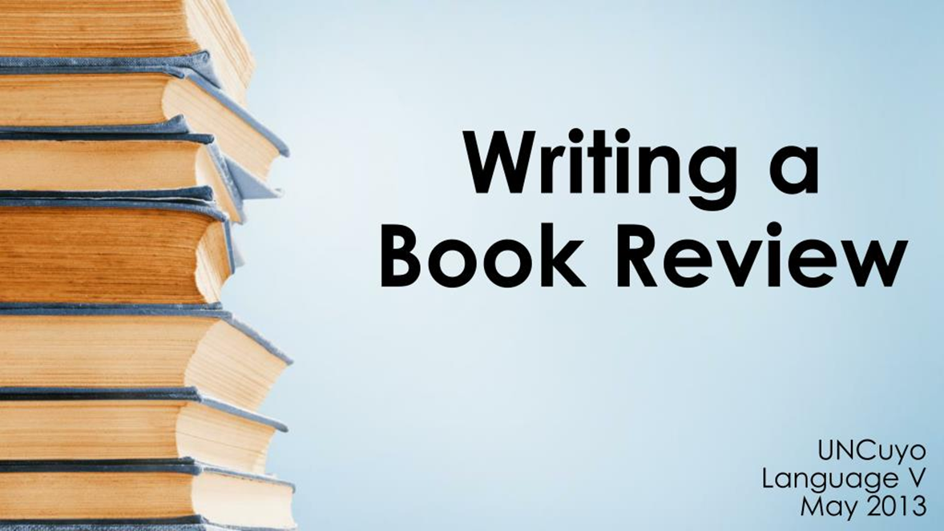
It’s a short description of a book.
What is a book review?

Slide 5

Where can we find book reviews?
websites
emails
magazines
newspapers

Slide 6

What should we write about?

Slide 7
Dear Ann,
introduction
Why are you writing this email?
Author? Type? Title? Where is it set?
main body
Main characters?
Main points of the plot?
Positive comments?
conclusion
Your opinion? Recommendation?
Closing remarks
Love,
Helen

Slide 8

Put the parts of the letter into the right order. What helped you?

Slide 9

What’s the email about?
title?
sort of story?
main characters?
about?
in the end?
like?
recommend?

Slide 10

Work out the recommendations
Which tenses should be used?
What makes it interesting to read?
Should the email be long?
What style should you use?

Slide 11
Our recommendations
Present Tenses;
a lot of adjectives;
in brief;
informal style!

Slide 12
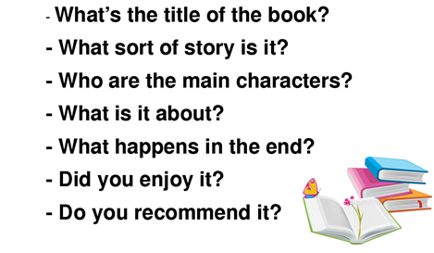
Talk to your partner about your favourite book. Then change your partner.

Slide 13

What do you think?
Are you ready to write an email?
Can you give your friend some recommendations how to write a good email?

Slide 14

Homework
Ex 7 p 83 (email 100-140 words)

