Slide 1
Present Perfect tense
Буранян Кристине Гамлетовна (УЧИТЕЛЬ АНГЛИЙСКОГО ЯЗЫКА)
МБОУ «Гимназия №1 им. А. Н. Барсукова»

Slide 2
Речевая разминка
I have tried climbing,
Time after time,
And I have learnt a little.
And this sport`s really mine!
I have tried hiking,
Time after time,
But now I am busy
And have to say goodbye!

Slide 3
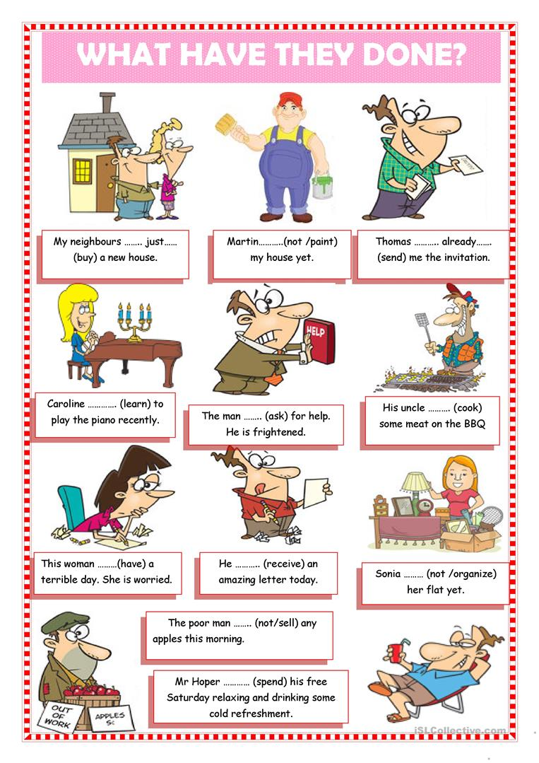
Цель- поставить познавательные задачи.

Slide 4
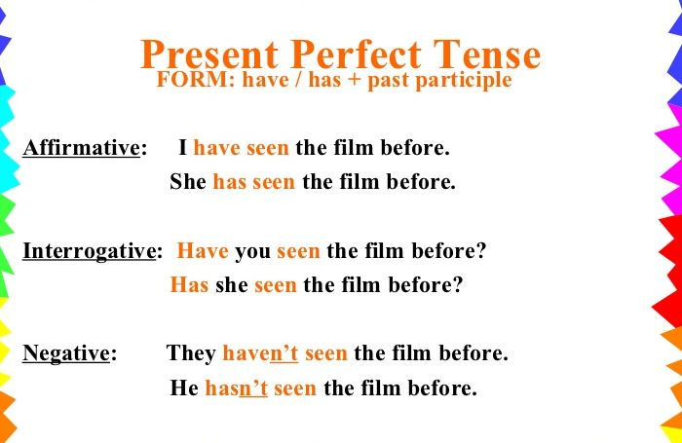
Present perfect
Повторение
Задание: составить предложения по образцу.
I have lost my key.
I haven’t lost my key.
I have drunk my cup of coffee.
I haven’t drunk my cup of coffee.

Slide 5
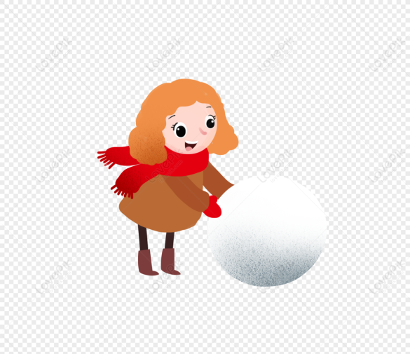
Игра: Снежный ком
T.: I have already begun reading this book.
P₁: You have already begun reading this book. I have written my homework.
P₂: She has already begun reading this book. You have written your homework. I have drawn a picture.

Slide 6
Отработка вопросительной и отрицательной формы.
T: Have you taken your dog for a walk yet? /today?
P1: Yes, I have.
T: Ira has taken her dog for a walk. (Ask me)
P1: Have you had dinner today?
T: No, I haven`t.
P1: K.G. hasn`t had dinner today. Etc.

Slide 7
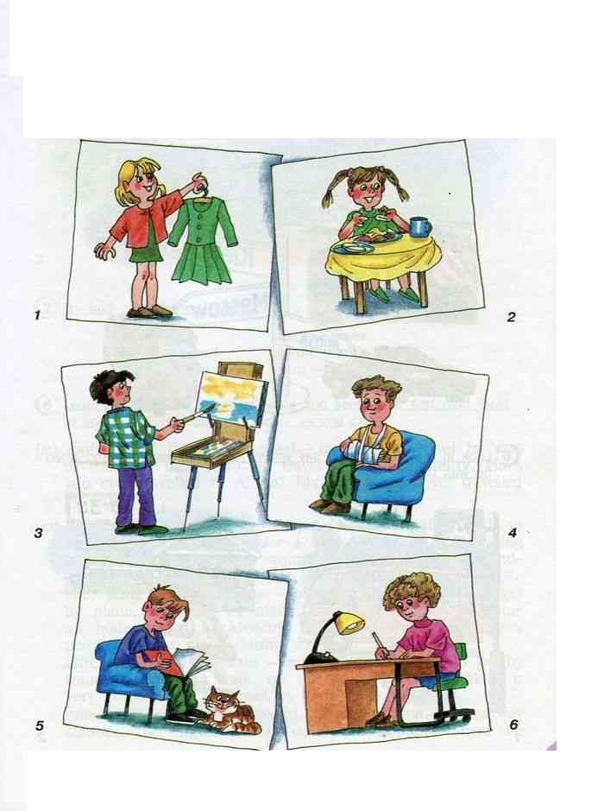
Отработка полученных знаний на практике.
Look at the pictures. Make up sentences.
She has written a letter.
He has drawn a picture.
He has read a book.
She has eaten her breakfast.
She has bought a new dress.
He has broken his arm.

Slide 8
match the sentences
(actions with a result)
1. I have just had lunch.
2. She has already left the house.
3. Somebody has broken the window in our classroom.
4. I have known her since our childhood.
5. We have left all the money at home.
6. David has been to the USA more than once.
7. Grandmother has written a letter.
8. The boy has fallen ill.
A) She must be on her way to college.
B) He knows this country very well.
C) It’s too cold here.
D) I am not hungry.
E) She is my best friend.
F) We can’t buy anything.
G) His mother is very upset.

Slide 9

Homework
Make up 10 sentences in Present Perfect Tense.

Slide 10
Thank you for attention

