Slide 1
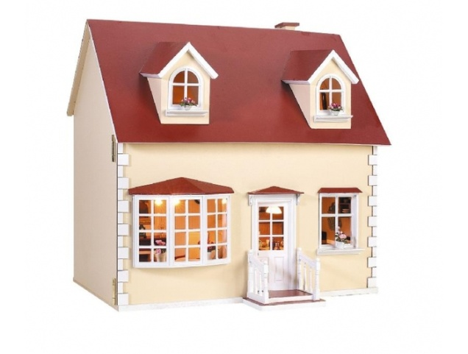

Houses of grammar
Пособие по английской грамматике для начальной школы как способ формирования языковой компетенции младших школьников Выполнила: Лемайкина Татьяна Юрьевна, учитель английкого языка МАОУ «Гимнаэия №1» г.Сосновоборска
2022-2022 уч.год

Slide 2

Present Simple

Slide 3
Present Simple (affirmative)
After school I am in the park. Usually I play with my friend there. Sometimes Lisa draws funny pictures and we see a lot of animals.
am, is, are …
I, you, we, they
He, she, it (e)s
Are you ready to test yourself?

Slide 4
Present Simple (negative)
am/is/are not …
I, you, we, they don’t …
He, she, it doesn’t …
Are you ready to test yourself?
In the morning I am not in the park. I don’t play with my friend. Lisa doesn’t draw funny pictures. We don’t see a lot of animals. We are in the school.

Slide 5
Present Simple (questions)
Am, are, is …?
Do/Does …?
Are you ready to test yourself?
Are you in the park?
Do you play with your friend there?
Does you friend draw funny pictures?

Slide 6
Past Simple

Slide 7
Past Simple (affirmative)
Правильные глаголы:
+ed
played
Неправильные глаголы:
be-was/were
draw-drew
see-saw
Are you ready to test yourself?
Yesterday I was in the park.
I played with my friend. We drew funny pictures and saw a lot of animals.

Slide 8
Past Simple (negative)
was/were not … .
Правильные глаголы:
did not - ed … .
Неправильные глаголы:
did not … .
Are you ready to test yourself?
I wasn’t in the park yesterday. I did not play with my friend. We didn’t draw funny pictures and didn’t see a lot of animals.

Slide 9
Past Simple (questions)
Was/Were in …?
Did …?
Are you ready to test yourself?
1
Were you in the park yesterday? Did you play with you friend? Did you draw funny pictures? Did you see a lot of animals?

Slide 10
Future Simple

Slide 11
Future Simple (affirmative)
will ….
Are you ready to test yourself?
Tomorrow I will be in the park. I will play with my friend. Lisa will draw funny pictures. We will see a lot of animals.

Slide 12
Future Simple (negative)
will not ….
Are you ready to test yourself?
Tomorrow I will not in the park. I won’t play with my friend. Lisa won’t draw funny pictures. We won’t see a lot of animals.

Slide 13
Future Simple (questions)
Will …?
Are you ready to test yourself?
Will you be in the park tomorrow?
Will you play with your friend?
Will Lisa draw funny pictures? Will they see a lot of animals?

Slide 14
Good luck!

