Slide 1
What | 100 | 200 | 300 | 400 | 500
Who | 100 | 200 | 300 | 400 | 500
Where | 100 | 200 | 300 | 400 | 500
How many\much | 100 | 200 | 300 | 400 | 500
Pictures | 100 | 200 | 300 | 400 | 500
Author | 100 | 200 | 300 | 400 | 500
Black Box | 100 | 200 | 300 | 400 | 500
Chronological order | 100 | 200 | 300 | 400 | 500

Slide 2
What job did Jarndyce offer Esther?

Slide 3
The job of housekeeper

Slide 4
What two things does the Doctor always take with him?

Slide 5
Sonic screwdriver, psychic paper

Slide 6
What does the Nurse give Romeo?

Slide 7
The Juliet’s ring

Slide 8
What is Mr. McCourt’s greatest success, biggest mistake, saddest experience, worst failure?

Slide 9
The lesson on excuse notes, he embarrasses Freddie Bell,
Kevin’s death, teaching students about research

Slide 10
What do both Jane and Tom enjoy doing?

Slide 11
They both like reading fiction

Slide 12
Who is the law student in London?

Slide 13
Tom Lefroy

Slide 14
Who looked for somebody under a sofa?

Slide 15
Clara

Slide 16
Who feels upset by information from the past?

Slide 17
Lady Dedlock

Slide 18
Who gives these things to whom? a news about Juliet b gold c poison d a letter for Romeo e a letter for Lord Montagu

Slide 19
a Balthasar to Romeo b Romeo to the doctor c The doctor to Romeo d Friar Laurence to Friar John e Balthasar to the Prince

Slide 20
Who likes American musicals?

Slide 21
Nancy Chu

Slide 22
Where does Romeo leave for early in the morning?

Slide 23
Romeo leaves for Mantua early in the morning

Slide 24
Where is Judge Langlois sending Tom to?

Slide 25
To Tom’s other relatives in Hampshire

Slide 26
Where did the TARDIS land?

Slide 27
In Bristol

Slide 28
Where did Esther talk to Lady Dedlock?

Slide 29
On a pretty seat under a tree in the gardens of
Mr Boythorn’s house

Slide 30
Where did Mr McCourt go to have doctorate?

Slide 31
To Trinity College in Dublin, Ireland

Slide 32
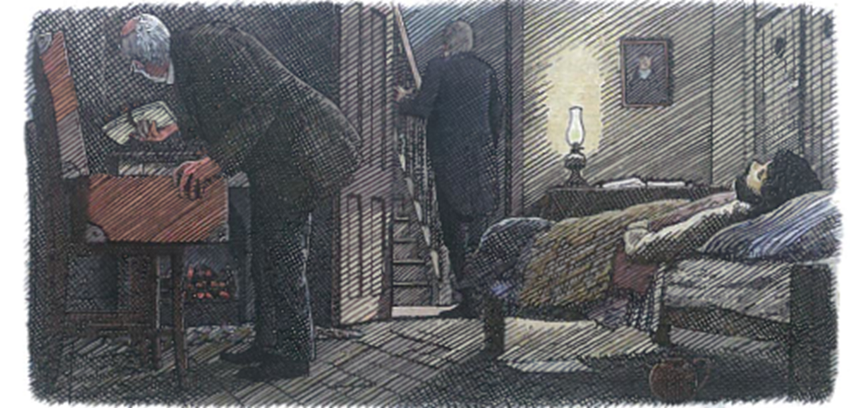

Slide 33
It’s from the book Bleak House. Mr Tulkinghorn comes to Krook and disovers that Nemo has been dead and he goes to the hall, shouts and sends for Miss Flite out for a doctor. Krook examins Nemo’s suitcase and finds letters

Slide 34
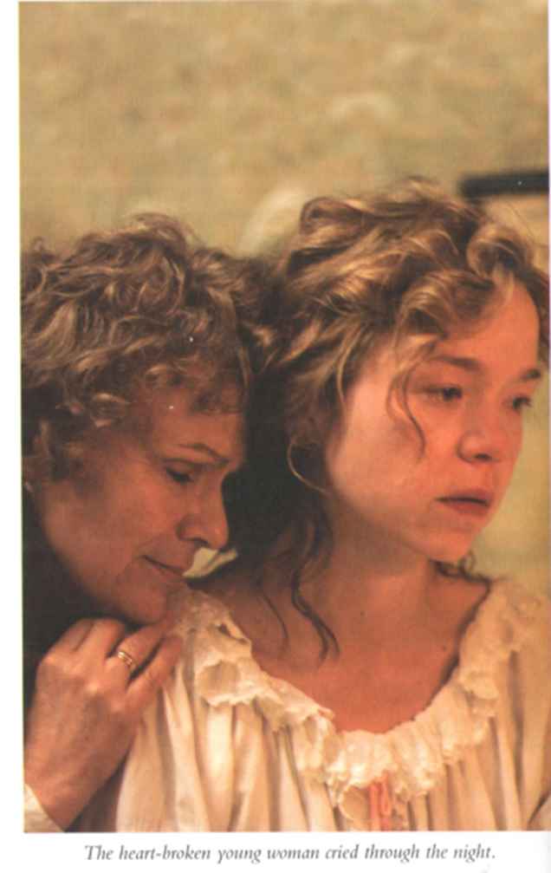

Slide 35
It’s from the book Becoming Jane. Cassandra knows that Robert Fowle is dead. Her mother tries to console her

Slide 36
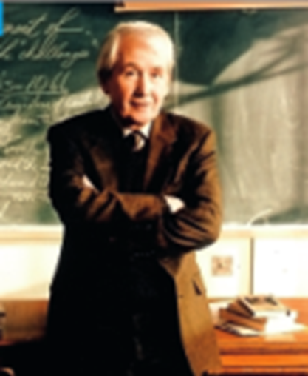

Slide 37
It’s from the book Teacher Man. Mr Frank Mc Court in the classroom, perhaps it is his first day at school

Slide 38
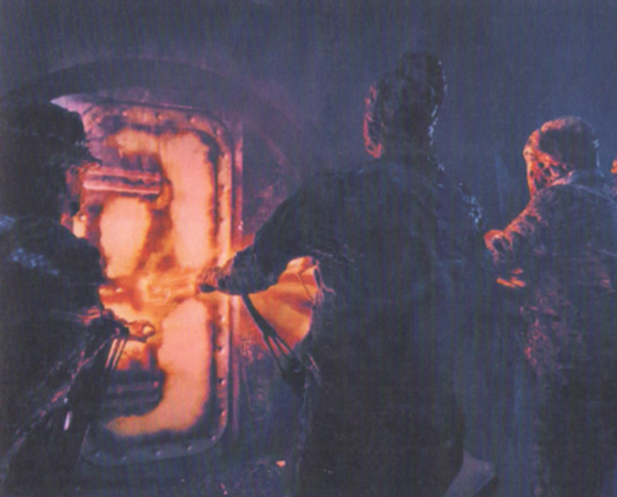

Slide 39
It is from the book Doctor Who, Flatline.

Slide 40
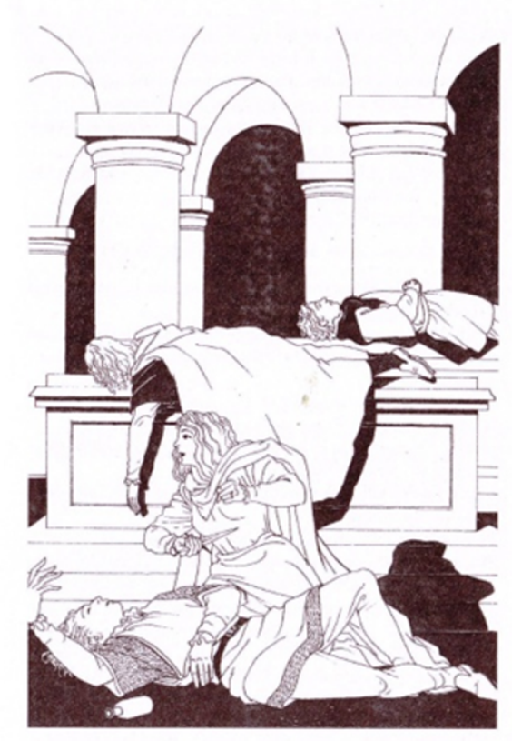

Slide 41
It’s from the book Romeo and Juliet. Paris, Tybalt, Romeo are dead in the Capulet’s vault. Juliet pushes the knife into her body because of the death of Romeo

Slide 42
He is the most famous writer in the English language. He was born in 1564 and died in 1616 in Stratford-Upon-Avon, England. In his late twenties, he went to London, where he began to write comedies, tragedies and historical plays and achieved great fame. His plays appealed to all social classes thanks to his vivid characterisations and his masterly use of the English language. Apart from being a playwright, he was also an actor and a brilliant poet

Slide 43
William Shakespeare

Slide 44
She is a much-loved English novelist. Born in 1775 in the Hampshire countryside, she was the seventh child in a family of eight. Her father was a rector. She started writing as a young teenager. She wrote six major novels. Sense and Sensibility (1811), Pride and Prejudice (1813), Mansfield Park (1814) and Emma (1816) were published during her lifetime, and Northanger Abbeyand Persuasion were published in 1818 after her death

Slide 45
Jane Austen

Slide 46
In 1997, he received the Pulitzer Prize for his book Angela’s Ashes. The novel, which describes his childhood in Ireland, came out when he was 66 years old. Before becoming a published author, he was a teacher.

Slide 47
Frank McCourt

Slide 48
He was born in 1812 in Portsmouth, England. His childhood was not a very happy one. His father was imprisoned for debt and the twelve-year-old was sent to work in a factory. The experience had a profound effect on him, and throughout his life he had a fear of the lack of money and this drove him to undertake increasingly debilitating workloads. Despite receiving little formal education, he worked hard, first as a solicitor’s clerk and then as a parliamentary reporter. He followed his first book, The Pickwick Papers (1836), with the classics Oliver Twist (1839) and A Christmas Carol (1843), both of which have been made into films. Towards the end of his life his novels became increasingly sombre, full of biting social criticism and savage comedy. Bleak House (1853), Hard Times (1854) and Little Dorrit (1857) are examples of this change of mood. He was married to Catherine Hogarth, but separated from her in 1858. They had ten children. He died in 1870, and despite his insistence that he wanted a normal, quiet family funeral, was buried in Poet’s Corner in Westminster Abbey in London

Slide 49
Charles Dickens

Slide 50
He has written for the UK TV programmes Being Human and Dirk Gently and for series 8, 9 and 10 of Doctor Who. In series 8 he wrote Mummy on the Orient Express and Flatline

Slide 51
Jamie Mathieson

Slide 52
a Esther sees Lady Dedlock for the first time in church. b Tulkinghorn finds Nemo dead in his bed. c Lady Dedlock leaves her house for the last time. d Esther agrees to marry Mr Jarndyce. e Mr Jarndyce gives Esther and Woodcourt a house. f Lady Dedlock recognises someone’s handwriting. g Bucket arrests Rouncewell for the murder of Tulkinghorn. h Sir Leicester becomes very ill. i The legal case ends. j Mr Guppy asks Esther to marry him.

Slide 53
a 4 b 3 c 7 d 5 e 9 f 1 g 6 h 8 i 10 j 2

Slide 54
a Rigsy met the Doctor. b Clara looked under a sofa. c Clara laughed at the Doctor. d Rigsy and Clara shook hands. e The Doctor gave Clara an earphone. f Clara couldn’t see the TARDIS anywhere. g Clara and Rigsy went to a small, modern flat. h Clara pointed the sonic screwdriver at a mirror.

Slide 55
a 8 b 7 c 2 d 4 e 3 f 1 g 5 h 6

Slide 56
a Friar Laurence tells Juliet to go to bed alone. b He explains to her that a cold feeling will run through her body. c She has to drink the medicine from the bottle. d Everybody will think that she is dead. e They will carry her body to the vault. f The Nurse can’t stay with her. g Her family will dress her in her best clothes.

Slide 57
a 1 b 4 c 3 d 5 e 7 f 2 g 6

Slide 58
a Mr. McCourt had a problem with Hector. b Mr. McCourt took a job at his wife’s school. c Mr. McCourt taught at Fashion High School. d Nancy’s story moved everybody. e The principal didn’t want Mr. McCourt back. f Mr. McCourt explained grammar using a pen.

Slide 59
1 c
2 f
3 a
4 e
5 b
6 d

Slide 60
a …. . Jane said goodbye to Tom. b …. . Suddenly, the coach stopped. c …. . John ran into the room. d …. . The coach stopped to change horses. e …. . Tom helped Jane into the coach. f …. . Jane read a letter written to Tom. g …. . Jane couldn’t see anyone in the sitting- room.

Slide 61
a 5 b 2 c 7 d 4 e 1 f 3 g 6

Slide 62
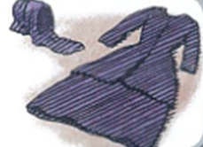

Slide 63
Miss Hortense’s dress. Lady Dedlock uses it to visit the house and grave of Nemo

Slide 64
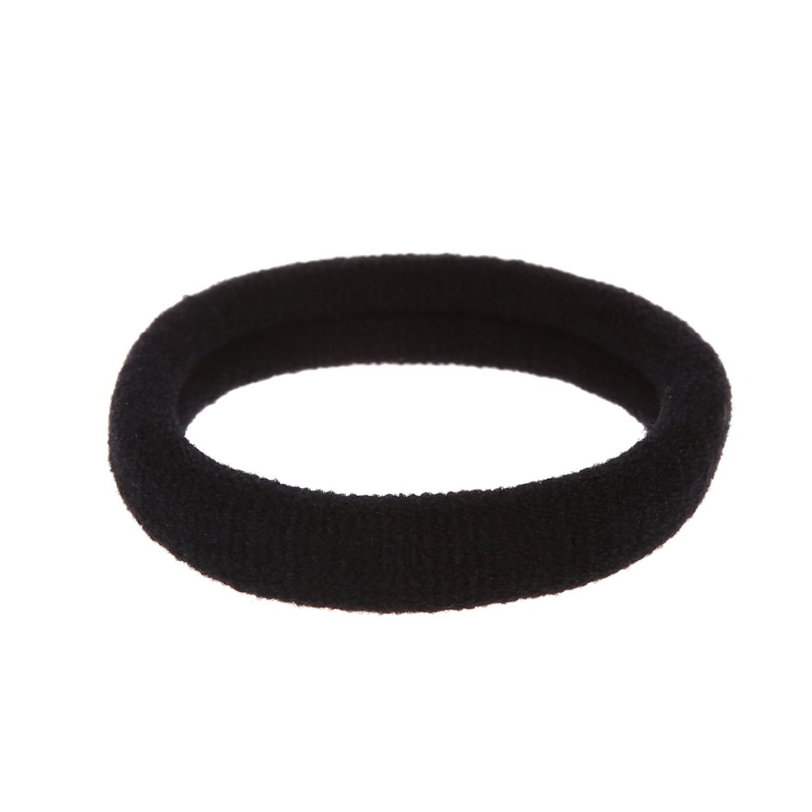

Slide 65
Hairband of Clara. She uses it to put around the dead man’s handle, she tied the other end lower down. Now the handle couldn’t move and the train couldn’t stop

Slide 66
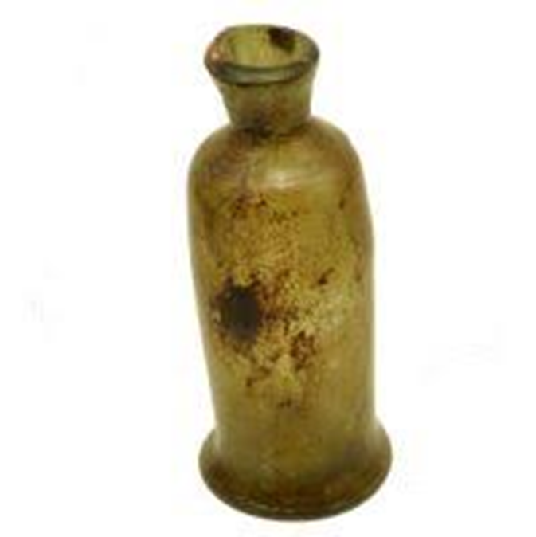

Slide 67
In this bottle there was poison that killed Romeo

Slide 68
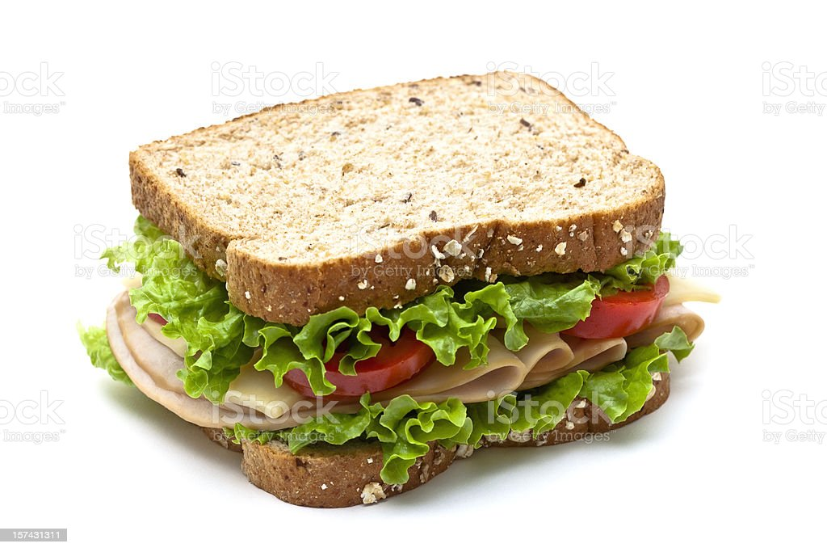

Slide 69
Petey’s sandwich which Mr McCourt ate

Slide 70
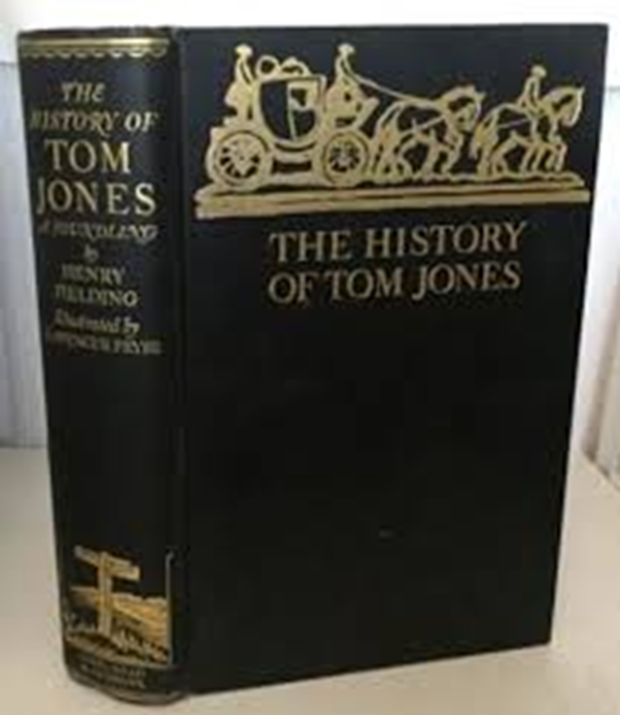

Slide 71
Tom Lefroy’s favourite book

Slide 72
How many sm high was TARDIS when it gets smaller?

Slide 73
15 sm

Slide 74
How old was Juliet?

Slide 75
14 years old

Slide 76
How many girls were there in Serena’s class?

Slide 77
29 girls

Slide 78
How many days was Jo searched for?

Slide 79
For 5 days

Slide 80
How many times does Jane dance with Tom Lefroy at Basingstoke Dance?

Slide 81
3 times

