Slide 1
Открытый урок английского языка в 8 классе.
Тема: «Do you know Britain?».

Slide 2
Начало урока:
What is the date of today?(дата)
Our topic is about Britain.(тема)
We must divide into two teams.(делимся на две команды). Закаждый правильный ответ 1 балл.

Slide 3
The first task:
- to describe the picture( ученики должны описать одну из картинок, около 7 предложений, опираясь на данные им картинки)

Slide 4
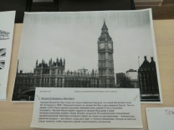

Slide 5
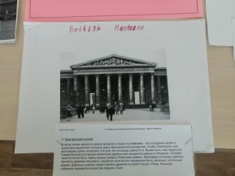

Slide 6
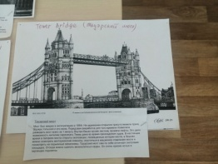

Slide 7
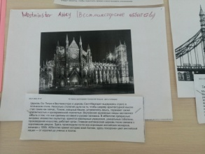

Slide 8
The second task: «Do you remember?»
Вопросы первой команде.

Slide 9
How many parts of the country are situated on the island of Great Britain?(3)
What river is the capital situated on?(on the Thames)
Who is officially the head of the country?(Queen Elizabeth2)
What is the seat of the British government?(the Houses of Parliament)
Who is the National Hero of Britain, the defender of poor people?(Robin Hood)

Slide 10
Вопросы второй команде:
How many parts are there in the United Kingdom?(4)
Who was the Leader of the Normal Conquest?(William the Conqueror)
What is the full name of the country?(the United Kingdom of Great Britain and Northern Ireland)
What was the fist most terrible prison in Great Britain?(the Tower)
Who is the architect of the famous St. Paul`s Cathedral?(Sir Christopher Wren)

Slide 11
The third task: Разгадать кроссворд. Вопросы к кроссворду:
The ocean that washes the Brinish Isles.(Atlantic)
The capital of Britain.(London)
The smallest country of Britain.(Wales)
The name of the queen of Britain.(Elizabeth)
The symbol of England.(rose)
The country that consist of England, Scotland and Wales.(Britain)
One of the colors of the flag of Britain.(red)
The language that the English speak.(English)
The favorite English domestic animal.(dog)
The weather in Britain.(foggy)
The widest river in Britain.(Thames)

Slide 12
Подводим результаты.
Считаем баллы.

Slide 13
Повторяем достопримечательности Лондона, опираясь на картинки.

