Slide 1
Тема урока: "The United Kingdom of Great Britain"
Форма проведения: урок-игра
Цели и задачи мероприятия:
Закрепление страноведческих знаний, расширение кругозора.
Развитие интеллекта, познавательного интереса, творческой деятельности, умения работать в группах.
Развитие мышления, памяти, внимания.
Воспитание уважительного отношения к культуре другой страны

Slide 2
Тема урока: "The United Kingdom of Great Britain"
Форма проведения: урок-игра
Цели и задачи мероприятия:
Закрепление страноведческих знаний, расширение кругозора.
Развитие интеллекта, познавательного интереса, творческой деятельности, умения работать в группах.
Развитие мышления, памяти, внимания.
Воспитание уважительного отношения к культуре другой страны

Slide 3
Ход урока-
Организационный момент. Речевая разминка.
Good morning, students! Today we’ll practice our English talking about the UK, its culture and traditions.
I’ll divide you into two teams and we’ll play a game.
I wish you all good luck and we’ll start with an overview of the UK.

Slide 4
Why people travel
to visit new places;
to meet people;
to study;
to practice English;
to take part in festivals;
to learn more about the culture and traditions.

Slide 5
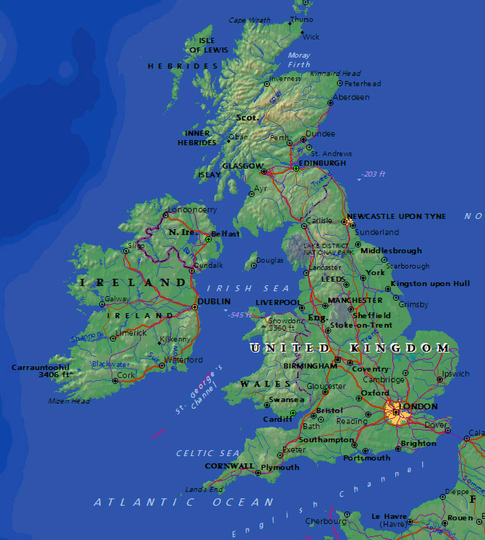
The United Kingdom of Great Britain and Northern Ireland is situated on the British Isles.
The British Isles consist of two large islands, Great Britain and Ireland, and about five thousand small islands.
Their total area is over 244,000 square kilometers.

Slide 6
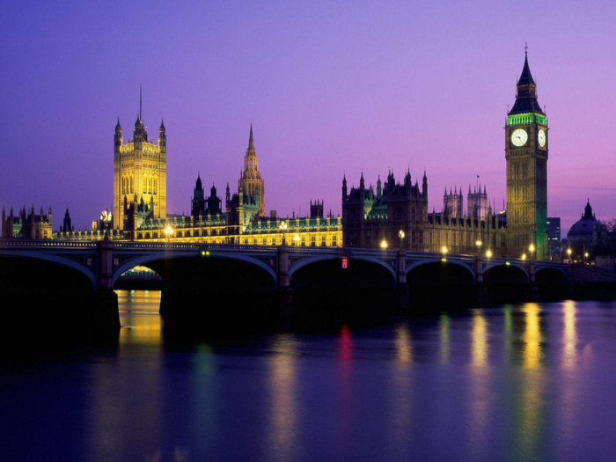
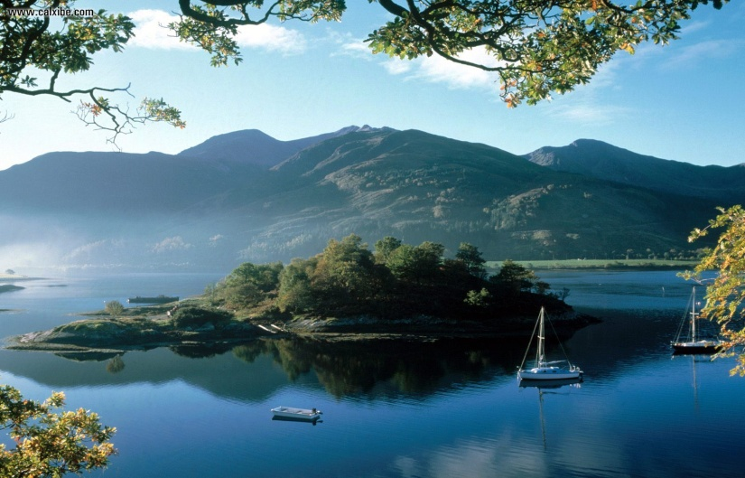
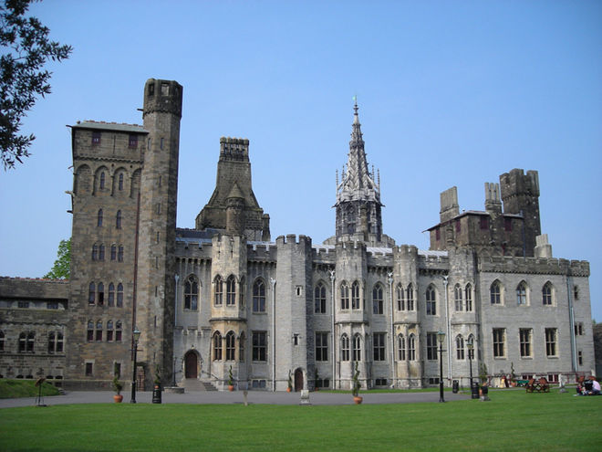
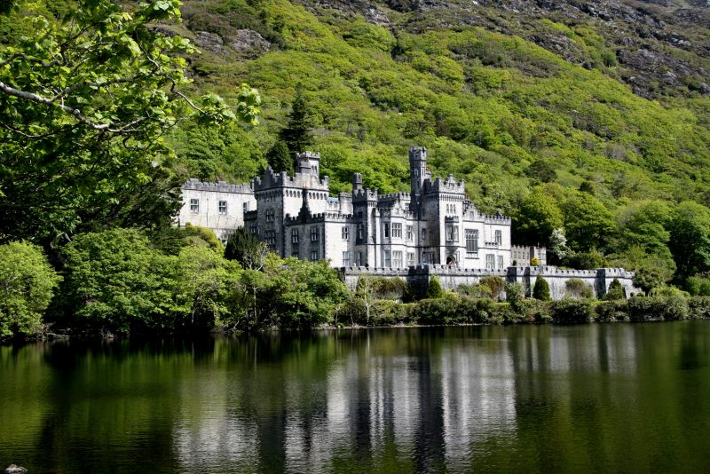
The UK is made up of four countries: England, Wales, Scotland and Northern Ireland. Great Britain consists of England, Scotland and Wales and doesn't include Northern Ireland. The capital of the UK is London

Slide 7
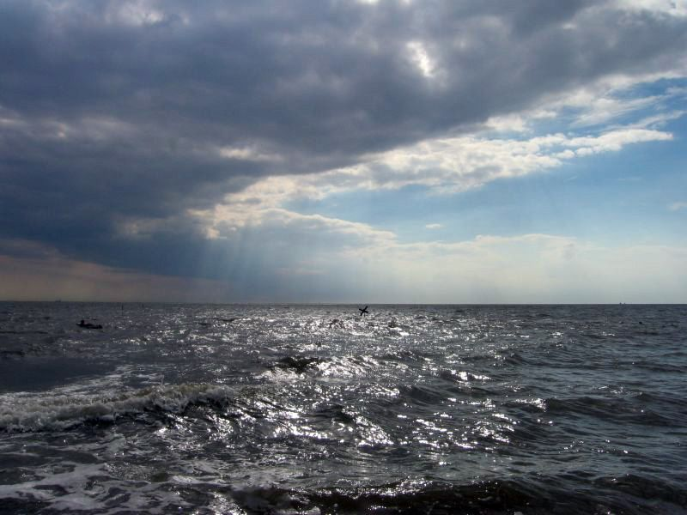
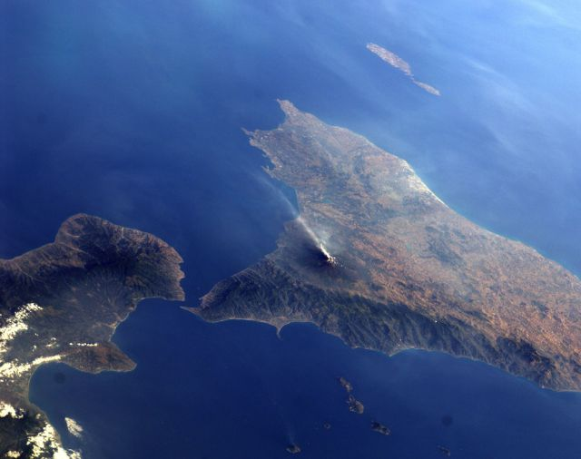
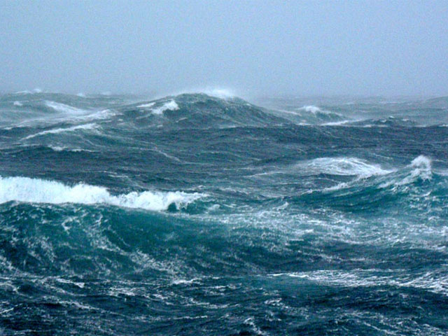
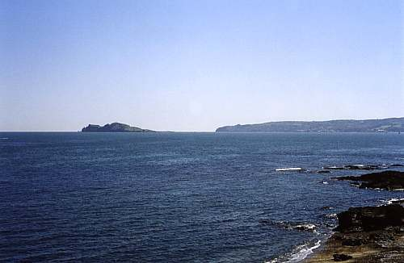
The British Isles are separated from European continent by the North Sea and the English Channel. The western coast of Great Britain is washed by the Atlantic Ocean and the Irish Sea.

Slide 8
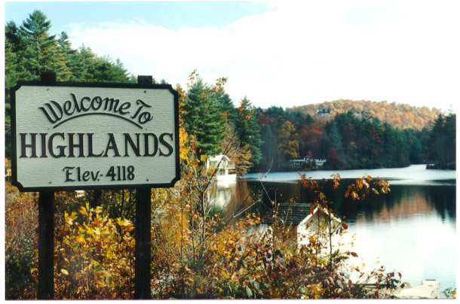
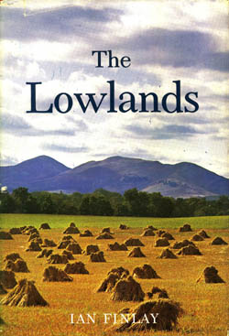
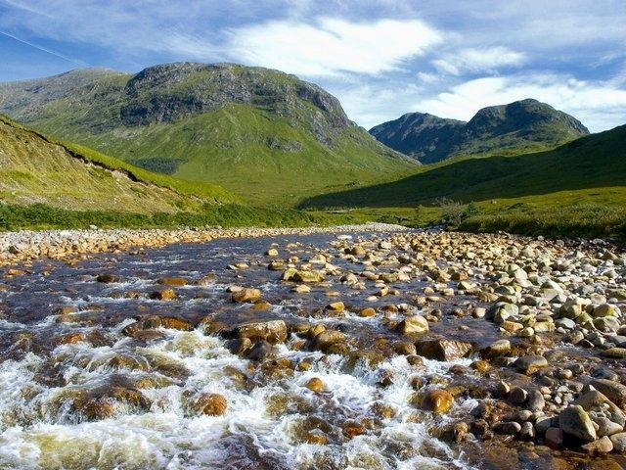
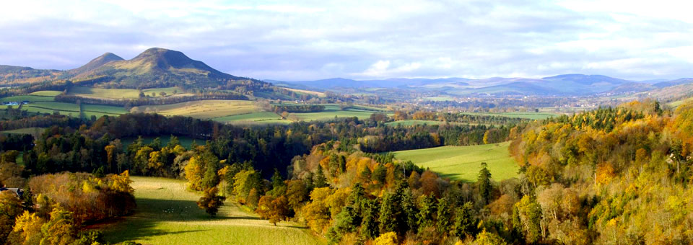
The surface of the British Isles varies very much. The north of Scotland is mountainous and is called the Highlands, while the south, which has beautiful valleys and plains, is called the Lowlands.

Slide 9
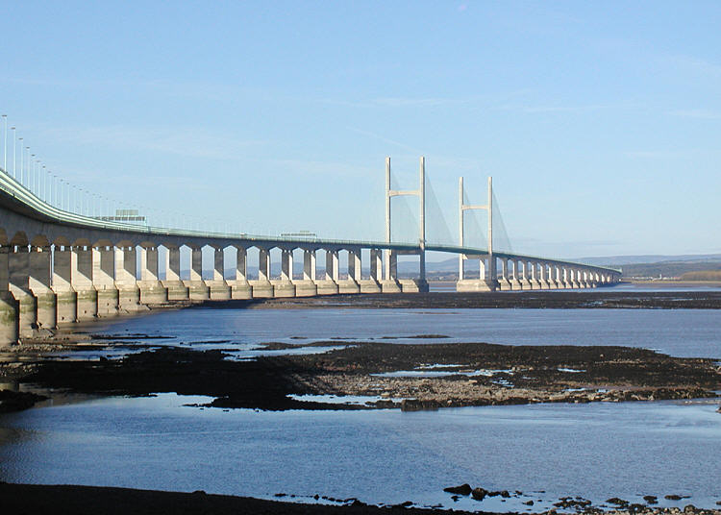
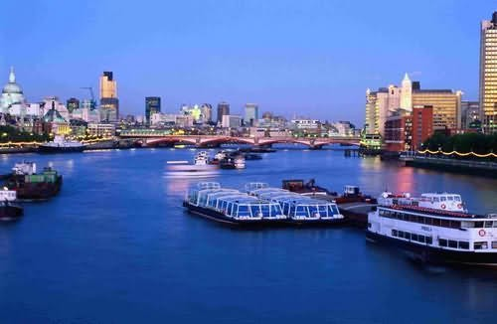
There are a lot of rivers in Great Britain, but they are not very long.
The Severn is the longest river,
while the Thames is the deepest and the most important one.

Slide 10
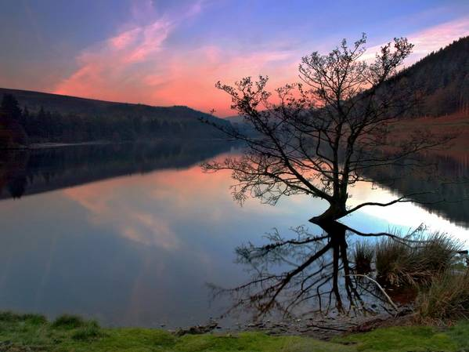
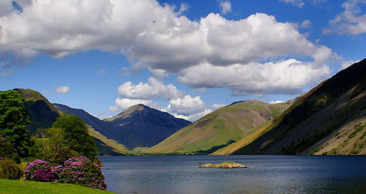
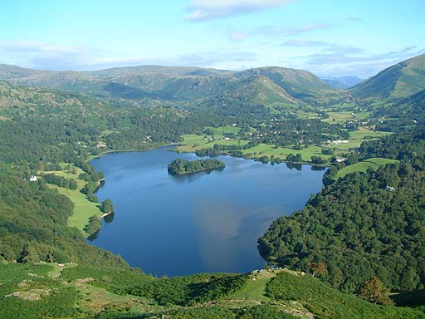
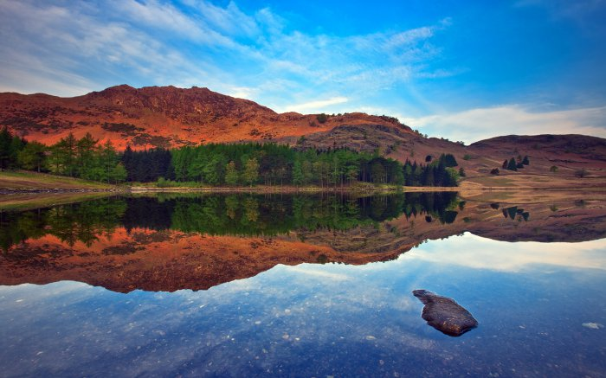
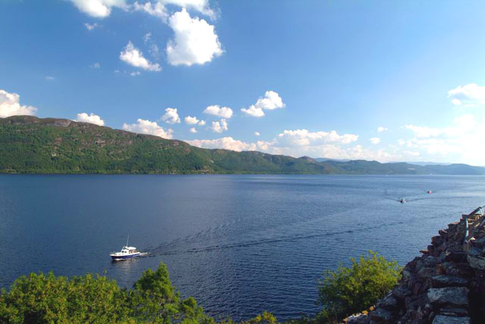
There are many lakes in Great Britain .

Slide 11
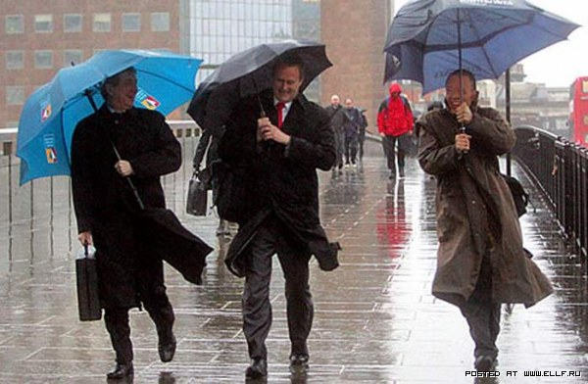
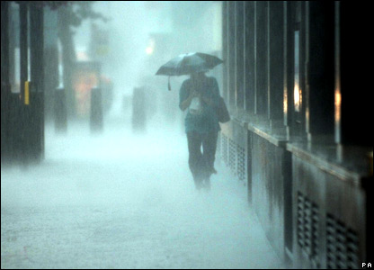
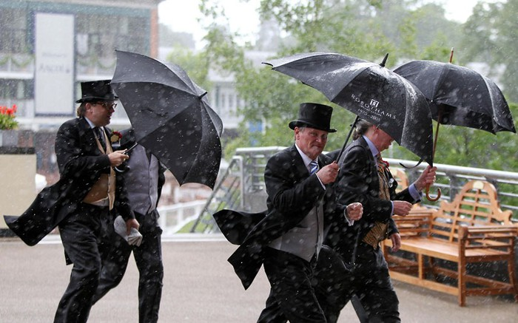
The weather in Great Britain is very changeable.
The English also say that they have three variants of weather:
when it rains in the morning, when it rains in the afternoon
or when it rains all day long.

Slide 12
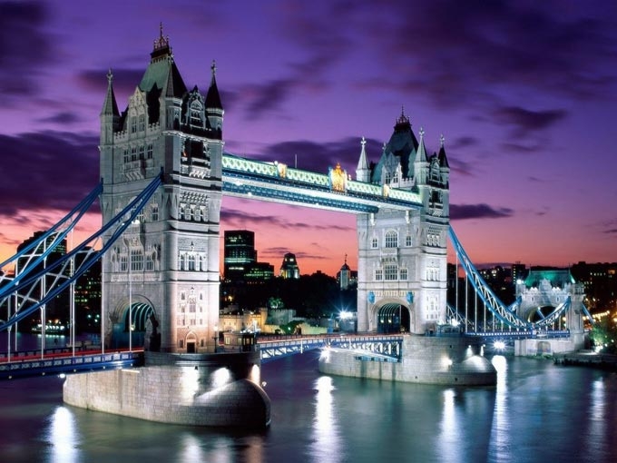
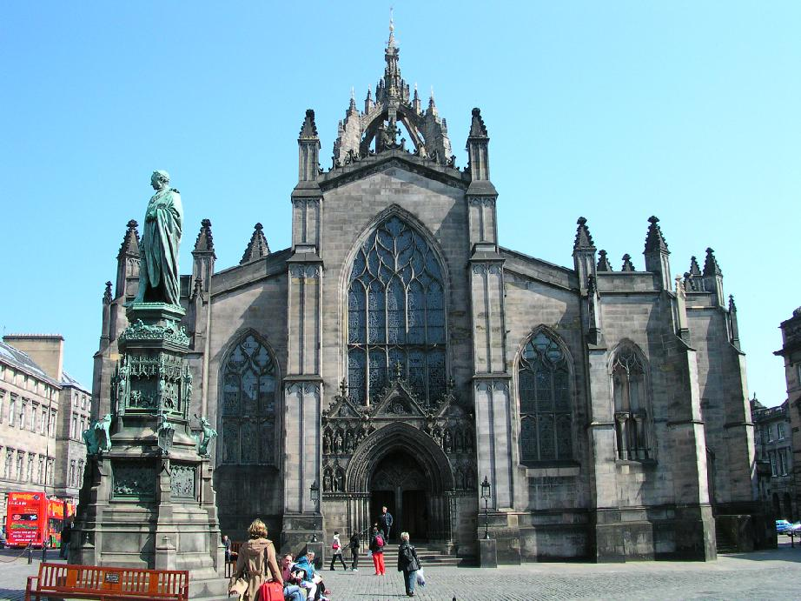
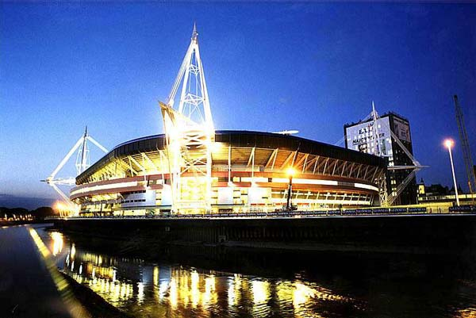
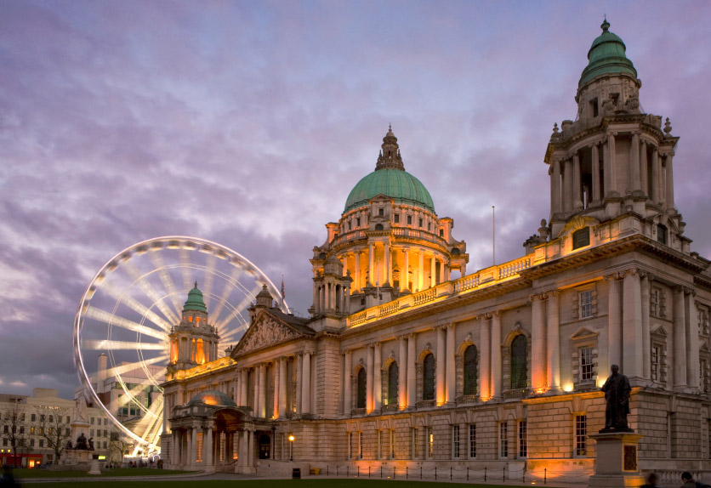
The capitals are: London in England , Edinburgh in Scotland , Cardiff in Wales and Belfast in Northern Ireland .

Slide 13
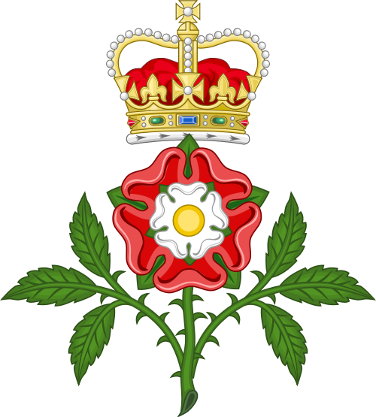
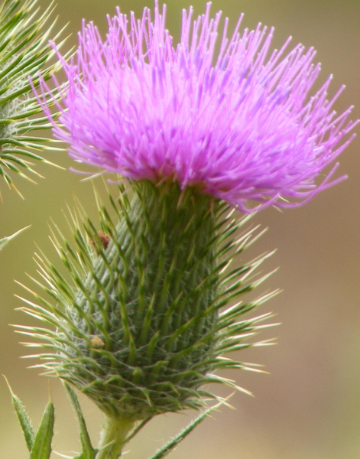

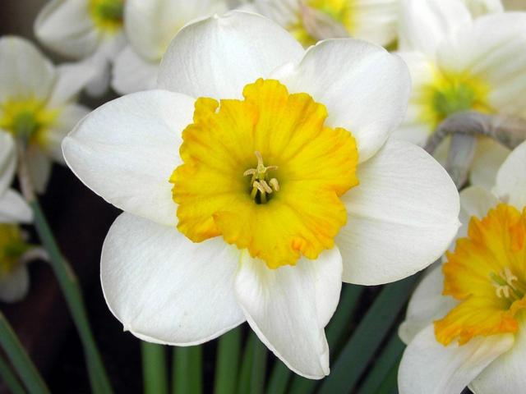
Every country has its own national emblem. The red rose is the national emblem of England. The thistle is the national emblem of Scotland. The daffodil is the national emblem of Wales. The shamrock is the emblem of Ireland.

Slide 14
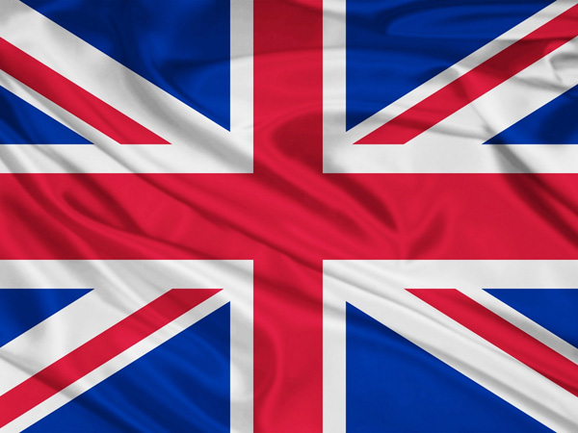
The flag of the UK is known as the Union Jack.The flag is made up of 3 crosses on the blue background.
.

Slide 15
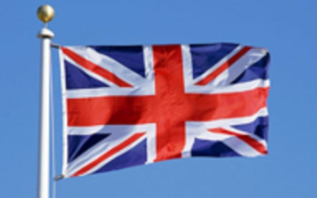
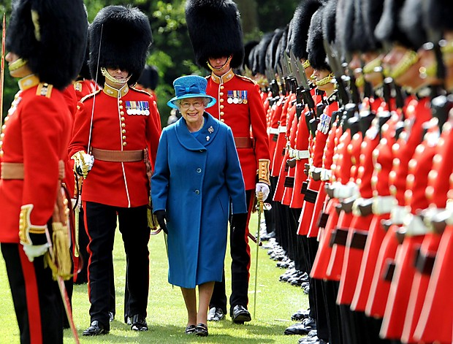
The national anthem is «God Save the Queen»

Slide 16
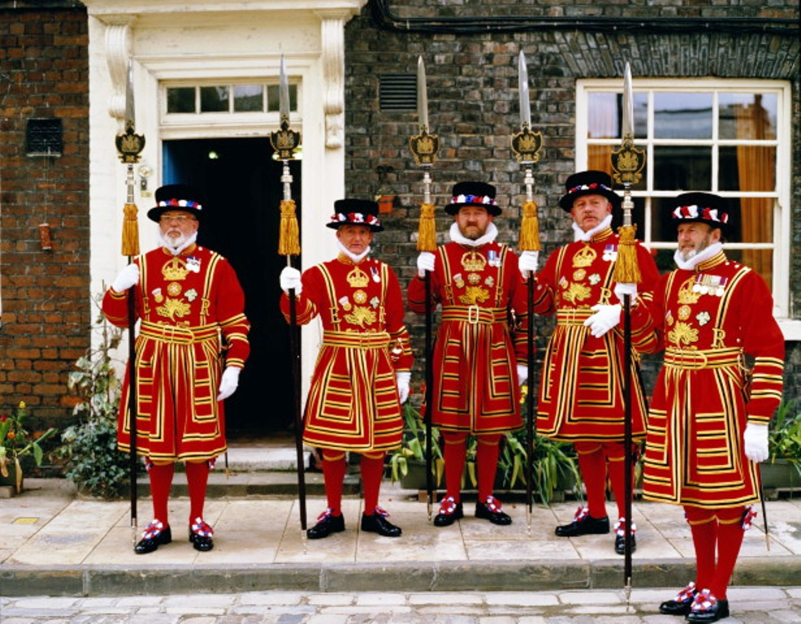
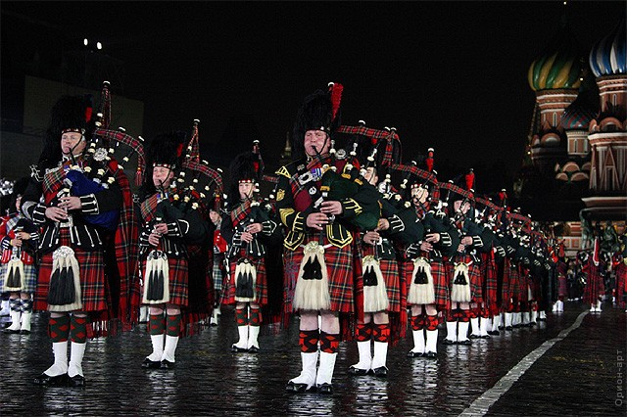
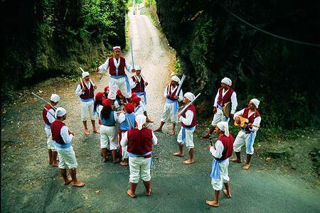
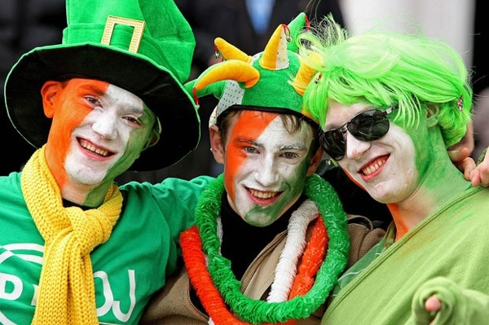
The population of the UK is over 62 The population of the UK is about 62mln people. The UK is inhabited by the English, the Scots, the Welsh and the Irish who constitute the British nation.

Slide 17
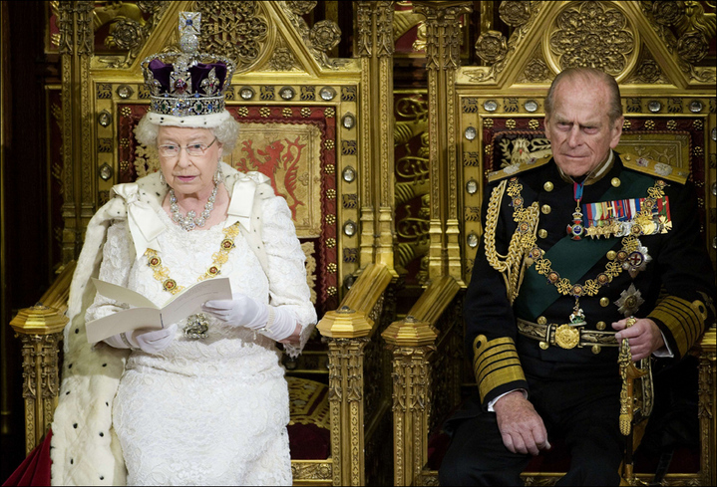
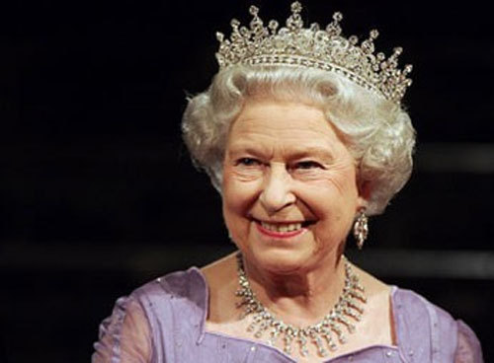
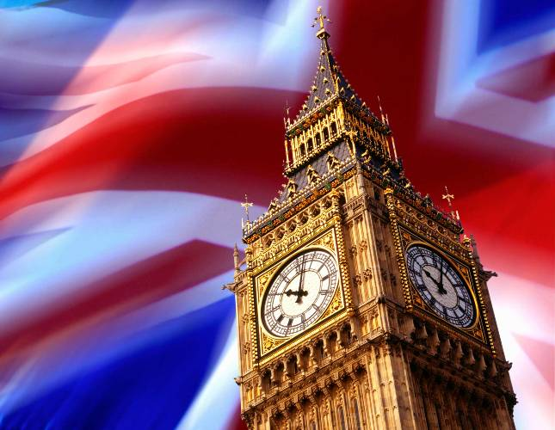
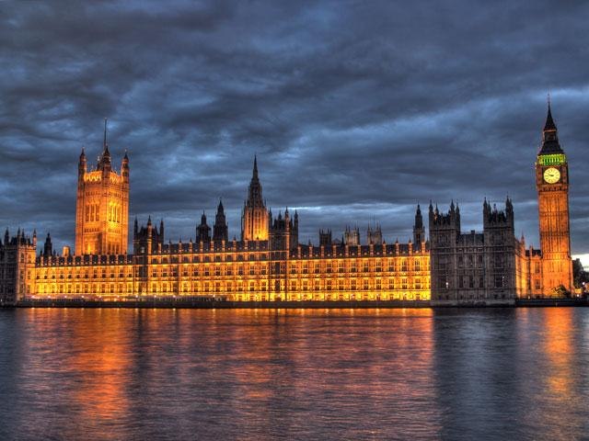
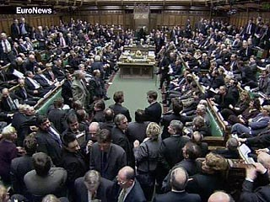
The UK is a constitutional monarchy. In law, the Head of State is the Queen, but in practice, the Queen reigns, but does not rule. The country is ruled by the elected government with the Prime Minister at the head. The British Parliament consists of two chambers: the House of Lords and the House of Commons.

Slide 18
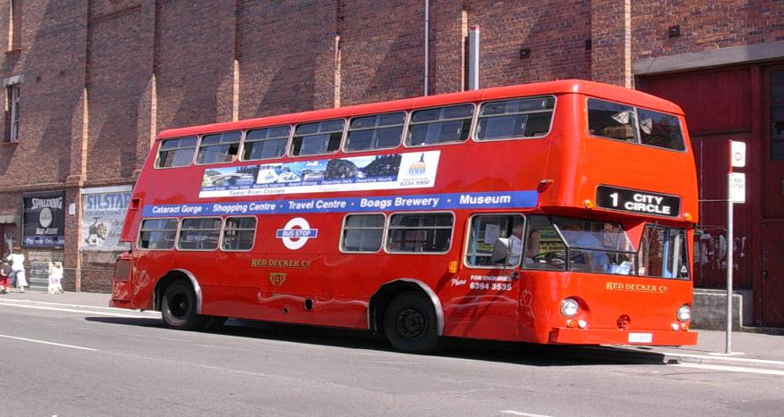
London – the city of traditions and exciting places
Red double-deckers – traditionaly means of transport

Slide 19
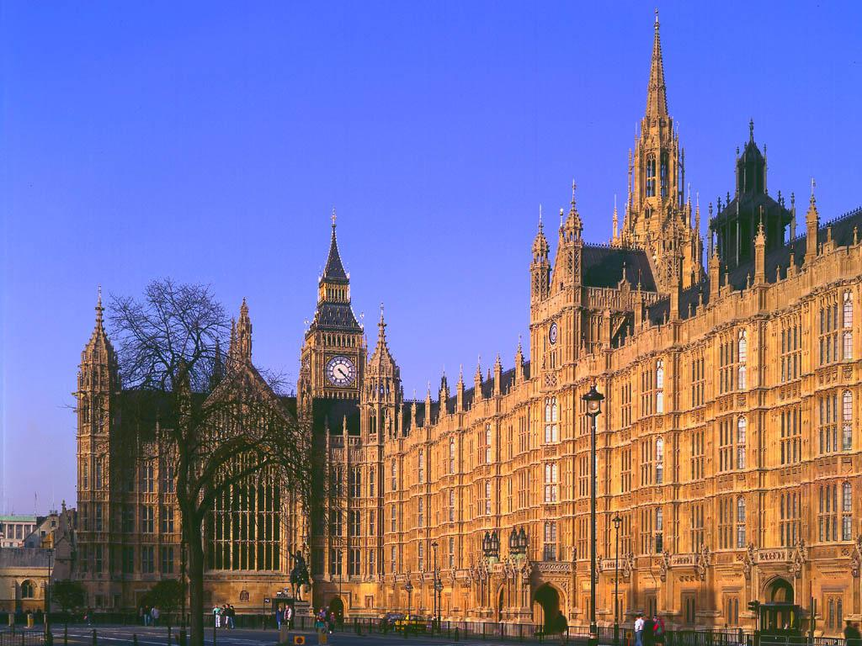
The Houses of Parliament

Slide 20
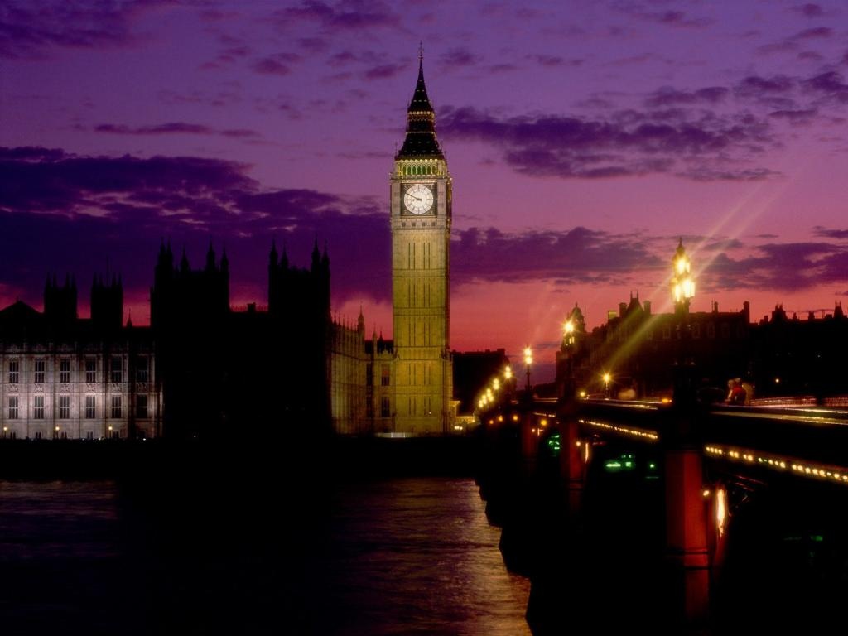
Big Ben – Symbol of London

Slide 21
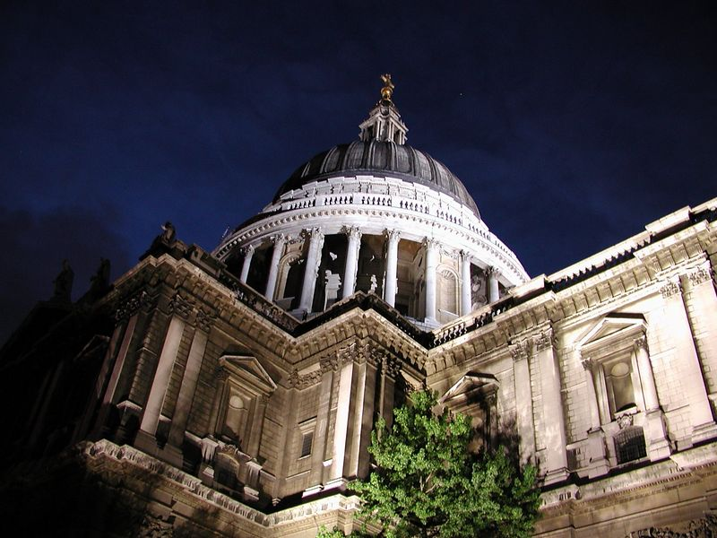
St. Paul´s Cathedral – One of the largest cathedrals in the world

Slide 22
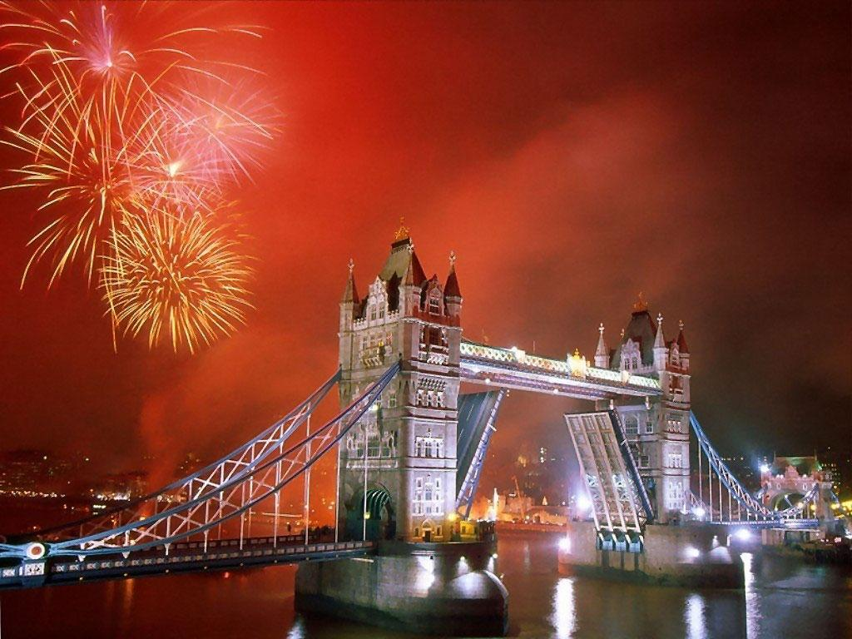
The Tower Bridge – beautiful monument above Thames

Slide 23
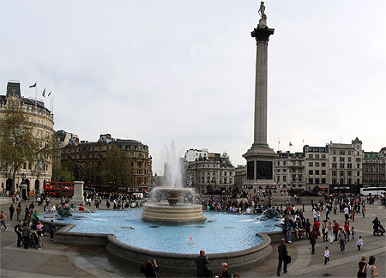
Trafalgar Square
TrTTafalgar Square

Slide 24
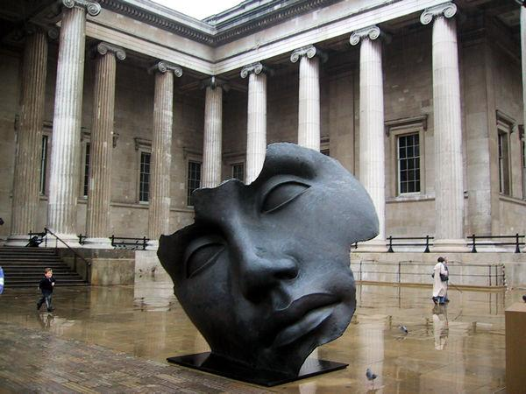
The British Museum – The largest museum in the world

Slide 25
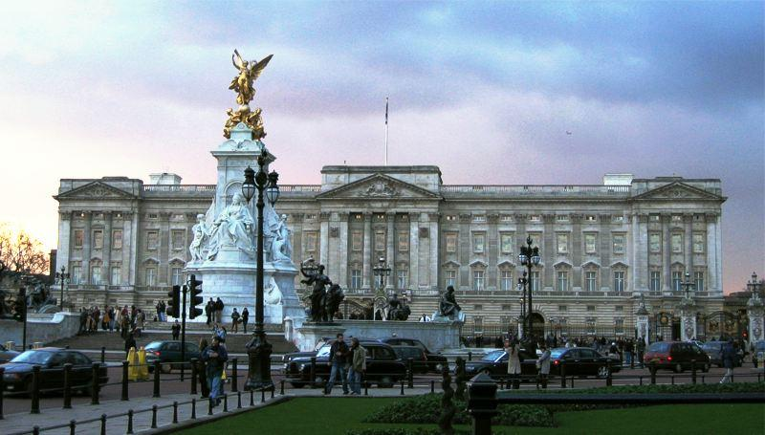
Buckingham Palace – The Queen´s residence

Slide 26

Piccadilly Circus – One of the most famous shopping centres

Slide 27

Royal Albert Hall – Place for the best musicians

Slide 28
Welcome to our game “The UK”
I contest “Brainstorm”.

Slide 29
. What river runs through London?
the Thames
b) the Volga
с) the Mississippi

Slide 30
What is a “double-decker”?
a bus
b) a train
c) a ship

Slide 31
What is the London Eye?
a telescope
b) an observation wheel
c) a newspaper

Slide 32
What country is located on another island?
Scotland
b) Northern Ireland
c) Wales

Slide 33
What is the most popular English holiday?
Valentine’s Day
Guy Fawkes Night
Christmas

Slide 34
What is traditional Christmas meal?
Porridge
Turkey and pudding
Rolls

Slide 35
What is the most popular drink in Britain?
Juice
Coffee
Tea

Slide 36
What is the capital of the UK?
Glasgow
London
Belfast

Slide 37
II contest: Countries of the UK Complete the table
country | capital | language | people | symbol
England
 | Edinburgh
 |  |  |  | Daffodil
 |  |  | Irish

Slide 38
III contest “Make a Sentence”.
1) Scotland, capital, Edinburgh, is, of, the.
2) to visit, Great, would, Britain, like, I.
3) Palace, of, Buckingham, is, Queen, the home, Elizabeth II.
4) is, England, capital, of, the, London.
5) Britain, the world, beautiful, in, is, Great, country, the most

Slide 39
IV contest: Finish phrases choosing appropriate word combinations.
Great Britain consists of (one large island, two large islands, about five thousand small islands).
The climate of the country is (dry, sunny, humid, mild).
At the head of the State is (the Prime Minister, Parliament, the King, the Queen).
The flag of the United Kingdom is made up of (one, three, several crosses).
(Scottish, Welsh, English) is the official language of the country.

Slide 40
V contest: Choose the prepositions
The British Isles consist _________ two large islands
a) In b) for c) of d) at
The United Kingdom is made up ________ four countries
a) of b) about c) at d) in
Great Britain is separated ___________ the European continent – the English Channel _________ the Strait of Dover.
a) from b) by c) at d) and
The climate of the United Kingdom is generally mild and temperate _______ the influence of the Gulf Stream.
a) because b) due to c) for d) by
The flag of the United Kingdom is made up ____________ three crosses.
a) in b) at c) of d) on

Slide 41







VI contest “Places of Interest”. Visual dictation

Slide 42





















VII contest: Christmas Symbols

Slide 43



END
of the game
Count
your points.

Slide 44




Подведение итогов. Рефлексия.
I see you can speak and write about the UK. I hope you can give a full information of it in your short composition . It will be your homework.
Просит заполнить обучающихся карточку рефлексии,( трудности, с которыми им пришлось столкнуться на уроке и ответить на вопрос, удалось ли им преодолеть данные трудности, побуждение обучающихся к оценке собственной деятельности на уроке.)
1. Do you like our lesson? Yes/ No
2. Was it difficult to understand? Yes/ No
3. Was the atmosphere at the lesson friendly? Yes/No
4. Was the information at the lesson useful for you? Yes/No
5. Give a mark to yourself, please. 5/4/3

