Slide 1

Social Media

Slide 2
Homework for today
Task 2. You are going to take part in a telephone survey. You have to answer six questions. Give full answers to the questions.
Remember that you have 20 seconds to answer each question.

Slide 3
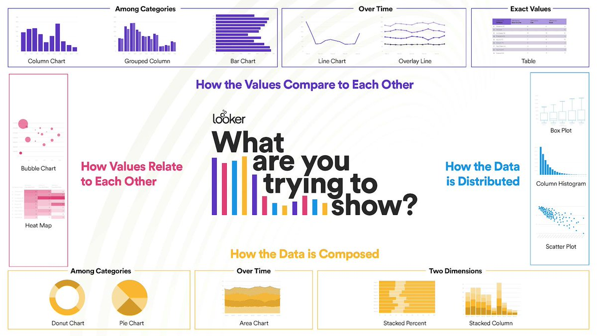
How to present data

Slide 4
Different forms of text | Which form of the texts to choose | 0 | 1 | 2
Data analyses | I can interpret information | 0 | 2 | 4
Data application | I can make decisions based on the data | 0 | 5 | 10

Slide 5
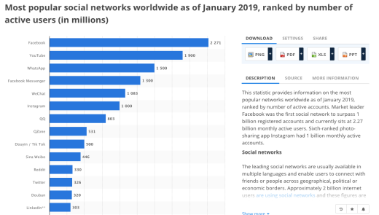
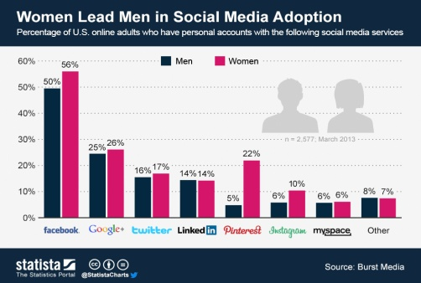
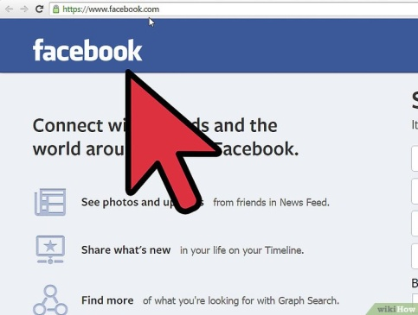
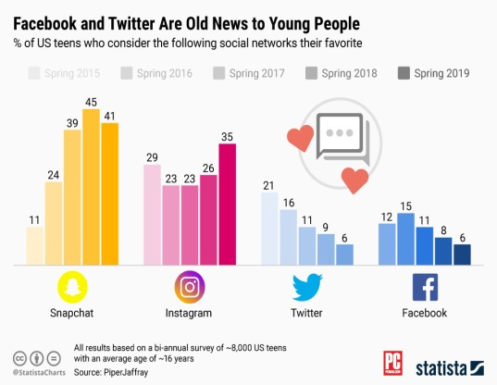
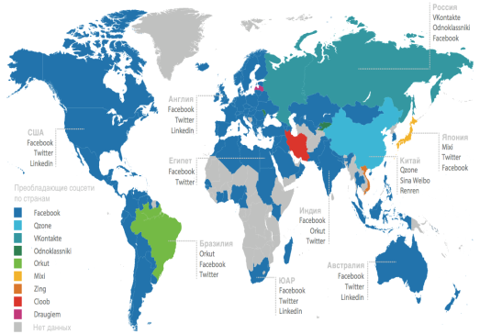
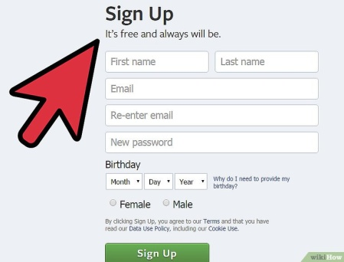
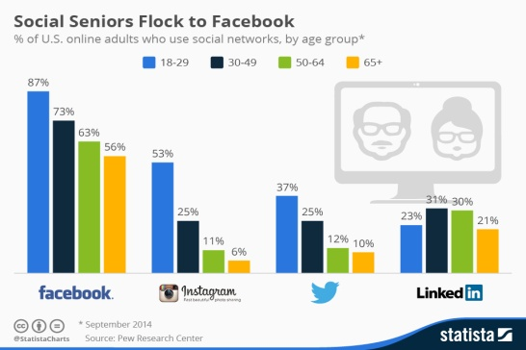

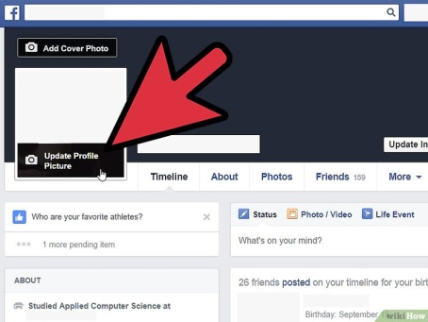
Forms of texts

Slide 6


Slide 7
Homework
To conduct a survey in your class about the amount of time spent on social networks.
Present data as a bar graph.
More points if you give a talk analyzing the data!

Slide 8


Slide 9


Slide 10


Slide 12


Slide 13
Group 1 Use data to decide what social networks to choose to launch your product. Your product is an app using one minute videos to teach young children to take care of a dog. You plan is to reach 100000 viewings in 6 months. The app uses only sign language, so there is no language barrier. Presentation: Speaker 1 Tell the class what the assignment is. Speaker 2 Tell the class what social networks you have chosen and what data you used. Speaker 3 Explain the reasons for your choices. | Group2 Use data to decide what social networks to choose to launch your product. Your product is an app using one minute videos to teach how to cook cakes. You plan is to reach 1000 viewings in a months. The app is in The English language, so there are certain limitations. Presentation: Speaker 1 Tell the class what the assignment is. Speaker 2 Tell the class what social networks you have chosen and what data you used. Speaker 3 Explain the reasons for your choices.

Slide 14
Different forms of text | Which form of the texts to choose | 0 | 1 | 2
Data analyses | I can interpret information | 0 | 2 | 4
Data application | I can make decisions based on the data | 0 | 5 | 10

Slide 15
Explain how to set an account in a social networking site | What social networks are popular with women /men
Social networks to surpass 1 billion registered accounts | Social networks popular in different age groups
Social networks popular in different countries of the world | The difference between Instagram and Facebook

Slide 16
Different forms of text | Which form of the texts to choose | 0 | 1 | 2
Data analyses | I can interpret information | 0 | 2 | 4
Data application | I can make decisions based on the data | 0 | 5 | 10

