Slide 1
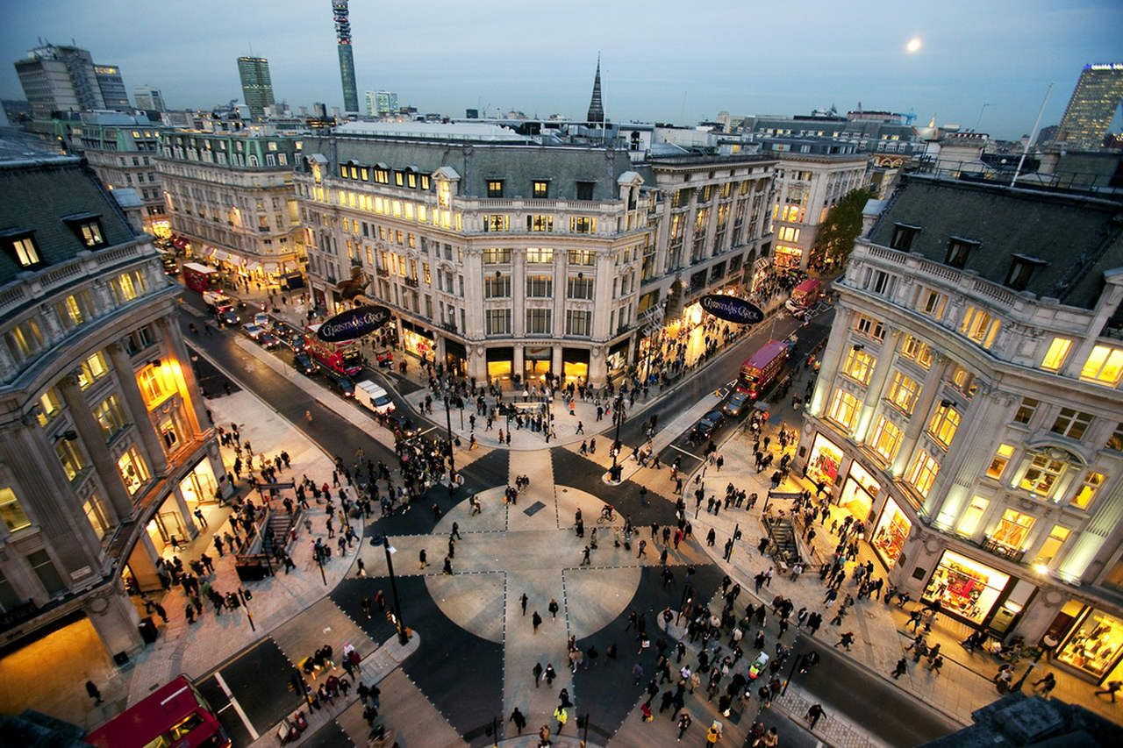
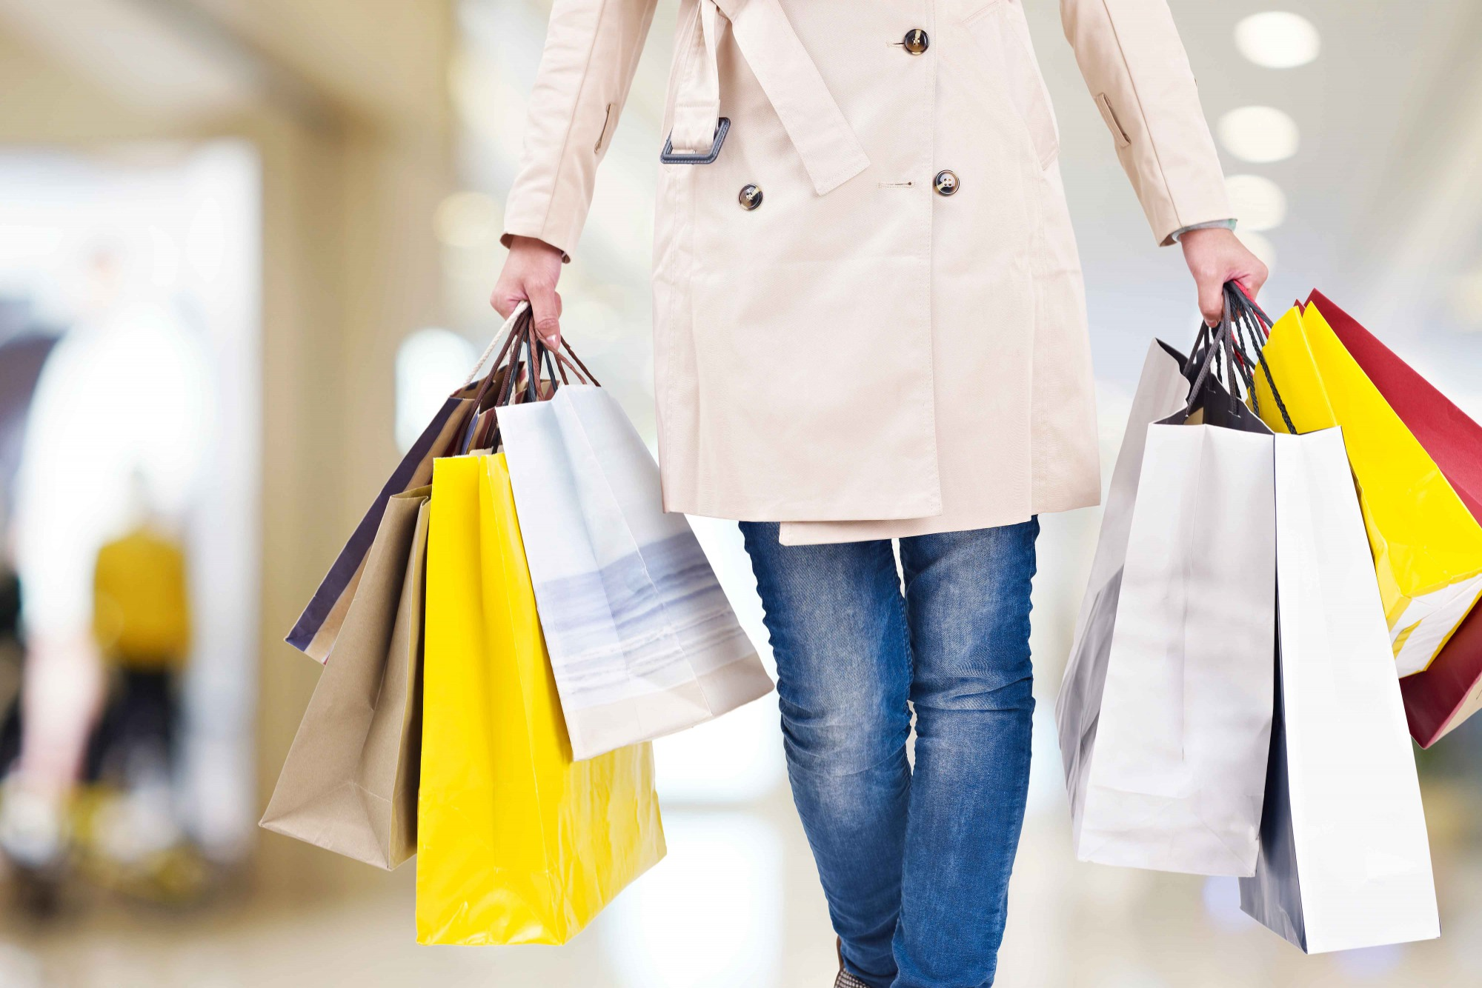
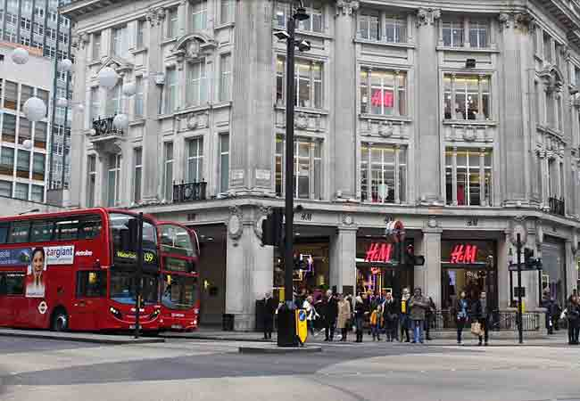
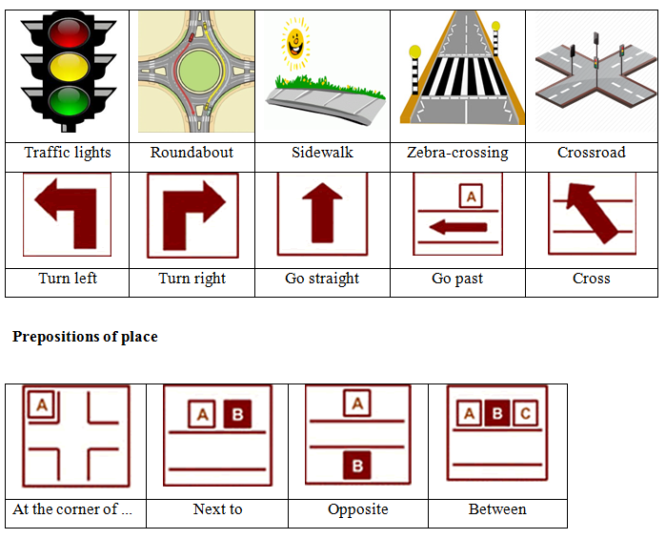
2
+
Giving directions and
Shopping in London

Slide 2
2
+
The objectives are:
revise shopping vocabulary;
learn new shopping phrases and practise dialogues.

Slide 3
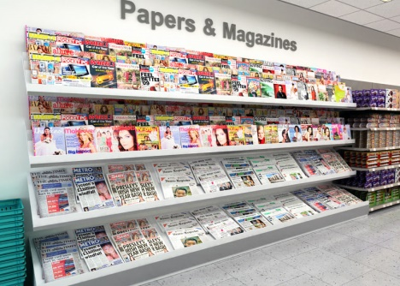
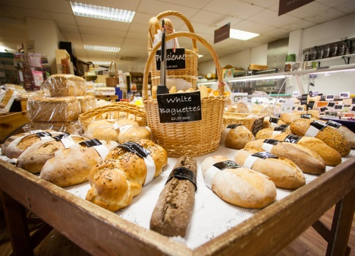
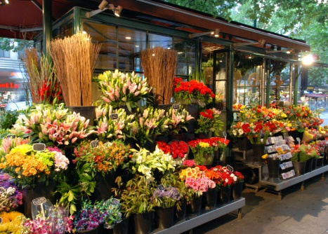
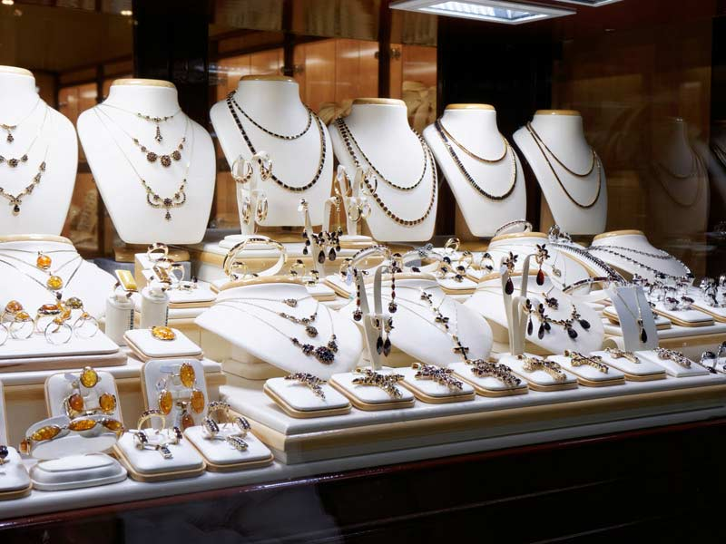
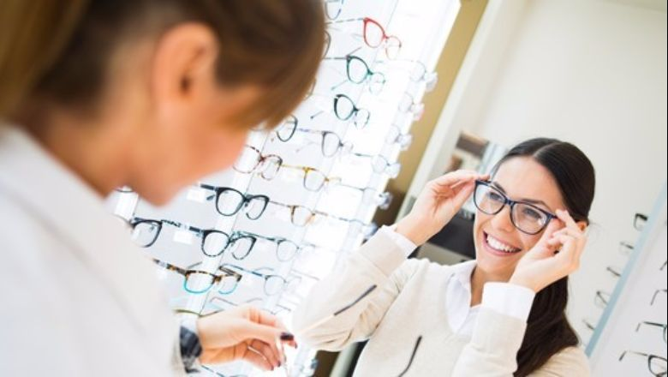
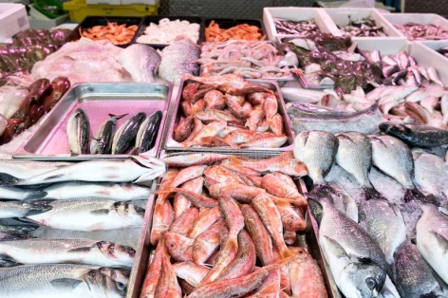
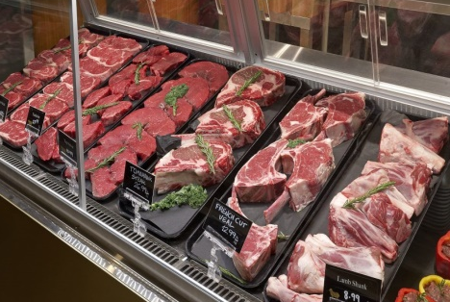

2
+
Look at the pictures, name the shops and pay attention to the pronunciation:
newsagent’s
baker’s
florist’s
jeweller’s
optician’s
fishmonger’s
butcher’s
chemist’s

Slide 4
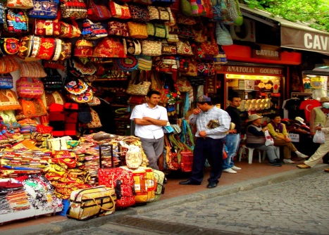
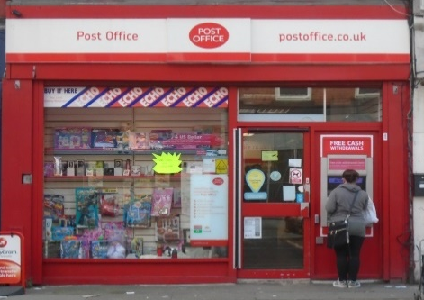
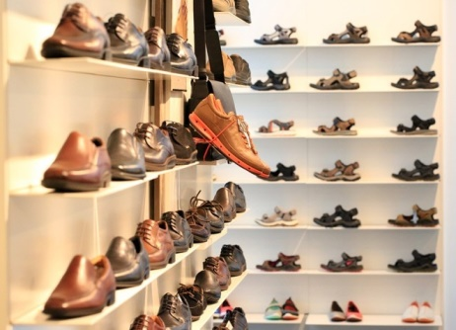
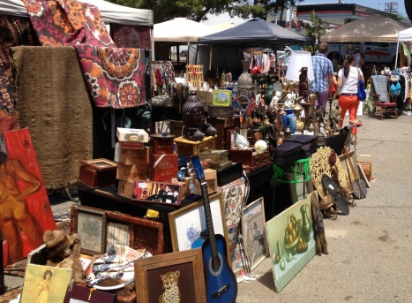
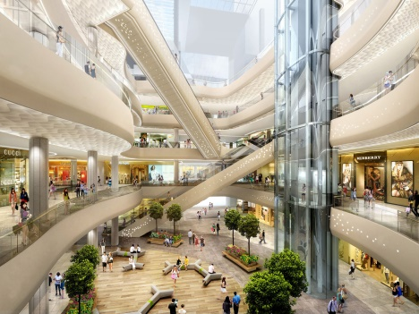
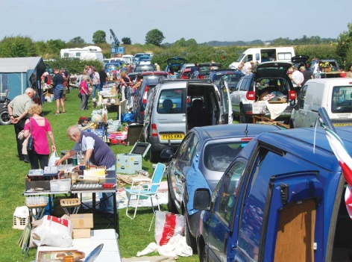
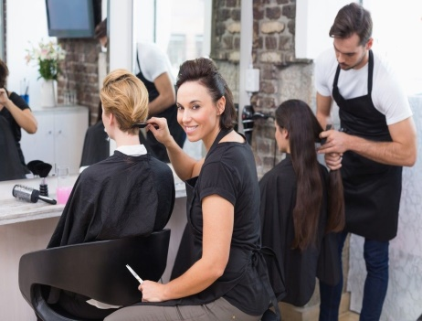
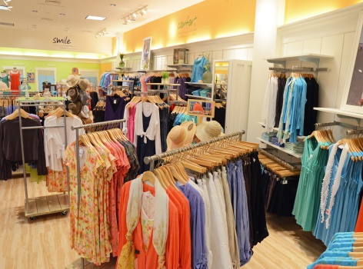
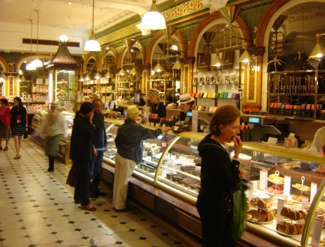
2
+
Look at the pictures, name the shops and pay attention to the pronunciation:
bazaar
post office
shoe shop
flea market
clothes shop
shopping mall
car boot sale
hairdresser’s
department store

Slide 5

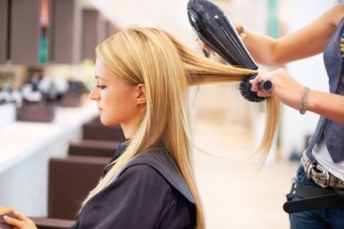
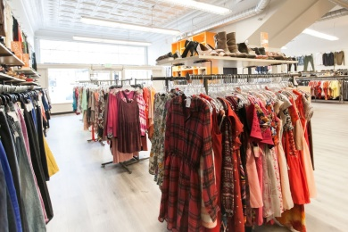
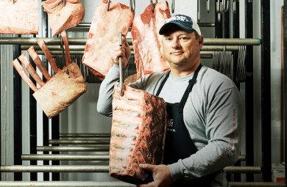

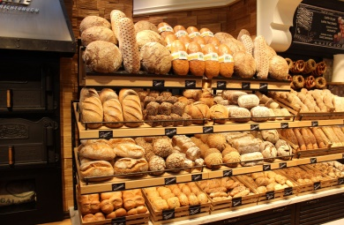
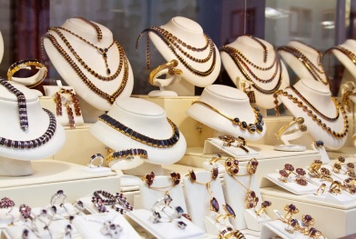
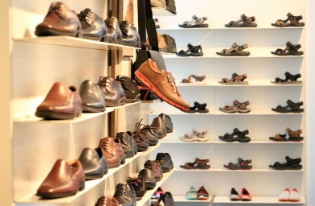
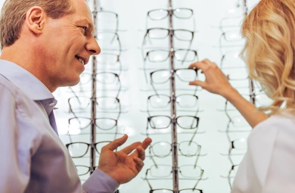
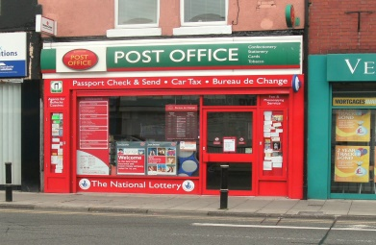
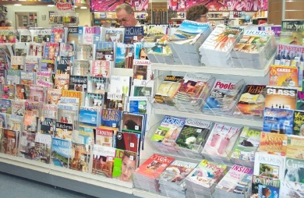
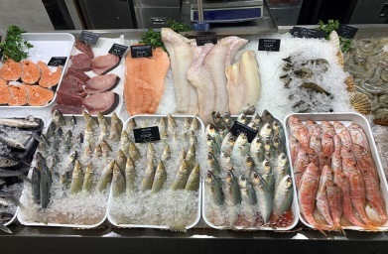
2
+
In which of the shops would you hear the following?
clothes shop
‘Do you have this in an extra large size?’
‘Just a wash and blow-dry, please.’
hairdresser’s
‘A kilo of steak, please’.
‘Do you prefer gold or silver?’
butcher’s
‘These are fresh from the oven.’
chemist’s
shoe shop
‘I’ve come to pick up my prescription.’
baker’s
jeweller’s
‘I take a size five, narrow.’
‘Is this the July issue?’
‘Are you long or short-sighted?’
newsagent’s
optician’s
‘I need to send this first class.’
post office
‘They were caught fresh this morning.’
fishmonger’s

Slide 6
2
+
Match the places to their definitions:
newsagent’s
8.
1. a shop that sells fish
florist’s
4.
2. a shop where you can buy medicines
baker’s
6.
3. a shop that sells eyeglasses
jeweller’s
7.
4.a shop that sells cut flowers and plants
fishmonger’s
1.
5. a shop where meat is sold
butcher’s
5.
6. a shop where bread and cakes are sold
optician’s
3.
7. a shop that sells, makes, and repairs jewellery
chemist’s
2.
8. a shop that sells newspapers and magazines

Slide 7
2
+
Match the places to their definitions:
department store
4.
a shop that sells all
kinds of clothes
6. a shop where you can buy
shoes
shopping mall
2.
2. a large shopping area
with a lot of different shops
car boot sale
8.
7. small shops selling things
of the same type
bazaar
7.
3. a shop with a person
who cuts people's hair
8. a public place where
people sell their unwanted
things from the backs of
their cars
flea market
5.
4. a large shop divided
into several different parts, each of which sells
different things
hairdresser’s
3.
shoe shop
6.
9. a place where stamps are
sold and from where letters
and parcels are sent
post office
9.
5. a market outside
where old or used goods
are sold cheaply
clothes shop
1.

Slide 8
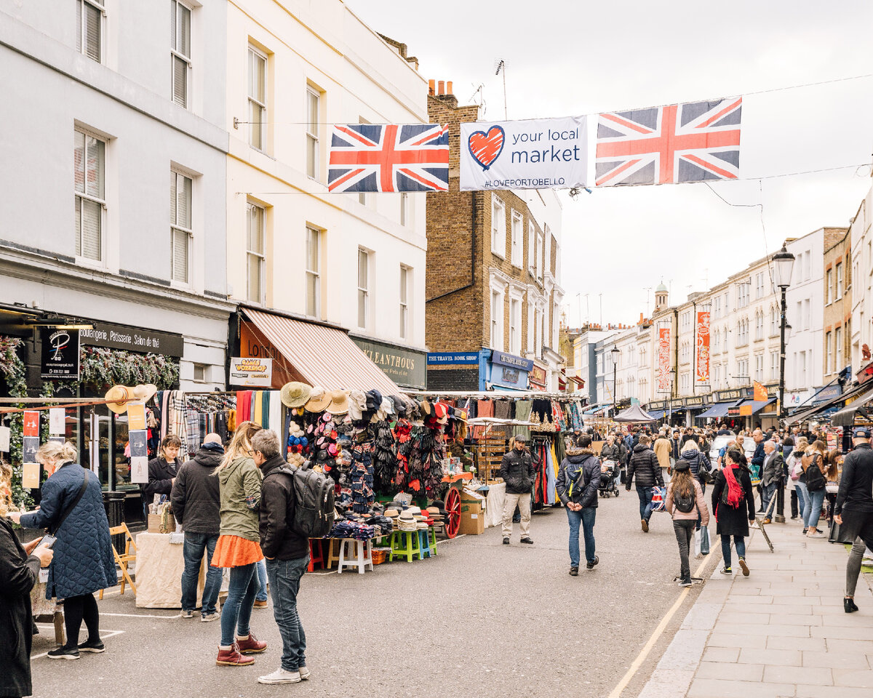
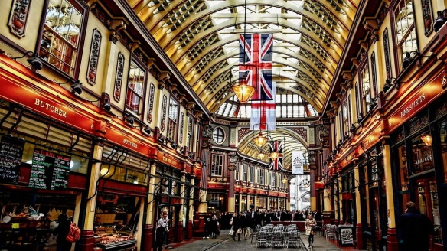
2
+
Read the dialogue and use the ideas from the box to make a new dialogue:
9:30 at the underground station / shoes / only £50 / on Sunday /
At Longchester, in the town centre / last weekend
-What nice sunglasses! Are they new?
-Yes, I bought them a couple of days ago. I’m glad you like them.
-They really suit you. Where did you get them?
-At ‘Stacey's’, in the town centre.
-Whereabouts is it exactly?
-In Crimpson Street, opposite the baker’s.
-Were they very expensive? -No, not at all. They were only £20.
-That’s a bargain. I think I’ll go and have a look myself on Saturday.
We can go together if you like.
-Great. 10:30 at the bus station.
-OK! See you there.
shoes!
last weekend.
-At Longchester, in the town centre.
- In Old Gloucester Street, near the Queen Square Park.
only £50.
on Sunday.
9:30 at the underground station.

Slide 9
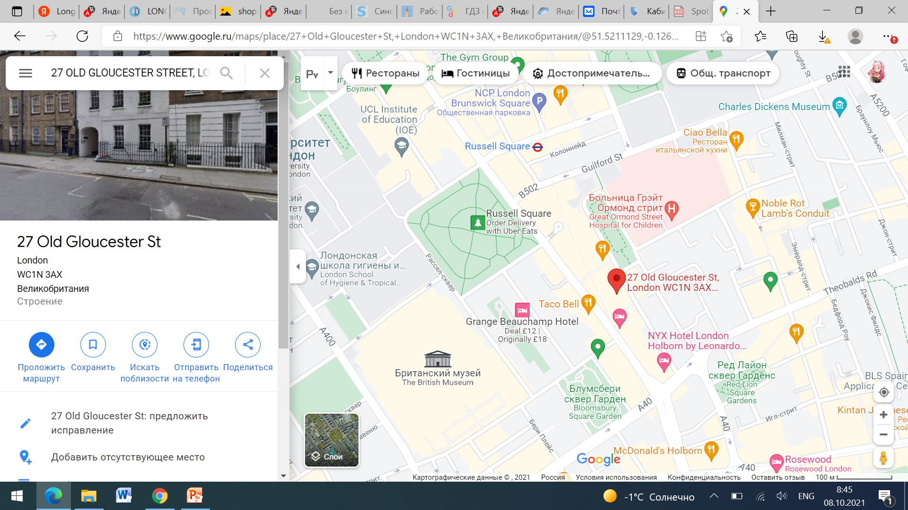


Your friend got ill and couldn’t come. It’s 9:30. You are alone at the station.
You don’t know how to get to the shop. Ask someone for the way.
Describe the second route and write
down the dialogue.
-Excuse me, how can I get to the shoe shop? Is it far?
It’s not far from here. It’s just a
ten-minute walk. Go straight ahead
and take the first turn on your left.
Then go straight on and turn left at
Guilford St. Go across the park and
there’s Gloucester St. on your right.
Asking for directions:
-Excuse me, how can I get to …? Is it far?
-Excuse me, can you tell me the way to…?
Giving directions:
- It’s not far from here.
It’s just a ten-minute walk. Go straight ahead and take the first turn on your left. Then go straight on and turn right at Guilford St. Opposite the Russell Square turn left and go straight on.
The shop is opposite Taco Bell.
Your destination point.

Slide 10
2
+
Today at the lesson
you have……
learnt…
memorised…
how to work with definitions of the words
(Ex., florist’s is a shop that sells cut flowers and plants)
the names of different shops
(Ex., car boot sale, flea market,
fishmonger’s, etc.)
revised…
found out…
phrases you can hear in different shops and while talking to your friend
(Ex., ‘Do you have this in an extra large size?’ ‘I think I’ll go and have a look myself on Saturday. We can go together if you like’.)
how to ask for and give directions
(Ex., -Excuse me, how can I get to …? -Go straight ahead and take the first turn on your left. )

