Slide 1
Открытый урок
английского языка
в 10 “ А “ классе
Учитель : Ермакова Н.О.
.
Владикавказ МБОУ гимназия № 45
2022 г

Slide 2
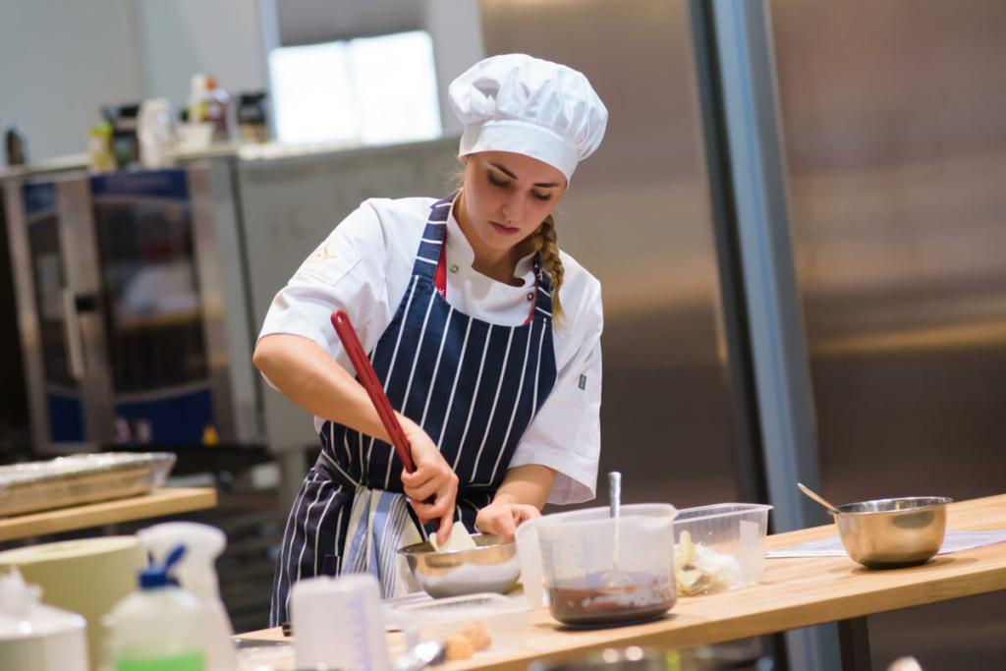
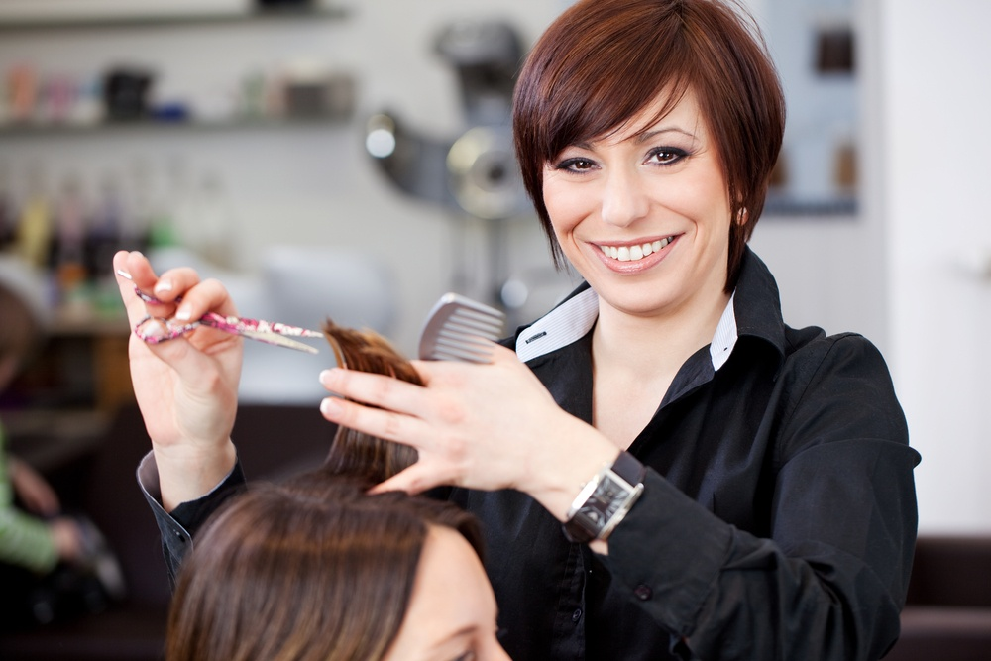
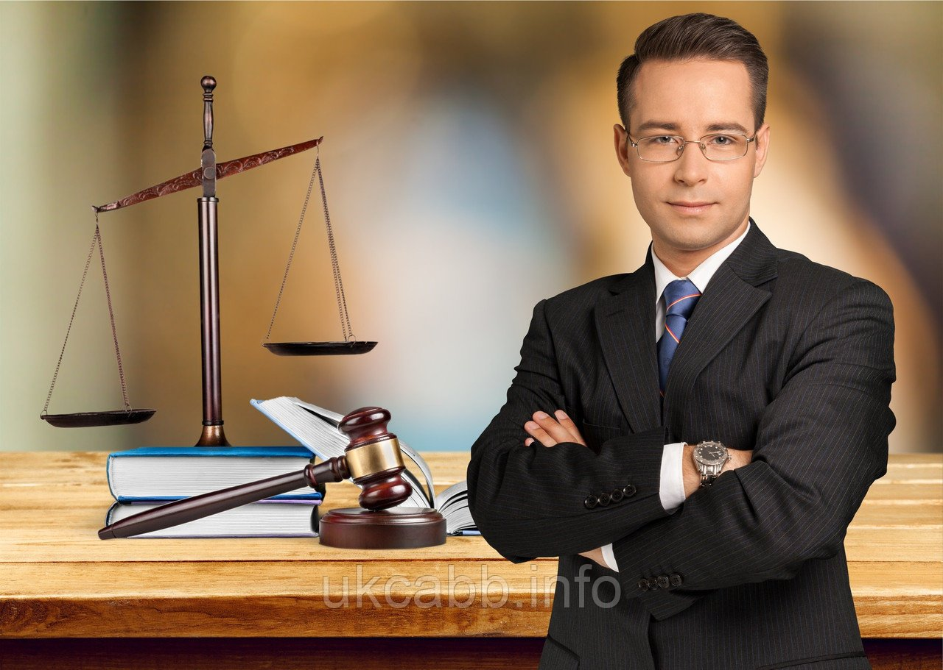
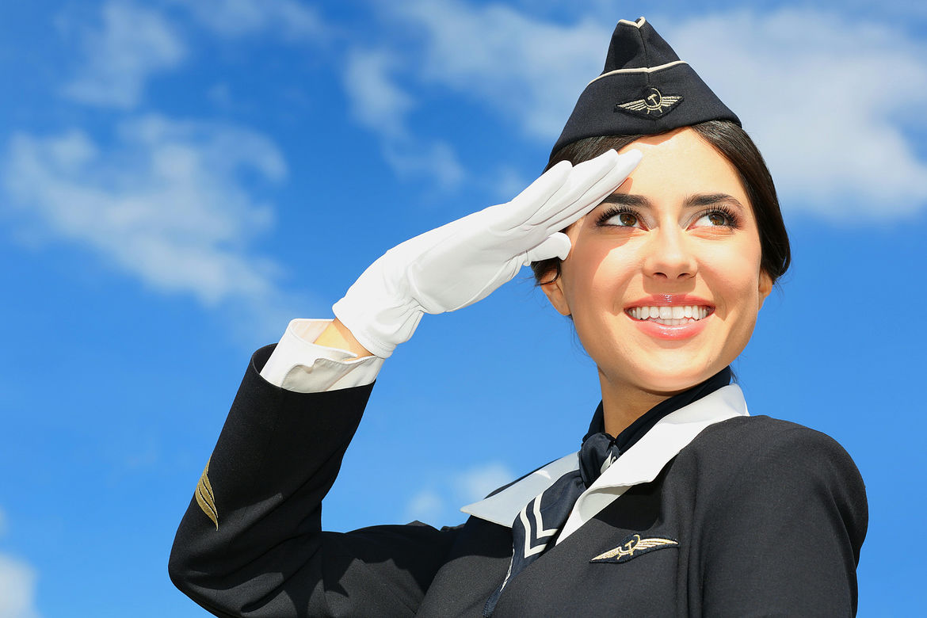

Slide 3
“The ticket to the future
or
the next step
to my future profession ”

Slide 4
Human
Humanus (Lat.)

Slide 5
Humanities
History
Social studies
Literature
Foreign languages
Jurisprudence

Slide 6
Humanitarian subjects
Professions
History
Lawyer
Jurisprudence
Historian
Social studies
Journalist
Literature
Linguist
Foreign languages
Interpreter

Slide 7
requirements
(skills, abilities)
categories
JOB
interview
payment

Slide 8
The answers:
medical emergency skilled armed shift highly-qualified common self job | profession services job forces work staff sense employed burnout

Slide 9


Slide 10
Tenses and forms to describe the future
Present Continuous
Am/is/are+Ving
Present Simple
V( Vs)
To be going to
Am/is/are going to+V
Future Simple
Will+V
Future Continuous
Will be+Ving
Future Perfect
Will have +V3

Slide 11
Present Simple or Present Progressive?
1” Attention, please”! The boat (sail) in a few minutes.
2 When the interview (begin)?
3-We can’t go to the sea.
- We (have) our exams in the first week of June.
4 Ice (melt) in a warm climate.
5 Be quiet. I (think).
6 We (have) a party tomorrow.
I have written all the invitations.

Slide 12
Future Simple or To be going to?
1 - What are your plans for the weekend?
- I (visit) my friend Kim in London
2 - It’s really hot in the office!
-I (open ) the window.
3 - Did you see that job advert in the newspaper?
- Yes, I (fill out) an application form tomorrow?
4 - I’m having trouble writing my CV!
- I (help) you if you want.
5 -There are no potatoes left.
- Ok.I (buy) some.

Slide 13
Future Continuous or Future Perfect :
1 -This time next week I (take) my driving test.
- Good luck !
2 - I am really hungry!
- Don’t worry. I (cook) lunch by the time you get home
3 -Have you tidied the room yet?
- No, but I (do) it by the time you get home.
4 This time next month ( relax) in the sea.
5 We (fly) non- stop for four hours before we get to Rome
6 I am not sure John (not read) “War and Peace”
by the end of the year.
7 By six o’clock John (play) on a computer for 5 hours.

Slide 14


Slide 15
What is the most important thing
in your future job?
Job security Career growth Being useful to society A good atmosphere Salary Meeting new people | Friendly boss and colleagues Travel opportunities Flexible working hours Development of skills

Slide 16
My future profession
As for me….
I’m going to be
I would like to follow my father’s steps …
I definitely hope…
But I can’t stand…
My goal is …
In my case…
The main reason of my choice is…

Slide 17


