Slide 1
Chores in my life: funny or boring? grade 3 Teacher: Tatyana Vasilyeva

Slide 2
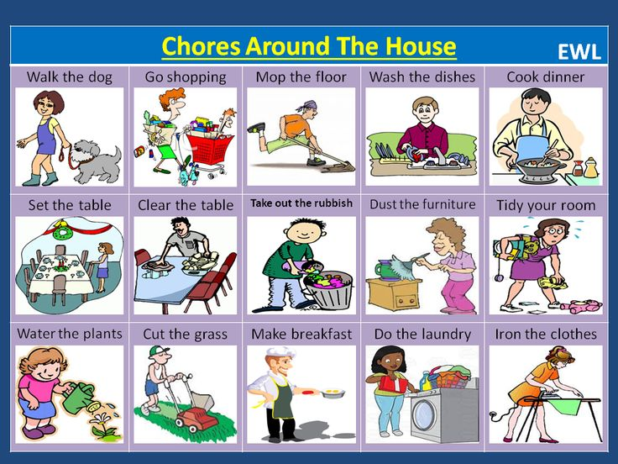
What chores do you do?

Slide 3
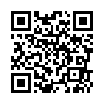
Match the words

Slide 4
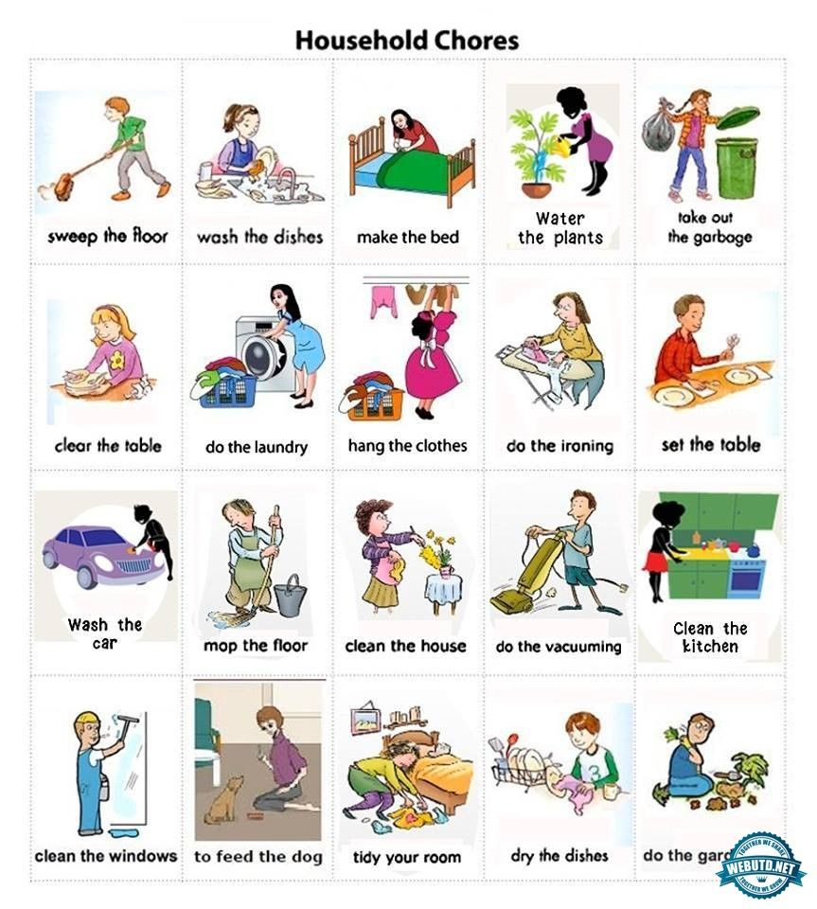
How often do you …?
Once
Twice a day
Three a week
times
a month
Four
times

Slide 5
Ask your friends

Slide 6
Open the brackets:
1. We always …………………….(dust) the furniture.
2. My cousin ……………………….(sweep) the floor now.
3. We ……………………….(water) the flowers now.
4. Look! They …………………….(wash) up.
5. My mum always……………………..(cook) breakfast for our family.
6. Before bed, we often…………… …(read) books.
7. My friends …………………….(play) computer games now.
8. My sister never …………………..(iron) the clothes.
9. Listen! They ……………………(watch) TV in the living room.
10. I hardly ever …………………(take) out the rubbish in the evening.

Slide 7
Listen to the text and fill in the words
We’ve got a robot. It lives in our house. It’s name is Blip. It’s grey and it’s got four eyes.
Blip __________ makes our breakfast in the morning.
After that, we go to school and Blip stays at home. It tides ____ our books and toys. Then it ________.
After school, it plays with us. We sometimes play computer games, but Blip usually likes reading __________.
Before bed, we always play chess. Blip’s very good _____ chess.

Slide 8
Check up
We’ve got a robot. It lives in our house. It’s name is Blip. It’s grey and it’s got four eyes.
Blip always makes our breakfast in the morning.
After that, we go to school and Blip stays at home. It tides up our books and toys. Then it dusts.
After school, it plays with us. We sometimes play computer games, but Blip usually likes reading comics.
Before bed, we always play chess. Blip’s very good at chess.

Slide 9
Group task Make up a project of your robot. Share your chores with it.
We’ve got a robot. It lives in our house. It’s name is ….. It’s ….
In the morning….
After that……….
Then it…………..
After school, it…..
Before bed…..

Slide 10
Homework
Draw your robot.
What chores does he do?
Tell the class about your robot.

Slide 11



