Slide 1

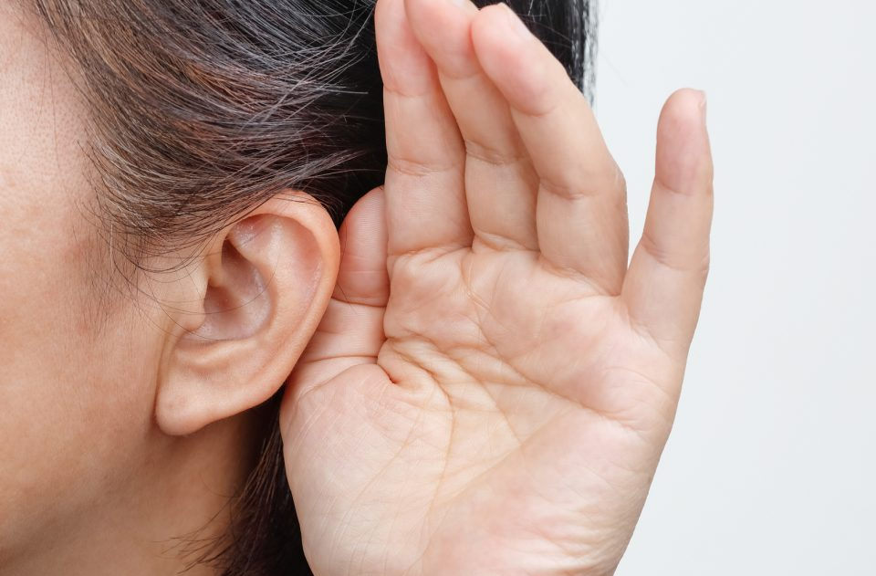


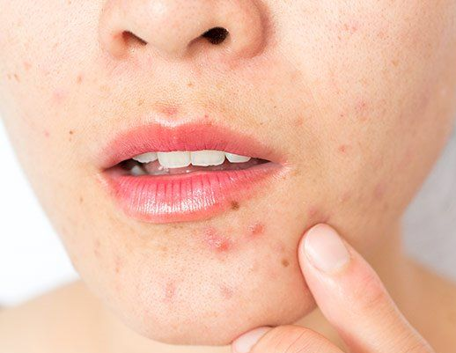
TECHNOLOGY & HEALTH

Slide 2

Practical case

Slide 3
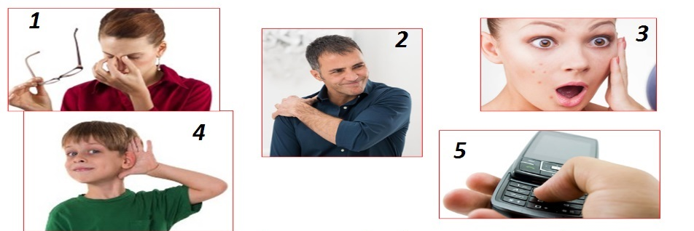
Card 1. Match the “problems” to the pictures.
a skin infection
eye strain
thumb arthritis
shoulder strain
hearing loss

Slide 4
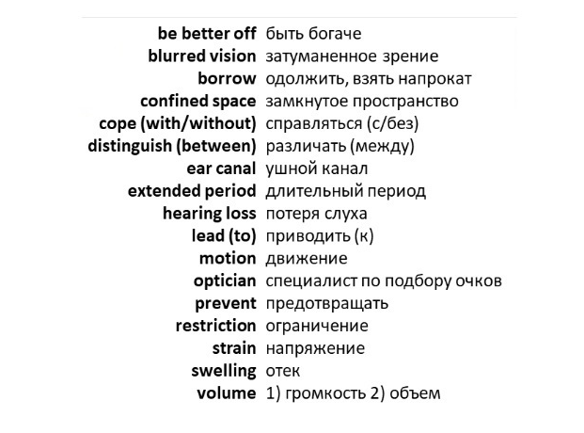
Card 2. Study the topic vocabulary

Slide 5
Use your laptop & go to the link
https://learningapps.org/16878424

Slide 6
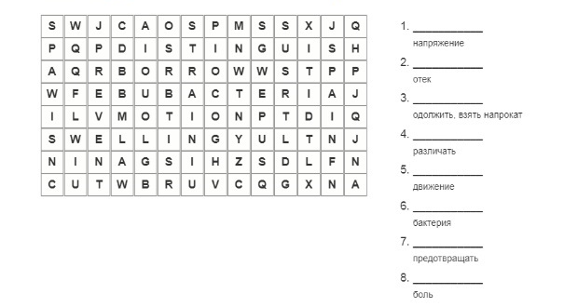
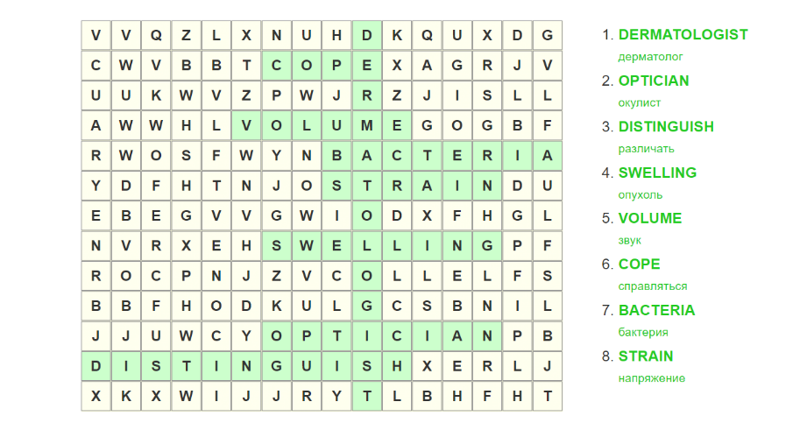
Card 3. Find the words in English

Slide 7

Relax time. Watch the short video.

Slide 8

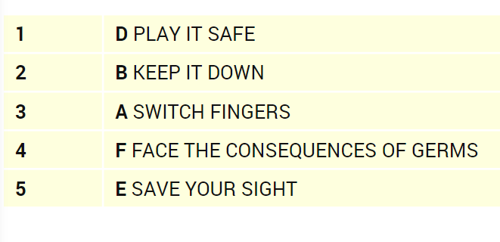
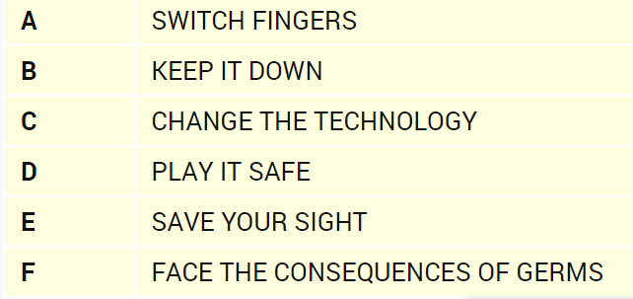
Card 4. Match the headings (A-F) to the paragraphs (1-5). There is one extra heading.

Slide 9
What 3 modal verbs are used in the text? (use a helping card 5)
Can
Must
Should
Уметь
Быть обязанным
Следовать

Slide 10
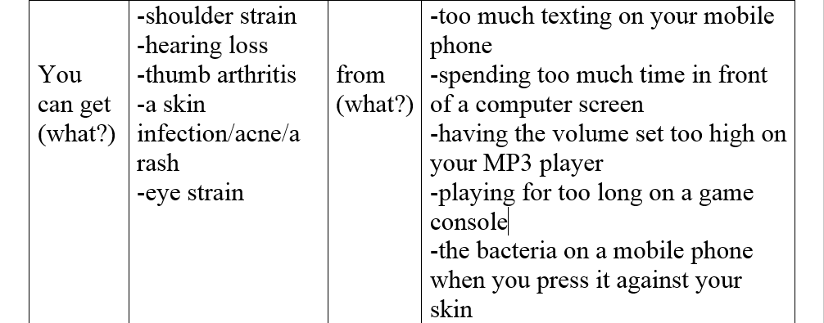
Card 6. Answer the question “How are the health problems related to the gadgets?”

Slide 11
Card 7. Reflection. Answer the questions.
What did you like in our lesson?
What difficulties have you had?
Have you learnt anything new?
What is your favourite gadget?
How can modern technologies affect our health?

Slide 12

Thanks for the hard work! Good bye!

