Slide 1

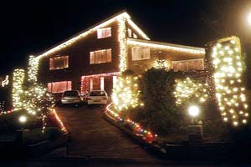
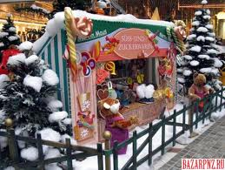
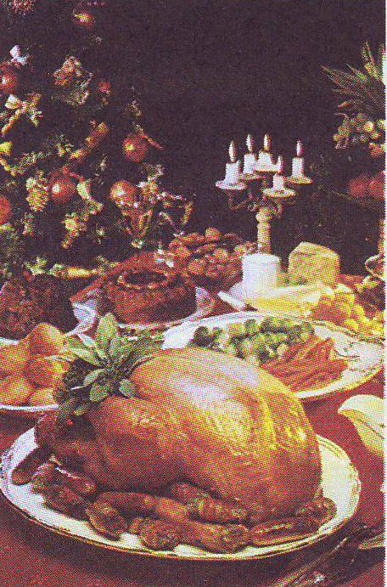
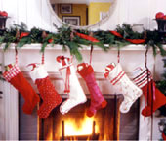

Slide 2
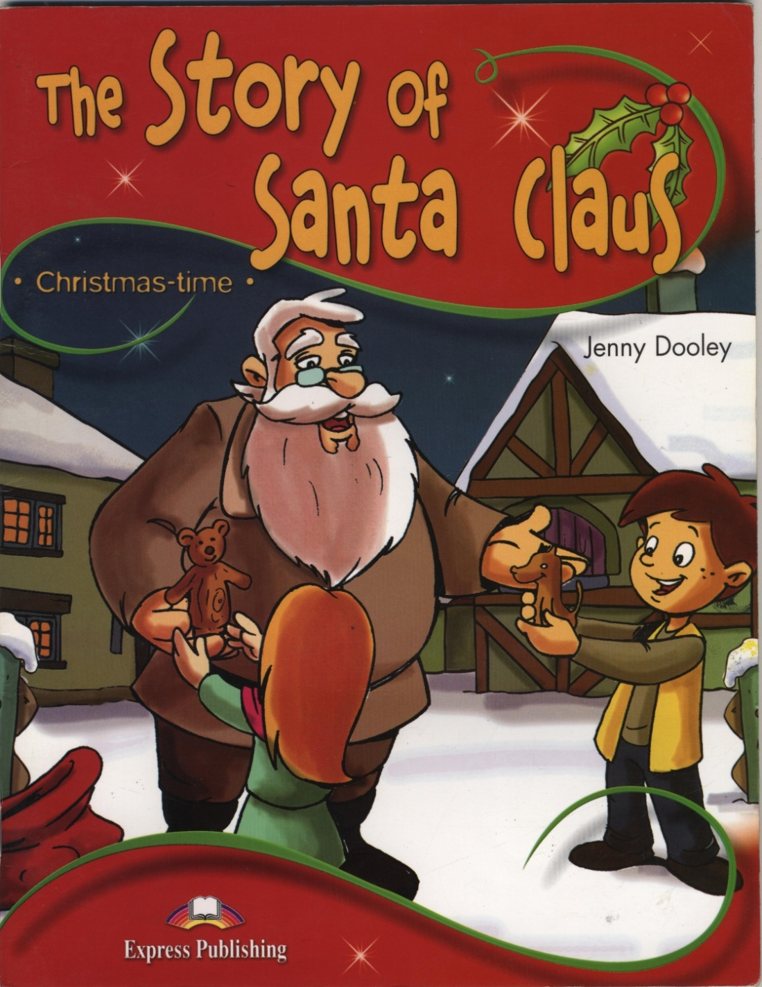
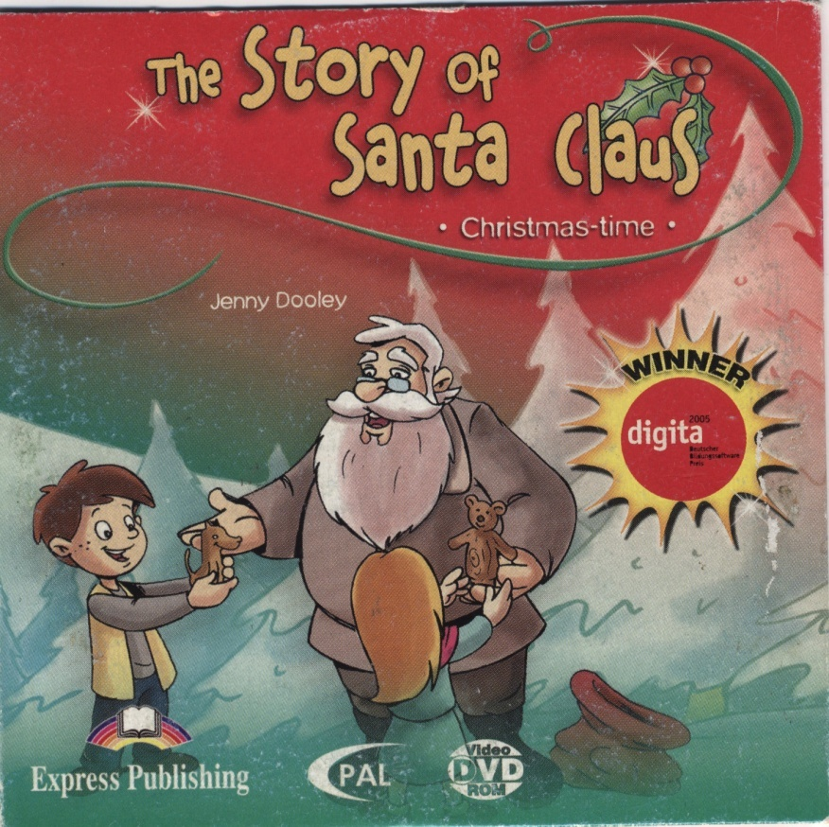
By Jenny Dooley

Slide 3
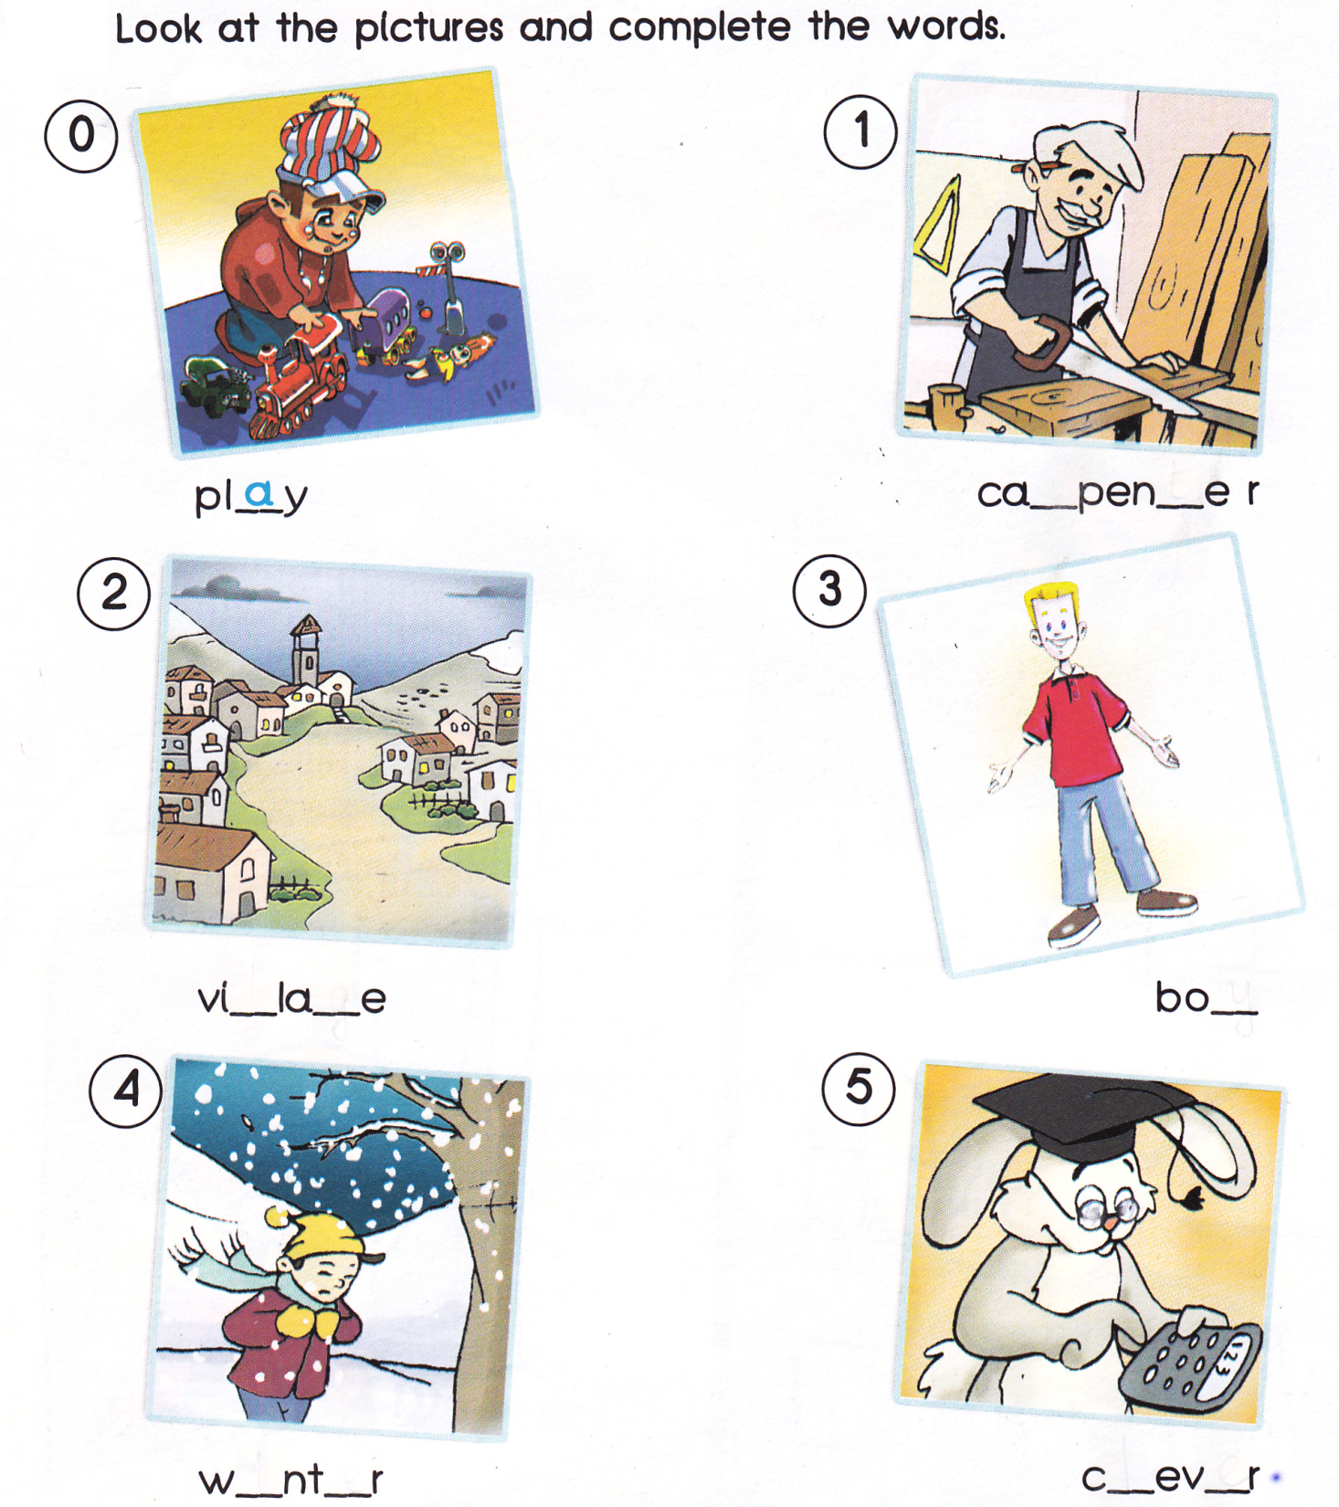
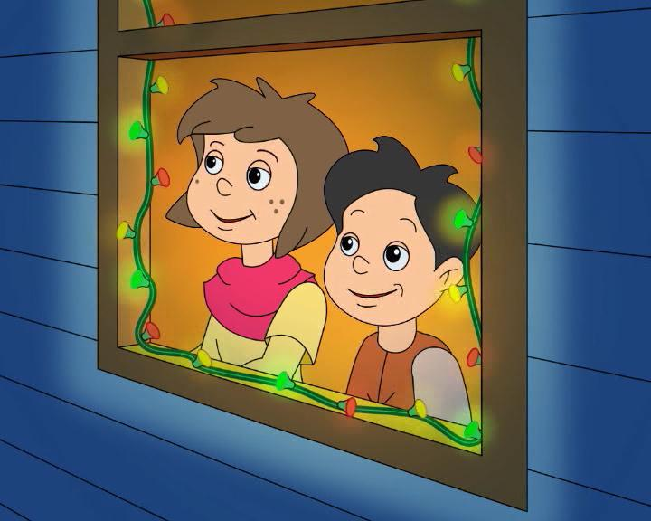

Slide 4
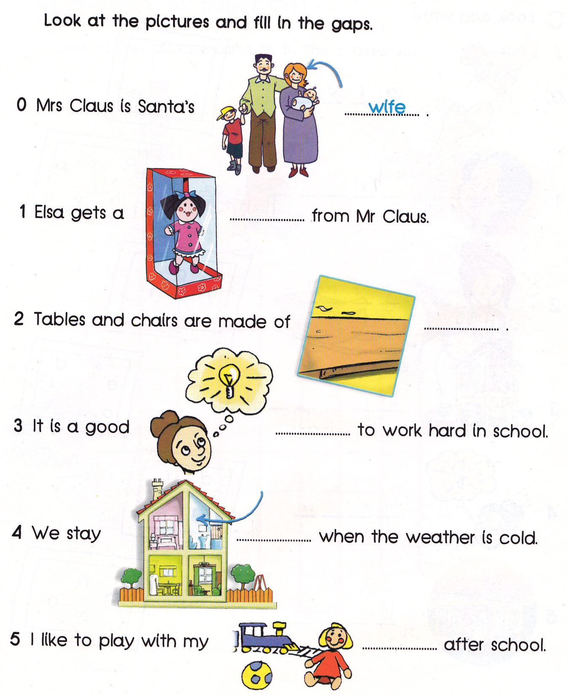
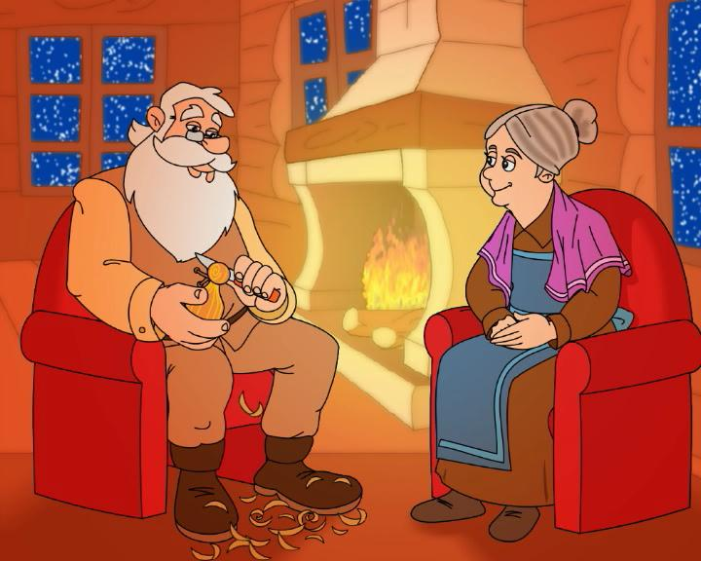

Slide 5
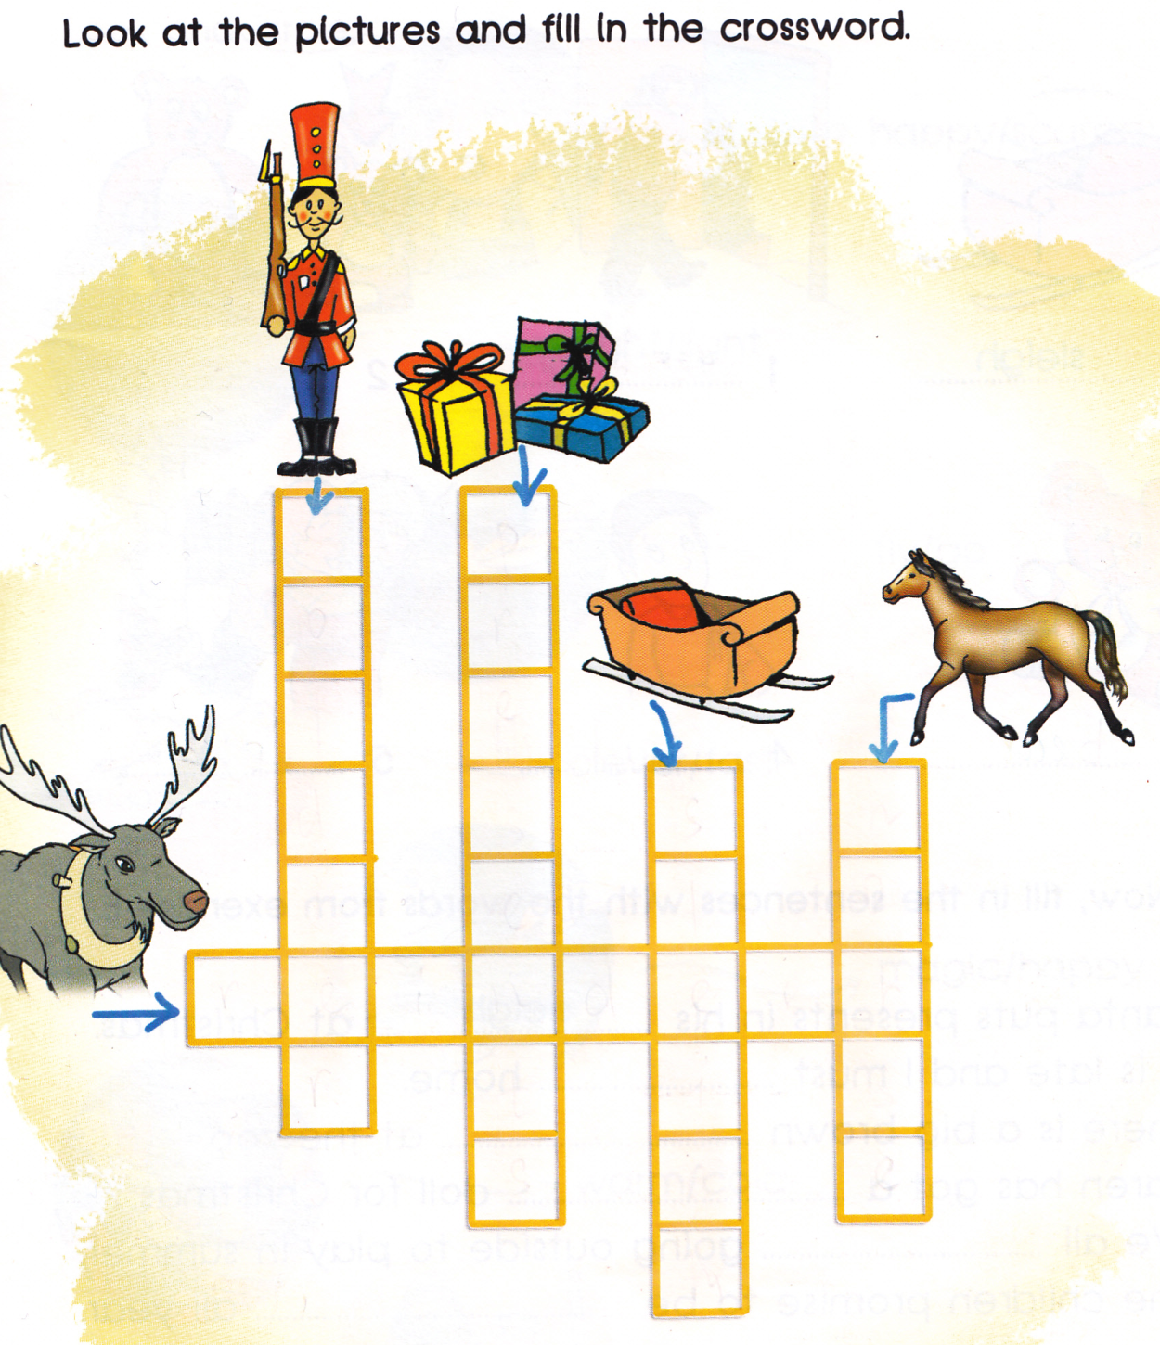

Slide 6
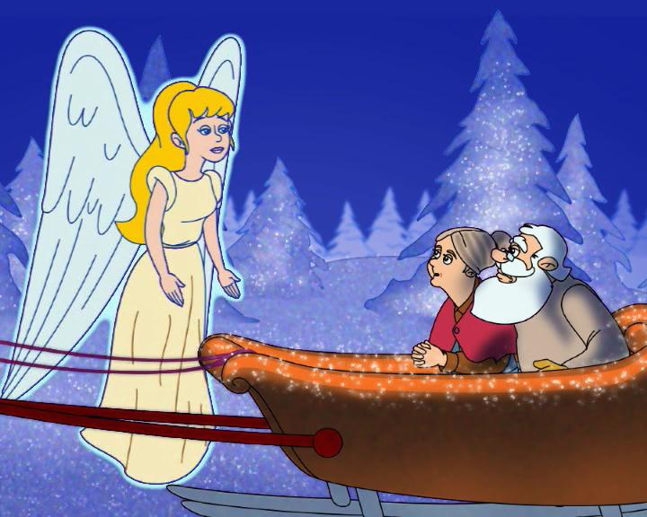
Who says it? S for Santa,
M for Mrs Claus and A for the angel
0 “It’s so cold this winter, the children can’t play.” S
1 “Can you make more?”
2 “We must go now. We’ve got lots to do.”
3 “Oh dear. It’s so cold, and now it is night.”
4 “Here, take this coat.”
5 “These magic reindeer can help you to fly.”
6 “Now you can give presents year after year.”

Slide 7
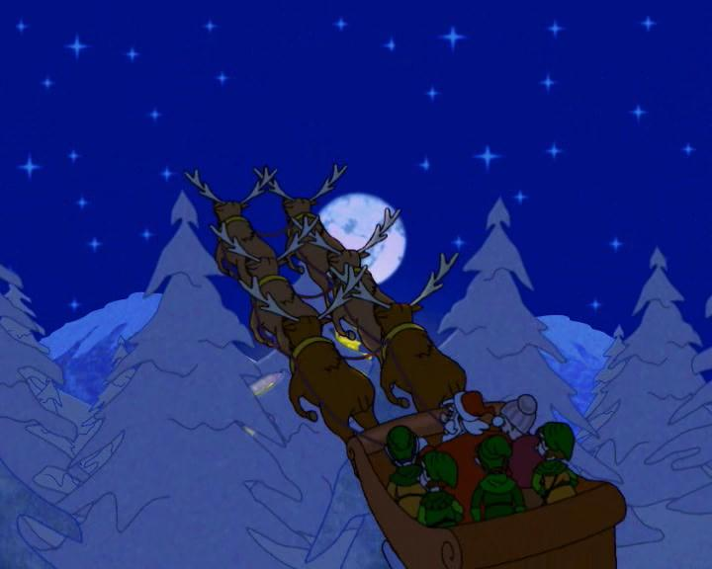
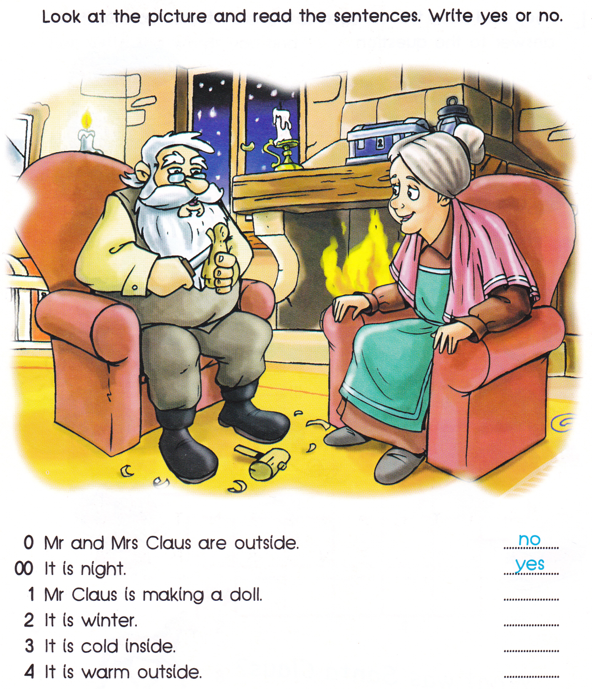
yes
yes
no
no

Slide 8
This is Mr Claus, a carpenter. He lives in the cold North with his wife, Mrs Claus.
An angel
On Christmas Eve,
Mr and Mrs Claus take
their sleigh and reindeer.
Christmas Eve
Mr and Mrs Claus are on their sleigh. An angel sees them.
The North

Slide 9
Put the sentences in the right order
They go to the village to give the toys
to the children.
b) On Christmas Eve, they give them
to the children.
c) They love children very much,
but they don’t have any.
d) So, every year, Mr and Mrs Claus
make toys.

Slide 10
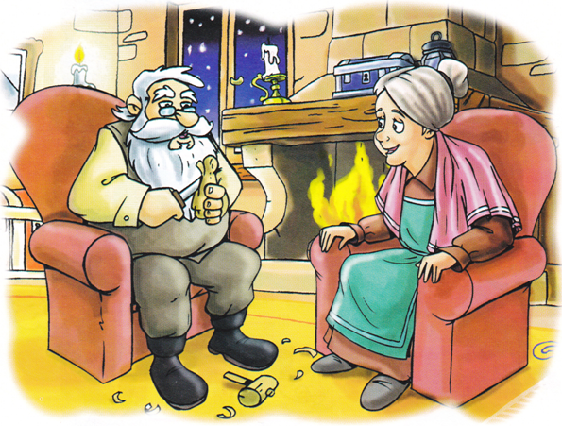
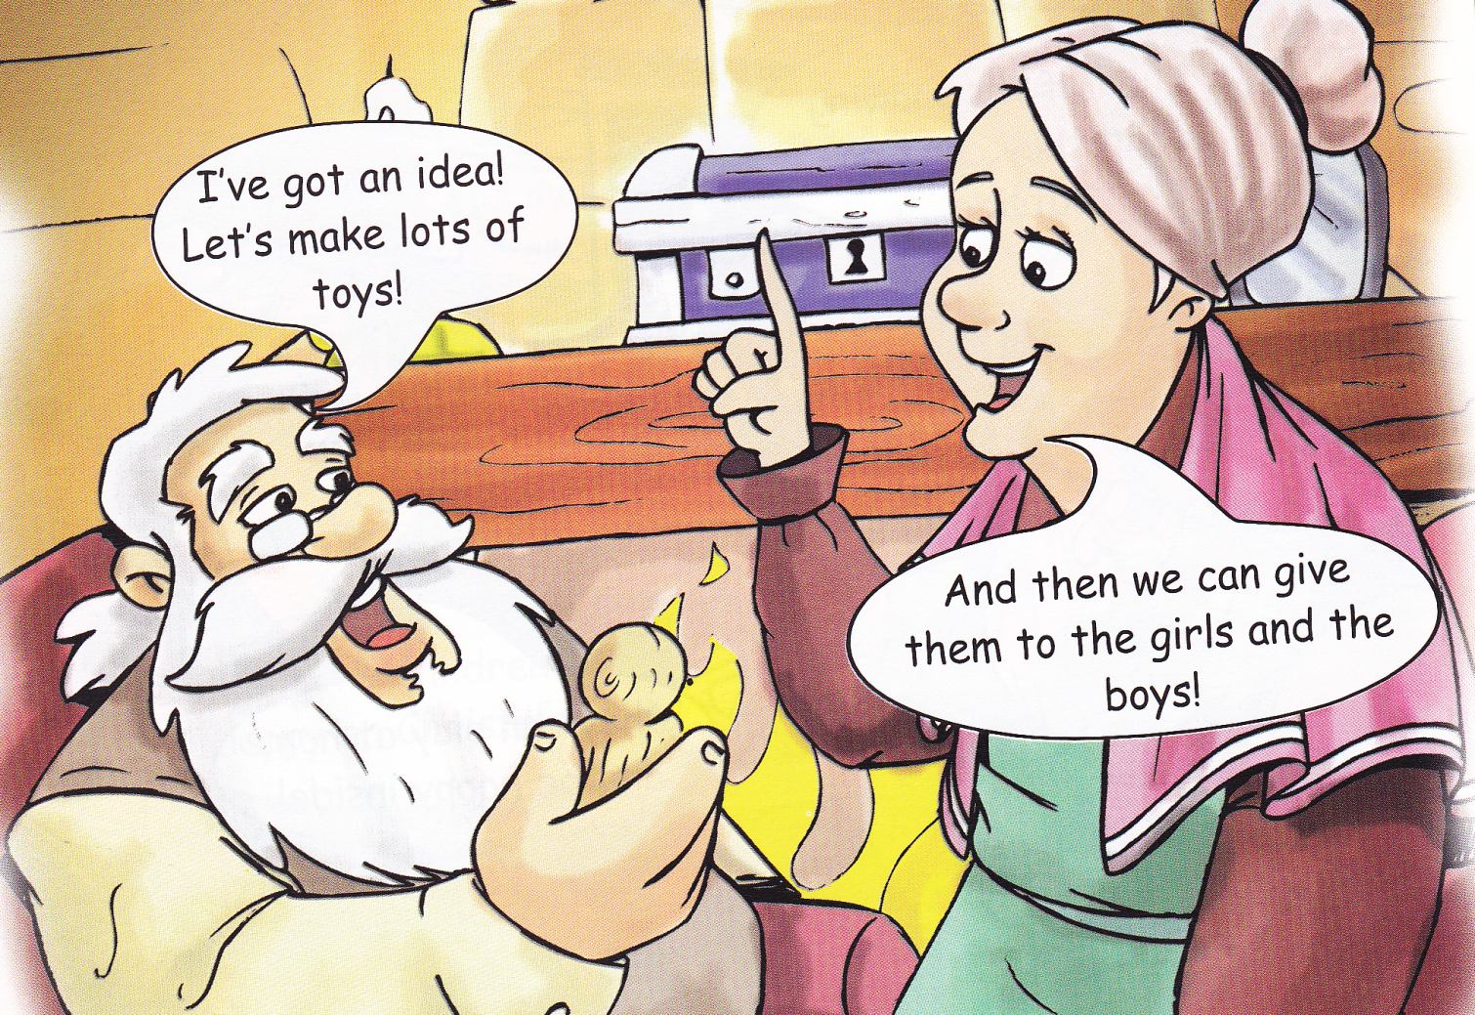
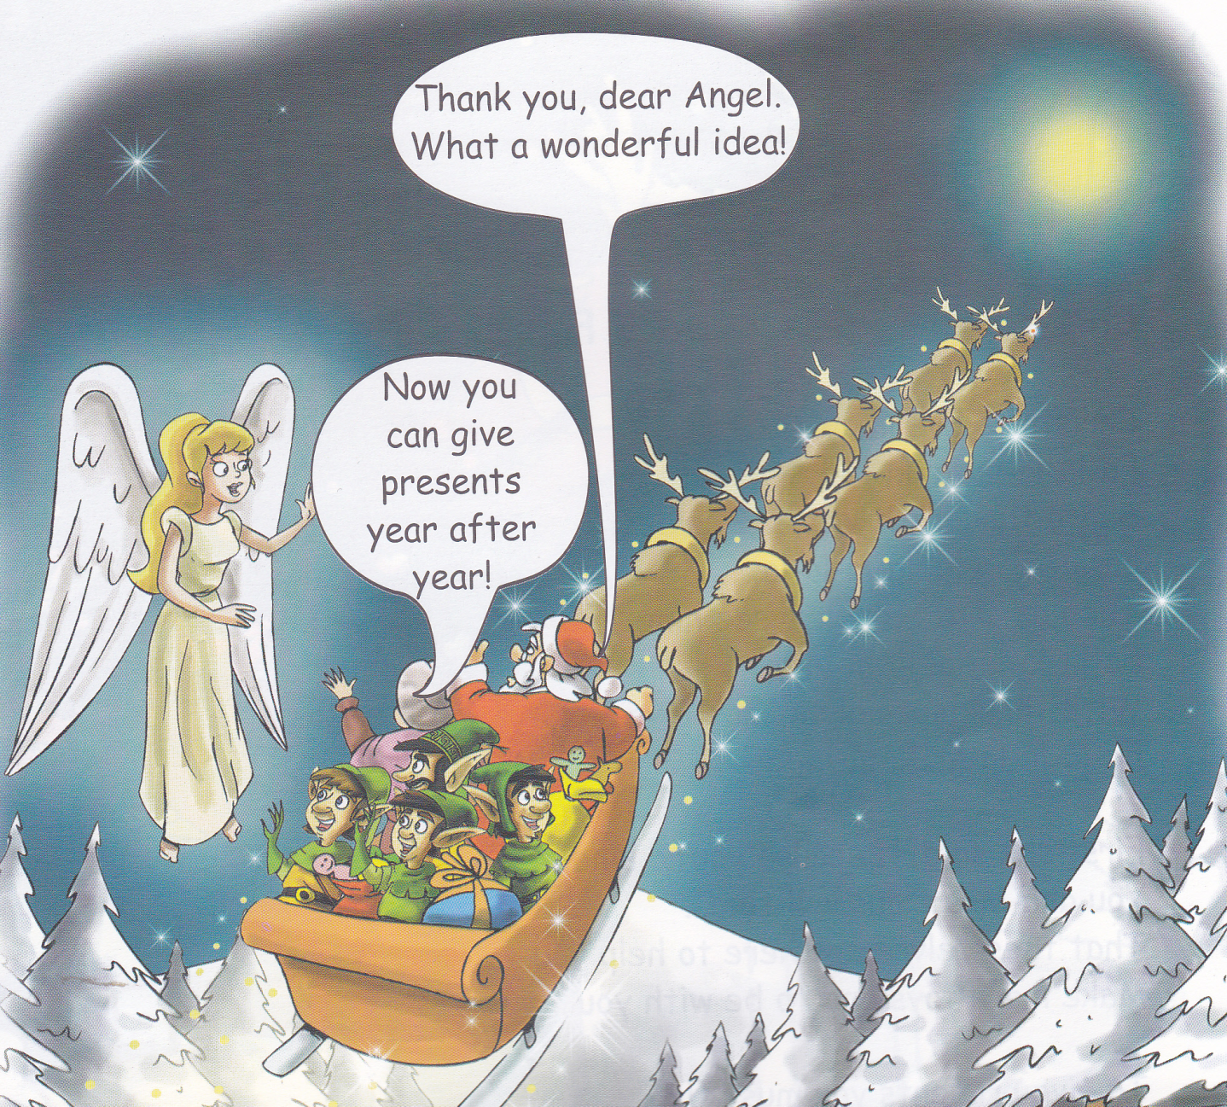
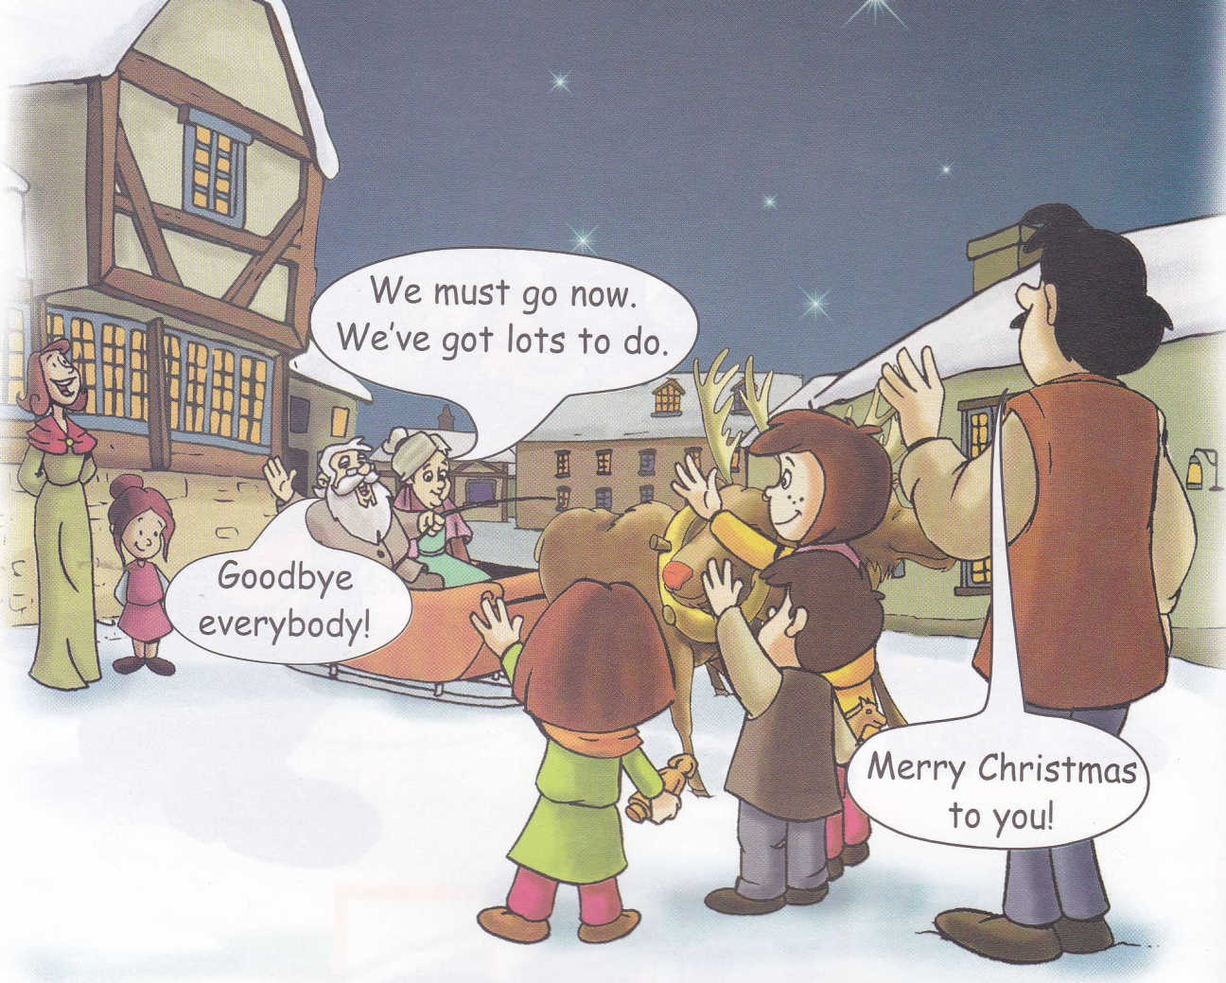
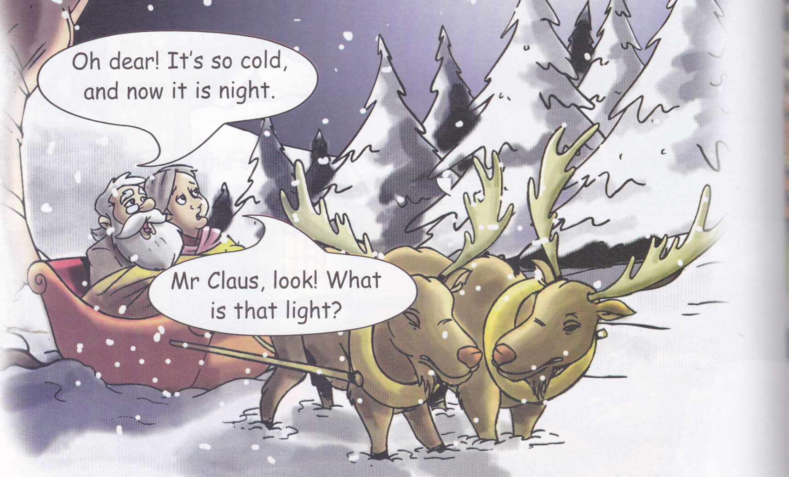

Slide 11
My favourite character

Slide 12


