Slide 1
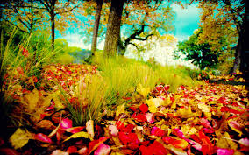
Once in a blue moon

Slide 2
COLOURS like music,louder than any words

Slide 3
Plan
1. To uderstand the meaning of colours.
2. Adjectives,describing characters of people in connection with colours.
3. Coloured idioms.
4. Conclusion about the role of colours in our world.

Slide 4

1. Have you ever thought about the meaning of colours?
2. Do the colours play any role in our life?
3. What can a colour tell about a person?
4. What preferences do you have?

Slide 5
So what does the colour mean?
Black - People who choose black as their favourite colour are often artistic and sensitive. While these people aren't introverts, they are careful with the details of their lives and do not share easily with others.
White - People who like white are often organized and logical and don't have a great deal of clutter (disorder, untidiness) in their lives.

Slide 6
Red -Those who love red live life to the fullest and are tenacious (цепкий/ упорный) and determined.
Blue - If blue is your favourite colour you love harmony, you are reliable, sensitive and always make an effort to think of others. You like to keep things clean and tidy and feel that stability is the most important aspect in life.
Green -Those who love the green colour are often loyal and frank. Green lovers are also aware of what others think of them and consider their reputation very important.

Slide 7
Yellow - You enjoy learning and sharing your knowledge with others. Finding happiness comes easy to you and others would compare you to sunshine.
Purple - You are artistic and unique. You have a great respect for people but sometimes you can be arrogant (высокомерный).
Brown - You are a good friend and try your hardest to be reliable and dependable. Flashy objects are not something you desire; you just want a stable life.

Slide 8
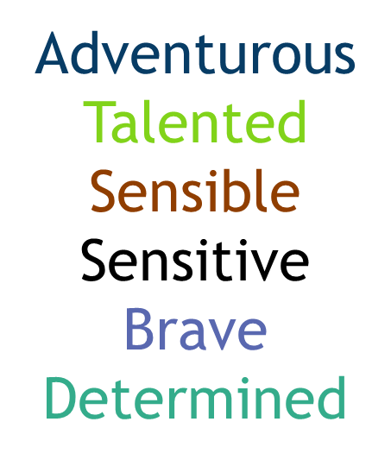
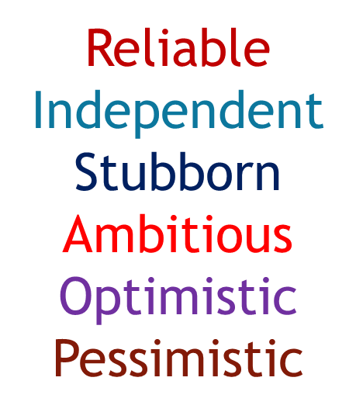

Slide 9
Joyful-yellow
Sociable-red
Conservative-brown
Passive-grey
Tidy-
Gloomy-black
white

Slide 10
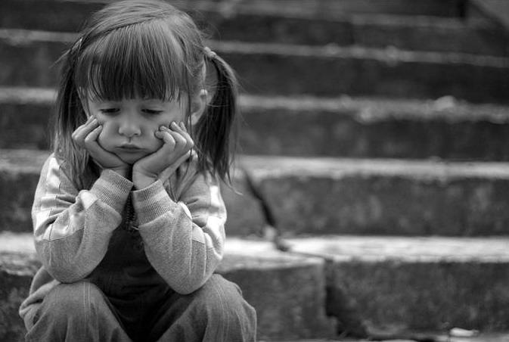
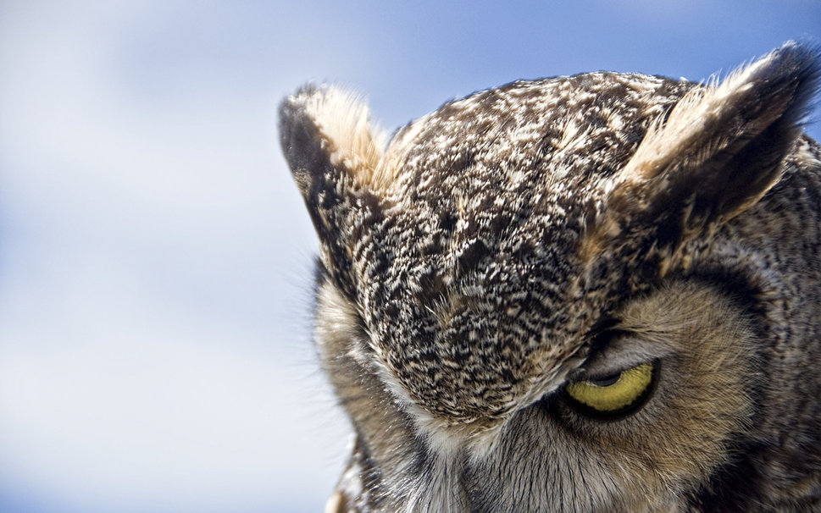

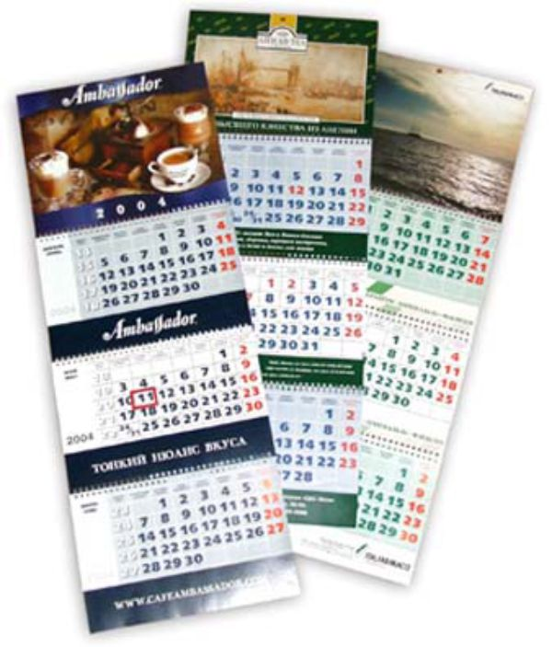
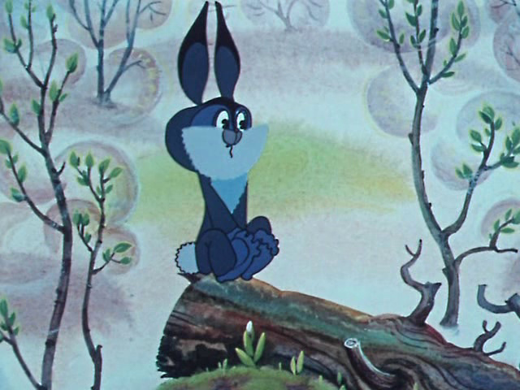
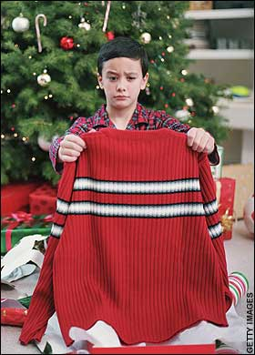
To give a black look
Once in a blue moon
To be ( feel) blue
To be like a red rag to a bull
A white elephant
To be yellow ( быть трусом)
a
b
c
d
e
f

Slide 11
“Colours are the smiles of nature”. -
Leigh Hunt
"If you could say it in words, there'd be no reason to paint." - Edward Hopper
“Like emotions, colours are a reflection of life." - Janice Glennaway

