Slide 1
Приемы развития умений аргументированного высказывания в задании с развернутым ответом письменной части ЕГЭ.
МБОУ г.Мурманска «Гимназия №1»
Красникова О.А.
Учитель английского языка

Slide 2
2. Раскрываем свое мнение и приводим аргументы.
1) четко раскрыть свою точку зрения в начале ВТОРОГО абзаца;
2) обосновать свою точку зрения с помощью 2-3 аргументов.
3. Прописываем точку зрения оппонентов и подкрепляем ее 1-2 аргументами.
4. Доказываем несостоятельность точки зрения оппонентов = опровергаем их аргументы.

Slide 3
Доказываем несостоятельность точки зрения оппонентов =
= опровергаем их аргументы.
показать, что:
— аргументы оппонентов не имеют отношения к нашей теме (они они про другое: например то, в чем убеждают нас оппоненты касается настоящего, а в будущем все будет уже не так);
— рассуждения оппонентов нелогичны, их выводы неверны;
— проблемы, о которой говорят оппоненты, не существует ИЛИ она не касается того, о чем говорится в теме ИЛИ для нее есть простое решение.

Slide 4
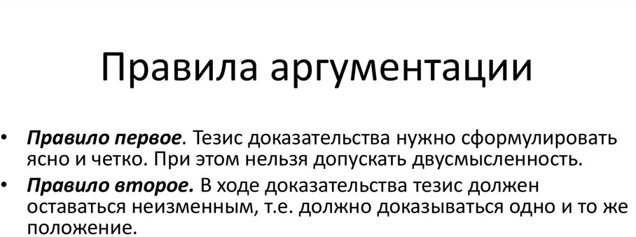

Slide 5
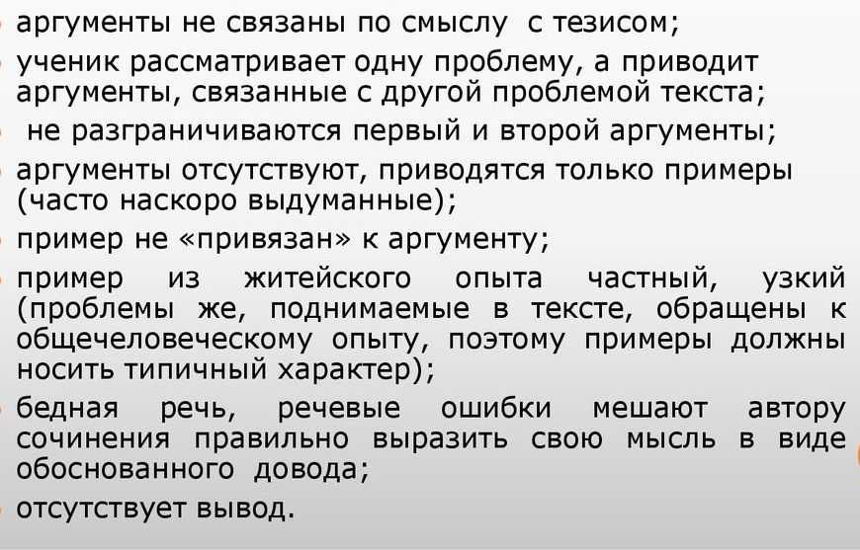
Типичные ошибки.

Slide 6
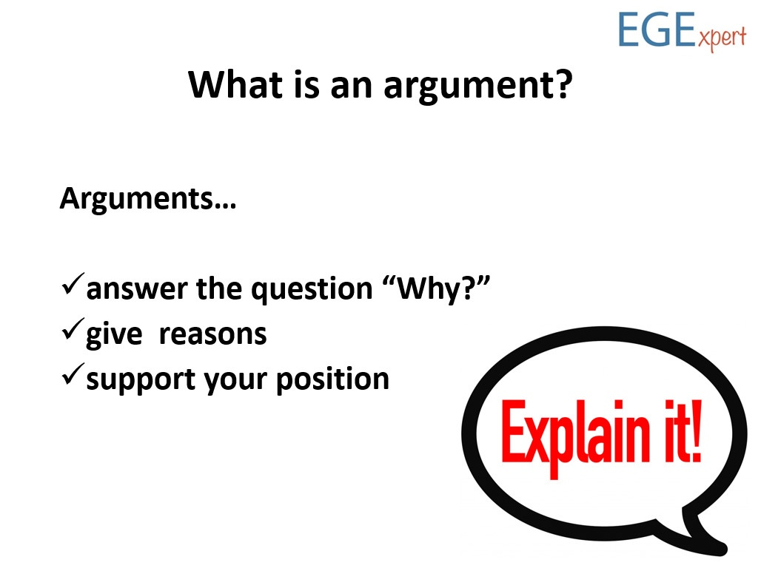

Slide 7
Factor | Why?

Slide 8
Advantages | Why ?

Slide 9
Benefits of volunteering.
Match the viewpoints with the examples/results/reasons.
Viewpoints | examples/results/reasons
1.gain new experiences | a. volunteering takes commitment and dedication
2.meet a wide range of people | b. do a sponsored sky dive to raise money for a charity
3.develop transferable skills | c. improve social skills
4.impress employers | d. fundraising can help develop budgeting skills

Slide 10
By volunteering you can gain new experiences. For example, you could do a sponsored sky dive to raise money for a charity.
Another benefit of volunteering is that you get to meet a wide range of people and , as a result, you can improve your social skills.
Also, volunteering can help you develop transferable skills. For example, learning about fundraising can help develop budgeting skills.
Finally, it will impress employers too as volunteering takes commitment and dedication.

Slide 11
Use the prompts to complete the main body paragraphs
Opinion: volunteering helps to gain valuable skills.
Improve your communication skills
Develop teamwork skills by working with others
Make you more desirable to employers
Volunteering helps you to gain valuable skills.
For example, you can improve your
communication skills and develop teamwork
skills by working with others. As a result, you
will make yourself more desirable to employers.

Slide 12
Opinion: working without pay is not real work.
Regular employment rules do not apply
No consequences for making mistakes as in paid employment
You cannot get tired from a job you do for free
Working without pay is not real work. As a
result, regular employment rules do not apply.
For example, there are no consequences for
making mistakes as there are in paid
employment. Moreover, you can no get tired
from a job that you do for free.

Slide 13
Opinion: charity work helps you stand out from crowd.
Taking part in meaningful activities in spare time
Employers see you are well-rounded with interesting experiences
Makes you different from other candidates
Charity work helps you stand out from the crowd.
For instance, those people who take part in
meaningful activities in their spare time are likely to
impress employers because they will see you are
well-rounded and with interesting experiences. So
this makes you different from other candidates.

Slide 14
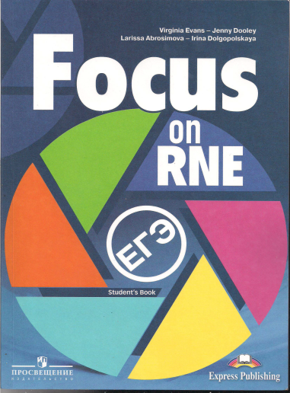
Comment on following statement:
To gain work experience, students should start work before they finish their studies.
Do you agree with this statement?
A) read the essay.
B)underline the topic sentences.
C)find the useful language the writer uses to give reasons, examples, results.

Slide 15
Opinion | Reason | Result example

Slide 16
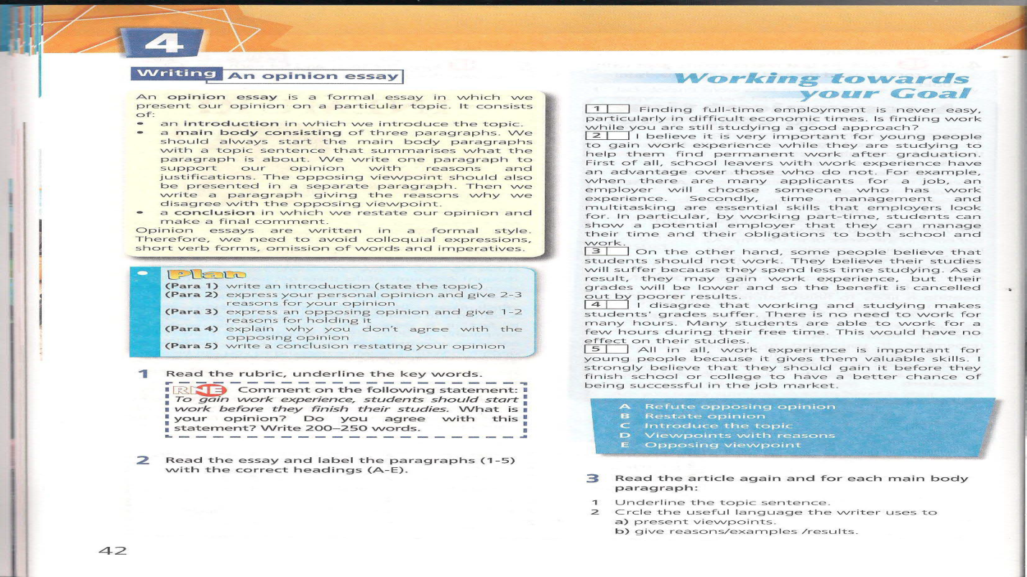

Slide 17
I believe it is very important for young people to gain work experience while they are studying to help them find permanent work after graduation.
Opinion | Reason | Result
it is very important … | Fist of all, school leavers with work experience have an advantages over those who do not. | For example, when there are many applicants for a job, an employer will choose someone who has work experience.
 | Secondly, time management and multitasking are essential skills that employers look for. | In particular, by working part-time, students can show that they can manage their time and their obligations to both school and work

Slide 18
On the other hand, some people believe that students should not work.
Reason | Result
They think their studies will suffer because they spend less time studying. | As a result, they may gain work experience, but their grades will be lower and so the benefit is cancelled out by poor results.

Slide 19
I disagree that working and studying makes their grades suffer.
Reason | Result
There is no need to work for many hours. | Many students are able to work for a few hours during their free time. This would have no effect on their studies.

Slide 20
Listen two people discussing ways to combine studying and working successfully.

Slide 21

Take notes under the headings
Opinions | Supporting points | Expected results

Slide 22
Opinions | Supporting points | Expected results
Good time management | Look for work in your area | Won’t spend hours travelling to and from work – more time to study
Draw up study timetable | Work varying shifts – plan timetable every week | Stick to timetable – won’t fall behind with studies
Include rest time | One day a week off work and study | Won’t overwork yourself – be able to perform at your best

Slide 23
Write your essay
All work experience-even unpaid work experience – is valuable.

Slide 24
VK EGExpert/ ЕГЭ/ОГЭ ПО АНГЛ.ЯЗЫКУ
https://vk.com/egexpert
https://vk.com/lingvistvk клуб педагогов английского языка
https://vk.com/learnenglish
https://vk.com/@egexpert-14-shagov-k-esse-na-14-ballov практические аспекты написания эссе, презентация и комментарии
https://www.youtube.com/watch?v=mL38ok9yfZw лексическая сочетаемость
https://www.youtube.com/watch?v=kU1p-0jJQ2Y типичные ошибки

Slide 25
Good luck
THANK YOU FOR ATTENTION

