Slide 1
Jeopardy game
Gateway B1+ Unit 2

Slide 2
Vocabulary 1 | Grammar 1 | Vocabulary 2 | Grammar 2
10 | 10 | 10 | 10
20 | 20 | 20 | 20
30 | 30 | 30 | 30
40 | 40 | 40 | 40
50 | 50 | 50 | 50

Slide 3
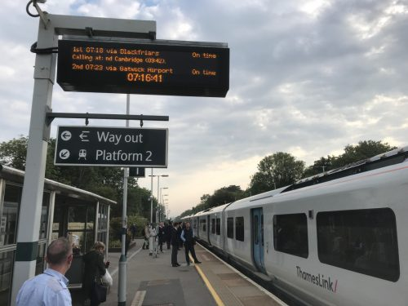
The time when trains are leaving.
departure
back

Slide 4

It’s when your train or plane doesn’t arrive on time.
delay
back

Slide 5
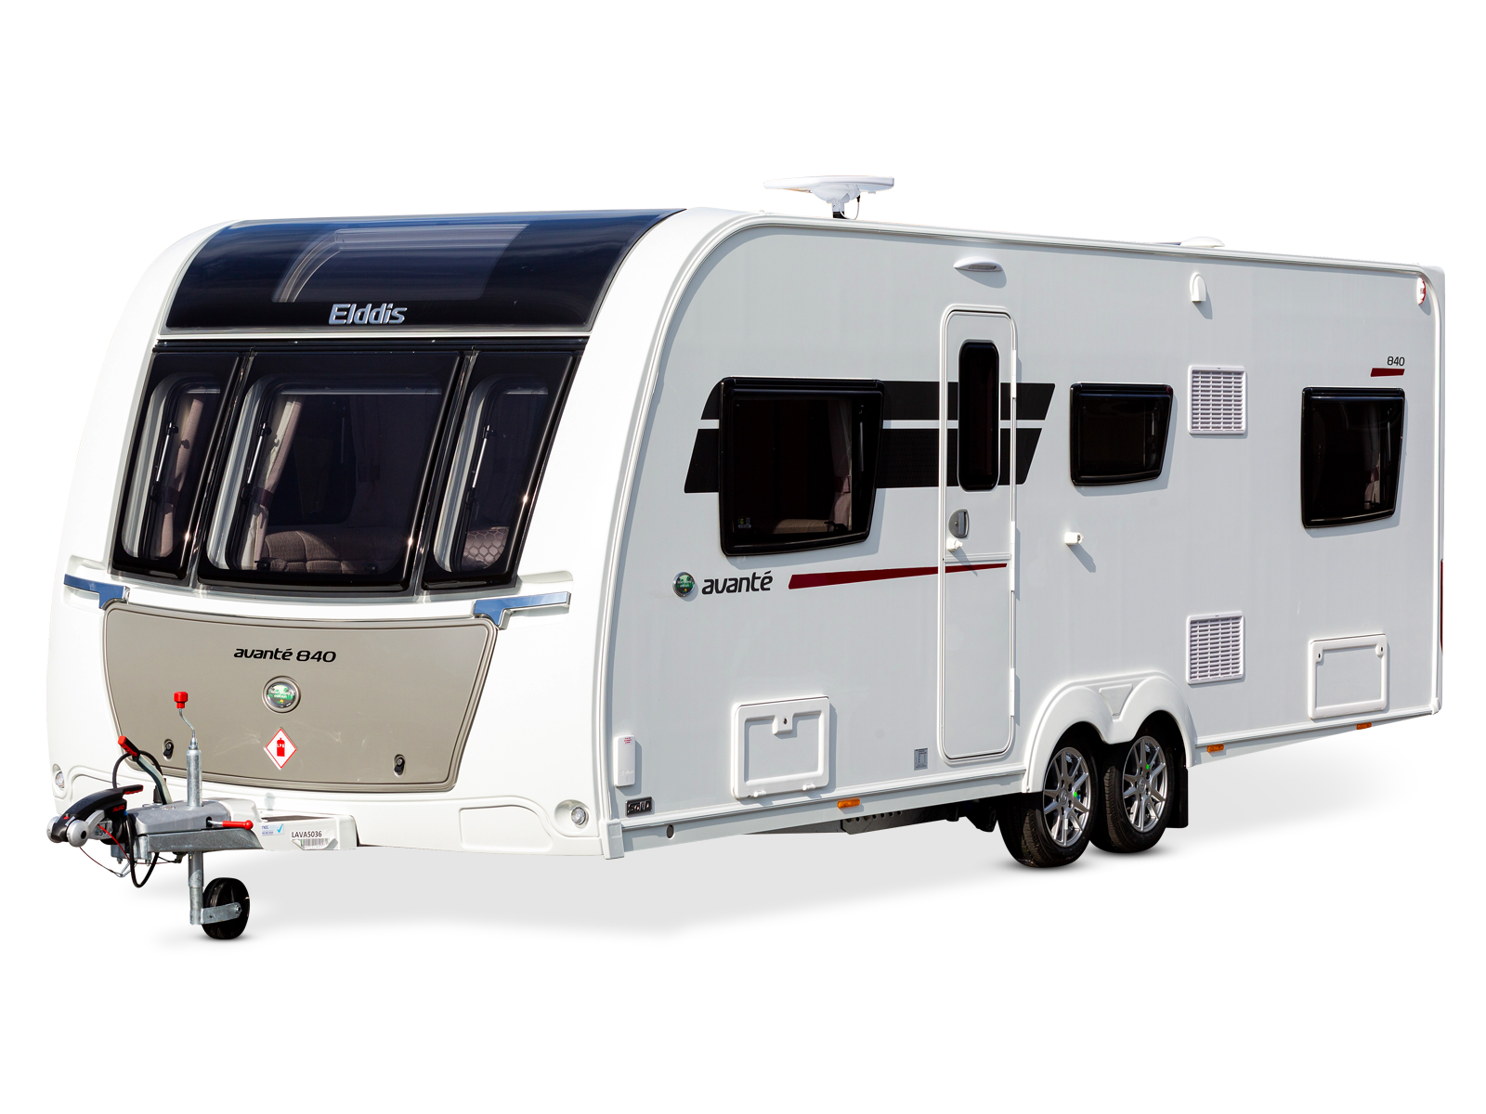
A vehicle where people can live.
caravan
back

Slide 6
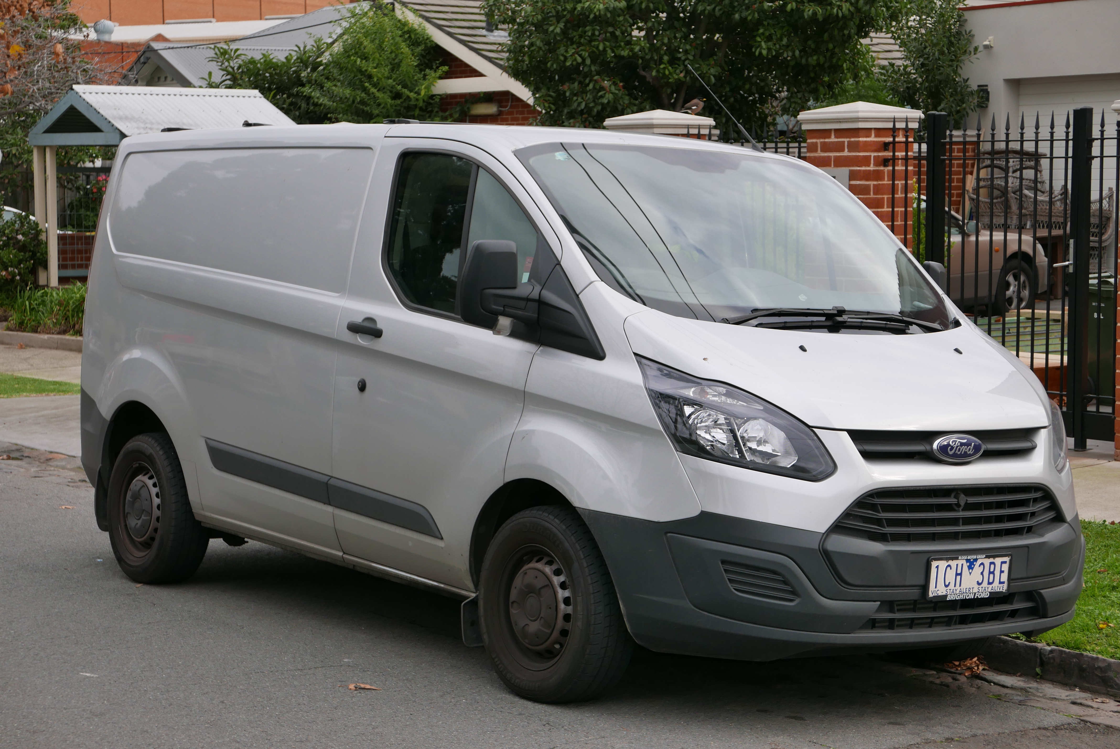
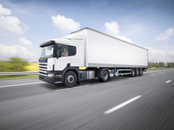
A large road vehicle for carrying goods from one place to another.
A vehicle that is used for carrying things but that is smaller than a lorry.
lorry
van
back

Slide 7
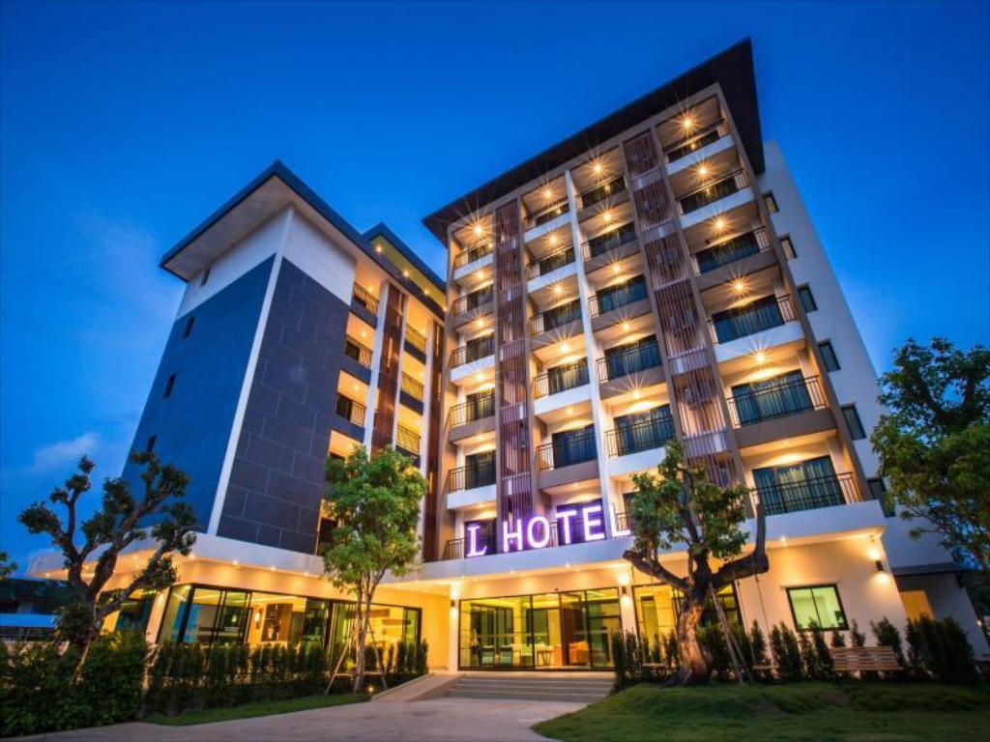
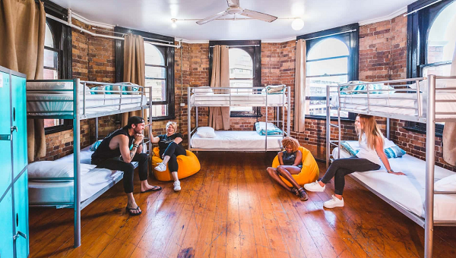
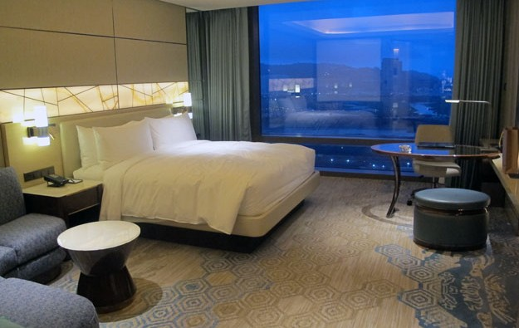
Explain the difference between these words:
hotel/hostel
back

Slide 8
Past Simple or Past Continuous?
was riding
While I __________ (ride) my bike to school this morning, I _________ (see) an accident.
saw
back

Slide 9
Past Simple or Past Continuous?
The boy __________ (try) to find a seat on the bus when he _________ (notice) his friend at the back.
was trying
noticed
back

Slide 10
Past Simple or Past Perfect?
My sister __________ (not take) her favourite dress on holiday because she _________ (give) it to her friend.
didn’t take
had given
back

Slide 11
Past Simple, Past Continuous or Past Perfect?
When we __________ (go) to the airport, she ___________ (remember) that she _________ (leave) her passport at home.
were going
remembered
had left
back

Slide 12
Past Simple, Past Continuous or Past Perfect?
While she _____________ (travel) in the UK, she ______ (miss) her train because she _________ (fall) asleep on the bus and ___________ (not arrive) at the station on time.
was travelling
missed
had fallen
didn’t arrive
back

Slide 13

Phrasal verbs
To start a journey.
set off
back

Slide 14

Phrasal verbs
To go somewhere different to have a rest or holiday.
get away
back

Slide 15
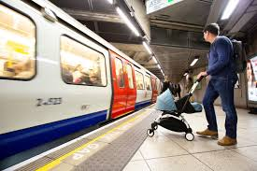
Phrasal verbs
gets in
We’ll be on the platform when the train _______ at five past ten.
back

Slide 16
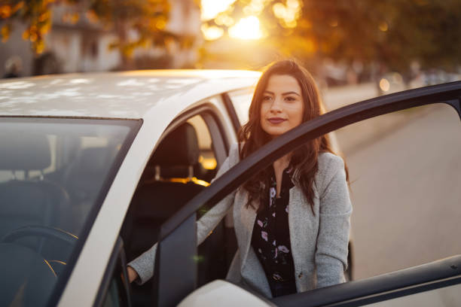
Phrasal verbs
She _______ the car and drove to the station. When she arrived she _________ the car and locked it.
got into
got out of
back

Slide 17
Phrasal verbs
We _______ the first train that came but we _______ when it ___________ and couldn’t go to the airport. When we arrived at the airport at last, we__________ our bags and went through the passport control.
got on
got off
broke down
checked in
back

Slide 18
Past Simple, used to or would?
I _______ the competition once when I was a child.
won
back

Slide 19
Used to or would?
didn’t use to help
I ________________ (not help) my mum when I was young.
back

Slide 20
Past Simple, used to or would?
used to be
Until I was 18, I _________ (be) outgoing, but then I _________ (become) shy.
became
back
back

Slide 21
Past Simple, used to or would?
Use all of them if possible.
lived/used to live
When I was young, I ________________ (live) in Paris. In the morning I ________________ (run) in the park and once I ____________ (see) a very famous singer there.
used to/would run
saw
back

Slide 22
Past Simple, used to or would?
Use all of them if possible.
spent/used to/would spend
At the age of 6, I ____________________ (spend) a lot of time with my grandparents. We all __________________ (have) bikes. We _____________________ (not go) for long trips but I ________________ happy!
had/used to have
didn’t go/didn’t use to go
was/used to be
back

