Slide 1


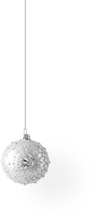



Christmas & New Year
Семина Ирина Дмитриевна
Учитель английского языка
ГБОУ Лицей №126
Санкт-Петербург

Slide 2
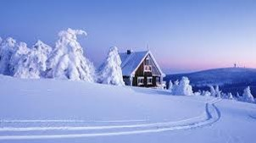

What’s the weather like in winter in Russia?
It is usually cold and frosty.
There’s a lot of snow.
Made by Irina Semina

Slide 3
What holidays do we celebrate in winter?
Christmas
New Year
Made by Irina Semina

Slide 4
Christmas vs New Year
New Year is celebrated all over the world as the beginning of a new year.
Christmas is a Christian holiday honoring the birth of Jesus.

Slide 5
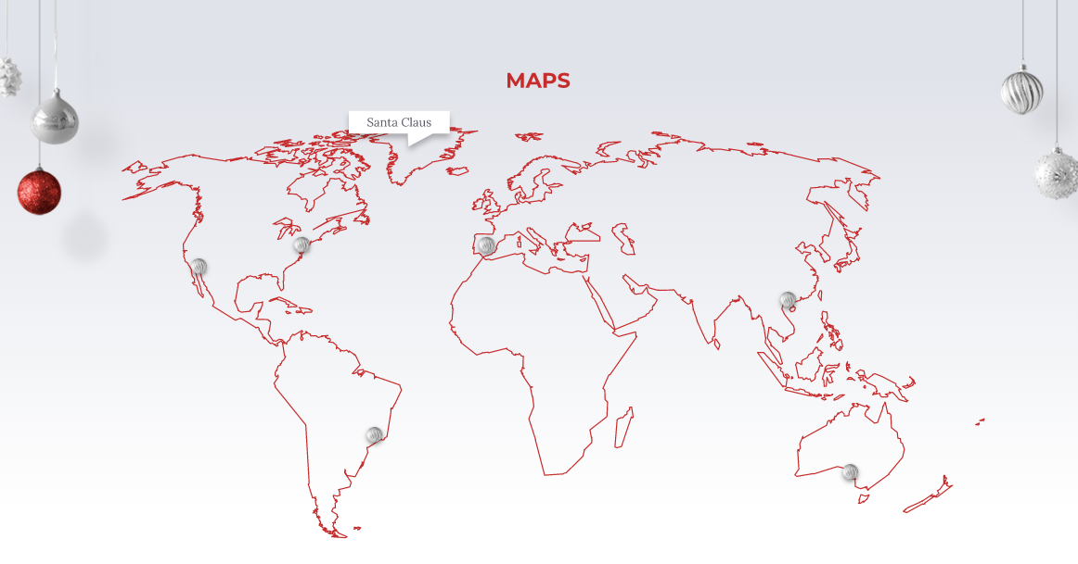
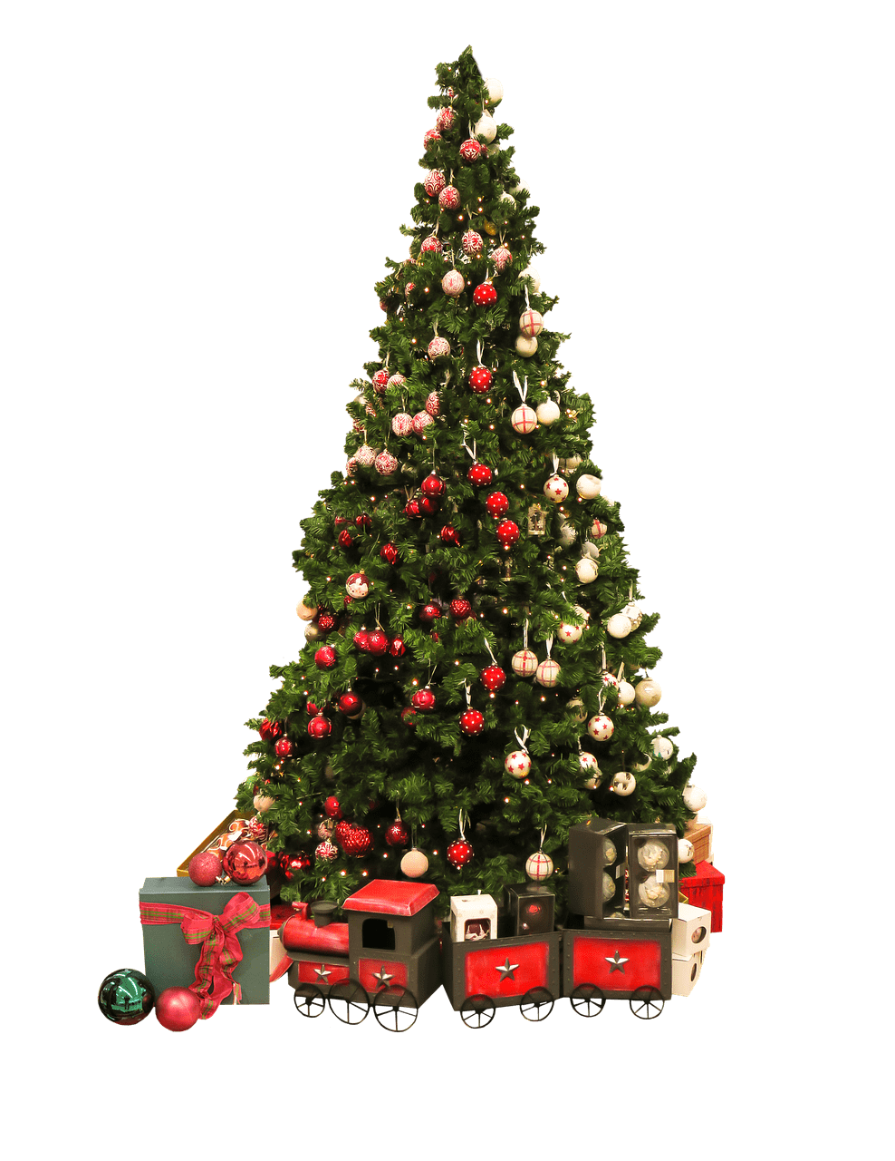
When do
people celebrate New Year?
… on the 31st of December.

Slide 6


When do people
celebrate Christmas?
… on the 25th of December.
… on the 7th of January.
Made by Irina Semina

Slide 7
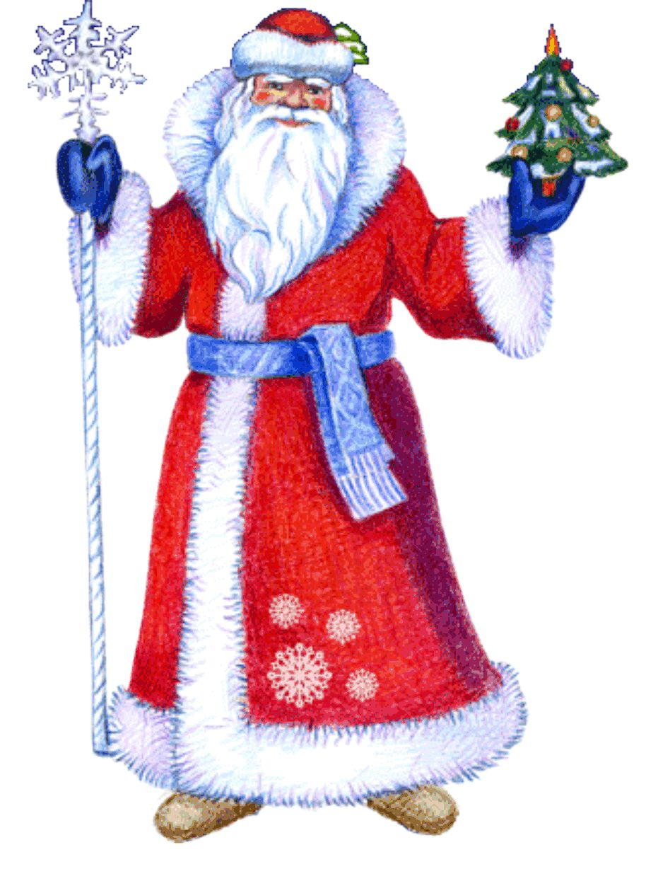
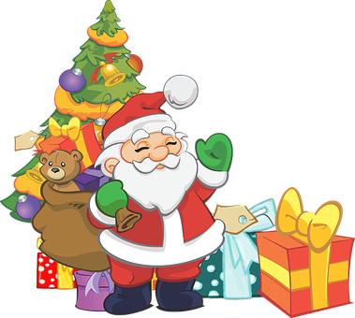
Who gives the children presents?
Santa Claus
Ded Moroz
(Grandfather Frost)
Made by Irina Semina

Slide 8
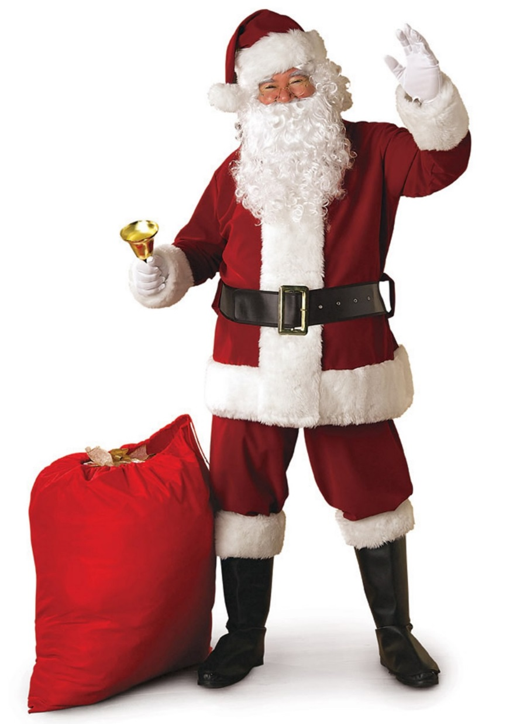
Santa Claus
a nightcap
a red coat with white fur collar and cuffs
a bell
a black leather belt and boots
red trousers with white fur cuffs
a bag full
of gifts to
nice children
Made by Irina Semina

Slide 9
Ded Moroz
a semi-round fur hat
warm
mittens
a long magic stuff
a heel-length
fur coat
valenki
Made by Irina Semina

Slide 10
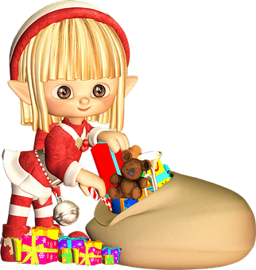
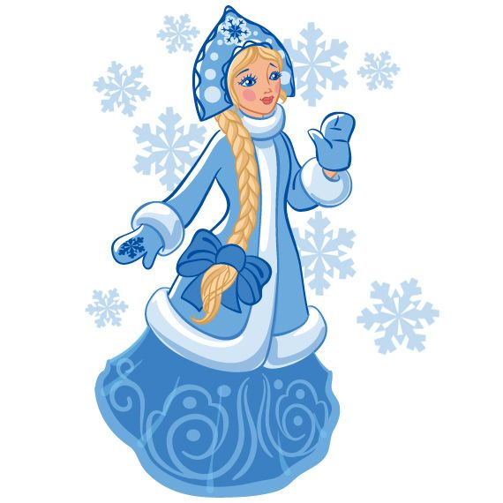
Who are their helpers?
Elf
Snow Maiden
Made by Irina Semina

Slide 11
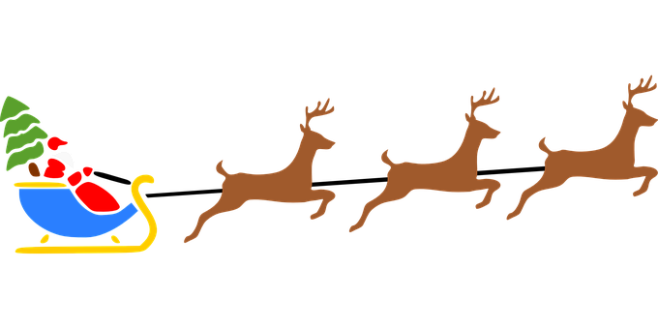
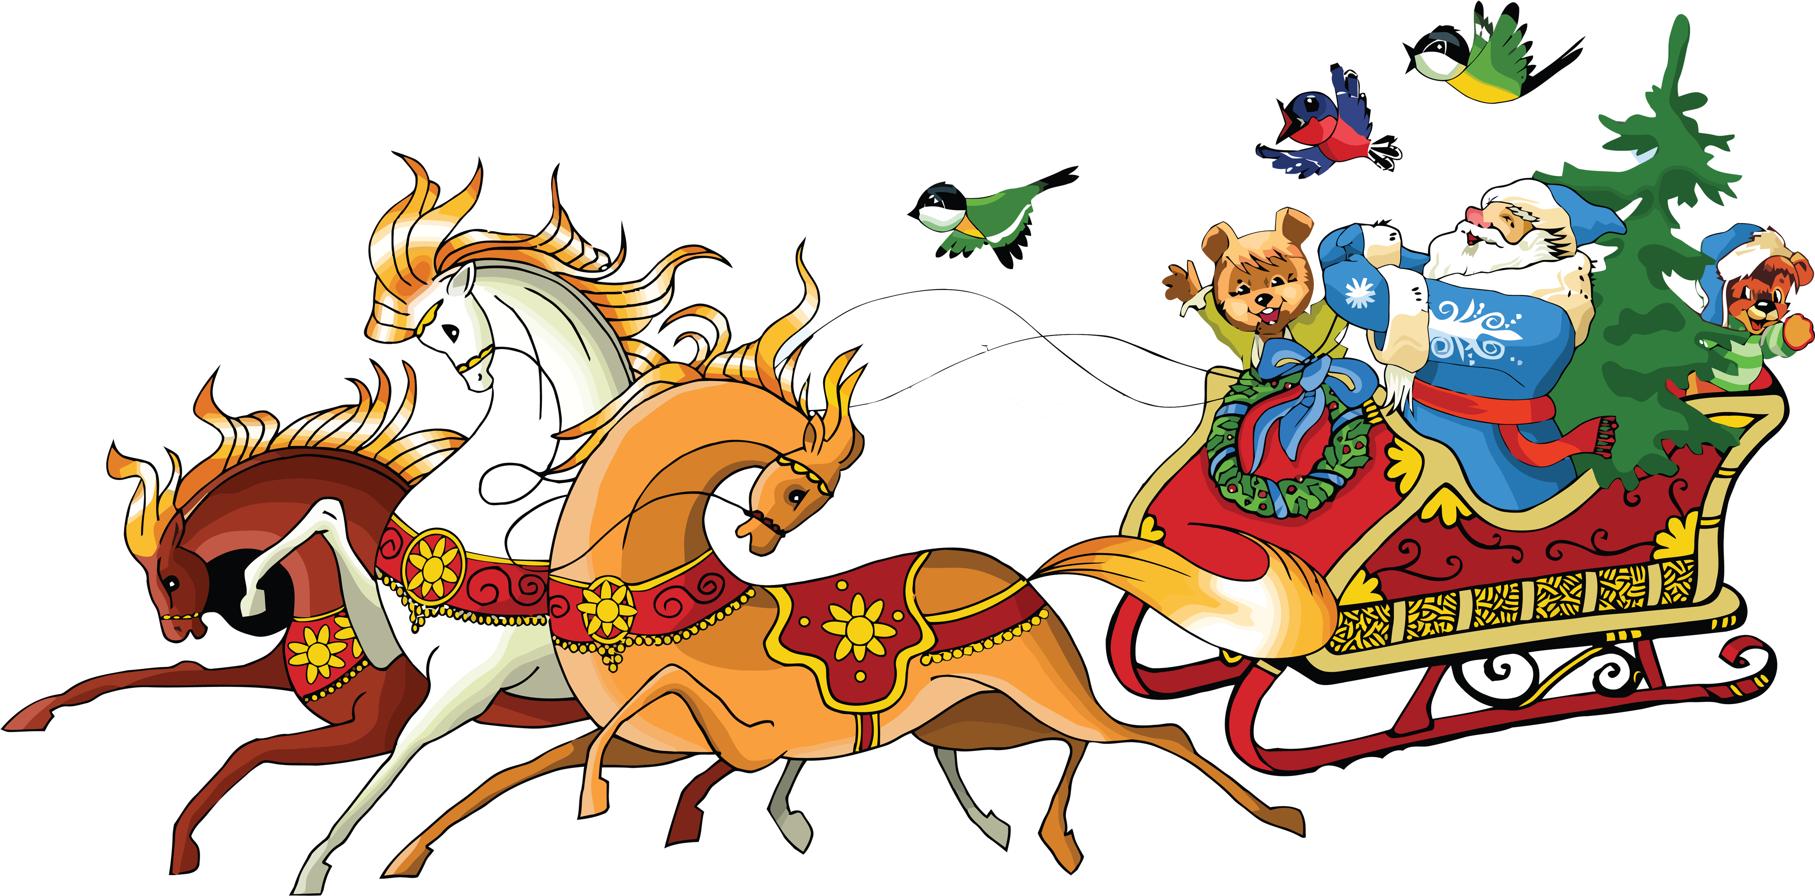
How do they deliver gifts to children?
... in a sleigh through
the night sky with the help
of reindeer.
… in a sleigh pulled by troika.
Made by Irina Semina

Slide 12
What do we decorate the Christmas tree with?
glass balls
a stocking
stuffer
Candy
Canes
a star
snowflakes
a wreath
an angel
a snowman
Made by Irina Semina

Slide 13


Where do kids find their presents?
… in the stocking
stuffer.
… under the
Christmas tree.
Made by Irina Semina

Slide 14
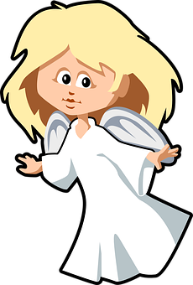
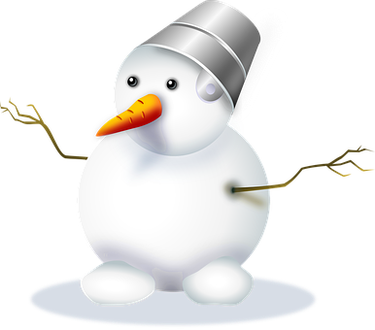




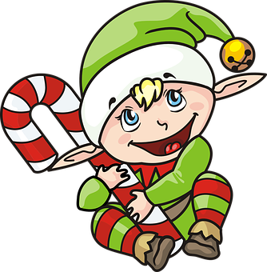

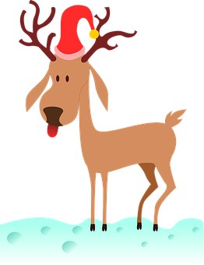
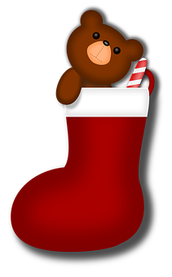
Do you remember what it is?
angel
C _ _ _ _ _ _ _ s
_ _ _ _
g _ _ _ _
_ _ _ _ _
_ _ _ _
_ _ _ w_ _ _ _ _ s
_ _ g _ _
s_ _ _ _ _ _
snowman
Christmas tree
glass balls
star
snowflakes
elf
_ _ _
_ _ _ _
s _ _ _ _ _ _ _ _ t _ _ _ e _
r _ _ _ _ _ _
bell
stocking stuffer
reindeer
Made by Irina Semina

Slide 15
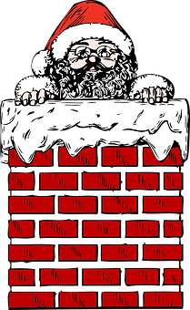
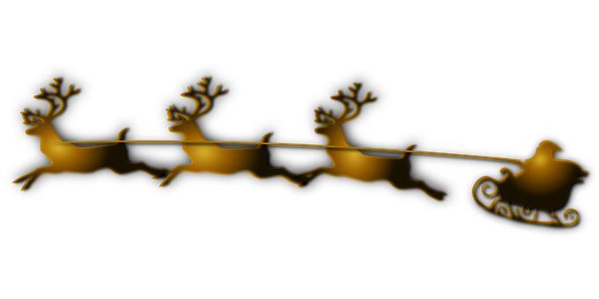
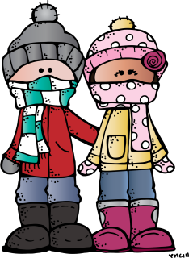
Tongue twisters
There’s chimney soot on Santa’s suit.
Santa's super sleigh slips
so swiftly through the snow.
Chilly chipper children chant cheerfully.
Made by Irina Semina

Slide 16
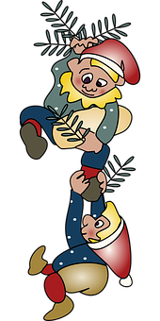
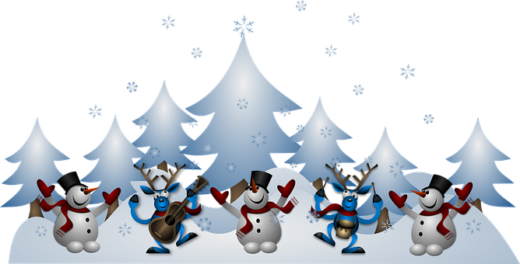

Tongue twisters
Eleven elves licked eleven little licorice lollipops.
Running reindeer
romp ’round red wreaths.

Slide 17
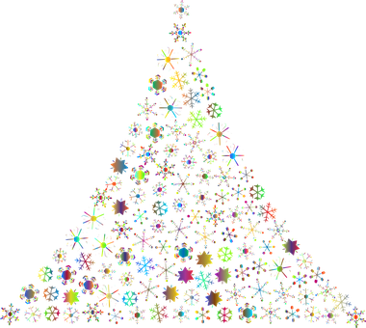
New Year is coming …
I wish you a MERRY CHRISTMAS
AND
A HAPPY NEW YEAR!
Made by Irina Semina

