Slide 1
My family

Slide 2
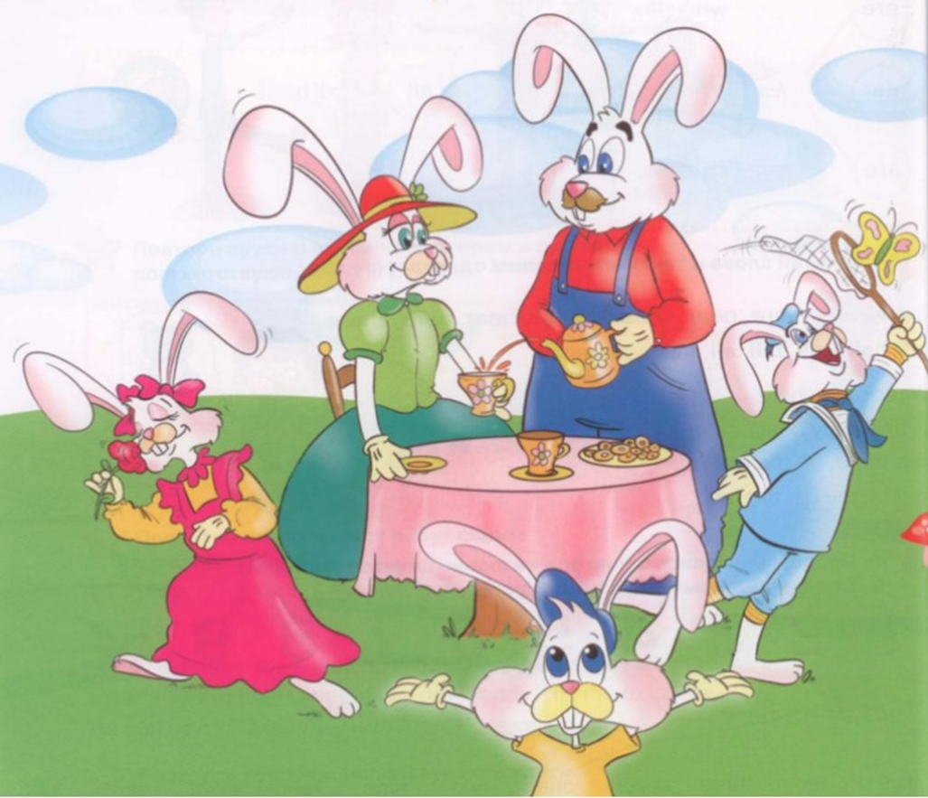

P. 20, ex. 1

Slide 3
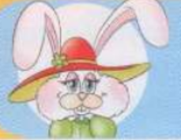

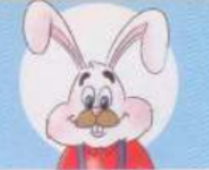
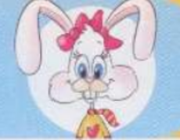
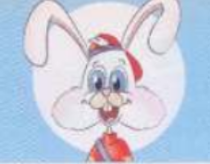
Who is this?
mummy
daddy
sister
brother
This is my … .

Slide 4
Who is he? – Кто он?
He is my daddy.
He is my brother.
Who is she? – Кто она?
She is my mummy.
She is my sister.

Slide 5
Let’s do p.3. ex.3

Slide 6
This is Ronny’s ….
mummy
brother
daddy
sister

Slide 7
Let’s do ex.4 p.21 and talk about your family.
This is my mummy, … (name).
This is my daddy, … (name).
This is my sister, … (name).
This is my brother, … (name).

