Slide 1
Mickey’s Christmas Carol

Slide 2
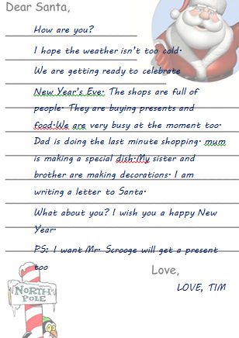
Tim’s letter

Slide 3
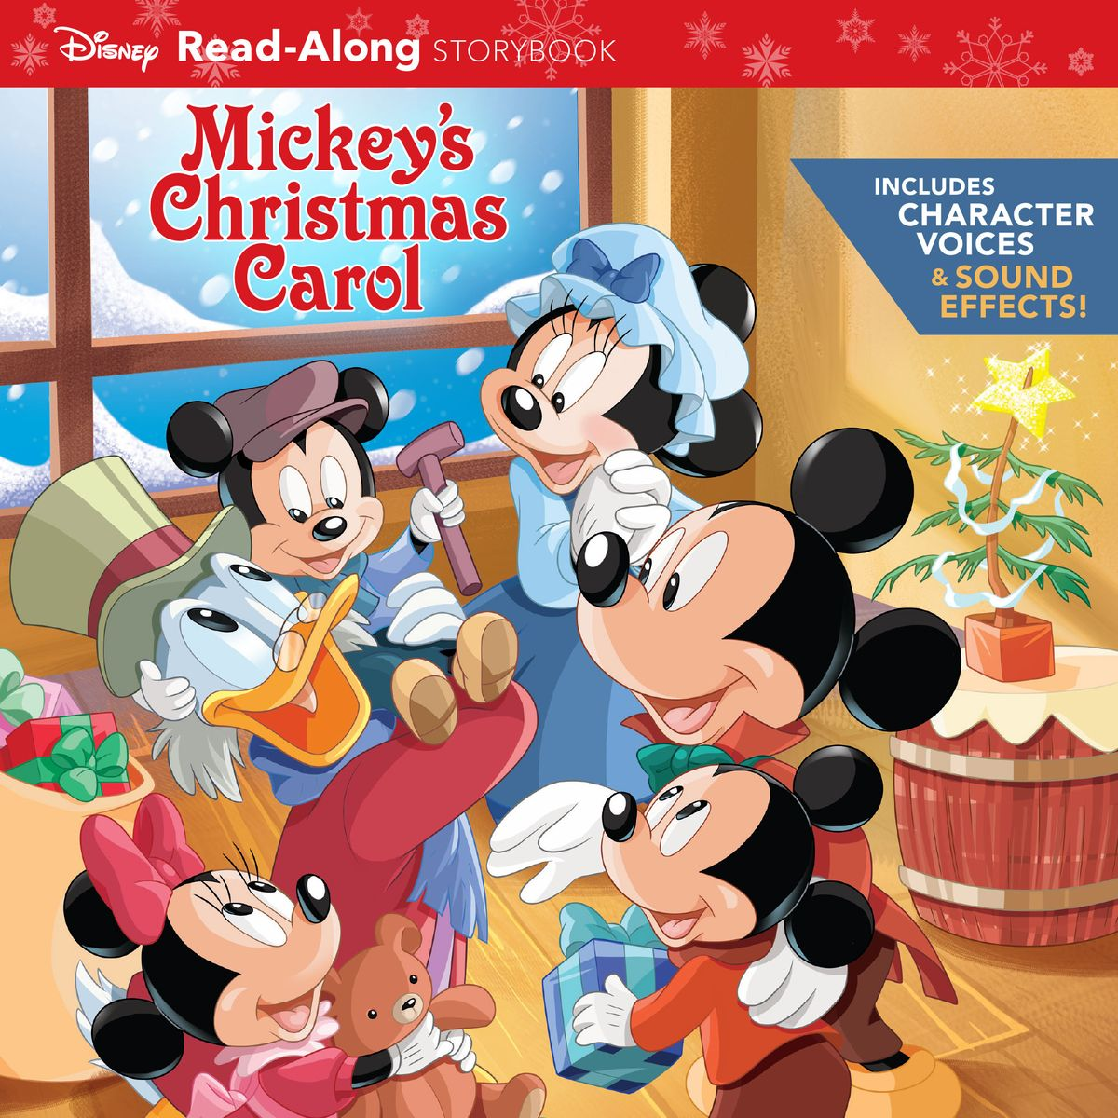
Let’s watch… https://yandex.ru/video/preview/?filmId=7649982175656279081&from=tabbar&parent-reqid=1600834825845123-1715374321241246133428835-production-app-host-sas-web-yp-72&text=mickey%27s+christmas+carol

Slide 4
Make it in the logical order :
2.He said NO to his nephew Fred's invitation to Christmas dinner.
3.In his house, Scrooge saw the ghost of his former business partner Jacob Marley.
4.Scrooge is visited by the Ghost of Christmas Past.
8.Scrooge decides to surprise Bob's family with a turkey dinner.
9.He spread happiness and joy around London.
5.At two o'clock, Scrooge meets the merry Ghost of Christmas Present.
6.He met the Ghost of Christmas Future.
1.On Christmas Eve Scrooge was at work.
10.Scrooge and the Cratchits happily celebrate Christmas.
7.Tiny Tim has «died».

Slide 5
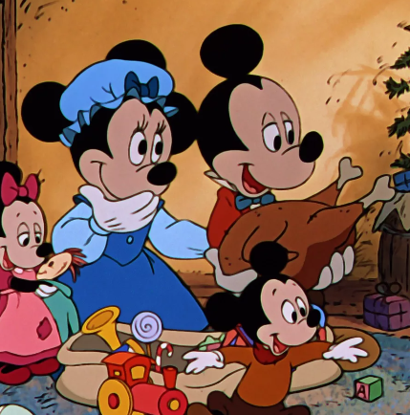
What are the family in the picture doing?
Use the model: + подлежащее+ смысл.глагол+ глагол

Slide 6

The three hats

Slide 7
Thank you for the lesson!

