Slide 1
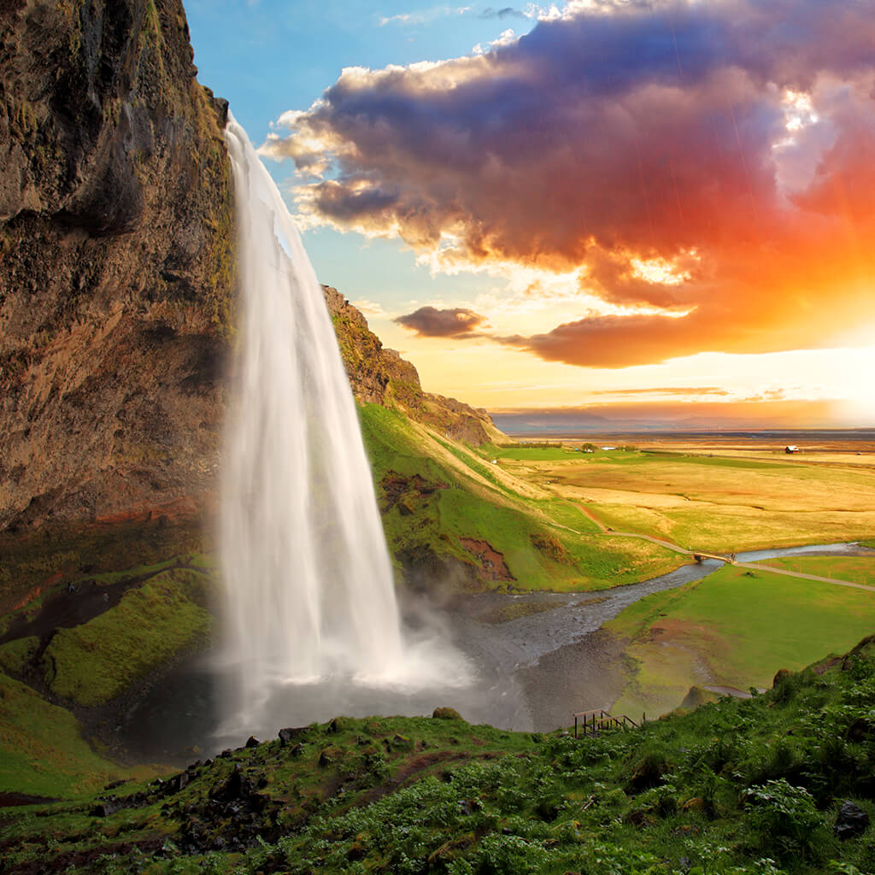
NATURE
Выполнена
Учителем английского языка
Кузнецовой Аленой Андреевной

Slide 2
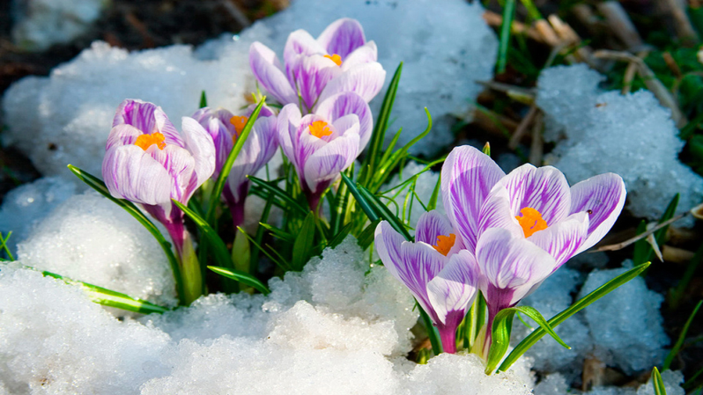
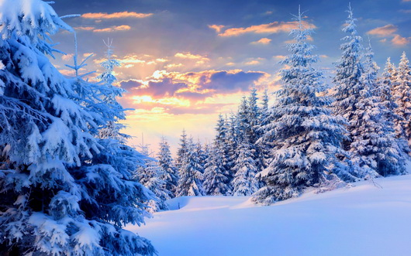
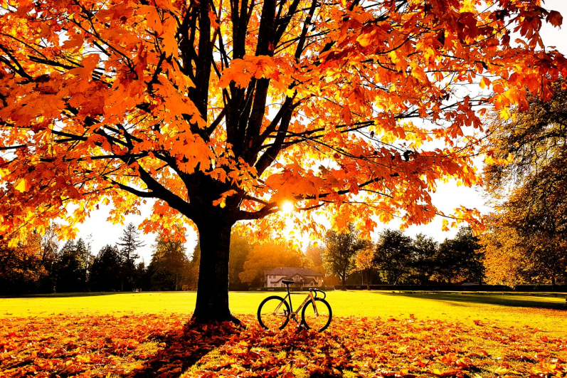
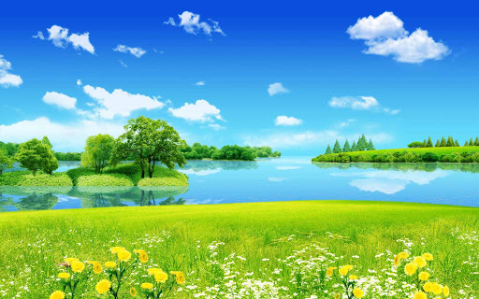
What seasons do you see in the pictures?
What’s your favorite season?
1
spring
2
winter
3
autumn
summer
4

Slide 3
Do you remember the names of months? Fill in the table.
Winter | Spring | Summer | Autumn
December
March
June
September
January
April
July
October
February
May
August
November

Slide 4
Make up the words. Write them.
Evrir -
Aes -
Ceoan -
River
Sea
Ocean

Slide 5
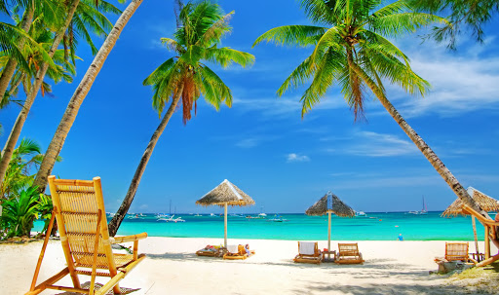
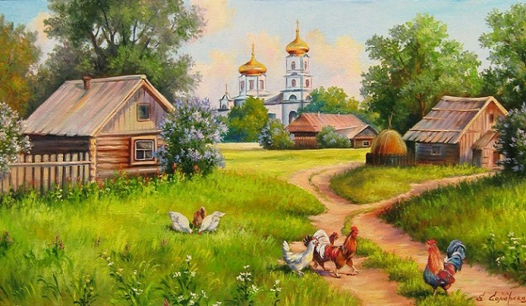
1. What can you see in the picture?
2. Where do you like to spend your holidays?

Slide 6
New
Words

Slide 7
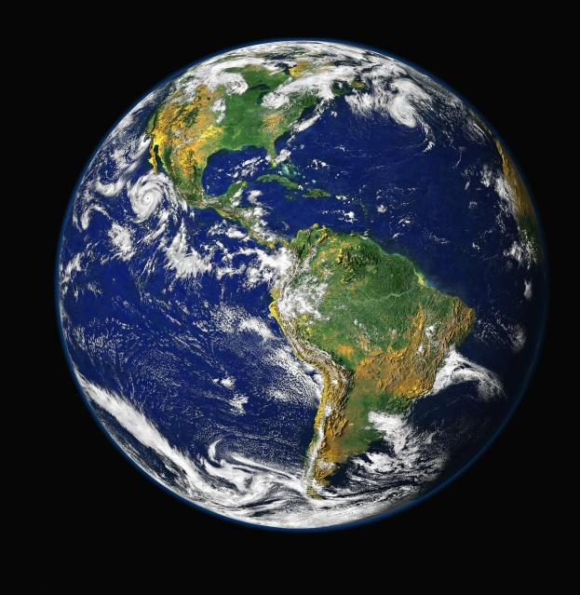
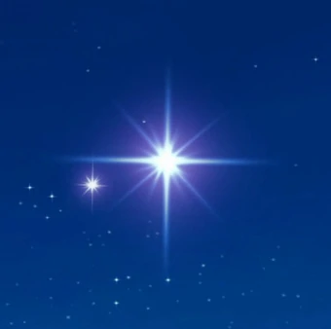
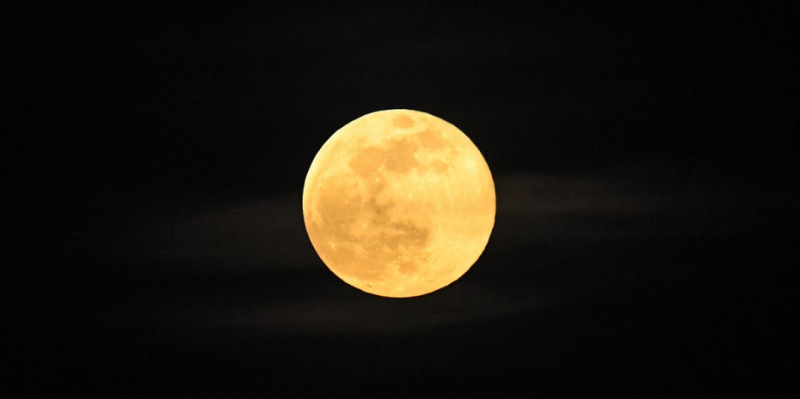
Earth
Star
Moon

Slide 8
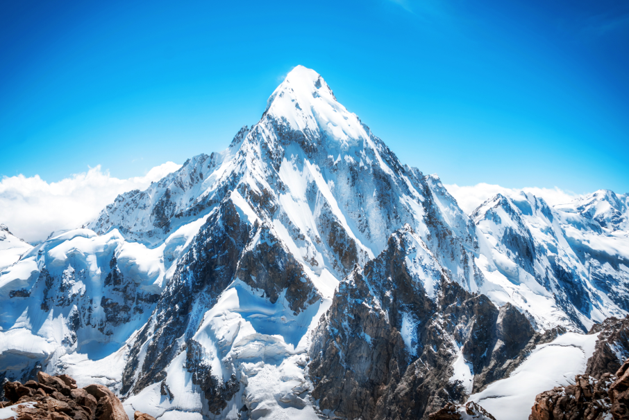
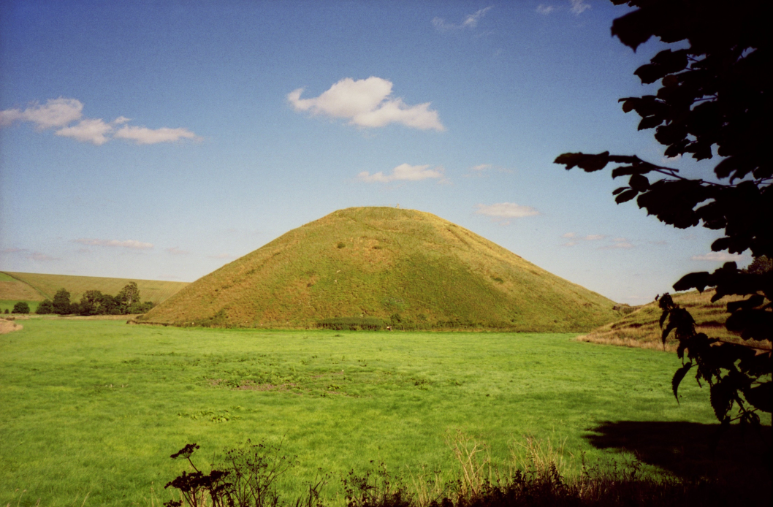
M
Mountain
Hill

Slide 9
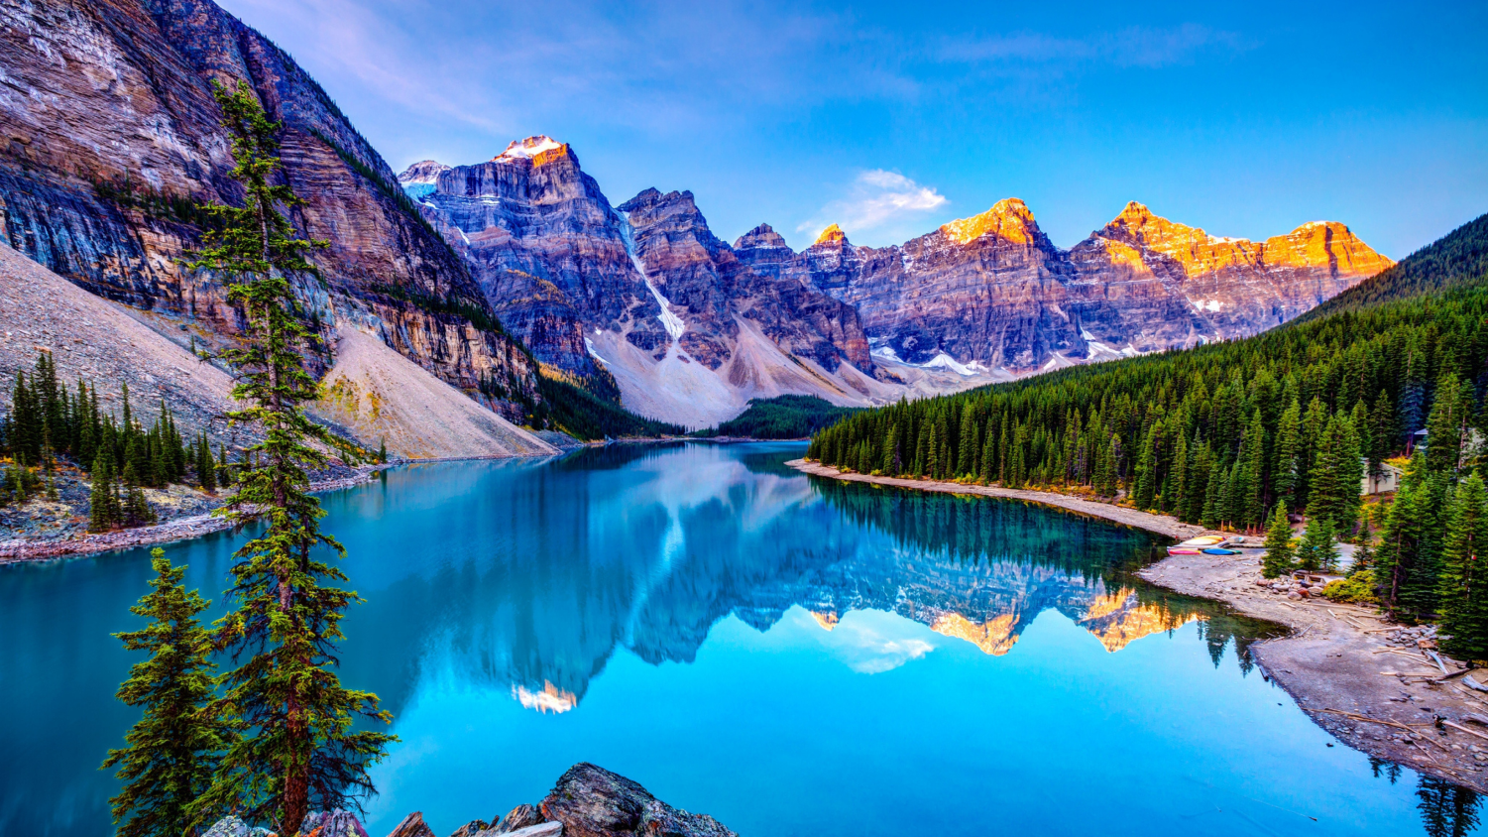
Nature

Slide 10
Translate from Russian into English.
Answers
1.Star
2.Moon
3.Earth
4.Hill
5.Nature
6.Mountain
1. Звезда
2. Луна
3. Земля
4. Холм
5. Природа
6. Гора

Slide 11
Complete the sentences with the words from the table.
sun sea hills mountains earth oceans field forest moon stars
Every summer I go to the ____ .
There are a lot of cows in the ________ .
________ are higher than ____________.
The big brown bear lives in the ___________.
The _______ rises in the east.
There are four ________ on the __________.
We can see the _______ and the _________ in the sky today.
sea
field
Mountains
hills
forest
sun
oceans
Earth
moon
stars

Slide 12
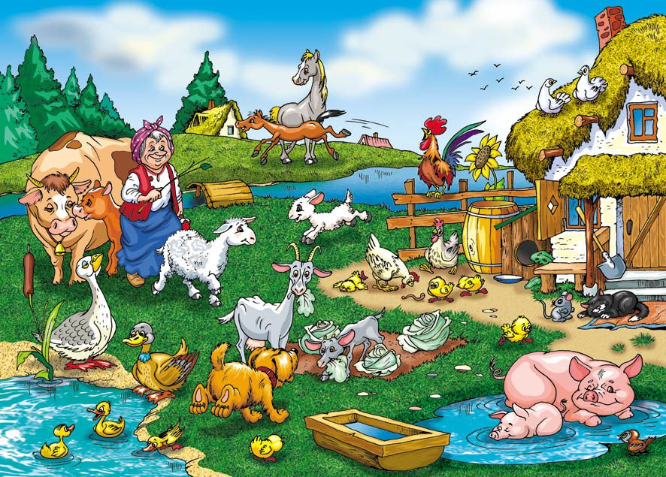
1. What can you see in the picture?
2. Whom can you see in the picture?
3. What are the ducks doing?
4. What is the woman doing?
5. What is the cat doing?

