Slide 1

Birthday celebrations

Slide 2
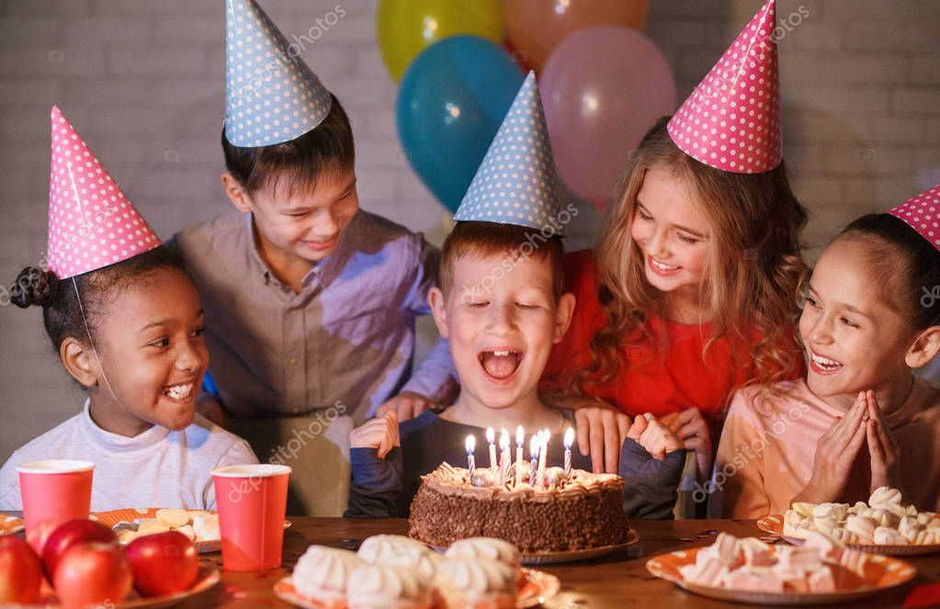
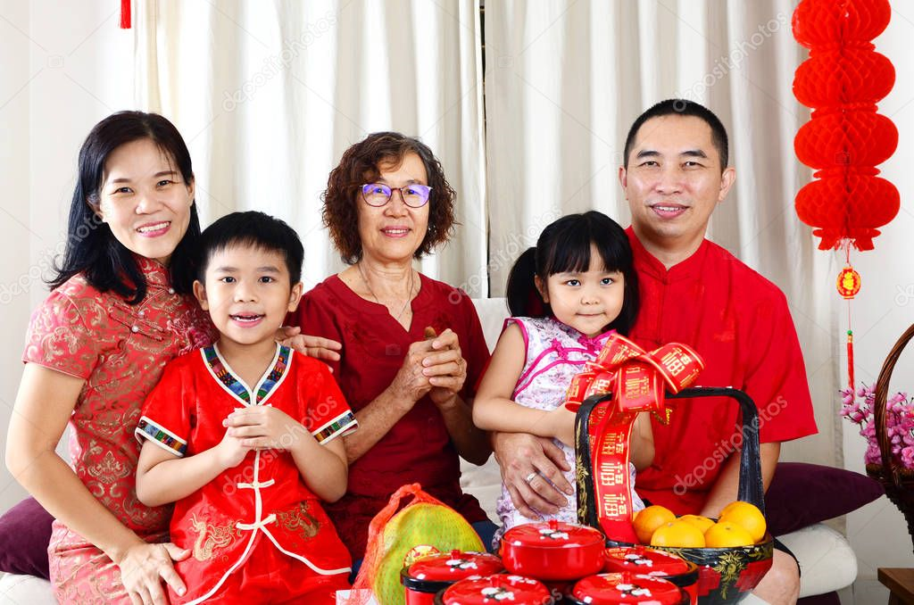
IN BRITAIN
IN CHINA

Slide 3
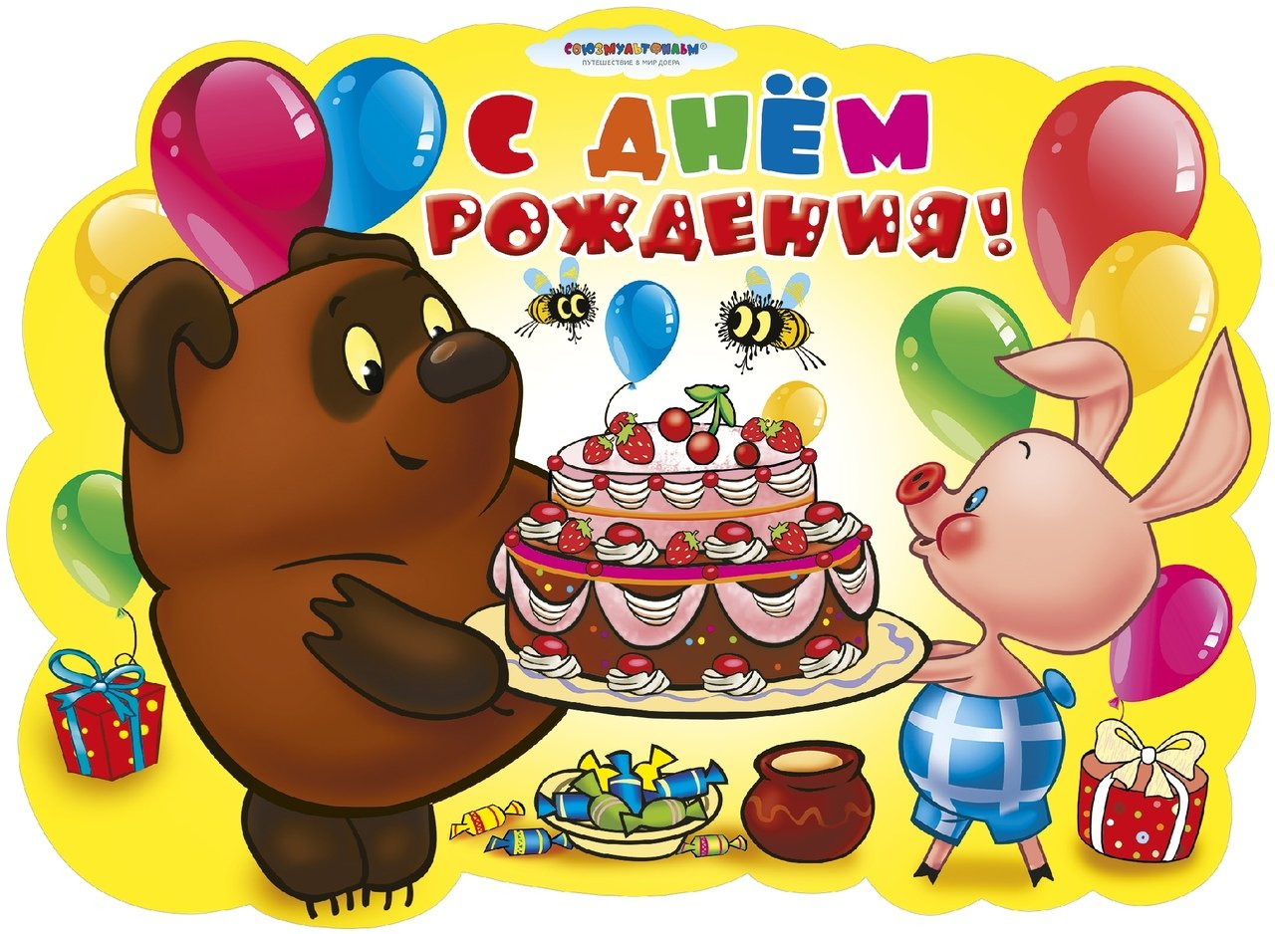
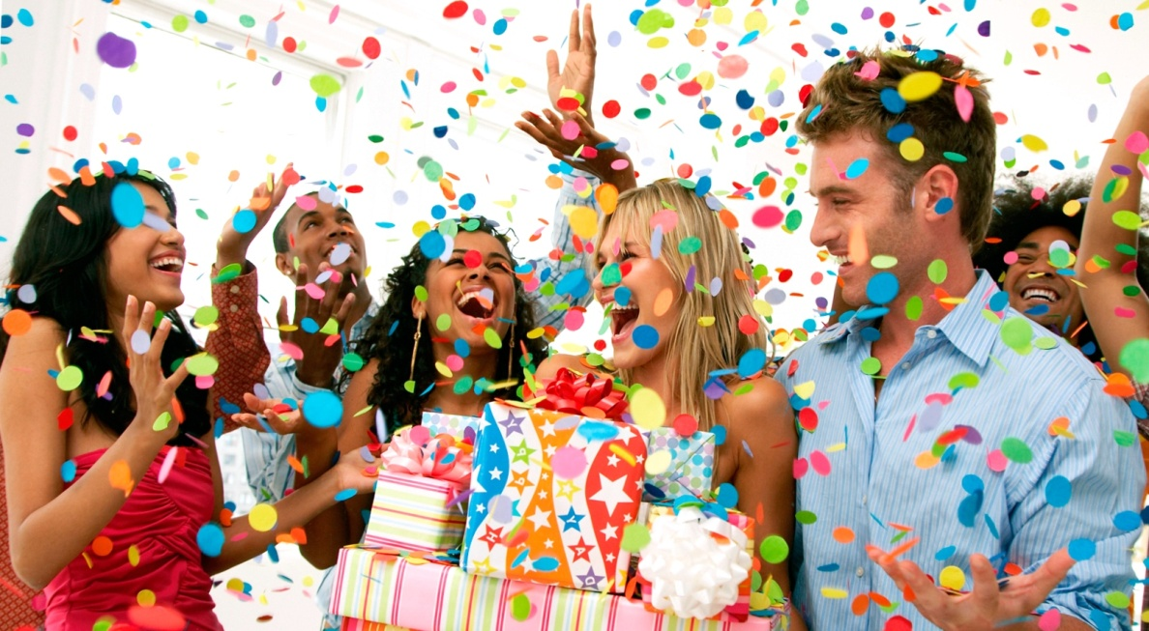
Warm-up
birthday
to celebrate

Slide 4
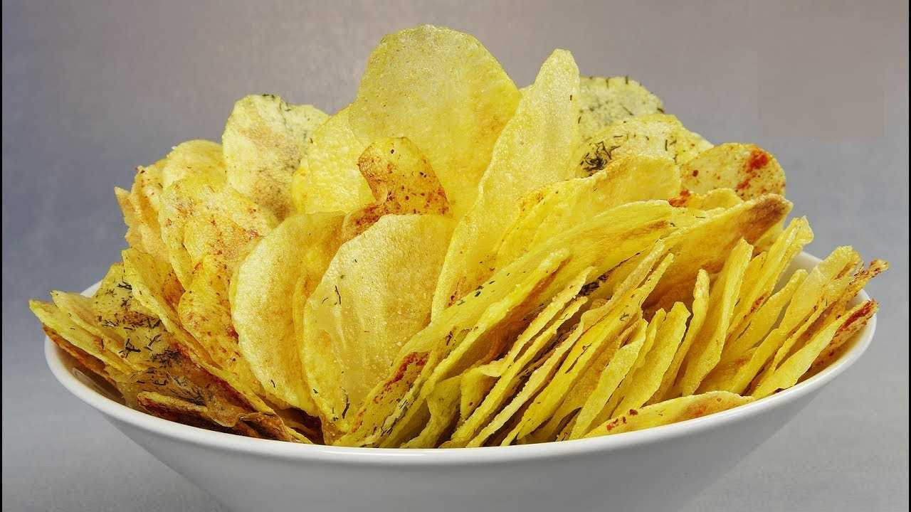
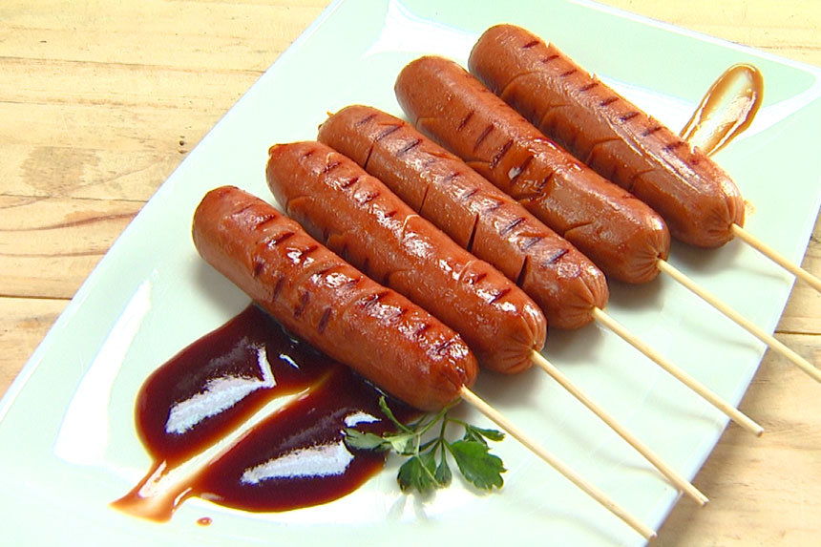
crisps
sausages

Slide 5
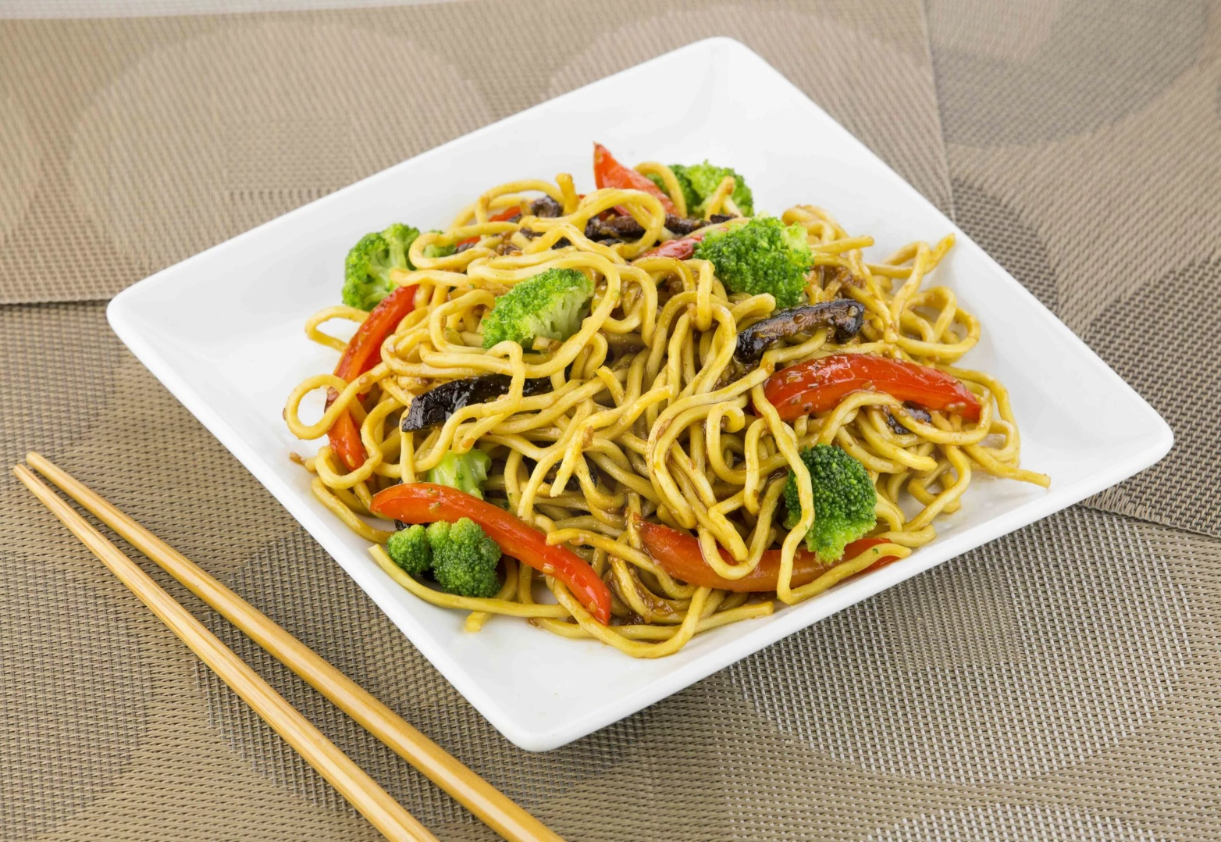
noodles

Slide 6
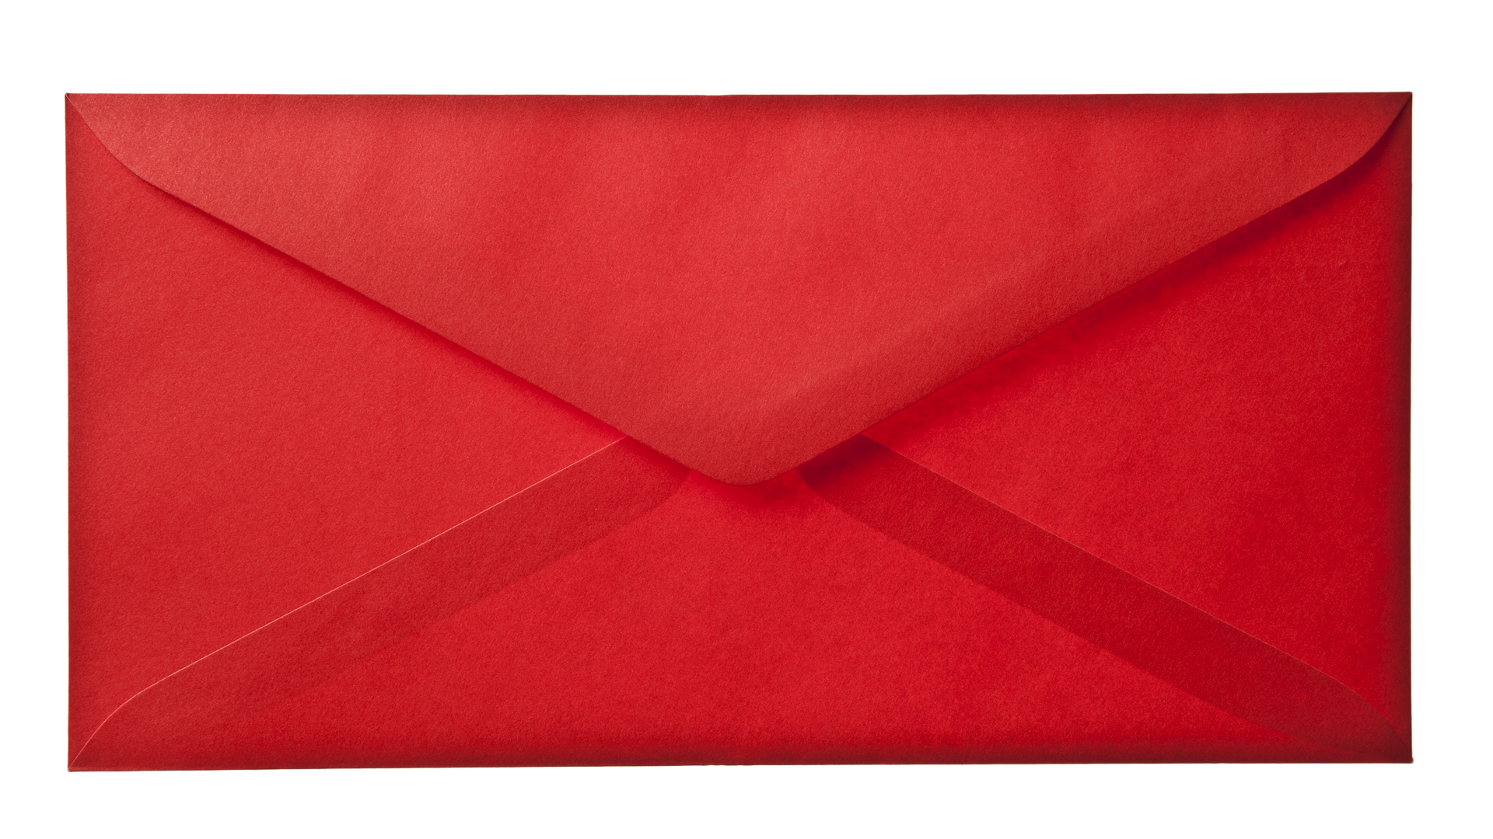
envelope

Slide 7
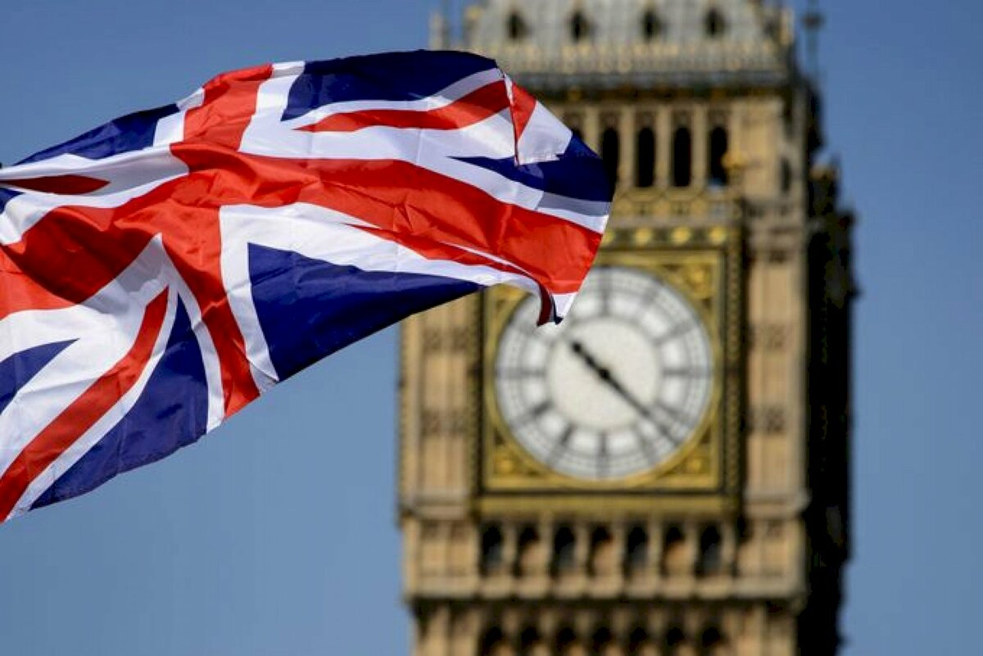
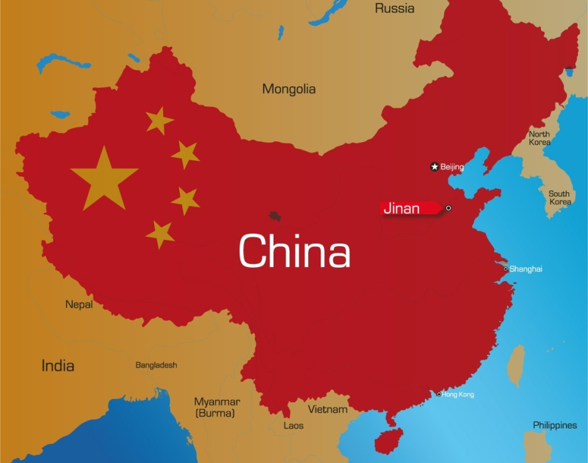
Britain
China

Slide 8
1) birthday
2) to celebrate
3) crisps
4) sausages
5) noodles
6) envelope
7) Britain
8) China

Slide 9
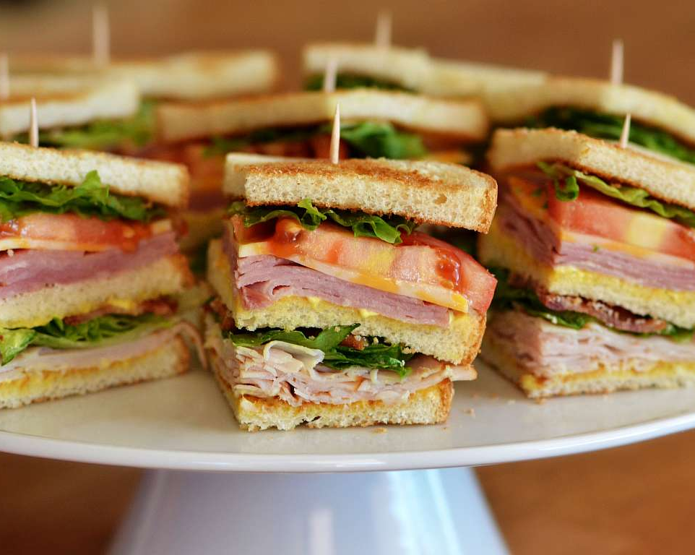
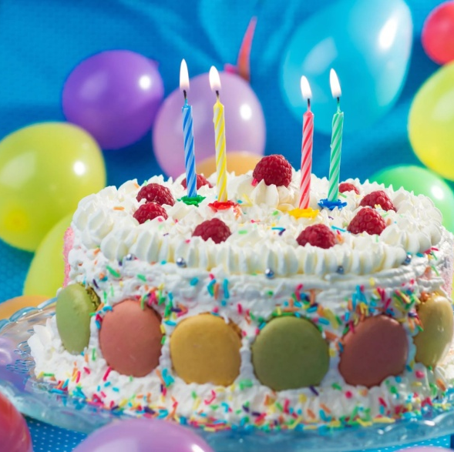
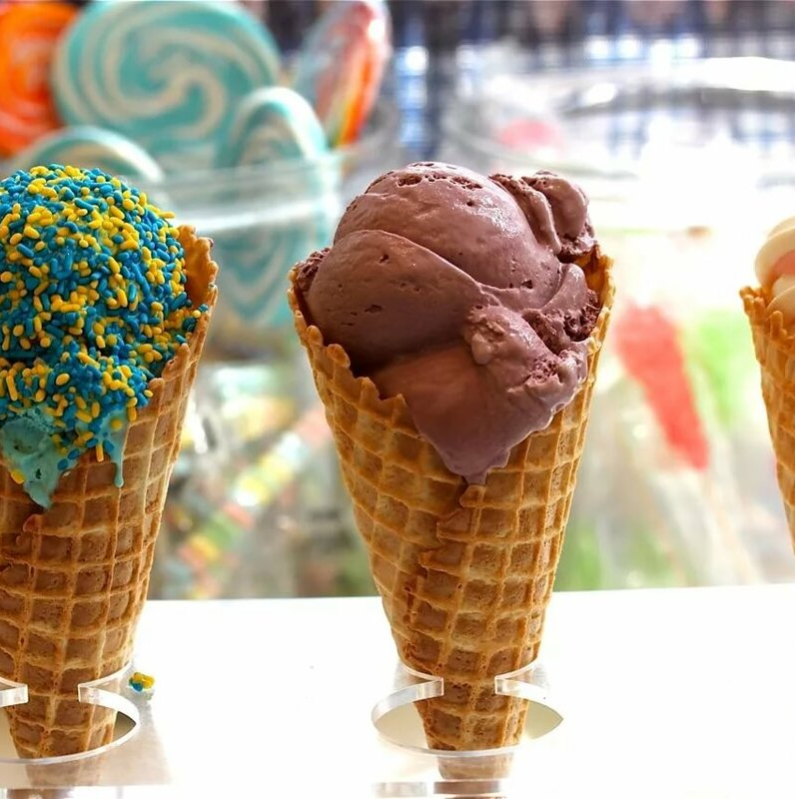
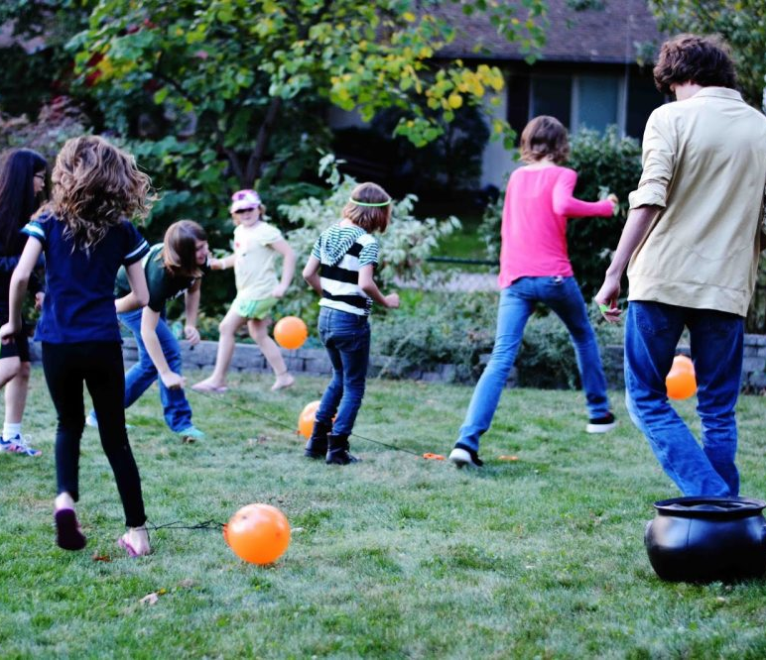
Britain
In Britain we have a party to celebrate our birthdays. Everyone brings a small gift. My mum always makes me a birthday cake. We have a table full of food: crisps, sandwiches, small cakes and chocolate biscuits, ice cream and very small sausages you eat on a stick. I just love them! We decorate the house with balloons and I play party games with my friends. It’s fantastic!
John (age 12)

Slide 10
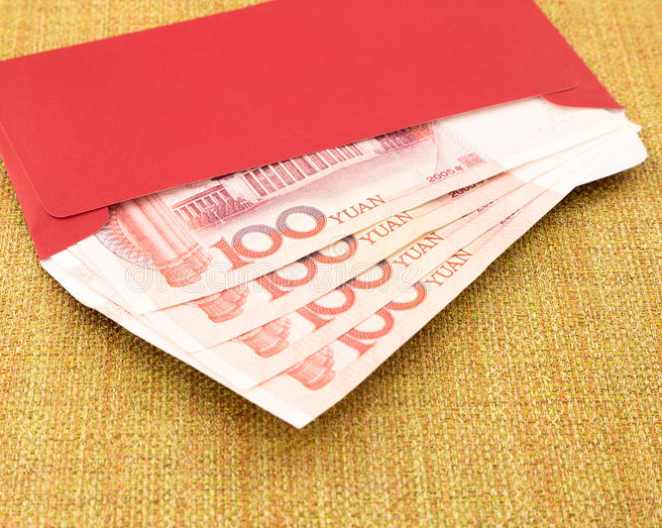
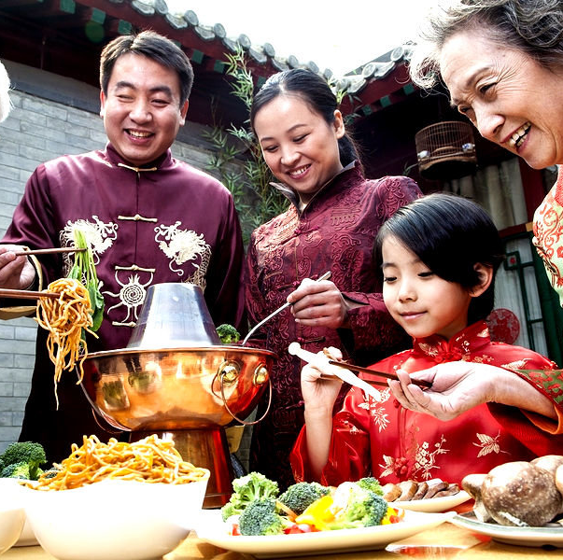
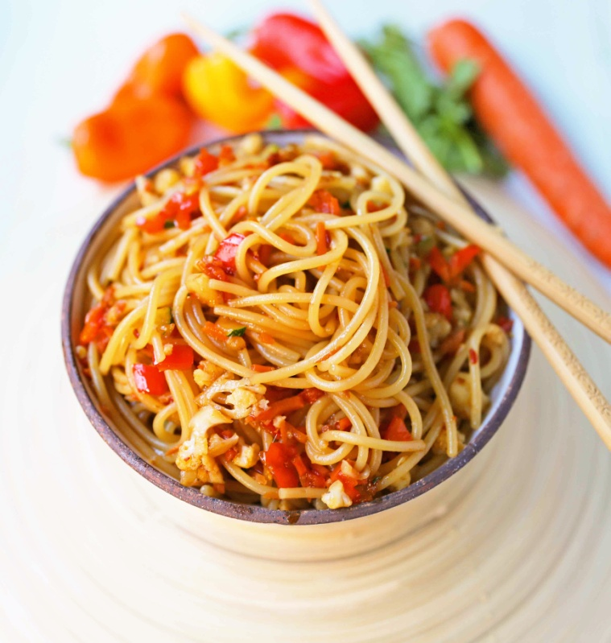
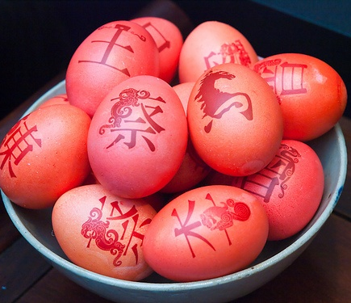
China
Birthday celebrations are very special in China. We eat very long noodles that mean we will have a long life. I eat them in soup and try not to cut them because it’s unlucky! We also eat red eggs. Red is a special colour in China. It always means something happy and brings good luck. We decorate the house with red paper and all the family comes for a party. We also get money in red envelopes. It’s fun!
Lee (age 13)

Slide 11
Match the words to make collocations:
to celebrate
long
a small
to come
a birthday
a special
to decorate
to bring
to play
to get money
for a party
birthday
colour
gift
in red envelopes
f) cake
g) noodles
h) the house
i) good luck
j) party games

Slide 12
Choose the correct answer:
1) Where is John from?
a) China
b) Britain
c) Russia

Slide 13
2) How do they celebrate birthdays in Britain?
a) they have a party
b) they light bonfires
c) they have street parades

Slide 14
3) What do they have on a table?
a) many books
b) many flowers
c) much food

Slide 15
4) How do the British decorate the house?
a) with balloons
b) with posters
c) with blue paper

Slide 16
1) Where is Lee from?
a) China
b) South Korea
c) Britain

Slide 17
2) What do they eat in China at birthday celebrations?
a) chicken and tomatoes
b) long noodles and red eggs
c) small sausages

Slide 18
3) What colour is a special colour in China?
a) white
b) orange
c) red

Slide 19
4) What do they get in China in red envelopes?
a) a bar of chocolate
b) money
c) a postcard

Slide 20

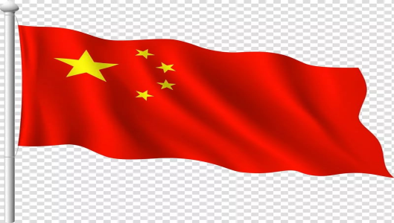

Fill in the table about birthday celebrations:
 | Britain | China | Russia
Food
Decorations
Activities

