Slide 1
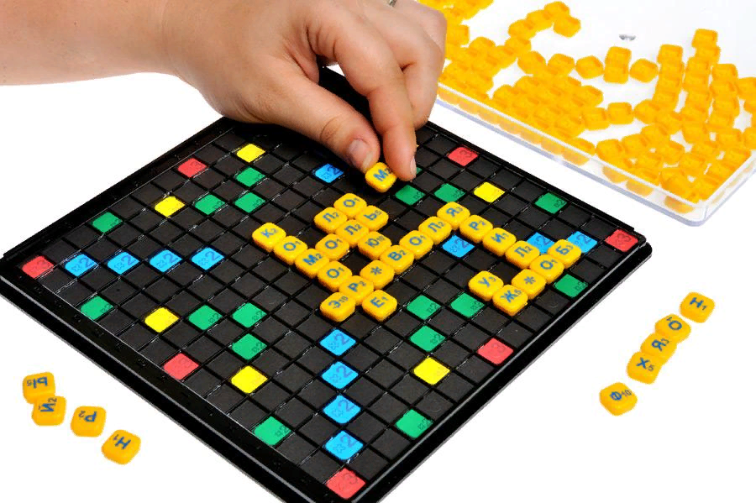
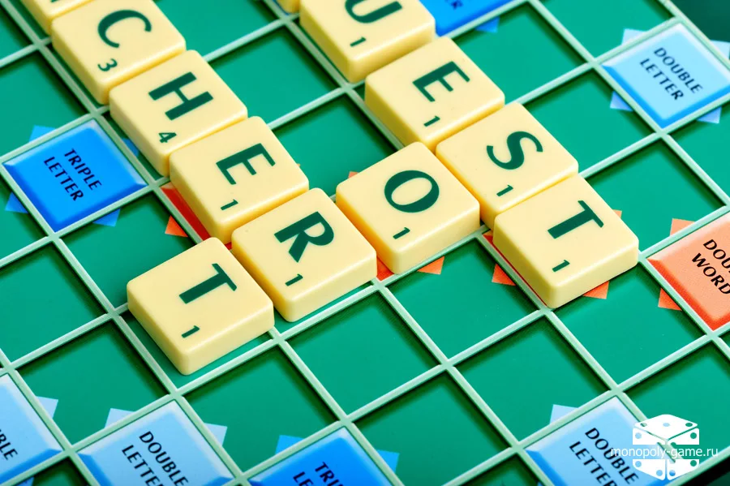
ERUDITE
Презентацию подготовила учитель английского языка ГБОУ ШКОЛА №2070 Горяинова Виктория Викторовна

Slide 2
Answer the questions
1. What is the second day of English calendar?
2. How many parts in Great Britain?
3. When is Halloween celebrated?
4. What holiday has a symbol as the turkey?
5. Who is the president in the USA now?
6. Who is the head of the state in the UK?

Slide 3
Answer the questions
1. Monday
2. Four (4)
3. 31. 10 (31st of October)
4. Thanksgiving Day
5. Donald Trump
6. Elizabeth 2nd

Slide 4
Unscramble
1. Ofx
2. Rirorm
3. Knis
4. Omdnya
5. Atr
6. Tyxsi
7. Pacter

Slide 5
Unscramble
1. Fox
2. Mirror
3. Sink
4. Monday
5. Art
6. Sixty
7. Carpet

Slide 6
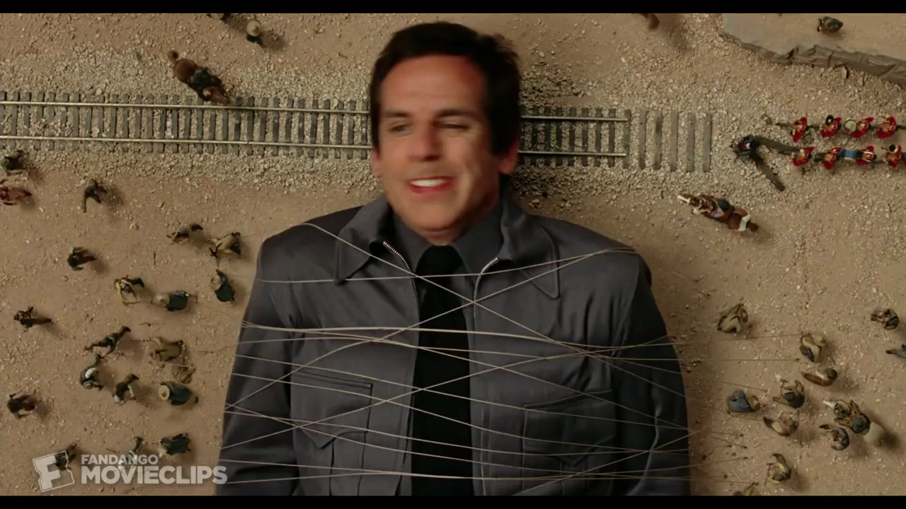
Video riddles

Slide 7
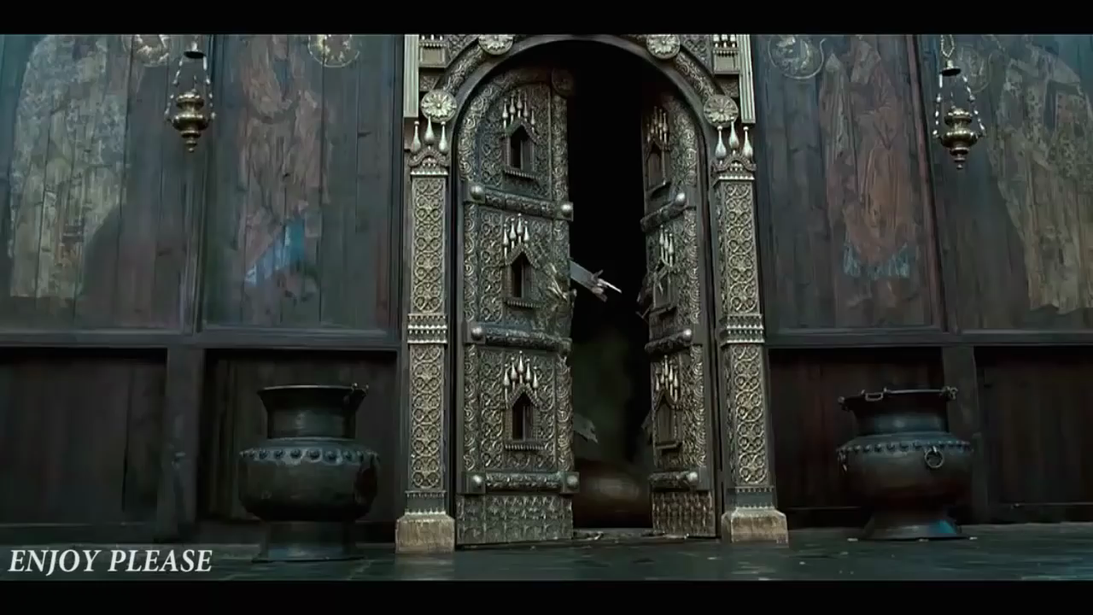
Video riddle

Slide 8
Folk wisdom
1. No news-is good news
2. Live and learn
3. Health is better than wealth
4. It's never too late to learn
5. A bird may be known by its song

Slide 9
Folk wisdom
1. Отсутствие вестей-хорошая весть
2. Век живи, век учись
3. Здоровье дороже богатства
4. Учиться никогда не поздно
5. Птица видна по полету

Slide 10
Odd word
1. Easter/ Christmas/ St. Valentine's Day/ Columbus
2. Tea/ Coffee/ Juice/ Lemon
3. Swimming/ Hockey/ Moving/ Football
4. Dress/ T-shirt/ Suit/ Boots
5. Tree/ Sun/ Rain/ Cold

Slide 11
Odd word
1. Columbus
2. Lemon
3. Moving
4. Boots
5. Tree

Slide 12
Opposites
Minute
Mother
Old
Boy
On
Moon
No
Year
Father
Young
Day
Yes
Under
Girl
Sun
Hour

Slide 13
Opposites
Minute
Mother
Old
Boy
On
Moon
No
Year
Hour
Father
Young
Girl
Under
Sun
Yes
Day

