Slide 1

Aotearoa –
“the land of the long white cloud”
.

Slide 2
The single objective of this project is to provide students with comprehensive information on different aspects of life in New Zealand – the country which, according to the annual global Prosperity Index of 2016, ranked as the most prosperous nation in the world.
https://www.youtube.com/watch?v=Dl2su4enJhI

Slide 3
Contents
General Facts
Geography Quiz
History
Sport
Famous People
Inventions
Languages
Nature
Maori Culture
NZ Sights
NZ Rates
Random Facts
Quizzes

Slide 4
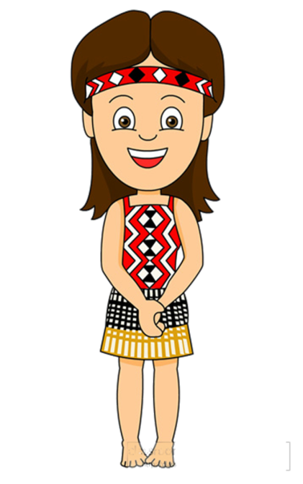
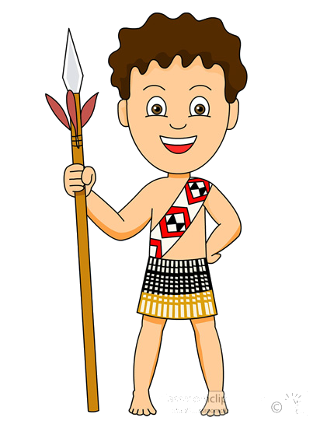
Kio ora!
We’ll be your travel guides and we’ll show you around our native country Aotearoa.
Have fun learning about NZ life!

Slide 5
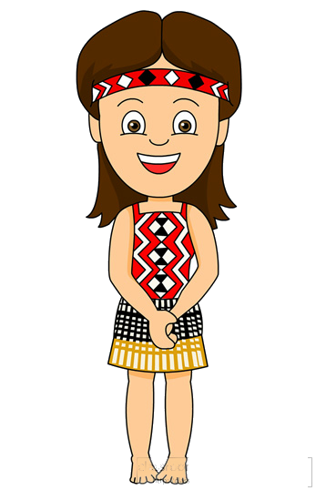
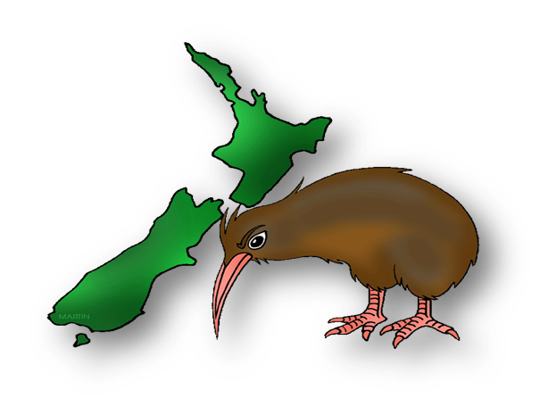
Aoteora
the land of the Long White Cloud
(Maori name)
The Land of Hobbits
varied landscape and unspoiled beauty of NZ provided filming locations of the “Lord of the Rings”
Godzone
this comes form the saying "God's Own Country.“
The land is so beautiful and scenic that Kiwis say: “God lives here”
New Zealand
the country was named NZ after the Dutch province of Nieuw Zeeland which means “Sea Land” in Dutch
Kiwiland
nickname of the country
Maoriland
Maoris are the indigenous people of NZ
The Shaky Isles
the land of volcanoes and earthquakes
(it has about 14,000 earthquakes every year)

Slide 6
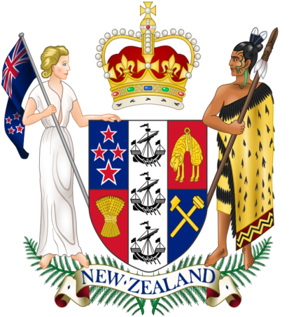
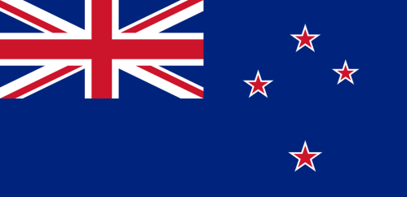

Flag and Anthem
The NZ flag features a blue background (representing the Pacific Ocean) the Union Jack in the top-left corner and, on the right, four stars representing the Southern Cross.
N.Z. has two national anthems:
“God Save the Queen”
“God Defend New Zealand”

Slide 7
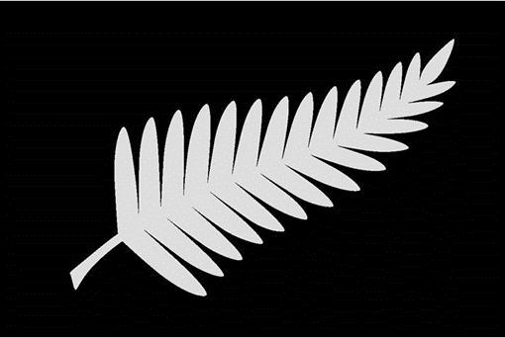

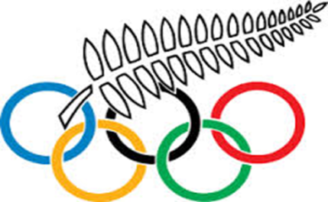
New Zealand
Icons
The Silver Fern
(unofficial flag of NZ)
Maori flag
1980 Moscow Summer Olympics
New Zealand officially boycotted the 1980 Moscow Olympics as part of the US-led boycott of the games. However, four New Zealand athletes competed under the flag of New Zealand's Olympic committee.

Slide 8
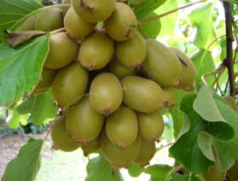
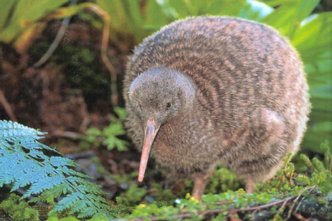
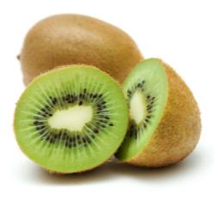
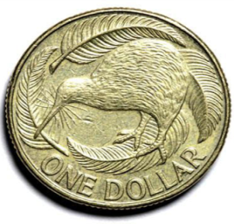
What is Kiwi?
The word “kiwi” is used as a slang to call a New Zealander
native bird
fruit
The kiwi fruit is not native from New Zealand. It’s actually from China and is also well known as Chinese Gooseberries, but it was named after the kiwi bird.
NZ dollar

Slide 9
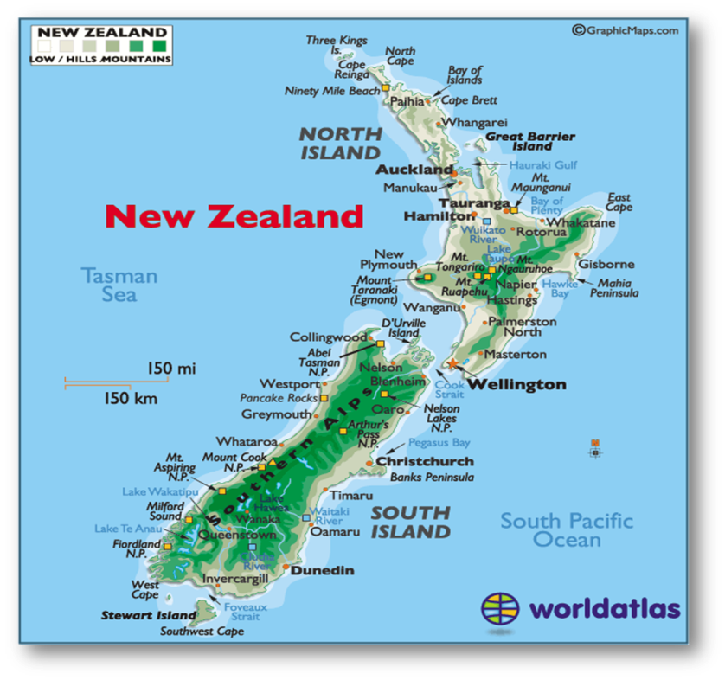
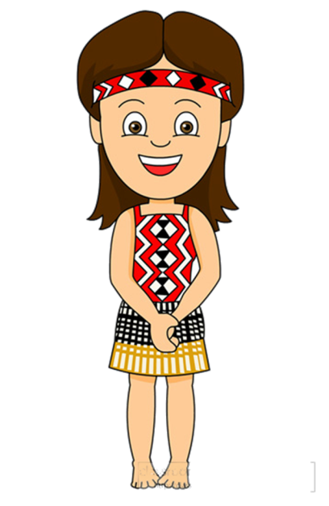
Study the map of New Zealand, solve the crossword puzzle and you’ll find out some useful facts about the geography of the country

Slide 10
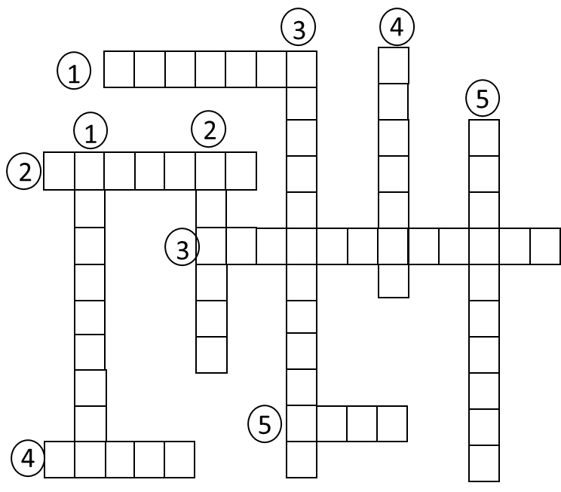
Down:
1. A continent/country situated to the west of New Zealand
2. A sea that separates NZ from Australia
3. The NZ largest city that lies on the South Island’s east coast
4. The island to the south of the South Island
5. A city located at the south-western tip of the North Island
Across:
1. The ocean New Zealand is located in
2. The longest river in the North Island
3. A mountain range running along the western side of the South Island
4. The largest NZ lake located in the North Island
5. A strait that separates the North and the South Islands

Slide 11
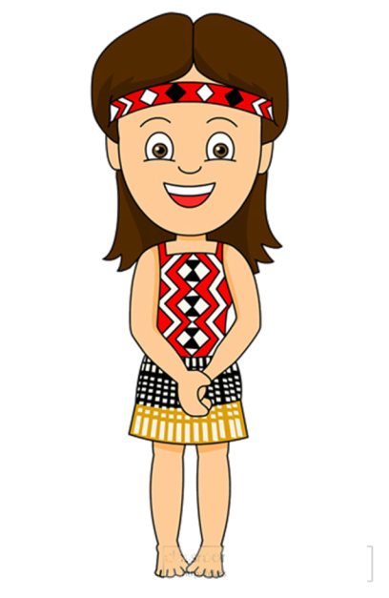
Keys to geography quiz:
3
4
1
P
a
c
i
f
i
C
S
h
t
5
1
2
r
e
W
2
W
A
i
k
a
T
o
i
w
e
u
a
s
a
l
s
3
S
o
u
t
h
e
r
n
A
l
p
s
t
m
c
d
i
r
a
h
n
a
n
u
g
l
r
t
i
5
C
o
o
k
o
4
T
a
u
p
o
h
n

Slide 12
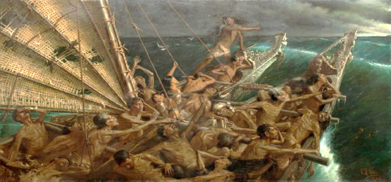
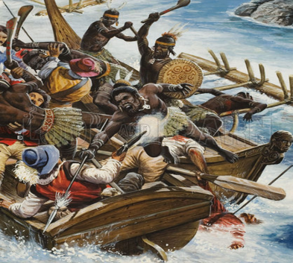
History
The Maori people arrived in NZ by 7 canoes from islands in Polynesia near Tahiti around 1,000 A.D.
The arrival of the Maoris in New Zealand
by Louis J. Steele and Charles Goldie in 1898.
New Zealand was first discovered by Europeans in 1642 when Dutch explorer Abel Tasman reached some unknown land. He left New Zealand after several of his crew were killed by Maoris, and it was not until 1769 that English Captain James Cook arrived and mapped the land.
Tasman’s men massacred at Murderers’ Bay
by Oliver Frey

Slide 13
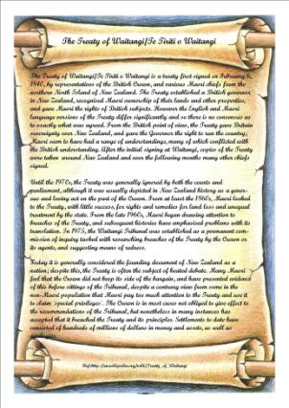
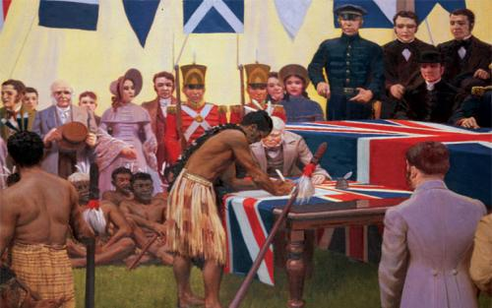
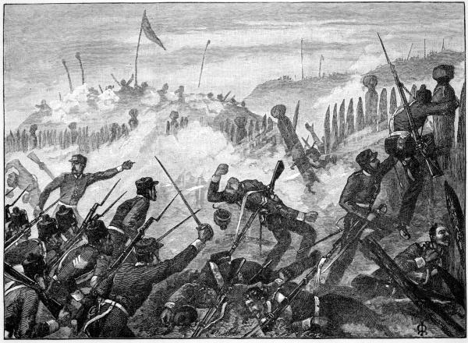
The British signed the Treaty of Waitangi with the Maori in 1840.
Maori granted the British Crown rights to govern and to continue settling the country with British immigrants.
The Maori protested the treaty after their lands were seized, and in the 1860s they began a 12-year war against the British.
Peace was restored to the islands in the 1870s.
The country became a dominion of Britain in 1907 and gained its independence from Britain in 1947.

Slide 14

New Zealand is a sports mad nation, placed third on a list of top sporting nations per head.
New Zealand's most popular sports are: 1. Rugby 60% 2. Netball 49% 3. Cricket 48% 4. Rugby league 43% 5. Rowing 41% 6. Football (soccer) 37%

Slide 15
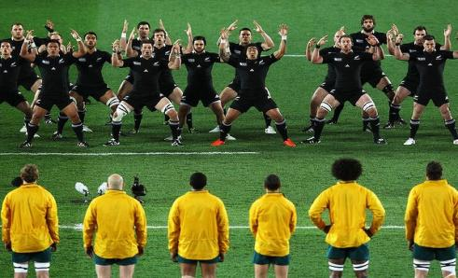
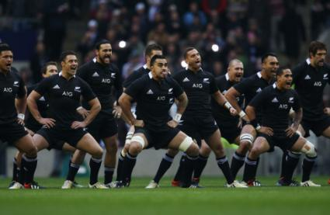
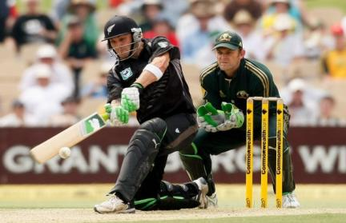
Sport
Rugby is popular across all ages and races in New Zealand.
The All Blacks
Kiwi’s national rugby team is one of the best rugby teams in all of the world!
The Black Caps
the national Cricket team

Slide 16
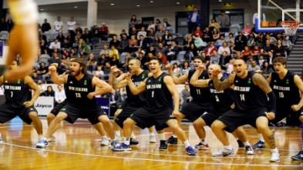
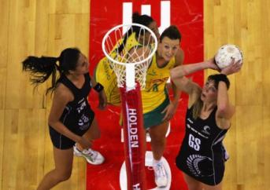
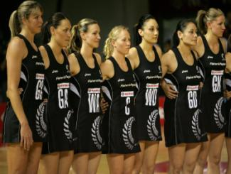
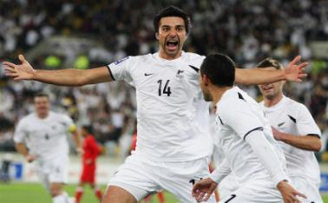
Sport
The Tall Blacks
the national basketball team.
the All Whites
Kiwi’s national soccer team
Netball
is the most popular women's sport in New Zealand.
The Silver Ferns
the national Netball team

Slide 17
For its small population, New Zealand is the homeland of many world-famous people,
who have changed or benefited the world in some way.

Slide 18
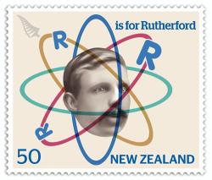
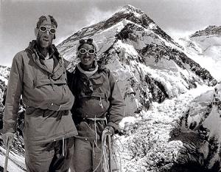
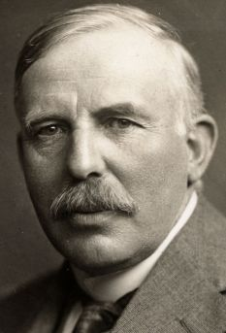
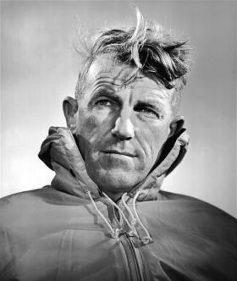
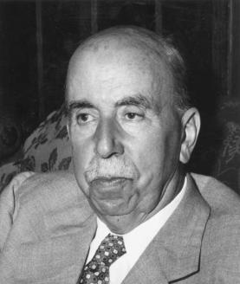
Famous Kiwis
Baron Ernest Rutherford
the first scientist in the world to split the atom in 1919
Sir Harold Gillies
the father of plastic surgery
Sir Ed Hillary
the first person to climb Mount Everest in 1953

Slide 19
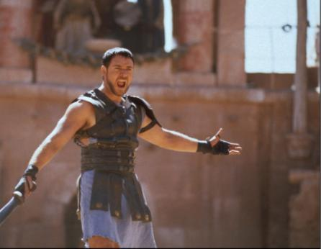
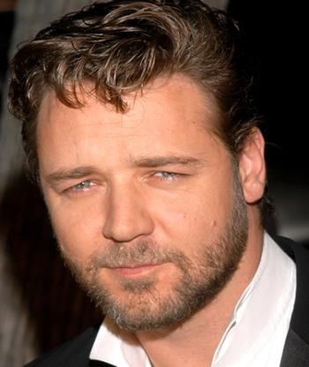
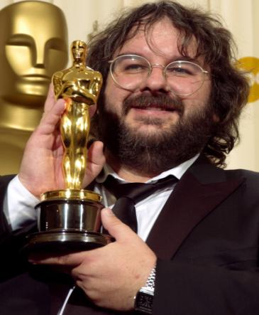
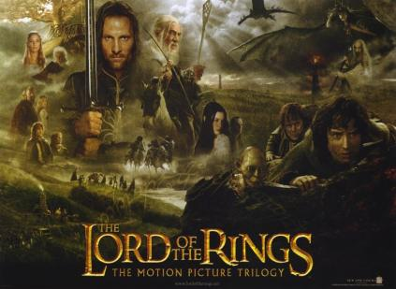
Famous Kiwis
Peter Jackson
the director and producer of The Lord of the Rings trilogy
Russell Crowe (Gladiator)
famous Hollywood actor

Slide 20

Kiwis are also responsible for some of the most famous inventions of all time.

Slide 21

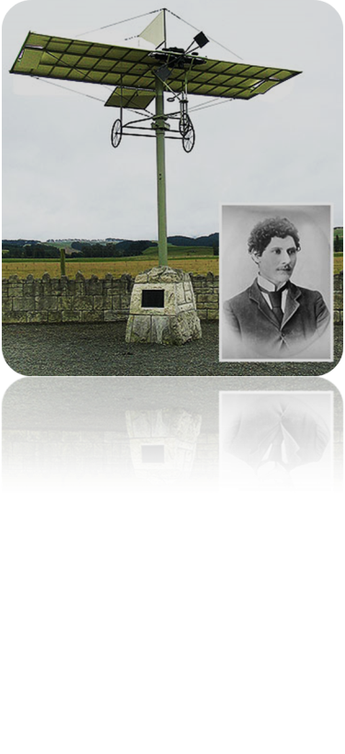
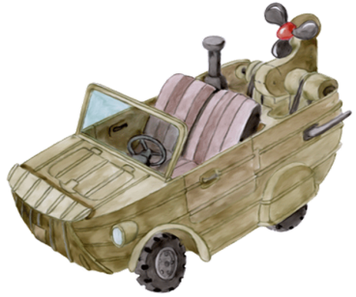
Kiwi Inventions
Richard William Pearse
Colin Murdoch
DISPOSABLE SYRINGE
Colin Murdoch came up with the idea for the disposable syringe, a simple device that has saved millions of lives around the world.
FLYING
New Zealander Richard William Pearse is believed to have taken the world’s first flight in a plane on March 31, 1903, nine months before the Wright Brothers in the United States.
AMPHIBIOUS VEHICLE
Alan Gibbs has invented the world's first high speed sports vehicle that travels on water as well as land.
Alan Gibbs

Slide 22
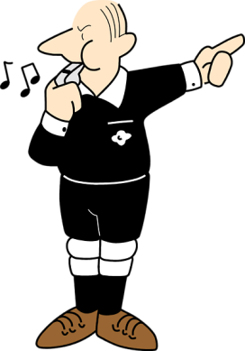
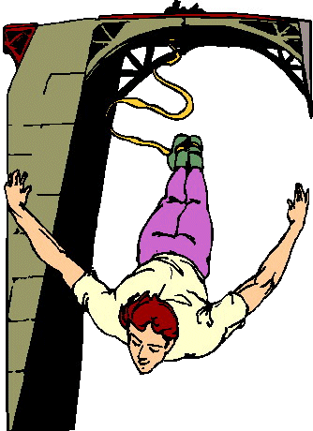
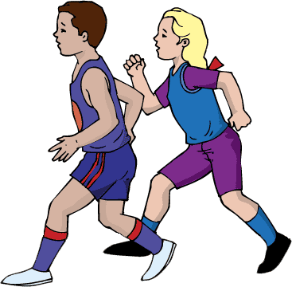
Kiwi Inventions
BUNGEE JUMPING
AJ Hackett pioneered the bungee jump, opening the world's first commercial site in 1988.
William Atack
AJ Hackett
REFEREE’S WHISTLE
New Zealand referee William Atack became the first person in the world to use a whistle to stop a game in 1884.
JOGGING
Running coach Arthur Lydiard developed a training technique for runners that the world now calls jogging.
Arthur Lydiard

Slide 23
New Zealand has three official languages: English, Māori and New Zealand Sign Language.

Slide 24
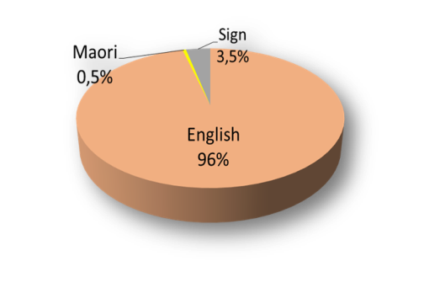
Language
Te Reo (the Maоri language) is considered a national treasure and is spoken by around 3 % of New Zealanders. You'll often hear conversations where Maori terms are dropped casually into the middle of English sentences.
Maori words:
Kia ora - Hello
Haere mai - Welcome
Kei te pehea koe? - How's it going?
Kei te pai - Good
Haere ra - Goodbye
Hei konei ra - See you later
Ae – yes
Kaore – no
New Zealand Sign Language, or NZSL, is the main language of the deaf community in New Zealand.

Slide 25
There is actually a word for New Zealand English, which is a mixture between English and Maori, it’s called ‘Newzild’.

Slide 26
How Kiwi Speak English
According to a BBC survey the New Zealand accent is the most attractive form of English outside the UK. New Zealand English is more liked than Australian, American and most regional British accents. . It is the 6th most 'socially attractive' accent, ahead of the Queen's English (7th) and well ahead of Australian (13th) and American English (15th).
Crook - sick
Knackered – tired, exhausted
Right as rain - perfect
Sweet as … - cool, awesome
Guttered - disappointed or sad
Jandals - flip flops
Brekkie - breakfast
Dag - amusing person or situation
New Zealand has its own special Kiwi words and phrases which are frequently used in daily conversation.
Chuddy - chewing gum
Rattle your dags - hurry up
Arvo - afternoon
She'll be right - everything will work out fine

Slide 27
Can you take a guess as to how much of NZ population is made up of animals? Amazingly 95%, making humans a mere 5% of the population of the country.

Slide 28
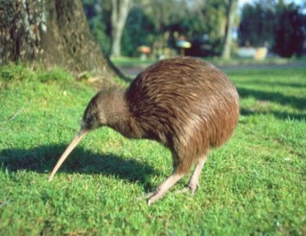
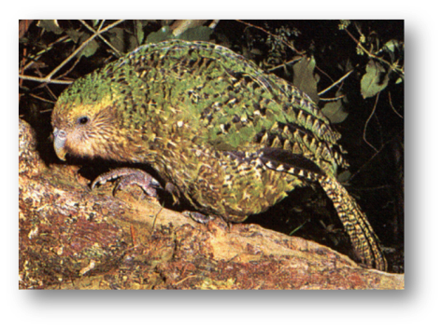
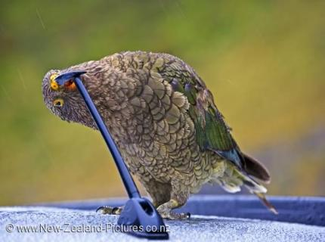
Nature
Because of its remote location, New Zealand is rich in unusual wildlife not seen anywhere else in the world.
New Zealand is home to …
KIWI
is a flightless little bird native to New Zealand, lays eggs that are about 20% of the mother’s body.
KEA
is one of the most intelligent birds in the world and will happily attack a car in order to steal a windscreen wiper or other bits of rubber!
KAKAPO
is the world's only flightless parrot as well as the world's heaviest one

Slide 29
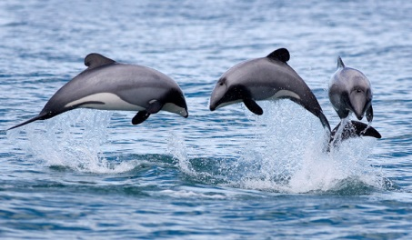
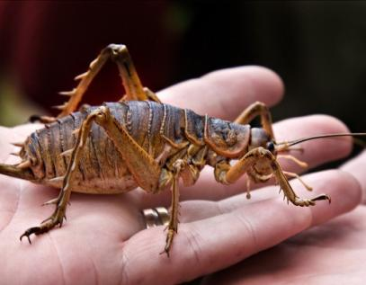
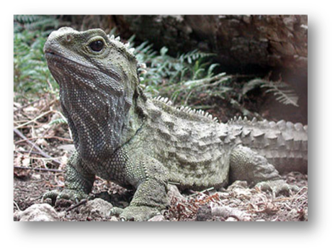
Nature
GIANT WETA
the heaviest insect in the world. It weighs 70 grams. It’s three times bigger than a mouse and looks like a giant cockroach. Yuk! It’s hard to imagine an insect that size.
TUATARA
This strange reptiles are really closely linked to dinosaurs. They’ve been around for about 150 million years and can live to be 300 years old. They are also the only creatures on earth that are born with a third eye, which gets covered with skin after 6 months.
HECTORS DOLPHIN
is one of the rarest dolphins and one of the smallest ones in the world – it can fit inside a bathtub.

Slide 30
Maori culture is a fascinating and important part of New Zealand life and history.

Slide 31
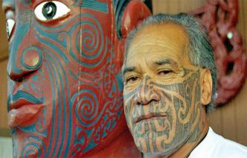



Maori, the indigenous people of Aoteora, make up 15% of the population
Maori Culture
.
The Maori are famous for …
Toi whakairo - a Māori traditional art of carving in wood, stone or bone.
Tā moko - Maori tattoos, each moko has personal significance of belonging to a particular family, tribe or position.
In men the moko can cover the whole face. Males also have tattoos on their buttocks , backs, stomachs . A woman's moko is worn on the chin, the forehead, upper lip, nostrils, and neck.

Slide 32




Haka is a type of ancient Māori war dance traditionally used on the battlefield. Today, haka is still used during Māori ceremonies and celebrations to honour guests and show the importance of the occasion. The All Blacks (New Zealand’s rugby team) traditionally perform the haka before the start of a rugby match.
The Haka involves loud chanting, aggressive body movements and fierce facial expression and is performed to intimidate the other team .
https://www.youtube.com/watch?v=BI851yJUQQw
Hongi is a form of greeting used by the Maori people. It is done by pressing your nose on the nose of person you meet. The hongi has a deep and spiritual meaning to the Maori people, as it reflects the beginning of man, when the God blew oxygen into the nose to give life to the first human being.
The literal meaning of "hongi" is the "sharing of breath."

Slide 33
The Maori
Choose the correct verb form ( past simple or present perfect)
The Maoris are the original people of New Zealand. They 1 lived/have lived in New Zealand for over 600 years. They 2 travelled/have travelled to New Zealand in canoes from the Polynesian islands in 1350. For a long time they
3 were/have been the only people in New Zealand. They 4 drew/have drawn pictures on rocks that told stories about their lives. Stories 5 were always/have always been important. European travellers 6 came/have come to New Zealand in the 19th century. Life 7 changed/has changed for the Maoris when the travellers 8 took/have taken a lot of Maori land. Now Maoris and European New Zealanders 9 lived/have lived together for over 200 years and the government 10 returned/has returned the Maori land. Although most Maoris speak English, they 11 didn’t forget/haven’t forgotten their traditions, customs, songs, dances and language.

Slide 34

New Zealand will take your breath away!
It is a country of spectacular scenery with stunning mountains, beautiful beaches and huge glaciers.
In a country filled with adventure and wildlife, everyone will find something to do and to see.

Slide 35











The Coromandel Peninsular
Ten Top Places to Go and
See in NZ
The Waitomo Cave
Rotorua
Abel Tasman Park
The Franz Josef Glacier
Tongariro National Park
Fiordland National Park
Wellington
Kaikoura
Milford Sound

Slide 36
Ten Top Places to Go and See
in NZ
Rotorua
the heartland of Maori culture and famous for its thermal spas, steaming craters and geysers
Milford Sound
described by Rudyard Kipling as the ‘Eighth Wonder of the World’
Tongariro National Park
is a hotbed of volcanism, with Mount Ruapehu being the most active volcano of the country
Coromandel Peninsula
is known for beautiful beaches with hot water with temperatures around 60 degrees Celsius
Wellington
the capital city offers many memorable tourist attractions
Abel Tasman National Park
famous for the beautiful beaches and blue water , forests with giant ferns, trees, and a great climate
The Franz Joseph Glacier
"descends into a rainforest zone", it means that you can start your journey hiking through a rainforest and end up coming face to face with a giant glacier
Fiordland National Park
must-see stunning scenery with deep fiords, steep mountains, cascading waterfalls and lush
rain forests
Kaikoura
possibly the best location on the planet for whale-watching and swimming with dolphins
The Waitomo Cave
lit by millions of glowworms

Slide 37
New Zealand ranks highly in international studies to measure everything from peace and happiness to quality of life.

Slide 38
New Zealand’s Ranking
Peacefulness - 2nd place
NZ ranks the 2nd most peaceful country in the world (according to the 2019 Global Peace Index).
Least corrupt nation - 2nd
New Zealand is the 2nd least corrupt nation (The Corruption Perception Index, 2018).
Generosity - 2nd
New Zealand is one of the most generous nations (The Charities Aid Foundation, 2016).
Education - 10th
NZ has one of the world's best educated populations (in 2009 PISA ranked NZ 7th best at science and reading in the world, and 13th in maths).
Happiness - 8th
New Zealand ranks 8th to measure personal happiness (the World Happiness Report, 2019).
Quality of life - 9th
New Zealanders have a quality of life that is ranked 9th in the world (The Quality of life Index, 2019).
One of the Best countries to live
According to the Legatum Prosperous Index, NZ ranked the 7th in 2019 and in 2018 – the 2nd most prosperous nation in the world (health, family life, community life, material well being, political stability and security, climate and geography, job security, political freedom and gender equality).

Slide 39
Here are some totally random facts that are hard to believe, but super interesting!

Slide 40




In 1893, New Zealand became the first country to give women the right to vote.
There are around 10000 Russians or Russian speakers in New Zealand .
NZ streets are very clean, that`s why a lot of people, especially in the center, walk without shoes (barefoot).
A New Zealand chef invented the meringue dessert known as the ‘pavlova’ in honor of the famous Russian ballerina Anna Pavlova.
At the entrance of parks there is special liquid to clean your shoes from infections - you need to spray your shoes to kill microbes. You can do that if you only want, there is no people who check it.
The longest place name in the world is Taumatawhakatangiangakoauauotamateapokaiwhenuakitanatahu, a hill in Hawke’s Bay.
New Zealand will deny people residency visas if they have very high BMI (body mass index) and there have been cases of people rejected because of their weight.
NZ has the worst internet in the entire world, which means it’s really bad, really slow, and really expensive. It’s also limited. LIMITED!!!

Slide 41
This is a test to see how well you really know New Zealand.

Slide 42










New Zealand by Numbers
Match the numbers and the facts about the country. There is one extra number and that is the post
code for New Zealand. When you work out which number it is, write it at the bottom of the exercise.
74 1. the height in meters of Mount Cook/Aoraki
3,724 2. the population of New Zealand
15 3. the population of Auckland
8 4. the length in kilometers of the Tasman Glacier
85 5. the approximate flight time in hours from Moscow to Wellington
462 6. the number of protected national parks in NZ
4,537,000 7. the surface area in square kilometers of Lake Taupo
27 8. the number of times sheep outnumber people in NZ
616 9. the size in square kilometers of NZ
1,418,000 10. the percent of European population in NZ
14 11. the percent of Maori population of NZ
268,000 12. New Zealand is the … ^{th} largest country in the world
21 13. the number of letters in the longest world’s place name(in Maori)
64 14. the depth in meters of Lake Hauroko
425 15. the length of the river Waikato
75
The calling country code of New Zealand is ___________ .

Slide 43

Keys:
New Zealand by Numbers
3,724 the height in meters of Mount Cook/Aoraki
4,537,000 the population of New Zealand
1,418,000 the population of Auckland
27 the length in kilometers of the Tasman Glacier
21 the approximate flight time in hours from Moscow to Wellington
14 the number of protected national parks in NZ
616 the surface area in square kilometers of Lake Taupo
8 the number of times sheep outnumber people in NZ
268,000 the size in square kilometers of NZ
74 the percent of European population in NZ
15 the percent of Maori population of NZ
75 New Zealand is the … ^{th} largest country in the world
85 the number of letters in the longest world’s place name(in Maori)
462 the depth in meters of Lake Hauroko
425 the length of the river Waikato
The calling country code of New Zealand is 64

Slide 44


One Odd Out
Look at these groups of words relating to New Zealand
Which word does not fit?
Languages
Maori
English
French
Sign language
Cities
Christchurch
Melbourne
Dunedin
Auckland
Famous Kiwis
Ed Hillary
Hugh Jackson
Harold Gillies
Peter Jackson
Fauna
Kea
Weka
Tuatara
Kookaburra
Maori Traditions
Haka
Hongi
Ta Moko
Corroboree
Sport Teams
All Whites
Southern Stars
Silver Ferns
Tall Blacks

Slide 45

What do New Zealanders mean when they talk about the following?
Choose the correct answer.
1. Kia ora is … .
a. Maori farewell words
b. a traditional Maori dance
c. a Maori greeting
2. The Ditch is … .
a. a public toilet
b. the Tasman Sea
c. a sewage system
3. Pakeha is … .
a. a white person
b. a meat dish
c. a recreation area
4. Hockey-Pockey is … .
a. a children’s game
b. vanilla ice-cream with toffee
c. traditional holiday
5. NCEA is … .
a. a system of school examinations
b. the national space exploration research project
c. the highest country’s award given for bravery
6. Zoning is … .
a. division into economic areas
b. business spheres
c. a way to limit the size of school based on where students live

Slide 46
These are only a few fun facts about New Zealand and there are many more of them.
You can experience all of them by paying a visit to this wonderful and enchanting country.

Slide 47
Haere Ra!
( Maori goodbye)

