Slide 1
Открытый урок по теме «Great Places for Children» к учебнику учебно-методического комплекса «Сферы» по английскому языку для 5 класса
Учитель английского языка
Комиссарова Людмила Александровна

Slide 2
Some people live in the country
Where the houses are very small,
Some people live in the city
Where the houses are very tall.
But in the country where the houses are very small,
The gardens are very big,
And in the city where the houses are tall,
The are no gardens at all.

Slide 3
1. shopping centre
2. town
3. theatre
4. school
5. city
6. flat
7. park
8. church
9. stadium
10. museum
11. cinema
12. house
13. library
a) театр
b) город (большой)
c) церковь
c) церковь
d) библиотека
e) квартира
f) стадион
g) дом
h) торговый центр
i) парк
j) город (небольшой)
k) школа
l) музей
m) кинотеатр

Slide 4
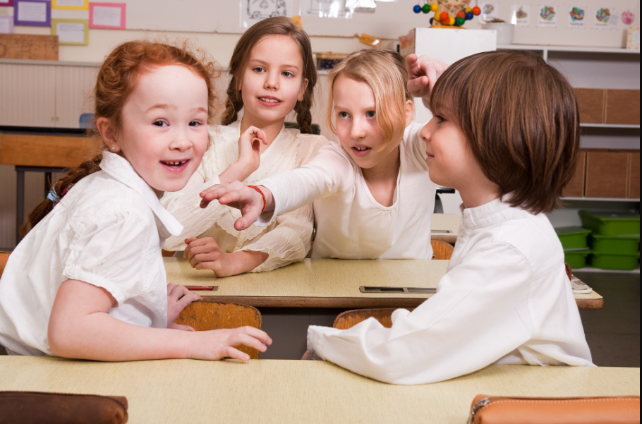
Now we’re going to listen to Mr. Kingsley in ex.2, p. 130. Before it let’ s learn some words which you’ll hear in the dialogue:

Slide 5

expensive--------дорогой cheap --------дешевый find out ------- выяснять try out ------- испытывать
handout--------раздаточный материал
sort out ------- приводить в порядок

Slide 6
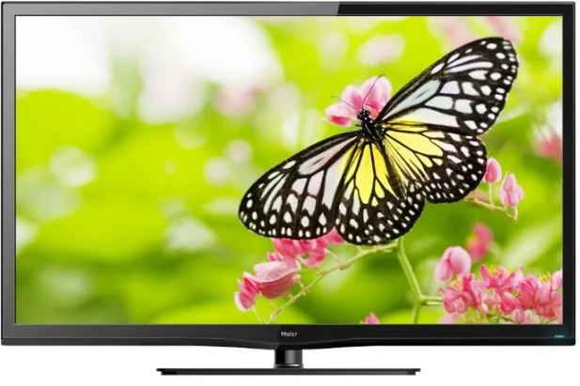
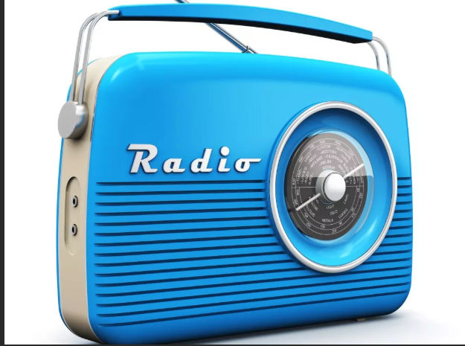
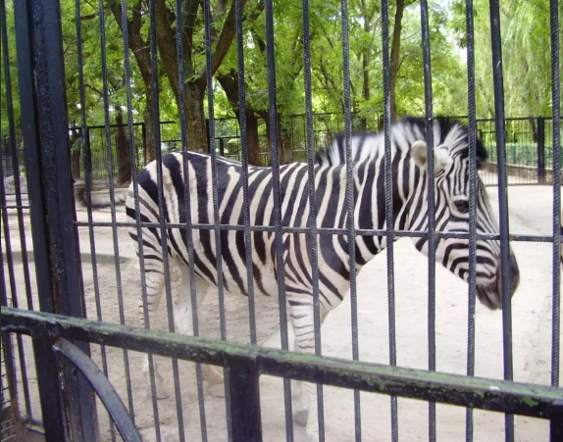
How often do you watch TV?
How often do you listen to the radio (music)?
How often do you go to the theatre (cinema, zoo, concert)?

Slide 7
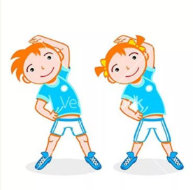
Well done, children. Let’s have a rest.
Can you hop like a rabbit?
Can you jump like a frog?
Can you walk like a duck?
Can you fly like a bird?
Can you swim like a fish?
And be still like a good child,
As still as you wish.

Slide 8
1. If I have free time, I usually_____________ .
2. I like to read books on__________________.
3. I watch TV ____or ____ times a week.
4. I don’t like to go to the__________.
5. I don’t often go to see my________.
6. I meet them_______ a week.
7. We like to play______ or ______ in summer.
8. Sometimes I spend my weekend__________.
9. When I stay in the country, I work in the____, swim in the ____and pick up _______and ________in the forest.

Slide 9
1. If I have free time, I usually walk, read, or watch TV .
2. I like to read books on history, detective stories, fairy tales.
3. I watch TV three or four times a week.
4. I don’t like to go to the cinema.
5. I don’t often go to see my friends.
6. I meet them twice a week.
7. We like to play football or tennis in summer.
8. Sometimes I spend my weekend in the country.
9. When I stay in the country, I work in the garden, swim in the river and pick up and mushrooms in the forest.

Slide 10
each corner= every corner
agree on a place
1. The students each make a place mat.
2. There is one idea that all the students have got.

Slide 11
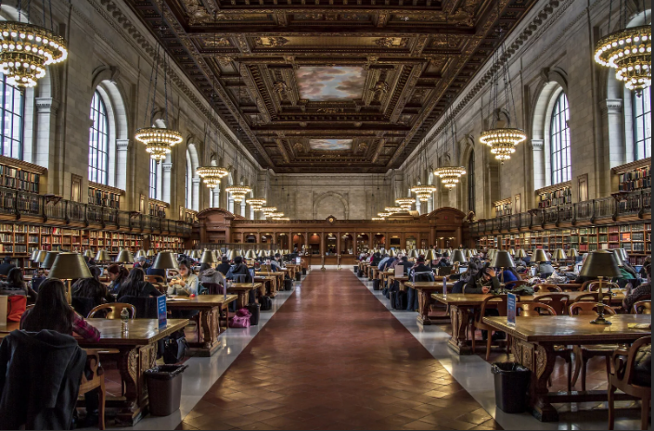
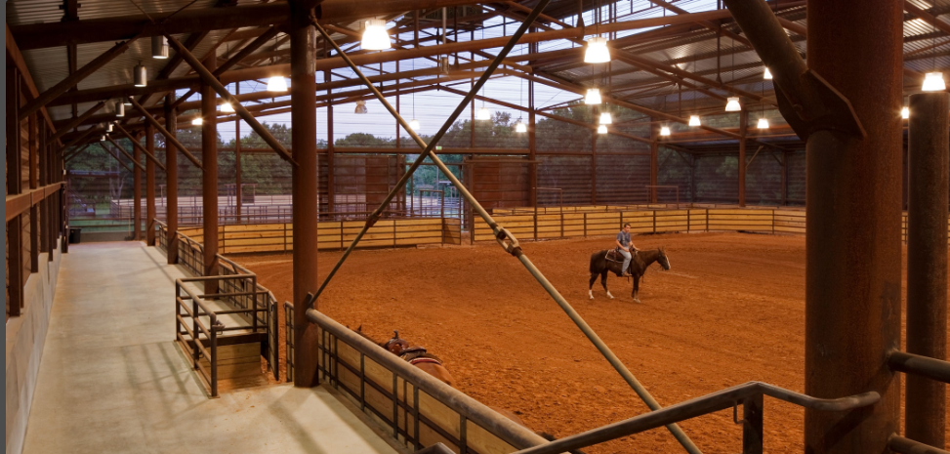
Listen to the dialogue of ex.4, p.131 and read it.

Slide 12
