Slide 1



What are they doing now?
How long have they been doing this?
since 3 o`clock
for ten minutes
all morning

Slide 2

The Present Perfect Continuous Tense

Slide 3
have been/has been +Ving
Key words:
since
for
all… (morning, evening, day)
How long…?

Slide 4
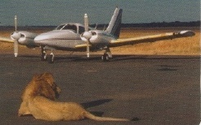
There is a lion lying at a small airport in South America.
Planes can`t leave because the lion is in the way!
The lion has been lying there since 9 a.m.
But no one wants to move them!
The passengers have been waiting for five hours!
The manager of the airport thinks this lion is enjoying
the sun and will move when the sun goes down.
Until then, everyone must wait!
(+) The lion has been lying there since 9 a.m.
(-) The lion hasn`t been lying there since 9 a.m.
(+) The passengers have been waiting for five hours.
(?) Have the passengers been waiting for five hours?
(?) How long have the passengers been waiting?

Slide 5
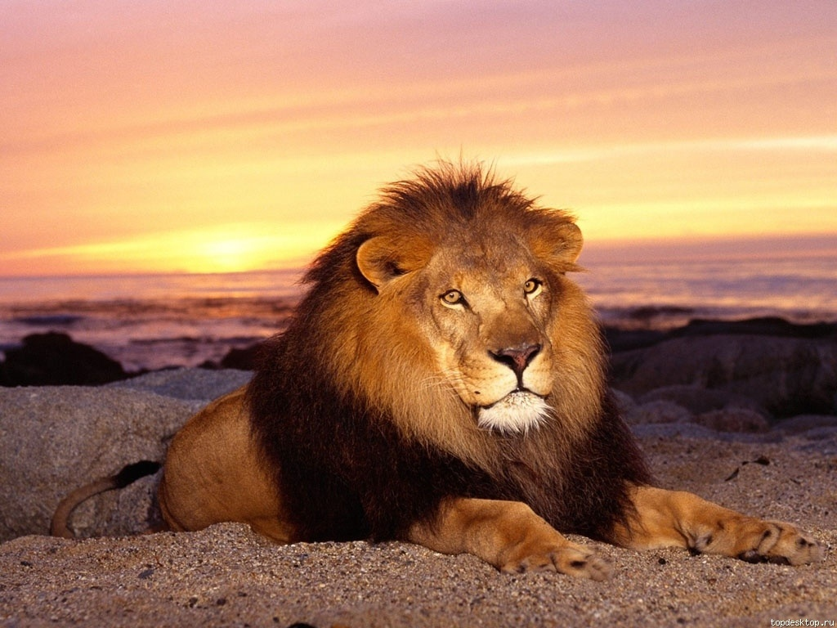
… five hours
… last month
… Friday
…20 minutes
since
for
since
for
since
for
since
for
… 5 o`clock
… September
… ten months
… his childhood
for
since
since
for
since
for
since
for
… two years
…a long time
… Christmas
… my birthday
for
since
since
for
for
since
for
since

Slide 6
for/since/all
I have been working on the computer for/since/all six o`clock.
Alice has been reading his book for/since/all afternoon.
Jess has been learning English for/since/all five years.
Where is the bus? We`ve been waiting here for/since/all twenty minutes.
The weather is awful! It`s been raining for/since/all day.
My mother has been cooking for/since/all ten o`clock.
The boys have been playing football for/since/all an hour.

Slide 7
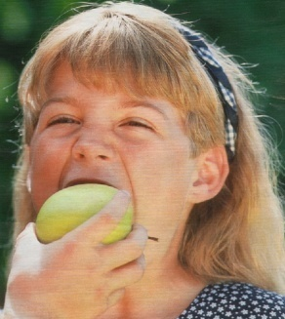
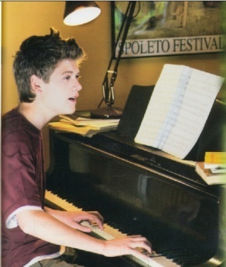
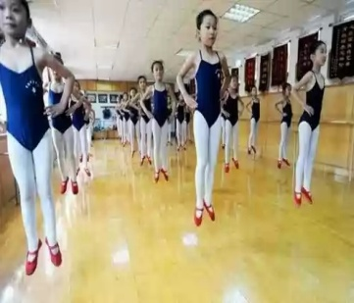
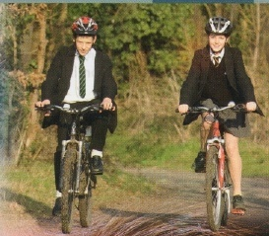
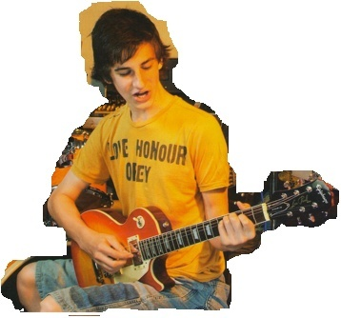
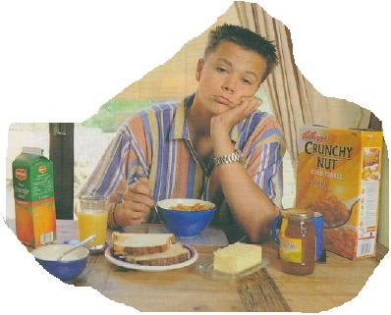
Make up the sentences
eat an apple/
a minute
2. play the piano/
2 o`clock
3. jump/
five minutes
She has been eating an apple for a minute.
He has been playing the piano since 2 o`clock.
They have been jumping for 5 minutes.
4. ride bikes/ morning
5. play the guitar/
5 o`clock
6. have lunch/ 30 minutes
They have been riding their bikes all morning.
He has been playing the guitar since 5 o`clock.
He has been having lunch for 30 minutes.

Slide 8
Complaining game
Pupil 1 : Oh…. I have been doing my homework for an hour!
Pupil 2 : That’s nothing! I have been doing my homework for two hours!

Slide 9
Find and correct mistakes
I have be living here for five years.
Has you waiting for me since 3 o’clock?- Yes, I’ve.
Children have been watch TV since three hours! How long they have been doing it?
Has Sally been working as a nurse for five years ? – Yes, Sally has.
They’ve been knowing each other for many years.
How long have your sister been training?
I haven’t been hearing from him since several months.
Andrew and Dan has been work together for last year.
You have been cooking for two hours?

Slide 10
Present Perfect Continuous or Present Perfect
1. I _____here for 10 years.
a) have been living b) have lived
2. He ______at that company since last year.
a) has been working b) has worked
3. Her hands are dirty. She ______ in the garden.
a) has worked b) has been working
4. How long ___children _____ English?
a) have __learned b) have____ been learning
5. They ______about house.
a) have just cleaned b) have been cleaning
6. He ______ training.
a) has finished b) has been finishing
7. I ______ my new job yet.
a) haven’t started b) haven’t been starting
8. . I _____ this book since the beginning of the summer.
a) have been reading b) have read
9. How long he ____ TV?- Since eight o’clock.
a) has watched b) has been watching
10. My brother _____ football since he broke his arm
a) hasn’t been playing
b) hasn’t played

Slide 11
Thank you very much!!!

