Slide 1
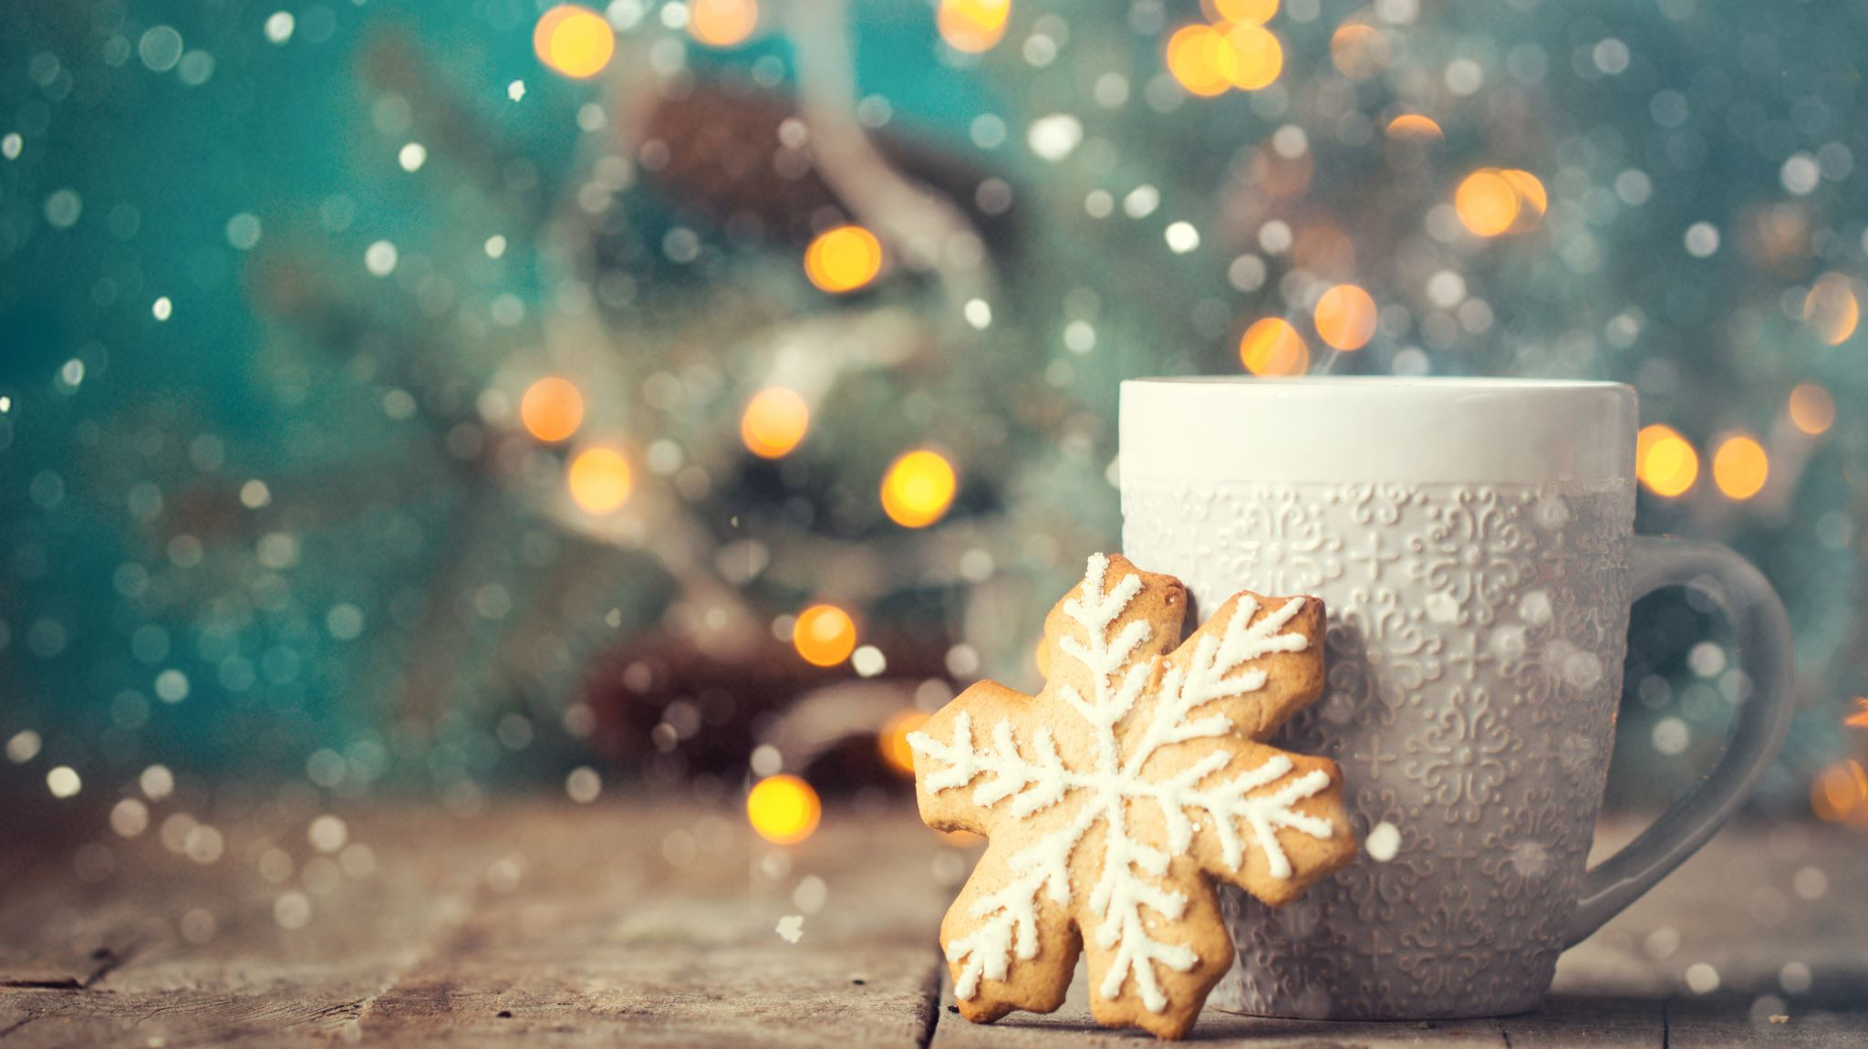
"How Christmas is celebrated in English-speaking countries"

Slide 2
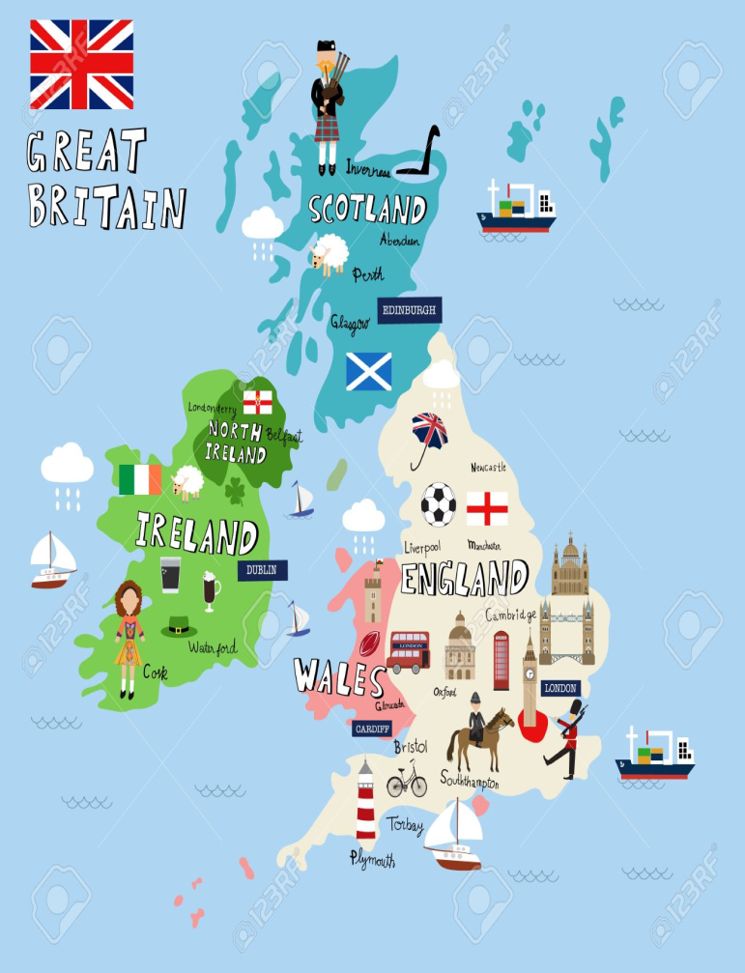
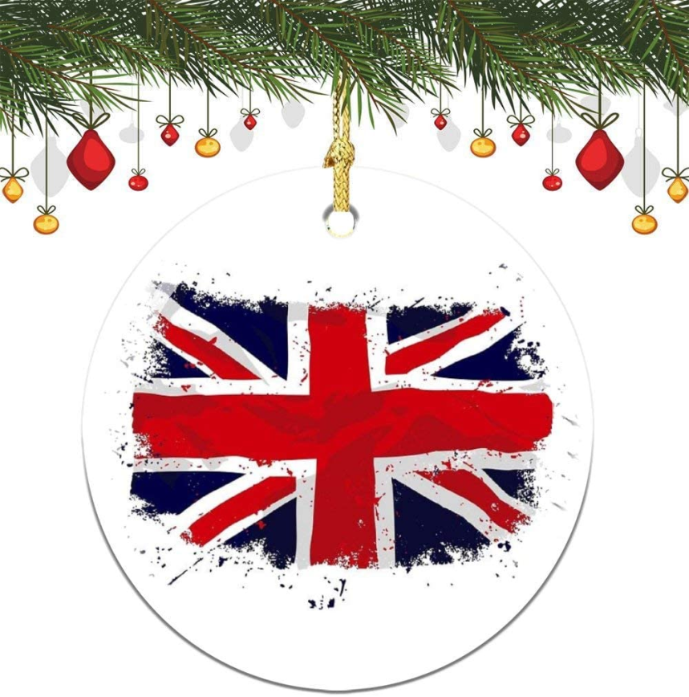
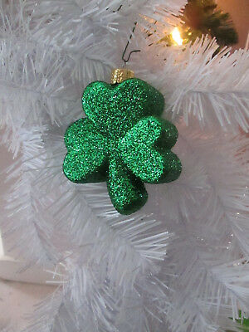

Warming-up
Look at the pictures.
Ask and answer questions using the submitted information.
GB consists of four countries…
Union Jack
A white field with centered red cross.
…is the national symbol of Ireland.
Saint George's Cross, also called the Cross of Saint George

Slide 3
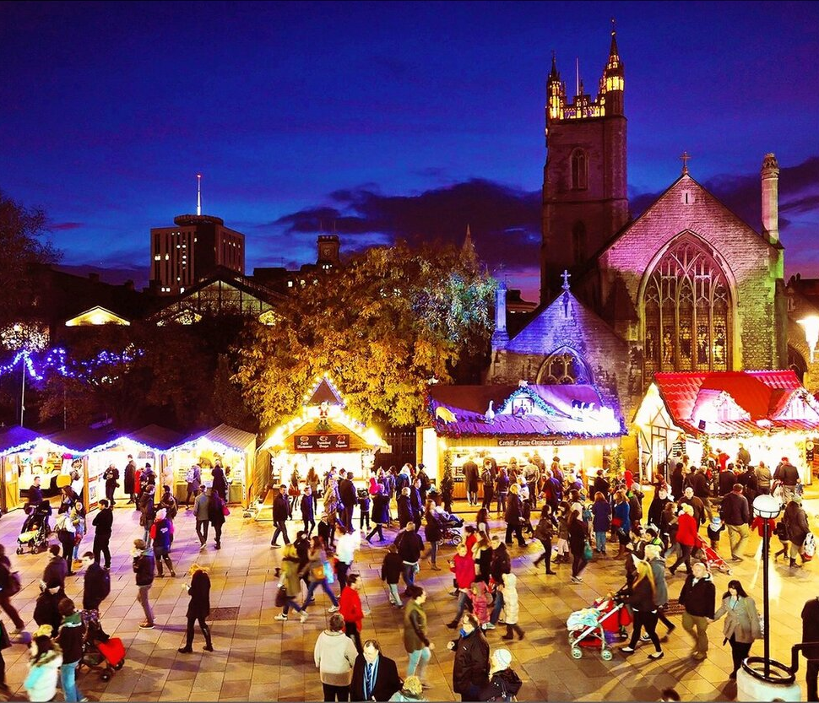
England
Christmas Day is celebrated on the 25th of December by Catholics, Lutherans and other Protestants. It is probably the most popular holiday in England. Of course, this is a family holiday. Traditionally, all relatives and friends gather together and give each other gifts. That is why children love and look forward to this holiday.

Slide 4
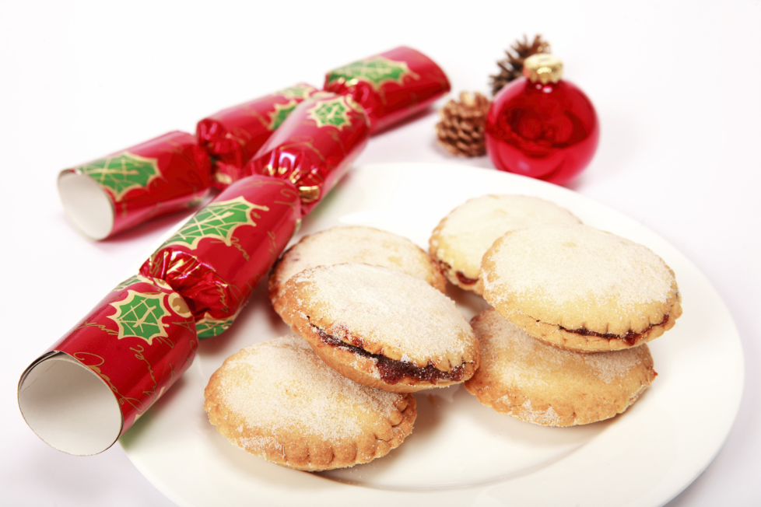
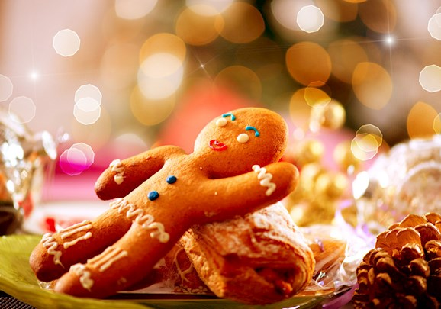
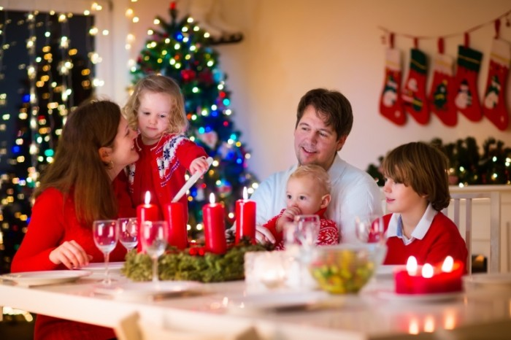
How do Englishmen celebrate Christmas?
Why do pople all around the world love and look forward to Christmas?
… use this time to read together, have a family game night, and lots of good, old-fashioned family fun.
dreams and wishes come true
Buying Tree's and Decorating
…sit by the fireplace, under the covers, sip hot chocolate, and have a marathon of favorite flicks
Christmas is all about the togetherness and spreading the love and joy with one another.
It is a holiday of magic.

Slide 5
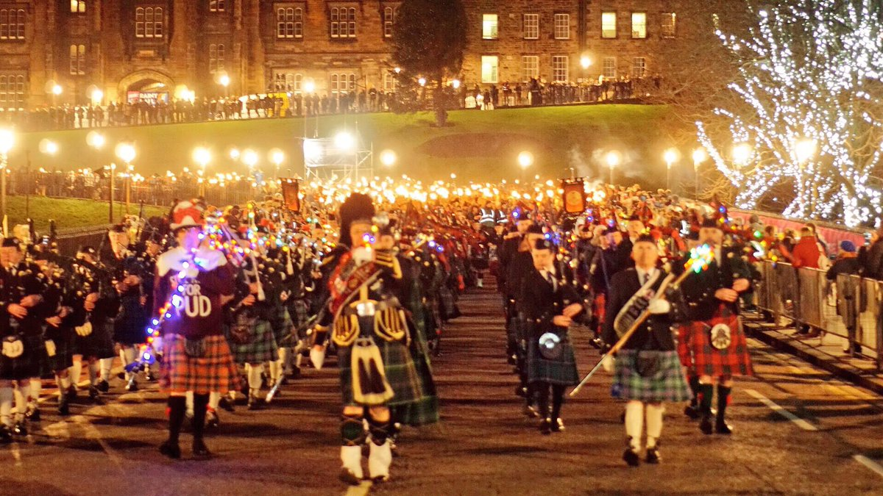
Scotland
Christmas was banned here for almost four centuries. The celebration of Christmas Day in Scotland became a public holiday in 1958.
Christmas or Hogmanay in Scotland is celebrated on the 25th of December, too. It is a quiet family holiday, which is not usually celebrated on a grand scale here.
There are no loud toasts at the table and there is no such fun as in the New Year holidays. Kids don't hang out their socks waiting for their presents or leave treats for Santa.

Slide 6
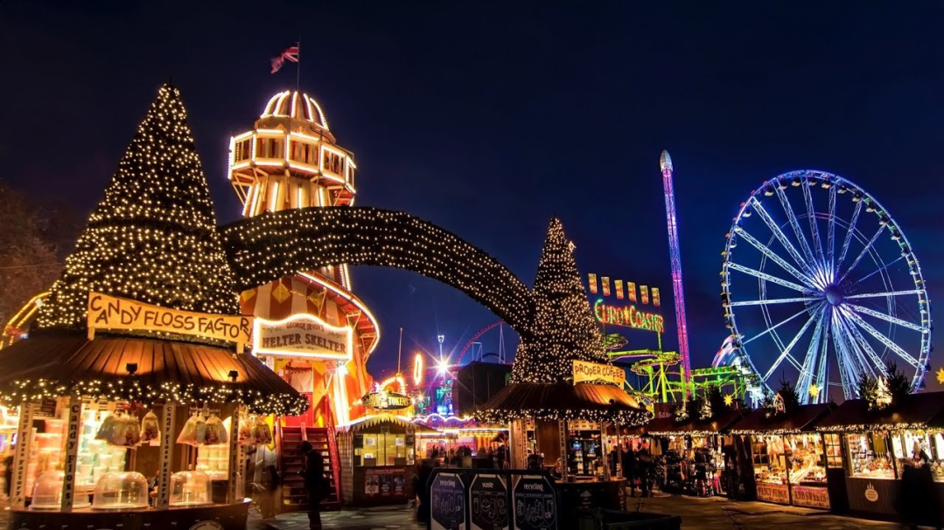
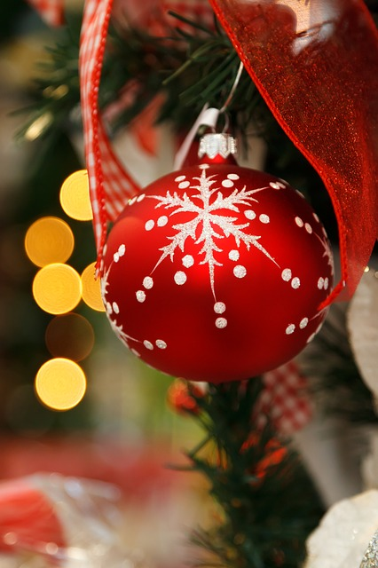
What is Christmas called in Scotland?
When did Scotland start to celebrate Christmas?
Why there aren't any loud toasts at the table and much fun as in the New Year holidays in Scotland?

Slide 7



Christmas and New Year Vocabulary
New Year’s tree – новогодняя елка
Father Christmas — Дед Мороз
(который приходит на Рождество)
Snow Maiden – Снегурочка
Jack Frost – Дед Мороз
decorations — украшения
glass balls, toys – шары,
новогодние игрушки
bell — колокольчик
candy cane — карамельная трость
lights — гирлянда
ornaments — украшения на елку
coloured lights – фонарики
a tinsel – гирлянда
crackers – хлопать хлопушки
hand-made gifts – самодельные подарки
tinsel — новогодний дождик, мишура
a star — звезда
garland — гирлянда
candle — свеча
a wreath —рождественский венок
red ribbon — красная лента

Slide 8
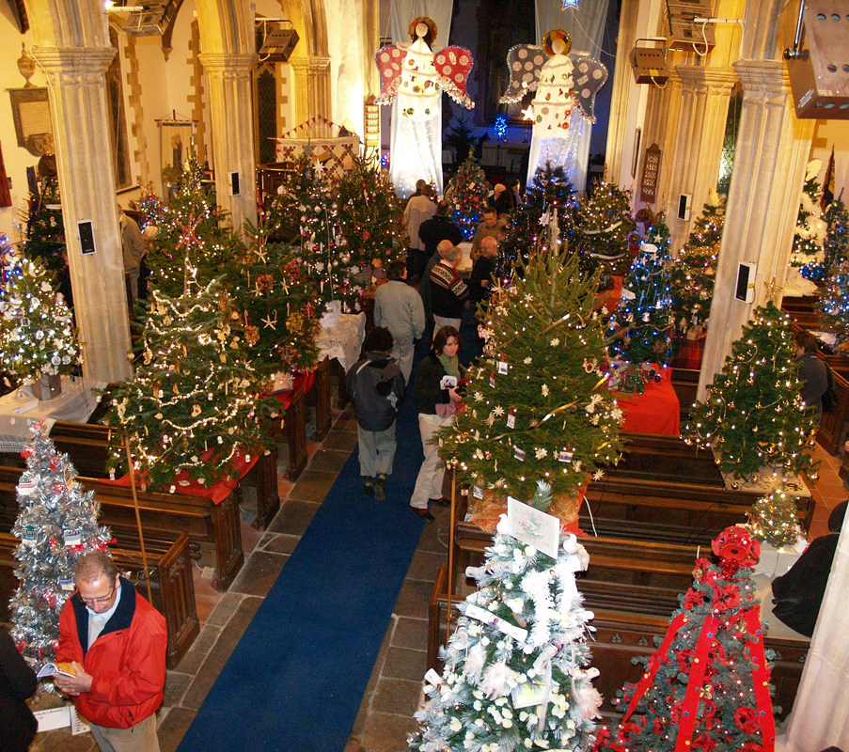
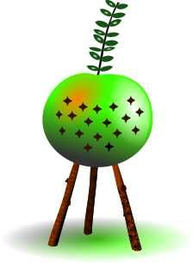
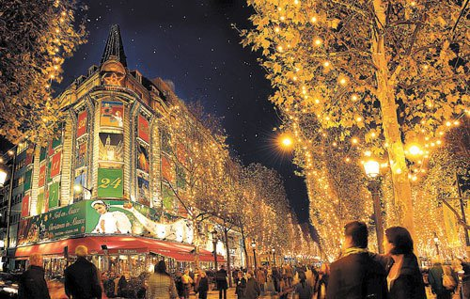
Wales
In Wales, it is customary to attend church services. It is called "Plygain“. Plygain is a traditional Welsh Christmas service which takes place in a church between three and six o'clock in the morning.
Another important tradition at Christmas is to give Calenigg, which is considered a symbol of good luck. It originates from the Roman custom of giving olive branches for the New Year, as a symbol of peace, but this custom got lost somewhere between Italy and the British Isles and changed to represent an apple with three legs – branches.

Slide 9
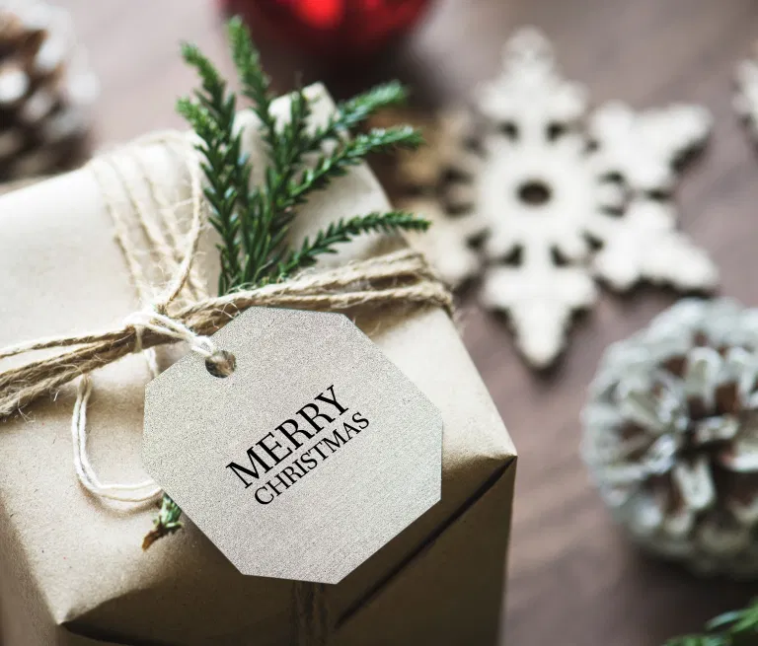
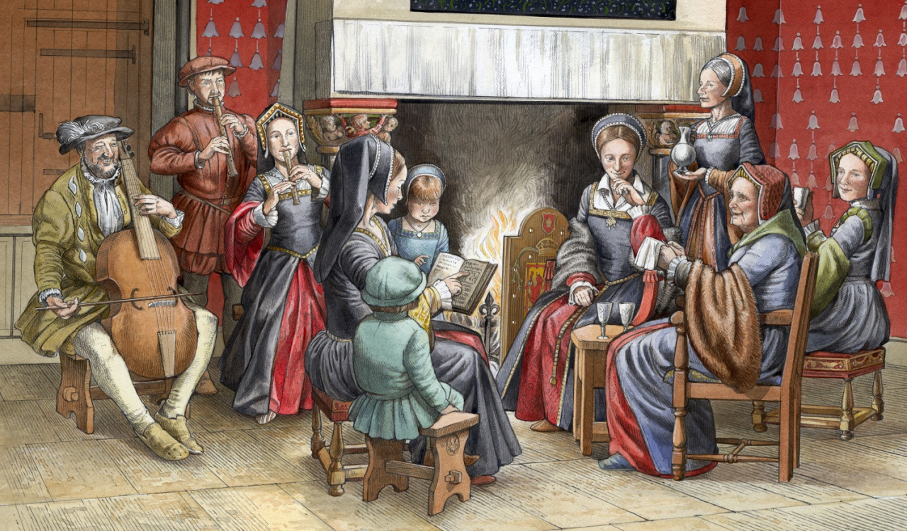
What is «Plygain»?
Where did the Christmas tradition to give Calenigg came from?

Slide 10
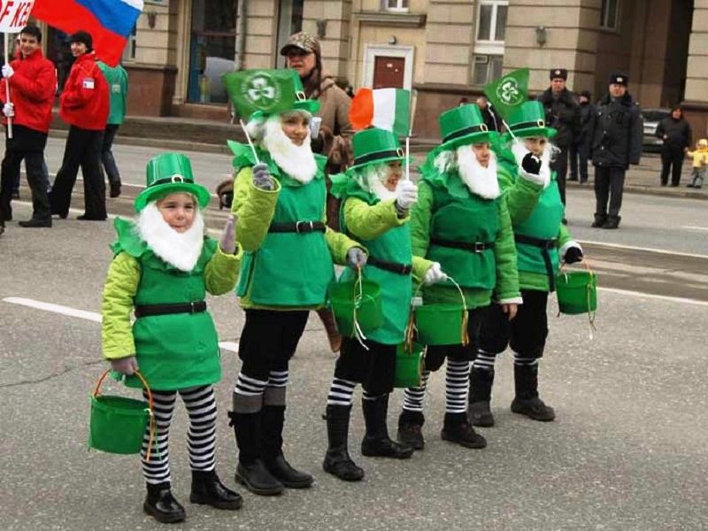
Northern Ireland
Christmas in Ireland is a religious festival. Here they are very sensitive to the observance of traditions and customs, and most of the time of the holiday is spent with family and friends. Loud parties and gatherings, all kinds of corporate parties fall on the Pre-Christmas period. Christmas is celebrated according to the Catholic calendar, from 24 to 26 December. However, preparation for the holiday begins as much as 4 weeks before.
It is very important for the Irish to prepare their homes for Christmas. They do the cleaning, clean out all the garbage, wash the dishes, clean up the garden and then they decorate the house .

Slide 11
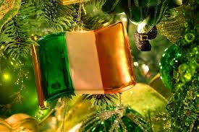
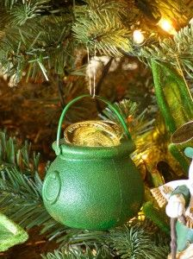
Fill in the missing words
Christmas in Ireland is a …. .
Most of the time of the holiday is spent with … .
Christmas is celebrated according to the Catholic calendar, from … to … December.
… for the holiday begins as much as 4 weeks before.
What do the Irish do to prepare their homes for Christmas?
What do you do to prepare your homes for Christmas?

Slide 12
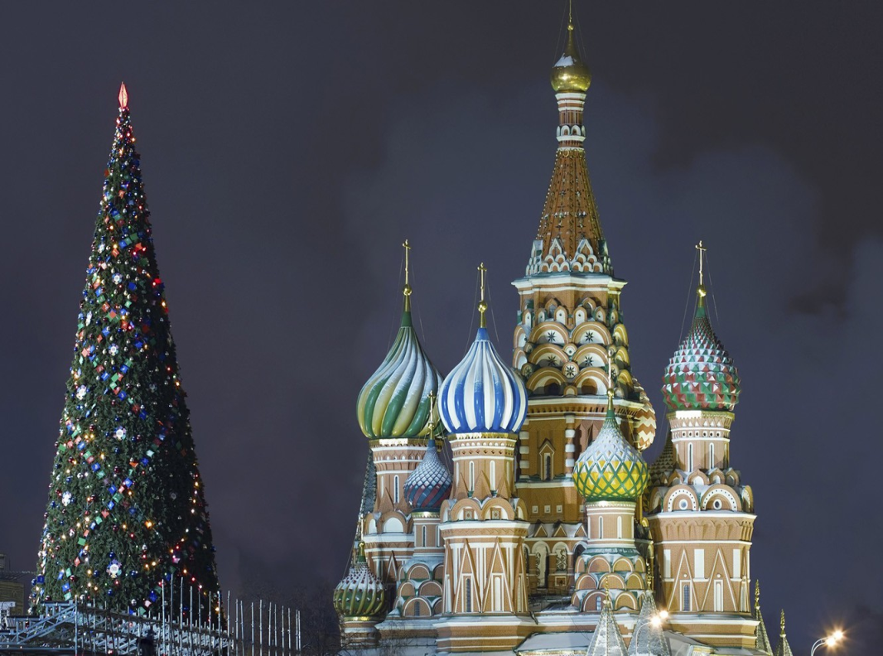
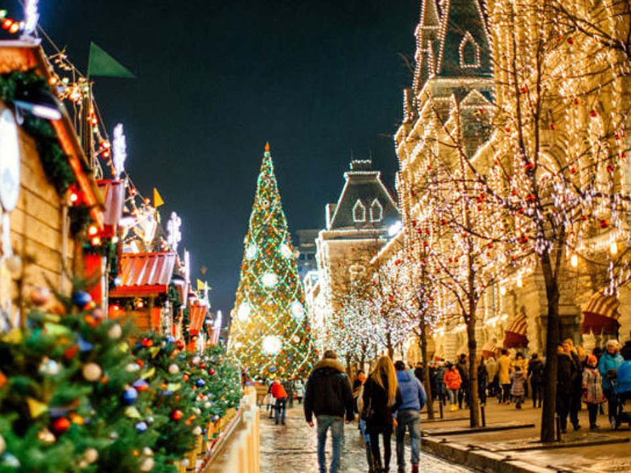
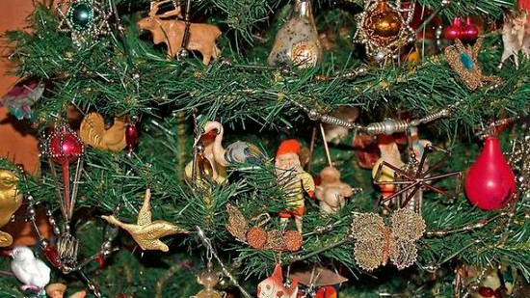
«East or West home is best»
When do people in Russia celebrate Christmas?
Do you have a family tradition of celebrating Christmas?
What do you usually do during Christmas days?
What English-speaking country would you like to visit on Christmas, and why?

Slide 13
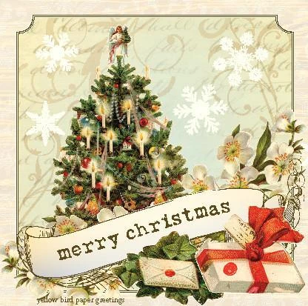
Sincerest wishes for hope, happiness and peace during this Holiday Season and throughout the coming year!

