Slide 1
ГБОУ школа №246 Приморского района Санкт-Петербурга
Презентация к уроку английского языка на тему:
«The blue planet. Crystal-clear wonder».
Выполнена: учителем английского языка Кондрашкиной Светланой Владимировной.
2018 год

Slide 2

Let’s watch the film “Introduction to…” and try to tell me the theme of our lesson.
.

Slide 3
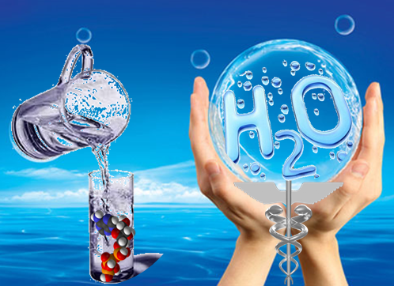
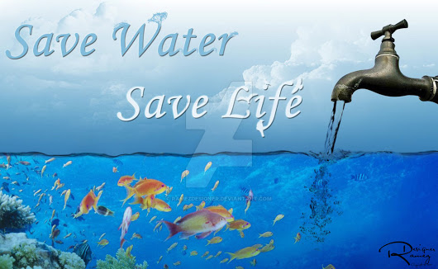
«Crystal-clear wonder».
we‘ll talk about water resources and learn to value water as a precious natural resource;
we‘ll talk about the variety of water wildlife and about water as the source of life on the planet.

Slide 4
Water is essential for all life on Earth.
drinking,
We need water for
washing,
producing food products,
medicine,
providing power,
controlling fire.
We enjoy having rest at the seaside.
So, the need for clear water is huge.

Slide 5
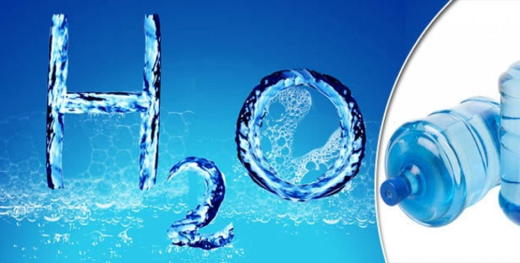
Complete the statements.
1. Water can come in the form of…
a) rain b)hail c)stream d)snow
2. Water can …
a) blow b) flow c) evaporate d)melt
3.Water is stored in…
a)seas b)hail c)lakes d) oceans
4. Water can be taken from …. and rivers. a)clouds b)streams c)lakes
5. Water can….ice at low temperature.
a) melt b) turn into c)choose

Slide 6
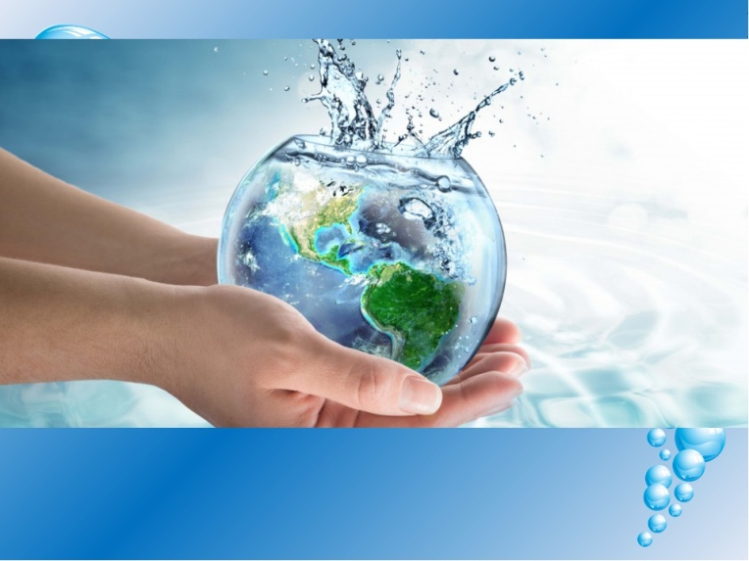
Do you know these words?
fogbnsharmfulokulakeoujoxygengte
poisonbrdsnowgerrainfwastreamjut
cloudboiatmospherevedecologyhdvgh
rubbishnbvwaterdhpollution

Slide 7
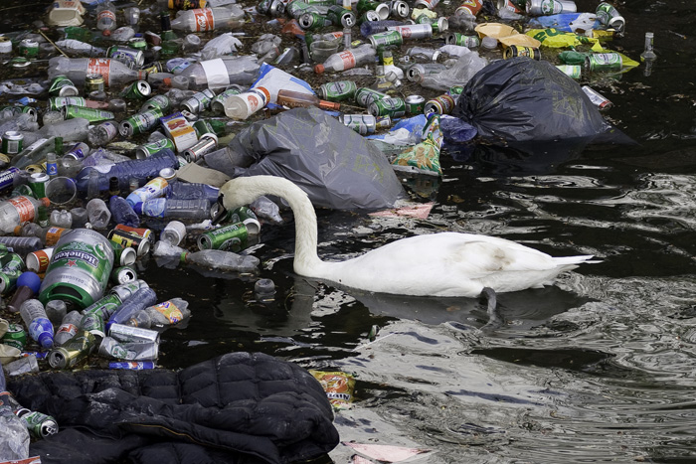
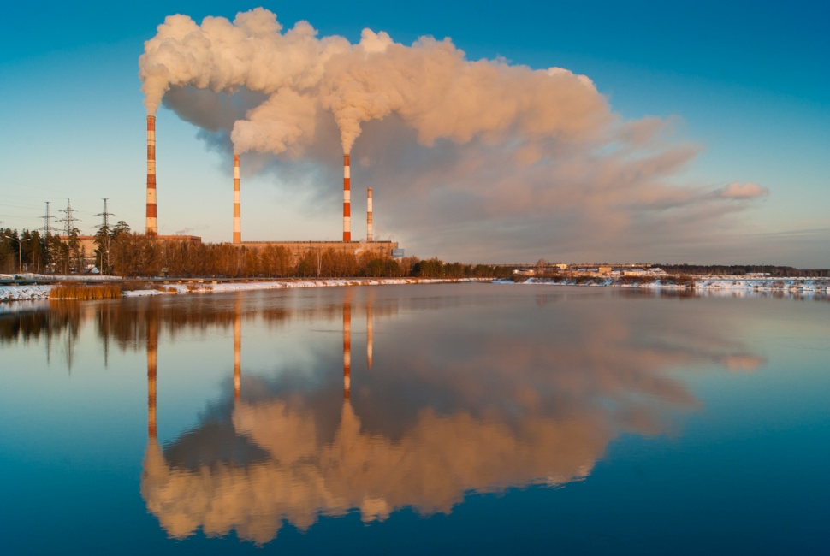
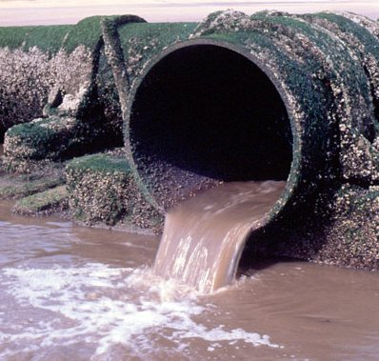
Match the words and use them to complete the sentences.

Slide 8
Toxic fumes, Factory waste ,Acid rain,
Natural habitats, Soil pollution,
Plant species, Solar power.
1…….is very harmful to the environment.
2.A lot of…….is dumped into this river.
3.Chemicals cause……
4……..is environmentally friendly.
5.Many…..are in danger of dying out.
6.Forest fires cause many animals to lose their…
7.How can I avoid breathing……from cars cycling in the city?

Slide 9
Can everyone get drinking water easily?
There is no exact data on how many people in the world can get safe drinking water, but it is said that 1,3 billion people cannot.
The problem is much worse in villages than in towns. For example, 85% of towns and cities worldwide are provided with safe water compared to65% of countryside areas.

Slide 10
.
100% of the population of USA and Europe drink safe water, only 75% of Indians and 28% of those who live in Kenya can drink water without a health risk.

Slide 11
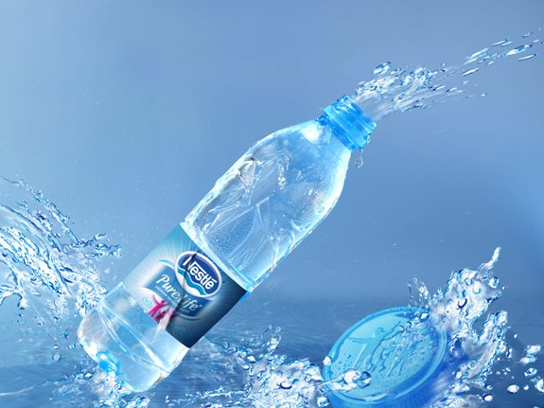
Would you like to
Cross the odd one out.
1.lake, river, drink, sea..
2. sparkling, skating, driving, sailing.
3.beautiful, handsome, mineral, attractive.
4. fog, hail, water, cloud.

Slide 12
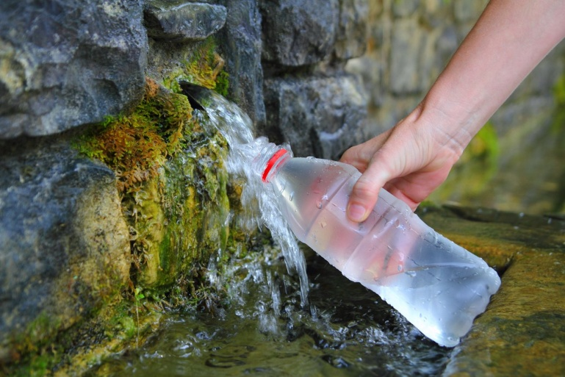
There is hardly a person who has never drunk sparkling mineral water.
Of course you can drink mineral water right from a spring running somewhere in the Caucasus, but most people buy it from shops on their way to a gym or to work, while having a walk or coming back home.
Have you ever thought how the water comes to your home?

Slide 13
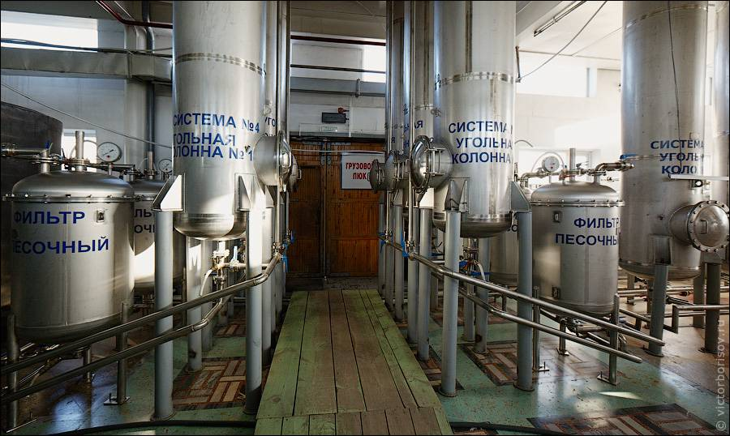
First, drinking water is stored and filtered in large reservoirs.
.

Slide 14
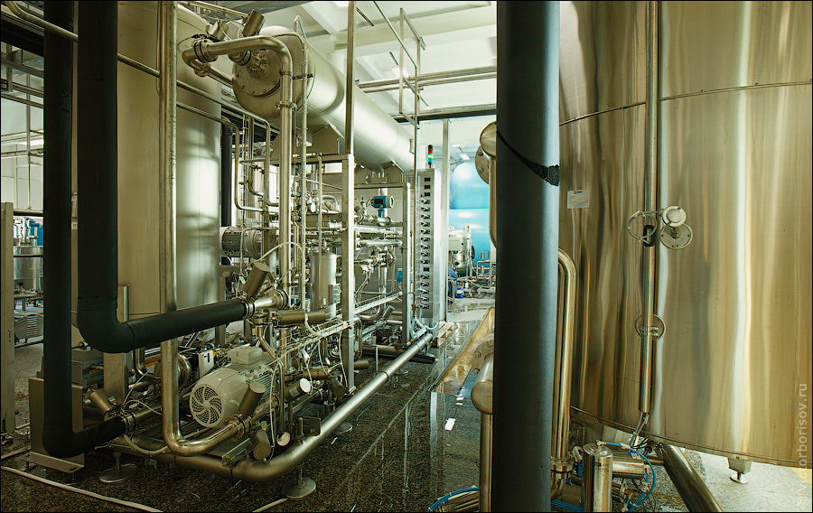
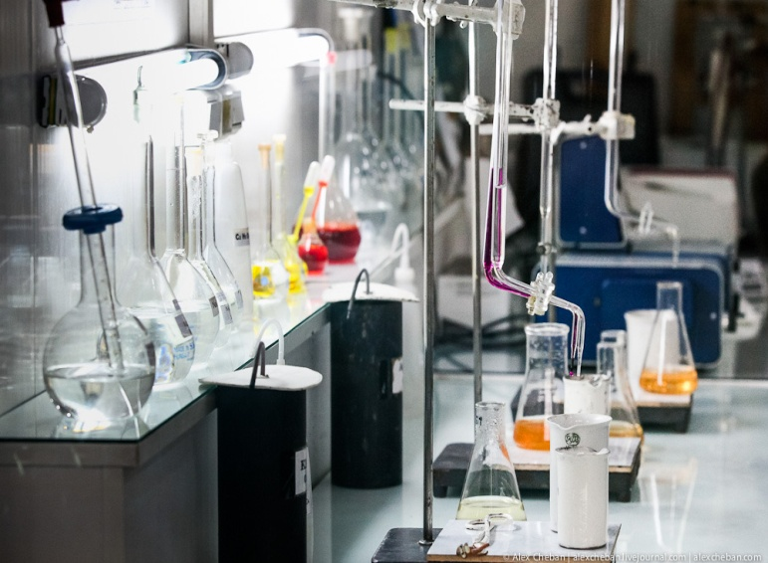
Then, it goes along plastic tubes and is poured into large reservoirs.
At this stage various kinds of minerals are added, to it to make it healthier and tastier.

Slide 15
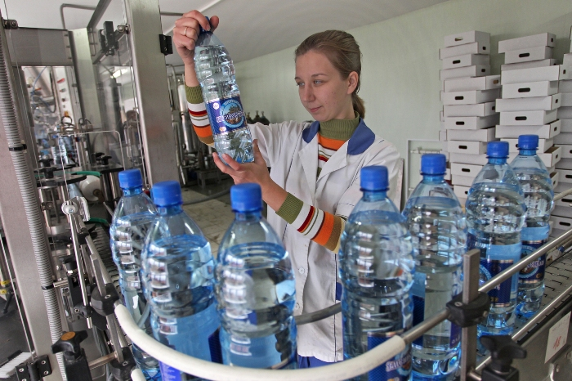
Afterwards it is bottled with special equipment and carbon dioxide is added which makes the water sparkle.
.

Slide 16
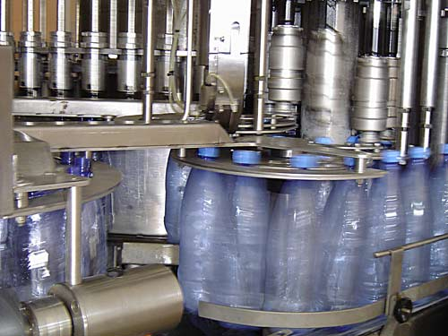
At the same time tight caps are put on the bottles so that the carbon dioxide does not come out.
.

Slide 17
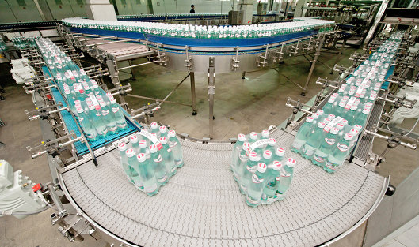
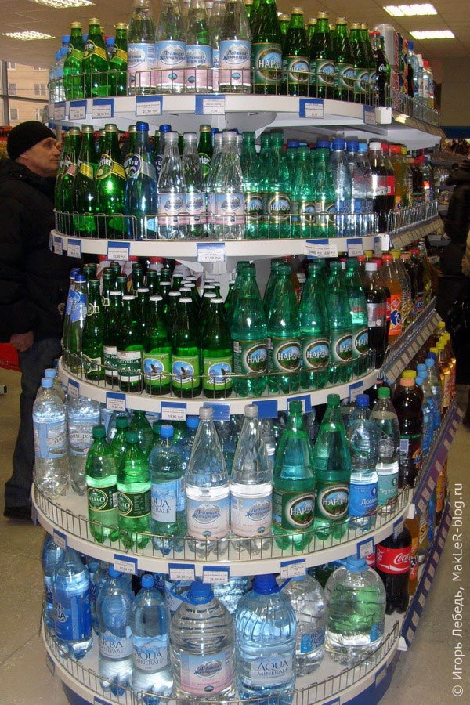
The bottles are put into boxes and delivered to different shops where customers buy them.
.

Slide 18
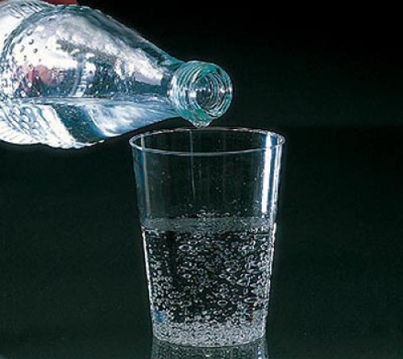
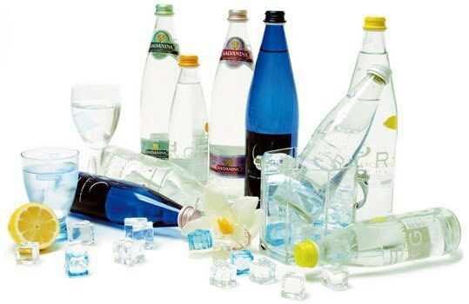
Enjoy sparkling mineral water!
.

Slide 19
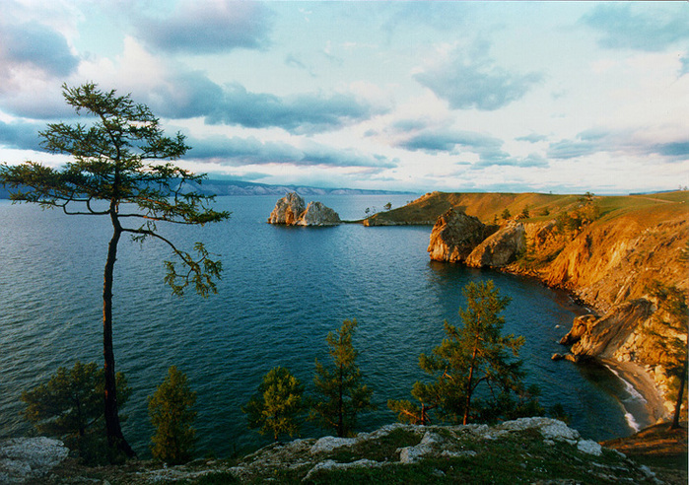
Are there any places in the world where there’s a lot of clean drinking water?
There’s no other country in the world that has as much high quality natural drinking water as Russia. You may have heard of Lake Baikal. It has one fifth of the total global fresh water resources and half of the global drinking water resources.

Slide 20
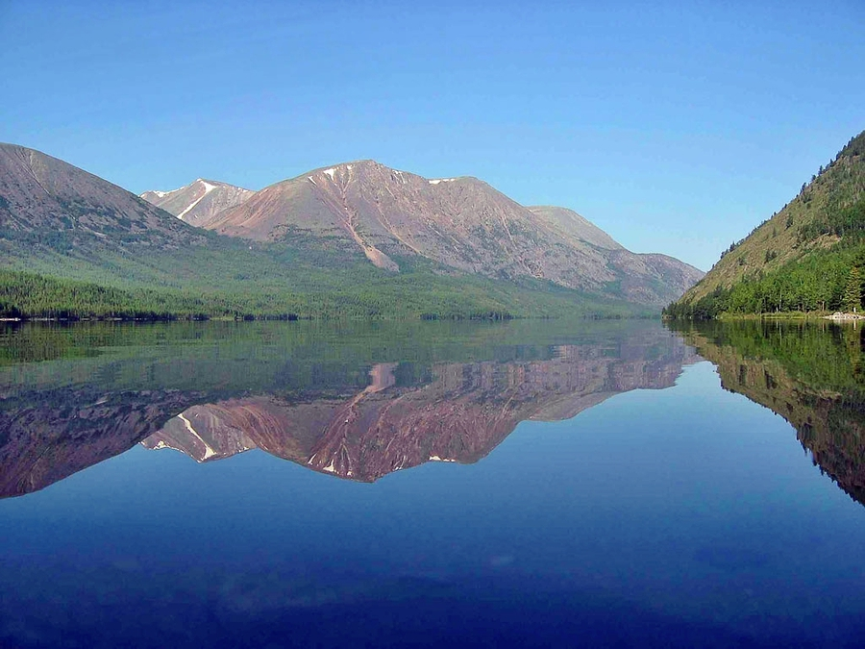
Why is Baikal a unique lake?
How deep?
How long?
Where?
What animals?
Why?

Slide 21
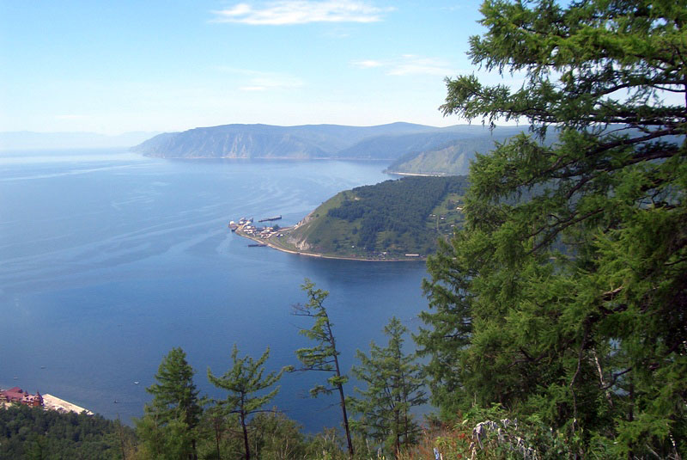
Baikal is the pearl of Siberia.
.

Slide 22
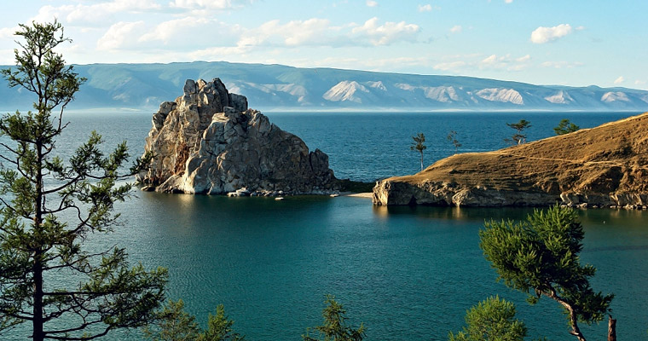
Baikal is the largest lake in Eurasia(636 km long and 80 km wide) and the deepest lake in the world (1,620metres).

Slide 23
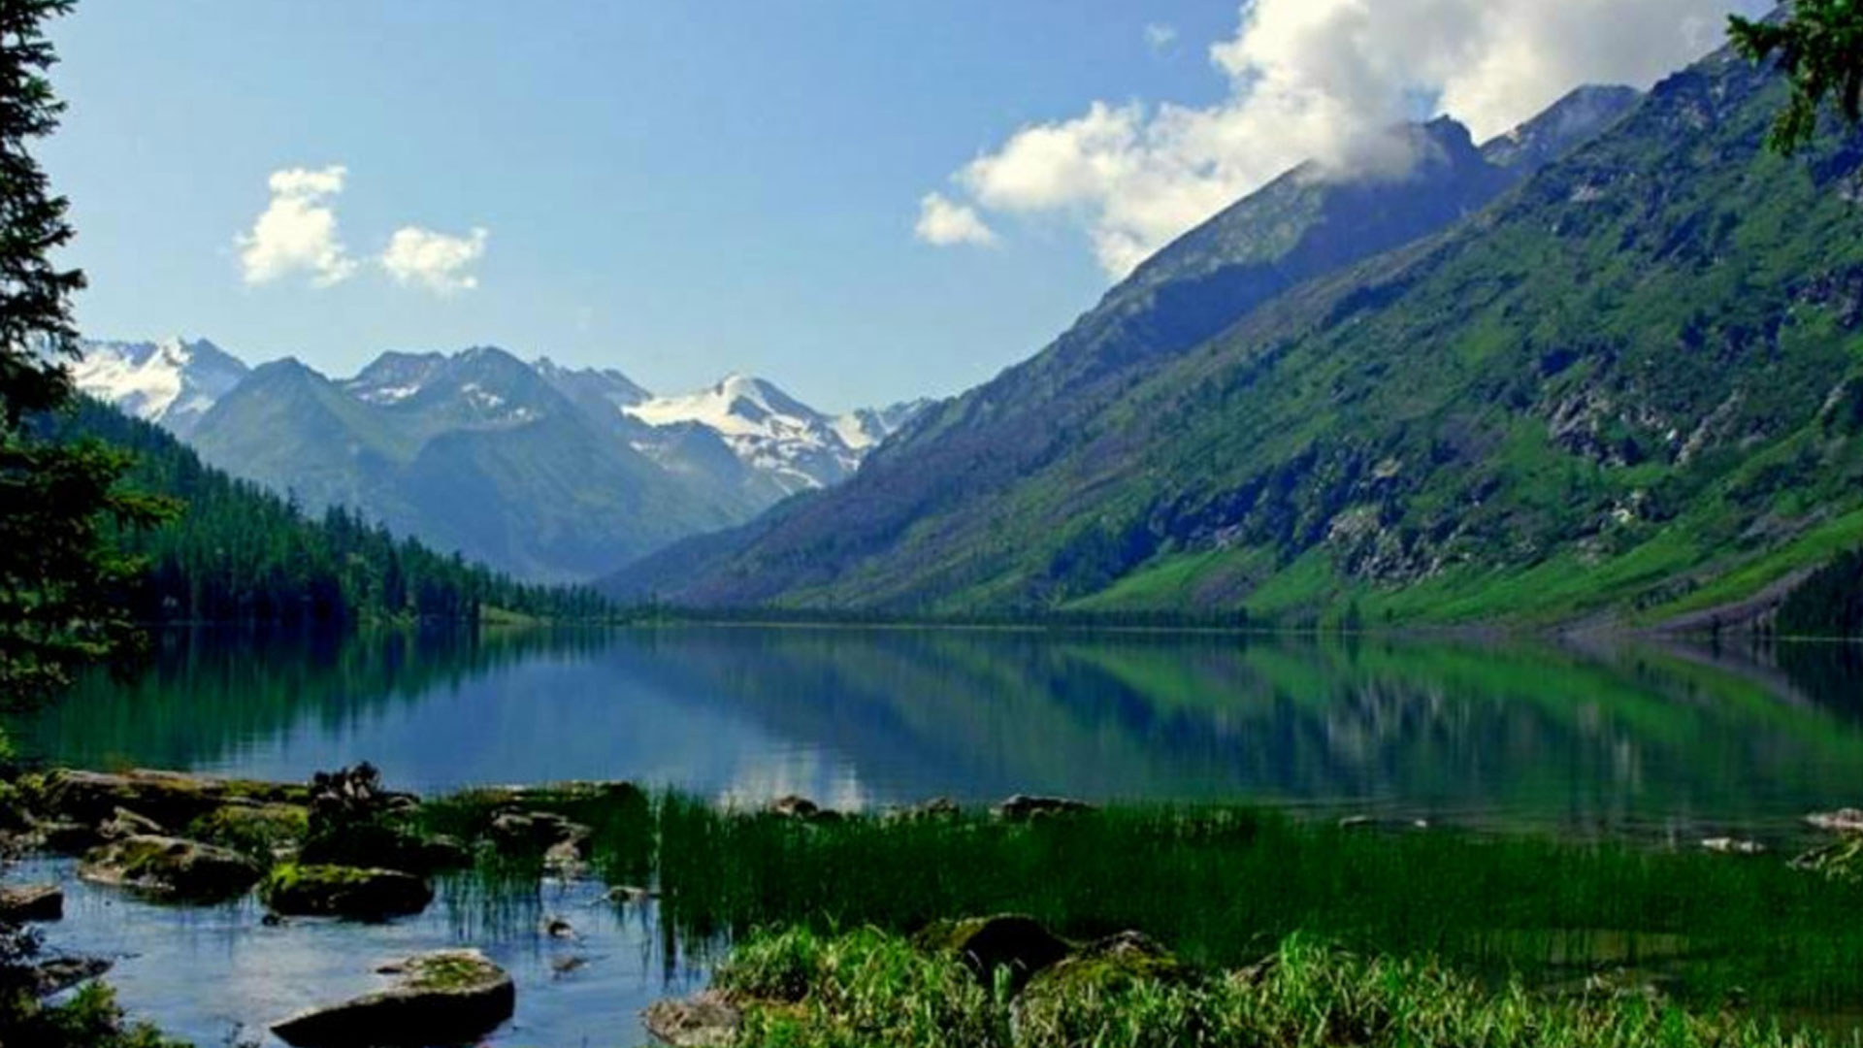
Baikal is situated in a very beautiful place, surrounded by forest and the Barguzin Mountains.

Slide 24
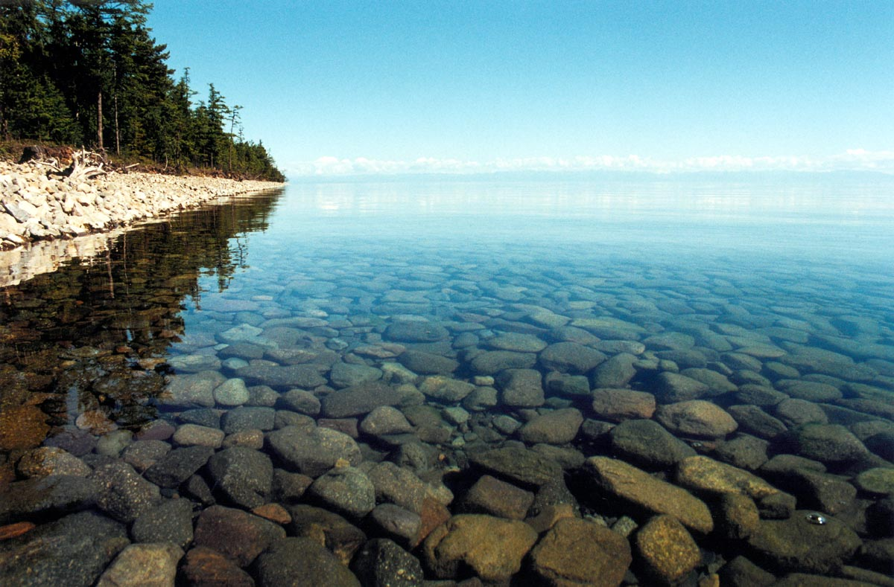
Lake Baikal is also the world’s largest freshwater lake with one fifth of the Earth’s liquid fresh water.

Slide 25
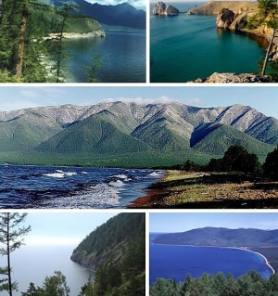
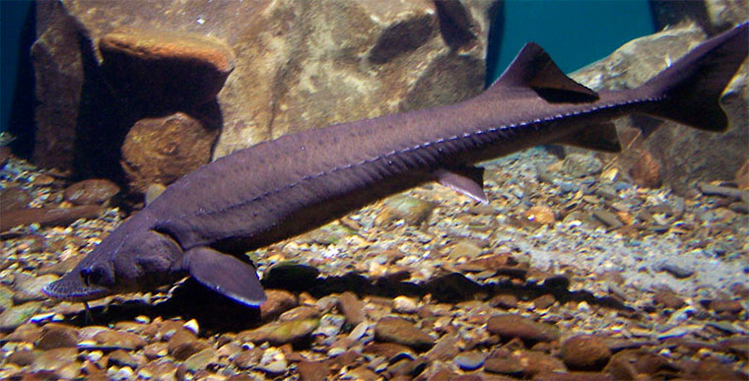
This huge old lake is the world treasure but it can only remain so, if the world treats it with love and respect.

Slide 26
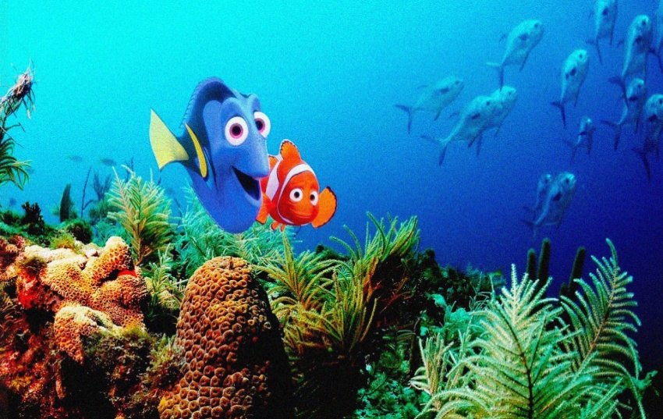
Are you tired? Let’s relax. Listen to the song and write down how rich marine life is.
Shark
акула
Seahorse
Морской конек
Crab
краб
Coral reef
коралл
Whale
кит
Jellyfish
Медуза

Slide 27
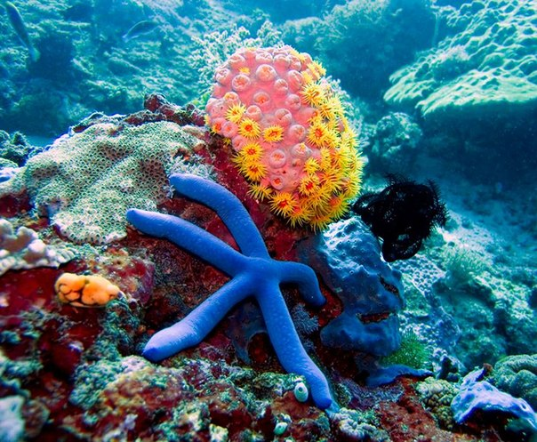
The Rainforest of the Sea.
Under the clear blue sea, there are beautiful underwater cities that are rich in life.

Slide 28
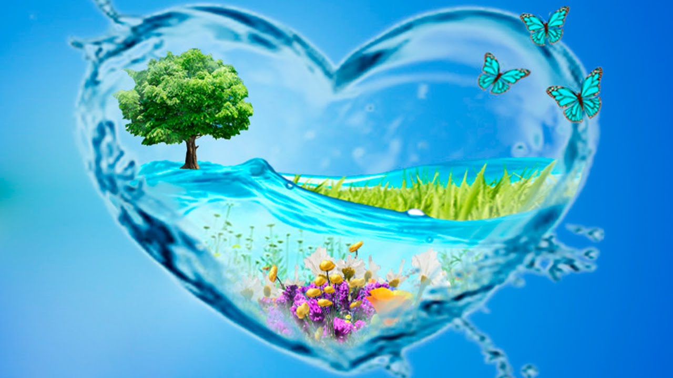
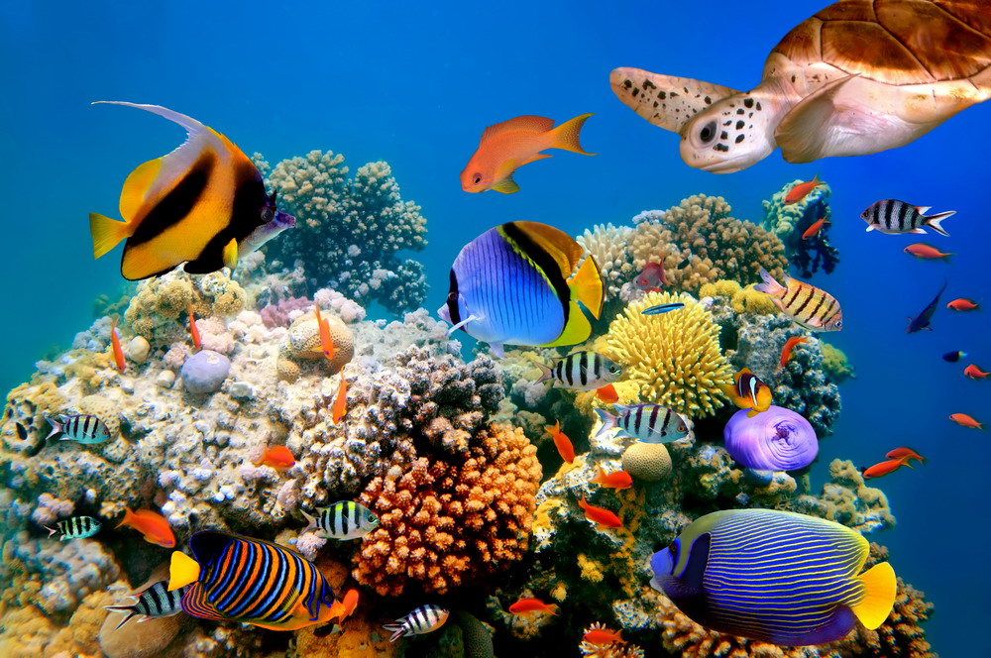
Why is it important to save water?
Let’s watch the film “Save water-save life”.

Slide 29
Tick the words you’ve heard in this film.
Water pollution, foreign languages, funniest movie, I don’t know what I can do, turn off the tap, types of music, watch science fiction, use water wisely, clean out a river, planting trees, don’t throw litter into lakes, see famous landmark, negatively affect our health, go to the seaside, save our planet from disaster, go sunbathing.

Slide 30
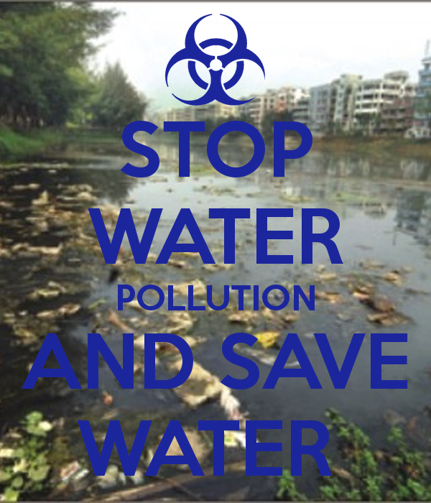
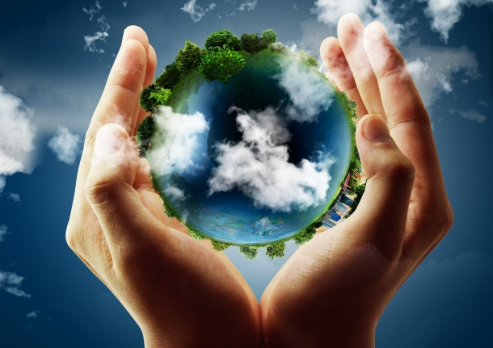
How can we prevent water pollution? What can we do to keep the water clean?
Work in groups. Organize an Eco-helpers group. Write a list of activities for the group.

Slide 31
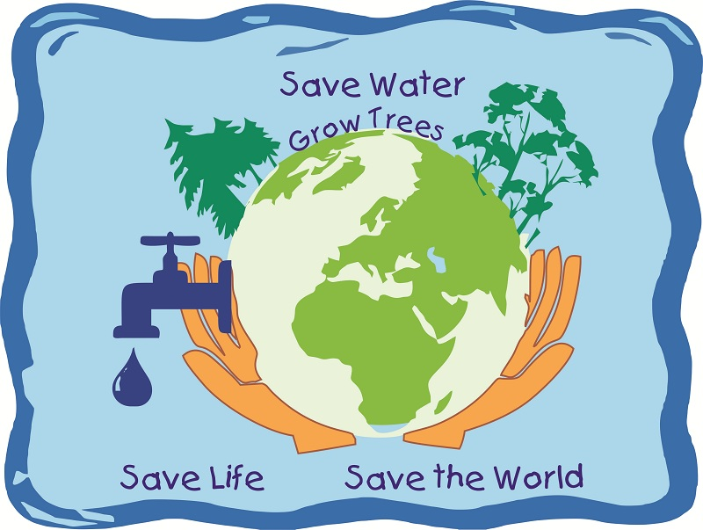
We MUST keep our planet and water of our planet clean.
If we want to live, we should guard our clean water and do not pollute it because we could live without food about a month but without water we could die in 4-5 days. Let's keep our water clean!

Slide 32
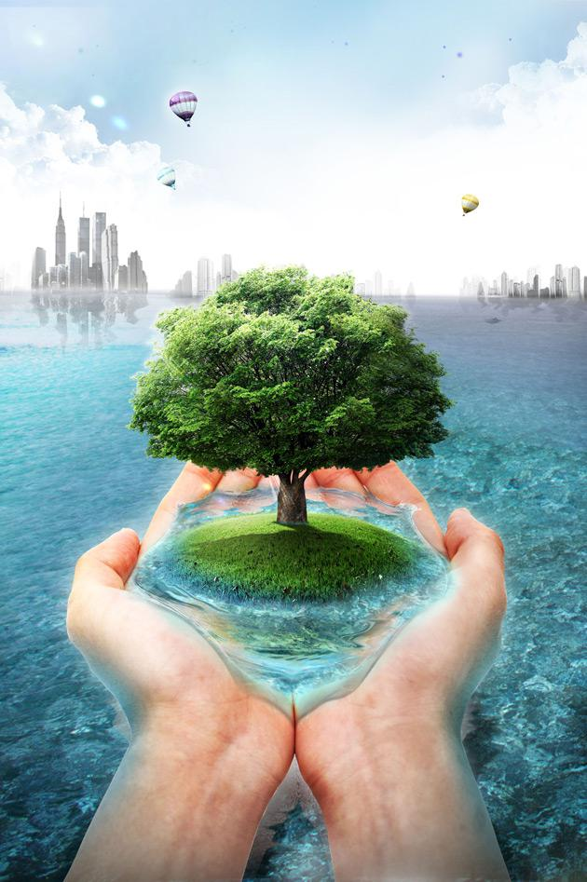
We speak about water, environment and its problems.
To my mind ...
I know ...
(words, words combinations about the environmental problems)
I can...
(translate words, make up phrases, sentences, tell about the environmental problems).

