Slide 1
Student life.

Slide 2
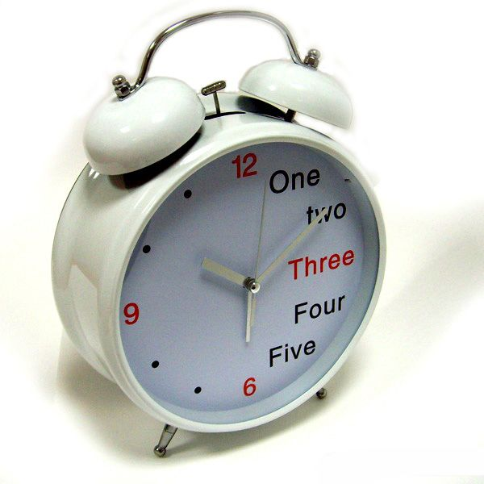
My classes begin at nine o'clock. So on weekdays I have to get up at seven o'clock. My alarm clock usually wakes me up and my working day begins.

Slide 3
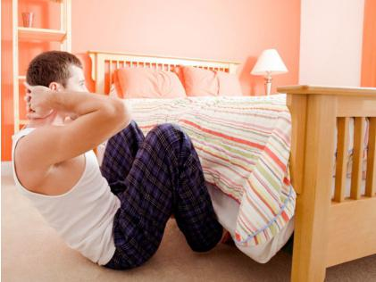
I turn on the radio, do my morning exercises, take a shower and brush my teeth. After that I get dressed and comb my hair. Then I have breakfast. I love to listen to the latest news on the radio while I am eating.

Slide 4
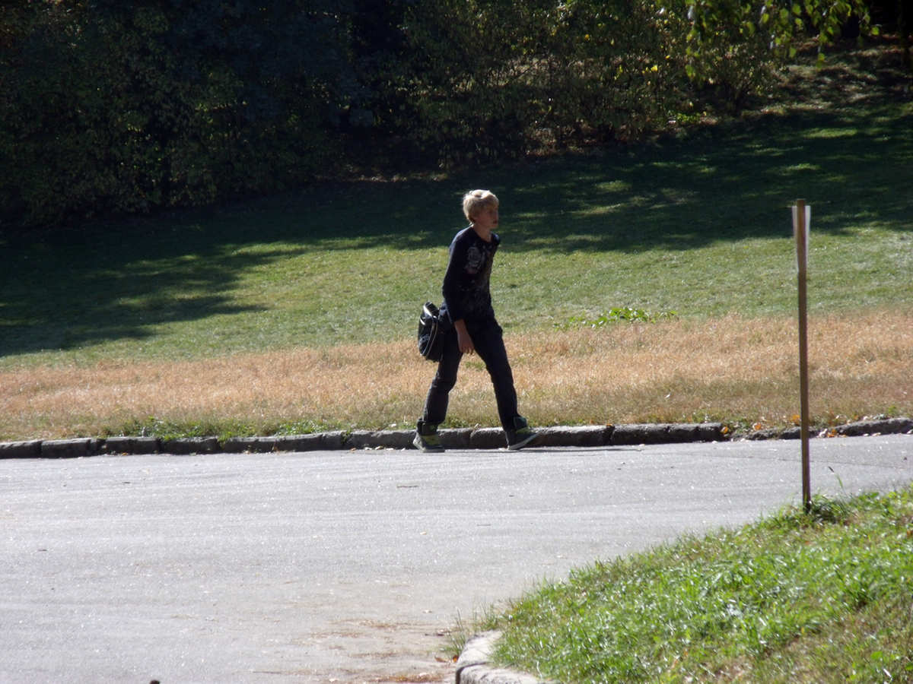
I leave the house at ten minutes past eight and walk to the nearest bus stop. I live rather far from the college and it usually takes me about a quarter of an hour to get there by bus. Sometimes when the weather is fine and I have enough time I walk to the college.

Slide 5
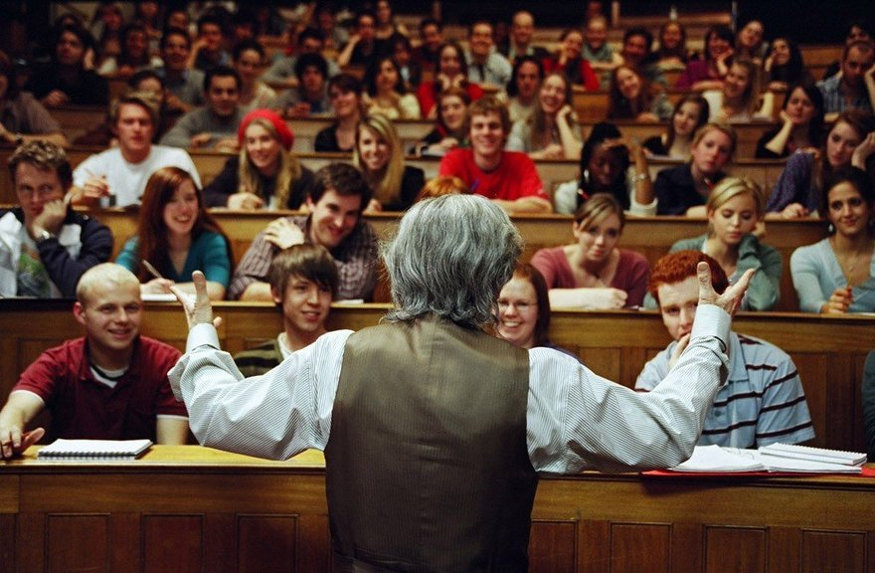
As a rule we have three or four classes a day. We have lectures in different subjects. Usually I don't miss my classes because I want to pass my examinations successfully.

Slide 6
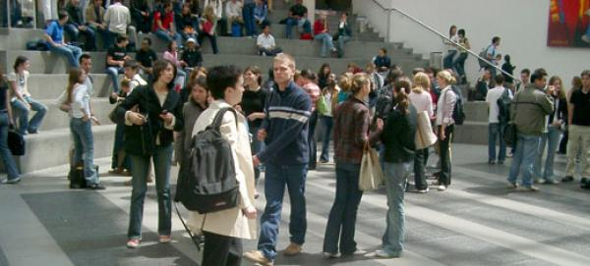
At twelve o'clock we have a big interval for lunch. That's my favourite time. That is the time to share the latest news with my friends. I prefer not to go to the canteen and we often have lunch in a small cafe not too far from the college.

Slide 7
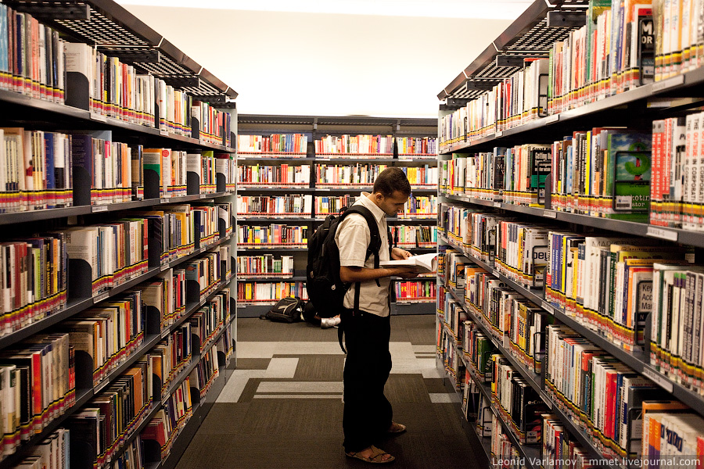
From time to time I have to stay at the college till late in the evening because I go to the library to get ready for my practical classes or to write a report. As a rule I have no free time on weekdays. So by the end of the week I get very tired.

Slide 8
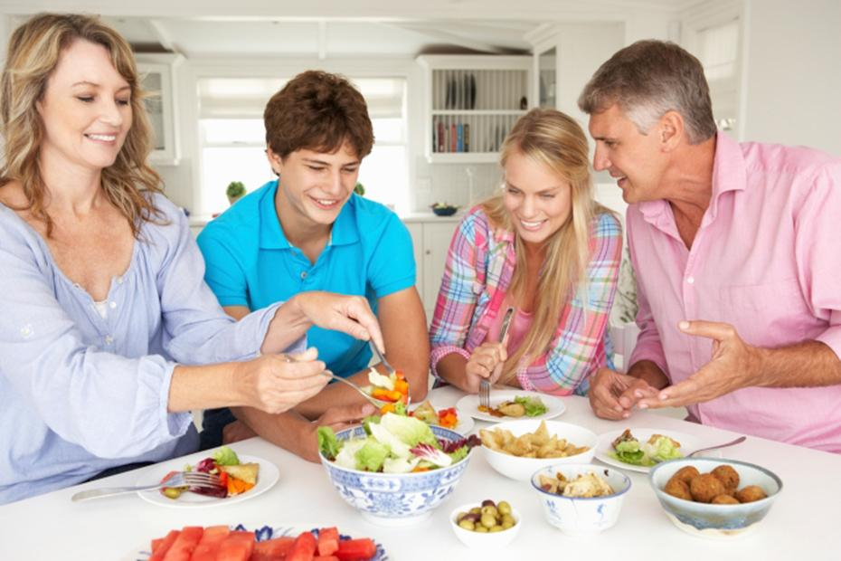
I come home at about 7 o'clock in the evening. My parents are already at home. We have supper together and share the lates news. After supper we wash dishes, drink coffee or tea and watch TV. I prefer old comedies and serials or films about travelling. Sometimes I go for a walk in the park or visit my friends.

Slide 9

At about eleven at night I go to bed. I like to read something before going to bed or to listen to some music. Sometimes I fall asleep while I am reading.

Slide 10


