Slide 1
Презентация к уроку английского языка в 4 классе по теме «Дикие животные» составила: Нието Серда Оксана валериевна гбоу сош 133 Красногвардейского района, Санкт Петербург

Slide 2

Watch the video and guess the theme of today’s lesson

Slide 3
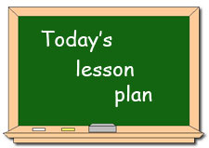
Home work check
Reading a text and searching for the information asked
Listening and filling in the gaps
Your own animal park presentation

Slide 4
Phonetic exercises
Let’s pronounce these vowels:
[æ] can, and, animal, have, plant, Africa
A [ ei] place, name
[ i ] insect, lizard, live, animal, sit, big
I
[ ai ] reptile, like, mice

Slide 5
Home work
Please, exchange your exercise book with your neighbor’s one and check your answers
Lizards are reptiles. They have got a tail, eyelids and usually have legs. Many lizards can see in color. They live in trees, on the ground and in the water. They are runners. They like sitting in the sun too. Many lizards live in places, for example, deserts. Some lizards live in forests and gardens. Big lizards can live for about 20 years or even longer. Some lizards eat insects with their tongues, others eat bigger animals or fruit and flowers. Lizards have teeth. People sometimes have them as pets.
long
four
fast
hot
long

Slide 6
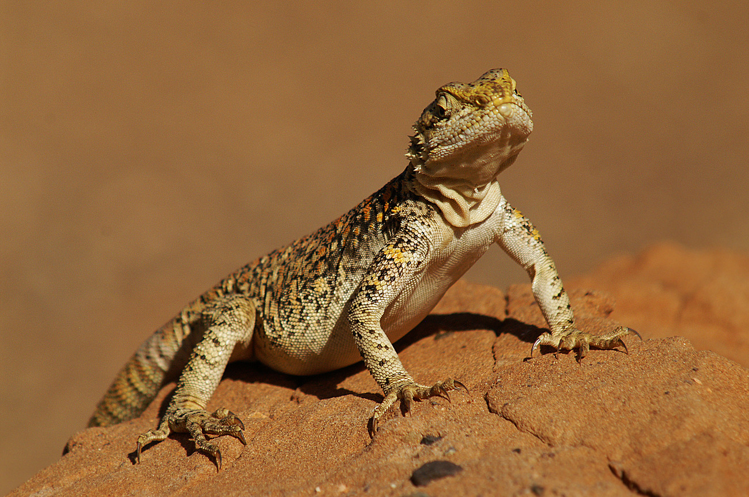
Reading the text
Read the text about lizards with your neighbor and answer the following questions:
Where do lizards live?
How many years do they live?
What kind of food do they eat?
Can lizards live at home?

Slide 7

What place might it be?

Slide 8
Animal Water Park

Slide 9

fill in the gaps as you listen to the speaker

Slide 10
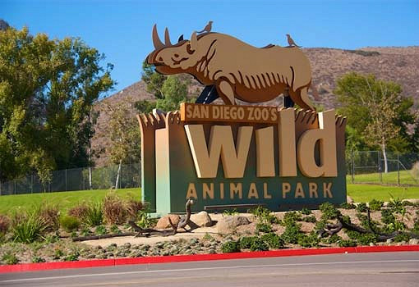
Imagine, you and your class mates work in a zoological park
Plan
Park name
Animals that live in
the park
A particular animal in
your park (its food and
habitat)
Ticket price
Use this plan and the
texts given to present
your park and its animals
to the class

Slide 11
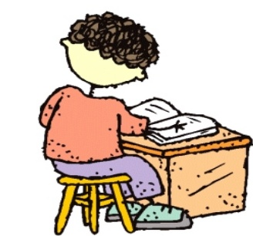
Home work
Your home work is to write about the wild animal you like most. Please, use the following plan in your written work.
Plan
Animal
Its body
Food
Habitat

Slide 12

Assess yourself
Task | Grade ( 2-5)
Home work check
Text reading and answering the questions
Listening skills
Animal Park presentation

