Slide 1
OBESITY: CURRENT GLOBAL AND RUSSIAN TRENDS

Slide 2
ГБОУ Школа № 1324 (учебный корпус «Сеченовский»)
Ученики Воронкова Татьяна 8 Н
Курашова Валерия 8 Н
Учитель Шплатова М. Е.

Slide 3

The World Health Organization (WHO) has defined obesity and overweight as "pathological or excessive accumulation of fat, which can negatively affect health" and declared this pathology a global epidemic.

Slide 4
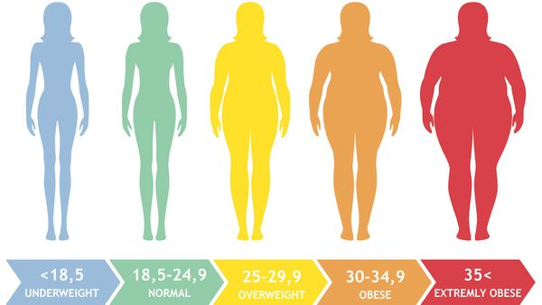
Classification
For the classification of obesity in many countries, including Russia, the body mass index (BMI) is used, calculated by the formula: mass (kg) / height (m 2). In this case, a BMI ≥25 indicates overweight, and a BMI ≥30 indicates obesity.

Slide 5
My class's BMI
Girls
Boys
Name | BMI
Argentina | 20,7
Anna J. | 23,84
Anna B. | 28,35
Julia | 15
Galya | 17,8
Lada | 17,3
Name | BMI
Algabas | 25,25
Gleb | 22,26
Vladimir | 19.6
Maxim | 26,8
Ilya | 20,17
Shamil | 17,58
Ivan | 25,35
Ivan | 25,35
Timophey | 18,8
Tanya | 20,76
Lera | 24,73
Dayana | 20,24
As you can see some of my classmates have underweight and overweight.

Slide 6

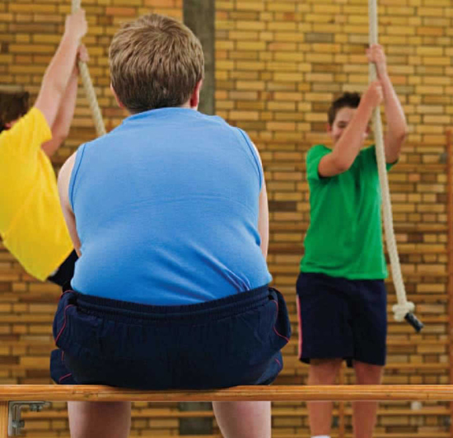
Etiology
The main reason for the development and progression of overweight and obesity over the past 30 years, scientists see in the violation of the energy balance between consumed and consumable calories, which is associated with high-calorie nutrition, eating disorders, increasing the size of portions, high content in food fats and sugars, low in vitamins.
Another important pathogenetic factor in the development of obesity and overweight is considered to be a sedentary lifestyle, low physical activity in all spheres of life of a modern person.

Slide 7
Rating of the fattest countries
Country | Percent of obesity
1. Mexico | 32,8
2. United States | 31,8
3. Syria | 31,6
4. Venezuela, Libya, Russia | 30,8
5. Trinidad and Tobago | 30,0
6. Vanuatu | 29,8
7. Iraq, Argentina | 29,4
8. Turkey | 29,3
9. Chile | 29,1
10. Czech Republic | 28,7

Slide 8
According to long-term observations, 60% of adults who are obese, overweight begins in childhood and is characterized by a more pronounced weight gain and a significant frequency of comorbidities than in obesity that debuted in the adult period. The prevalence of obesity among children and adolescents increased dramatically in the second half of the twentieth century, marking a new public health problem in many countries. In 2013, according to WHO, 42 million children under the age of 5 were overweight or obese. Today in developed countries up to 25% of adolescents are overweight, and 15% are obese of varying degrees.

Slide 9
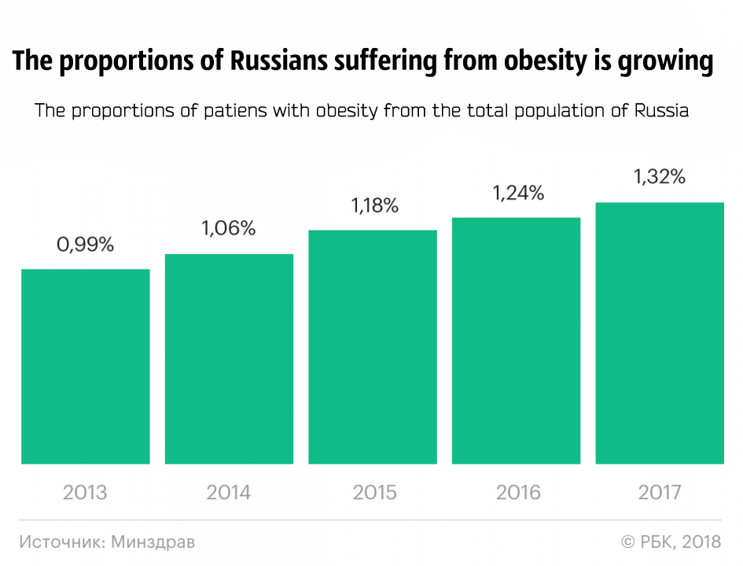

Slide 10
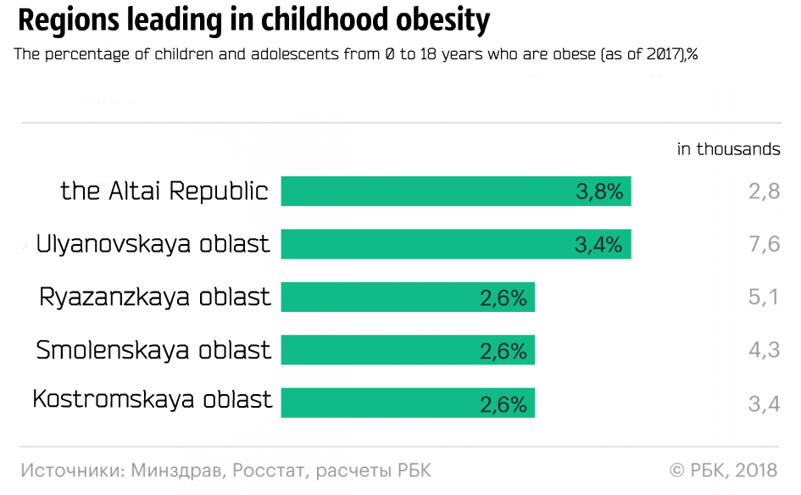

Slide 11
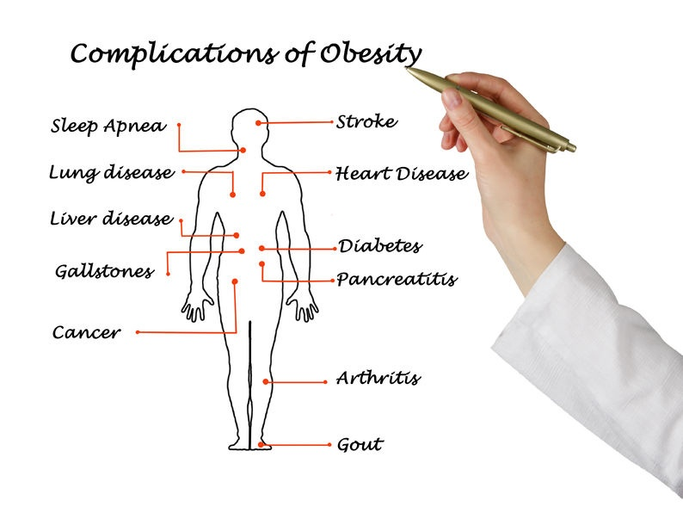
Related diseases and health risks associated with obesity
Overweight and obesity negatively affect the quality of life and all areas of human activity, often leading to the development of serious diseases, unfitness for work and disability.

Slide 12
Some health risks associated with overweight and obesity among adults:
Ischemic heart disease
Type 2 Diabetes
Cancer of the intestine, gallbladder and pancreas
Cancer of the kidney, urolithiasis disease, prostate cancer
Asthma
Arthrosis, the damage of the intervertebral disc
Miscarriage and a poor pregnancy outcome, infertility
Depression

Slide 13
The role of lifestyle and the environment in the pathogenesis of obesity
The World Health Assembly in 2013 adopted the Global Action Plan on Noncommunicable Diseases for 2013–2020, which includes a number of activities for Member States, international partners and the WHO Secretariat. The document regulates the actions aimed at promoting healthy lifestyles, nutrition and increasing the level of physical activity.
An important task of domestic health care formulated in the Strategy for the Development of Medical Science in the Russian Federation for the period until 2025 has become “the development of a system of measures to reduce the public health risks and promote a healthy lifestyle among citizens of the Russian Federation.”

Slide 14
Experts focus on the problems of environmental pollution, environmental problems, unhealthy diets and toxins. Tightly built offices and shopping centers, along with the introduction of "gentle, immobilizing" technologies (lifts, electronic communications, and automated household appliances) lead to a total decrease in motor activity at work, at home, inactive leisure and inactive entertainment. All these factors undoubtedly contribute to the development of the current epidemic of obesity.
Interdisciplinary studies of recent years demonstrate the effectiveness of complex programs, including the food optimization, increasing of physical activity, as well as changes in the anthropogenic environment connected with motor activity.
It is noted the positive impact of long-term projects to change urban architectural planning, the accessibility of leisure facilities and active leisure activities (landscape zones, pedestrian infrastructures, bicycle tracks), as well as the providing of educational institutions with the necessary equipment for physical education and sport.

Slide 15

Conclusion
Thus, the priority directions of the state policy of many countries, including Russia, with regard to the prevention and treatment of obesity have become integrated multisectorial programs for environmental change with the aim:
- to increase motor activity
- to control the quality of the food we eat
- to promote a healthy lifestyle.
Moreover, all pathogenetic methods of therapy are effective only with the active voluntary participation of patients in the treatment process.

Slide 16
Literature
А.О. Разина, С.Д. Руненко, Е.Е. Ачкасов. - Проблема ожирения: современные тенденции в России и в мире. Вестник Российской Академии Медицинских Наук., -№ 57, 2016
Полина Звездина, Дада Линделл, Валерий Романов и др. Минздрав назвал страдающие от ожирения регионы. РБК., 2018
Россия впервые попала в рейтинг «самых жирных стран». WeekJournal., 2014

