Slide 1
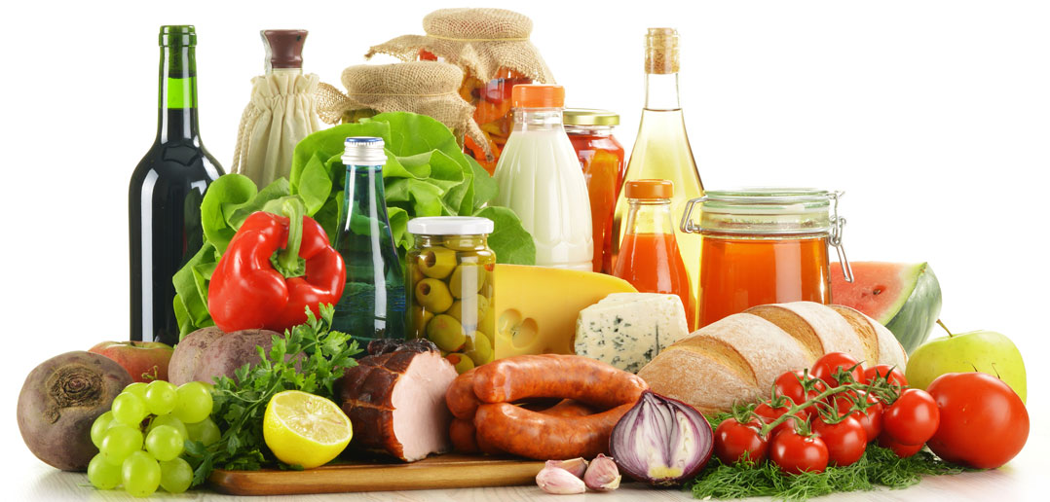
Food competition

Slide 2




Slide 3
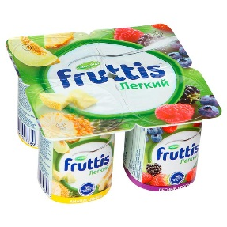
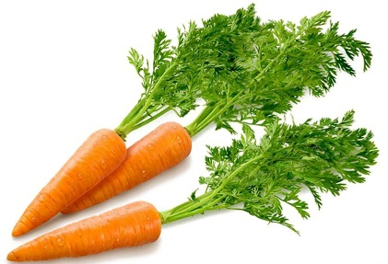
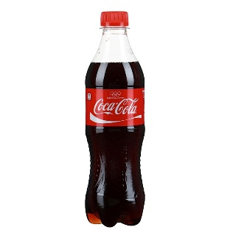
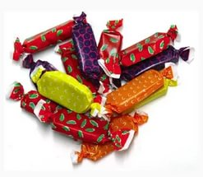
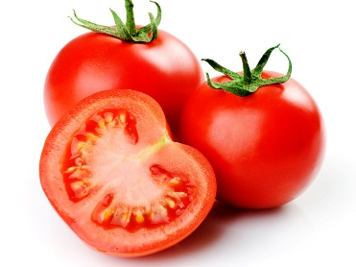
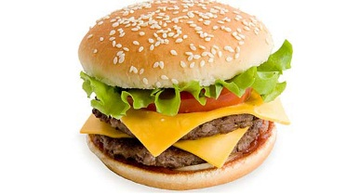


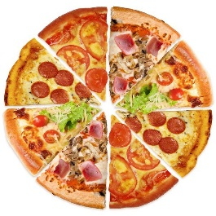
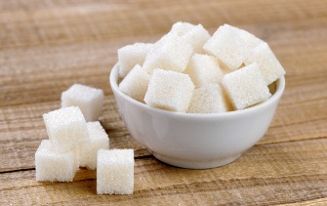
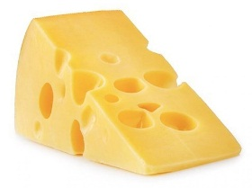
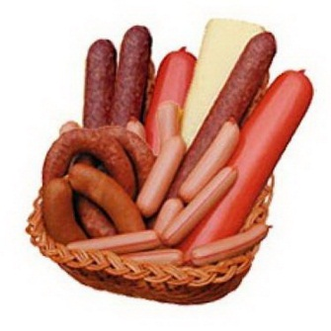
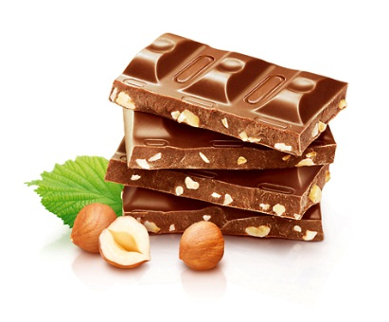
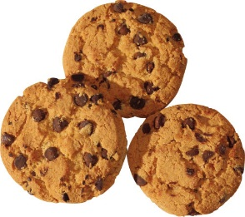
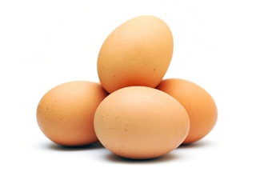
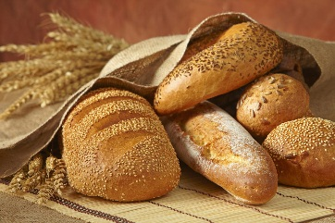
Healthy
Unhealthy
tomatoes
pizza

Slide 4

Answer these questions:
1. Do people like fried eggs for breakfast?
2. Does a vegetarian eat vegetables?
3. Can people eat carrots every day?
4. Can a vegetarian eat cheese?
5. Do you have lunch every day?
6. Is Coke good for your health?
7. Are hamburgers bad for your health?
8. Do meat, fish and beans give you iron and protein?
9. Do bread and grains give you fibre and vitamin B?
10. Do dairy products protect your bones?

Slide 5


Clean, but not water. White, but not snow. Sweet, but not an ice-cream. What is it?
It's white and cold and sweet. All children like it.
I’m white. You can eat me at the cinema.
I’m a vegetable. I’m brown. I’m small and round.
I’m a fruit. I’m big. I’m yellow inside and brown outside.
Take off my skin – I will not cry, But you will. What am I?
It is red and sweet, It is good to eat.
I am white. I am good to drink. What am I?
I am yellow, I am made from milk, you eat me with bread.
I’m sweet. You can eat me at the birthday party.

Slide 6


This is a note from your mother. Write a shopping list.
My dear,
We’ve got some salt, but we haven’t got any sugar. We’ve got some milk, but we haven’t got any butter. We’ve got some flour, but we need some apples and eggs.
Mummy
My dear,
We’ve got some sugar, but we haven’t got any salt. We’ve got some beets, but we haven’t got any potatoes and onions. We’ve got some carrots, but we need some cabbage and tomatoes.
Mummy

Slide 7

Let’s have a break!
Put your hands up in the air and shake your body round Hand up on your toes and turn around
Hands way up high, hands way down low Stamp with your feet and jump, jump, jump﻿

Slide 8


Match the English proverbs to the Russian translation.
1. Appetite comes with the eating.
2. Bread is the staff of life.
3. Canine appetite.
4. Eat at pleasure, drink with measure.
5. Eggs can't teach a hen.
6. The first wealth is health.
7. An apple a day keeps the doctor away.
8. One man’s meat is another man’s poison.
9. I am as hungry as a hunter.
1. Хлеб на ноги ставит, а вино с ног валит.
2. Яйца курицу не учат.
3. Я голодный, как волк.
4. Аппетит приходит во время еды.
5. Здоровье-главное богатство.
6. Волчий аппетит.
7. Хлеб всему голова.
8. Яблоко в день- и доктор не нужен.
9. Что для одного еда, то для другого яд.

